Slide 1
Introduction to MS Dynamics NAV XIV.
Ing.J.Skorkovský,CSc.
MASARYK UNIVERSITY BRNO, Czech Republic
Faculty of economics and business administration
Department of corporate economy

Slide 2
Item Charges
It enables to post and apply additional costs of various types to :
  stored away items
  items which were already sold
  item which were used as a components (part of BOM) of produced products

Slide 3
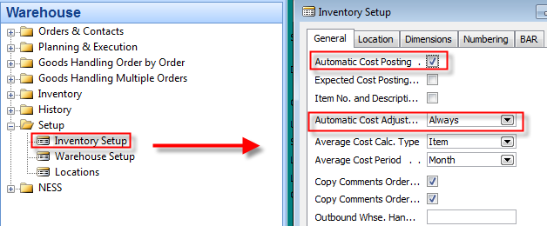
Inventory setup

Slide 4
Item Card used in this model
Find in demo-database Item card with no one
entry !!
Found card must have ZERO in all calculated field such as :
  Inventory
  Quantity on Purchase Order
  Quantity on Sales Order
  Quantity on component lines
You have to erase exiting costs and unit price on Tab Invoicing

Slide 5
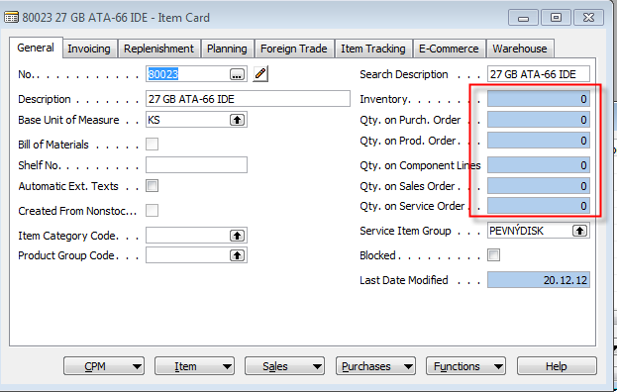
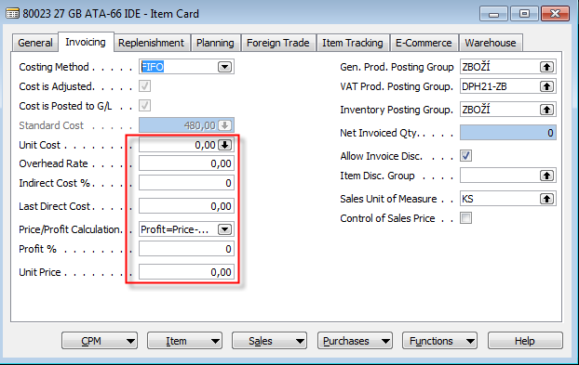
Item Card used in this model
NEXT Step is Purchase Order creation->10 Pcs of
above specified item. Purchase price=10,0

Slide 6
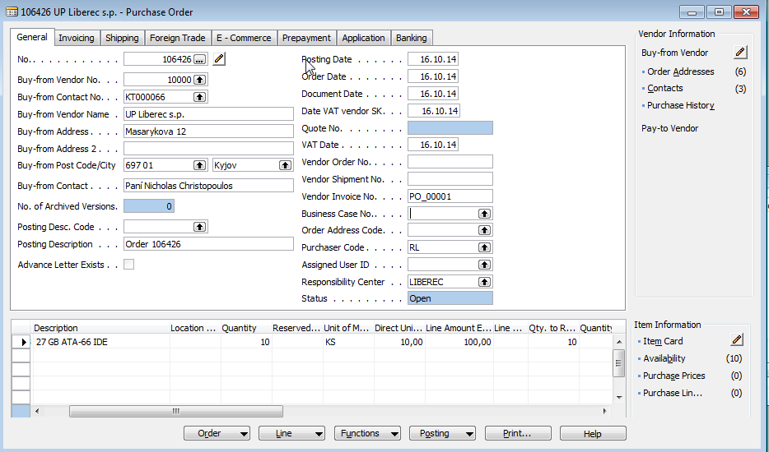
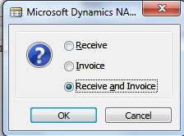
Purchase Order
NEXT Step is Purchase Order Posting by use of F11 !!!

Slide 7

Item and Value entries after PO was posted
Ctrl-F5
Ctrl-F5

Slide 8
Value Entry explanantion
This window shows all amounts relating to an item
Every time you post an order, invoice or credit memo as invoiced, revalue an item or do anything else that means a change in value for items in your inventory, the program creates one or more value entries.
Changes in quantity on inventory are stored as quantity postings in the Item Ledger Entry table.
When the inventory is reconciled with the general ledger, G/L entries are created on the basis of Value entries. The amount to be posted to general ledger is calculated from the value entry as:
Cost Amount (Actual)- Cost Posted to G/L.

Slide 9
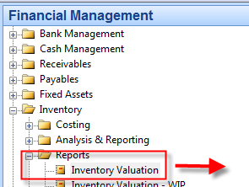
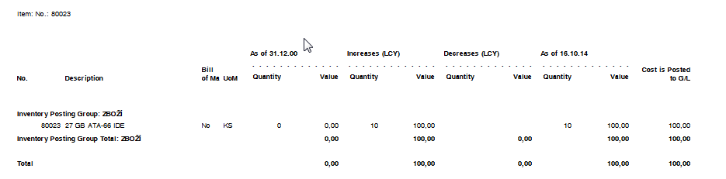
Inventory Valuation

Slide 10
General Ledger Entries
AND

Slide 11
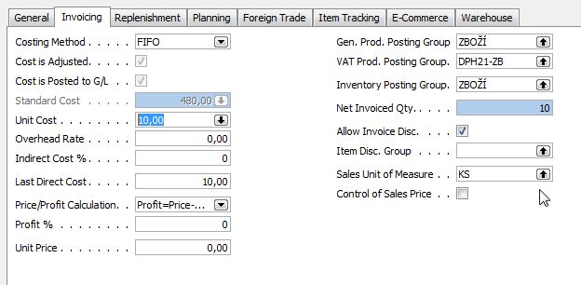
Item card after PO was posted

Slide 12
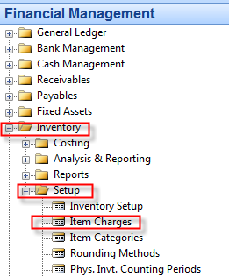
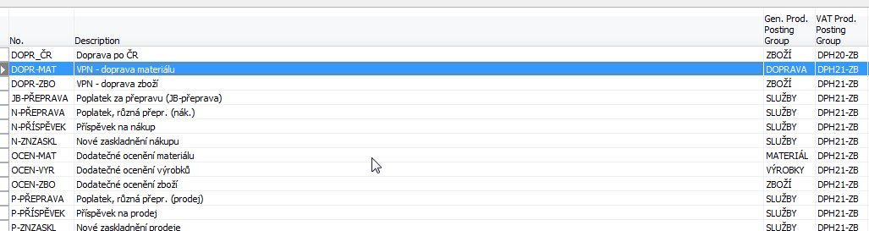
Charge Items parameters (CZ data in database were used)

Slide 13
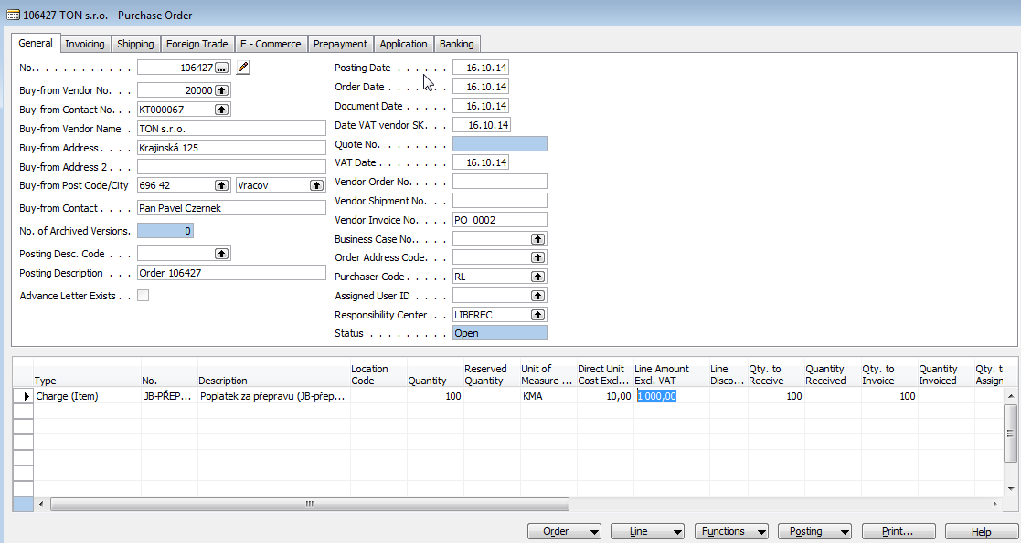
Purchase Order – transport costs

Slide 14
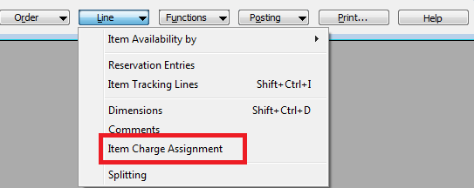
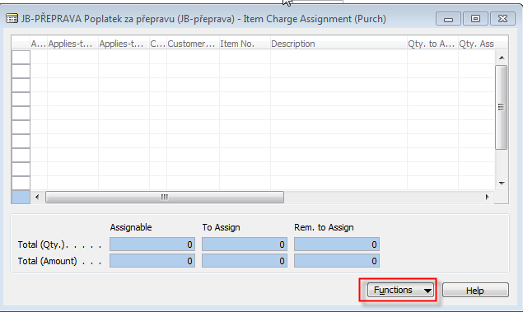
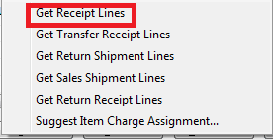
Item Charge Assignment
Lower part of Purchase Order

Slide 15
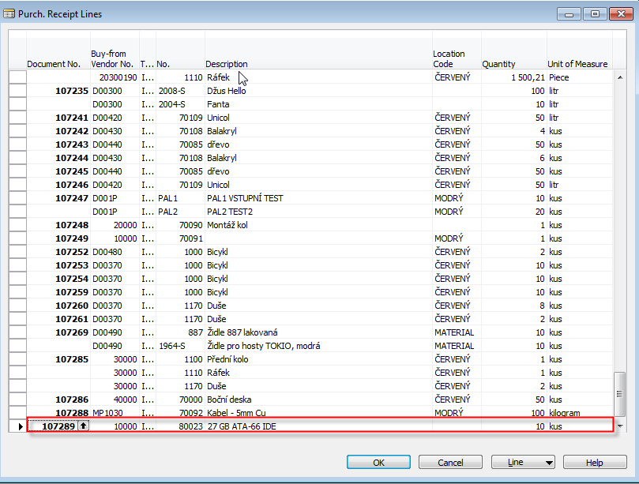
Item Charge Assignment

Slide 16
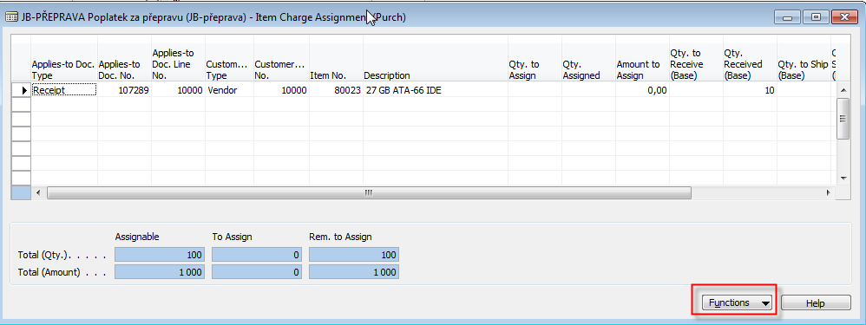
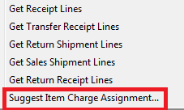
Item Charge Assignment

Slide 17
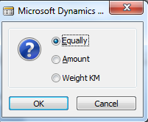
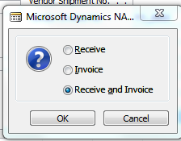
Item Charge Assignment
Weight KM option is not standard but customized
assignment rule !!!
OK
ESC
Purchase Order
OK

Slide 18
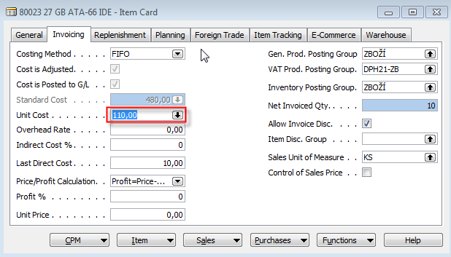
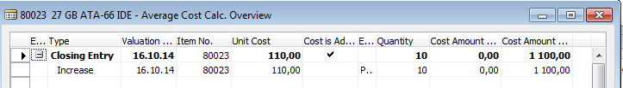
Item Card after PO for transport was posted

Slide 19
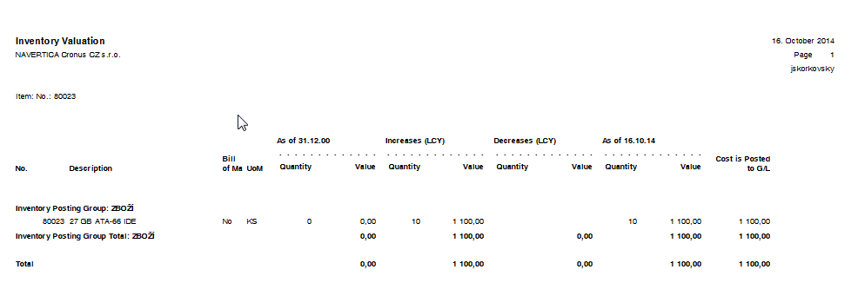
Inventory Valuation

Slide 20
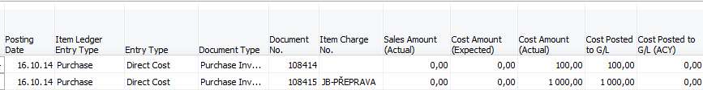
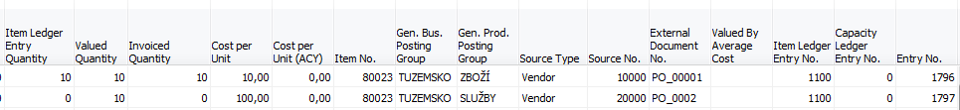
Item Ledger Entries and Value Entries
Item Ledger Entry
Value Entry

Slide 21
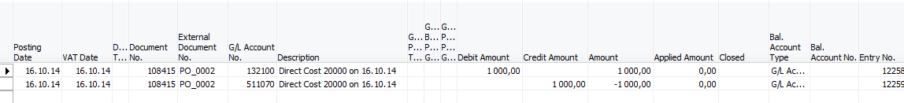
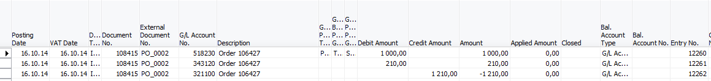
General Ledger Entries
PO-Transport

Slide 22

End of the section XIV.

