Slide 1
Introduction to MS Dynamics NAV XV.
Ing.J.Skorkovský,CSc.
MASARYK UNIVERSITY BRNO, Czech Republic
Faculty of economics and business administration
Department of corporate economy

Slide 2
Lot numbers (batches)-Item Tracking
It enables to mark Item Ledger Entries by Lot (Batch) Number, which is part of the batch card. It enables :
  Item tracking from purchase, possible subsequent production , transfers and sales
  It enables to control quality and better specification of rejects (scraps)
  It enables to control warranty and expiration

Slide 3
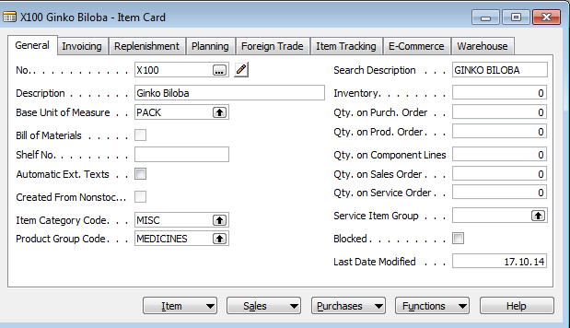
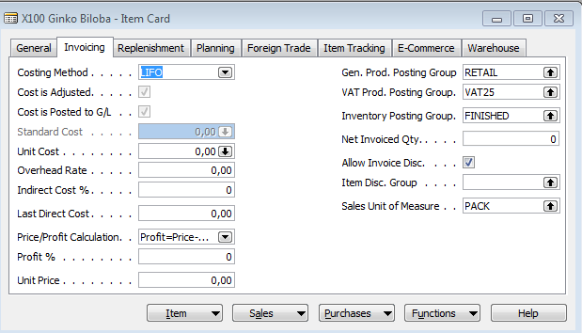
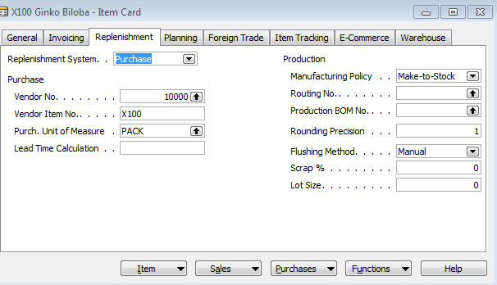
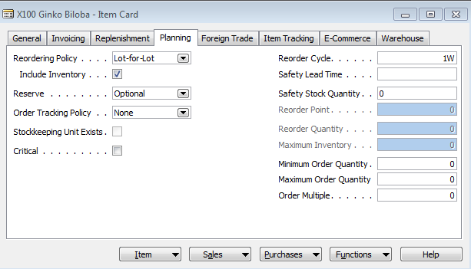
New card creation
150

Slide 4
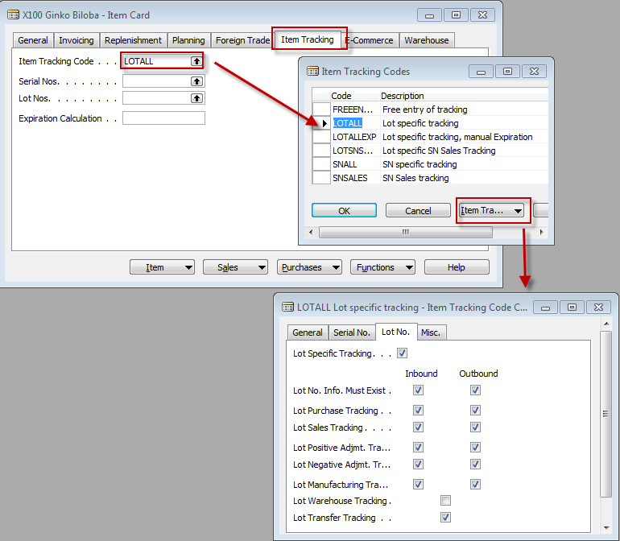
New card creation

Slide 5
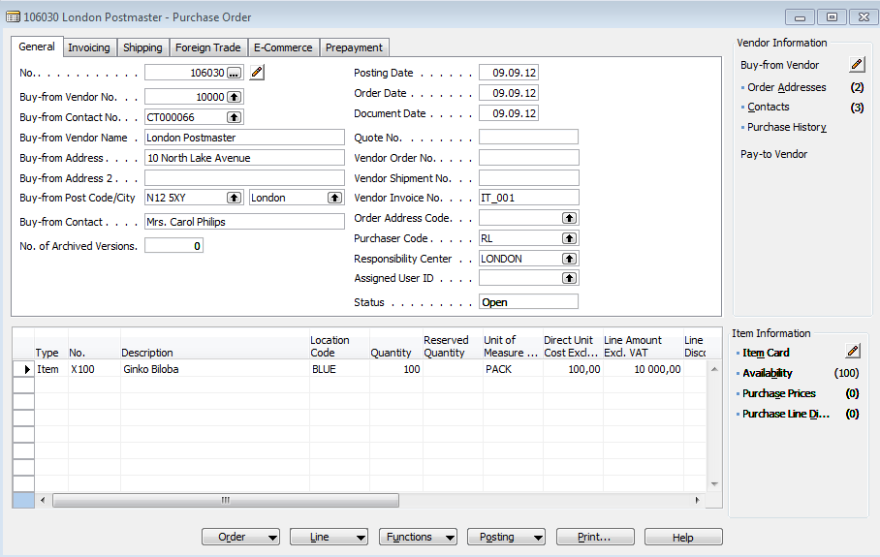
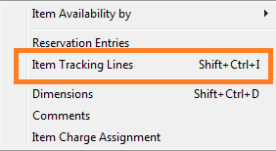
Purchase X100

Slide 6
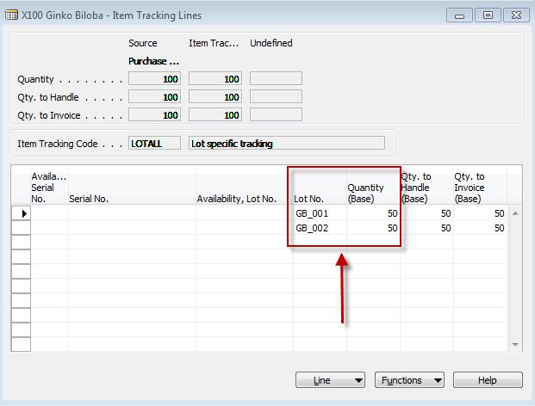

Item tracking lines
Data entered by user

Slide 7
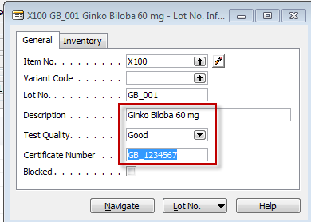
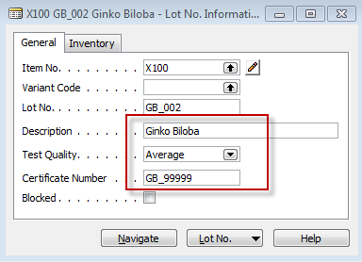
Lot Number Cards
You can use the Navigate function to find where the lot number is used in documents and ledger entries. Will be shown later !!
Lot Number inormation is saved by ESC

Slide 8
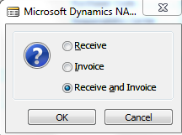
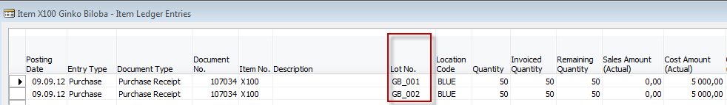
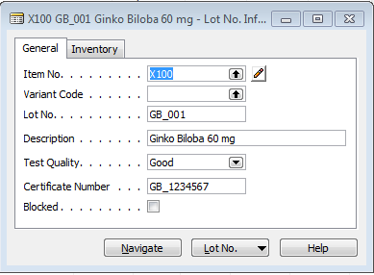
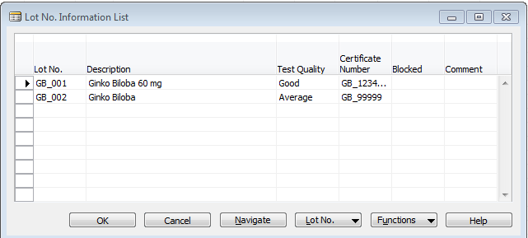
Post PO and Item Ledger Entries

Slide 9
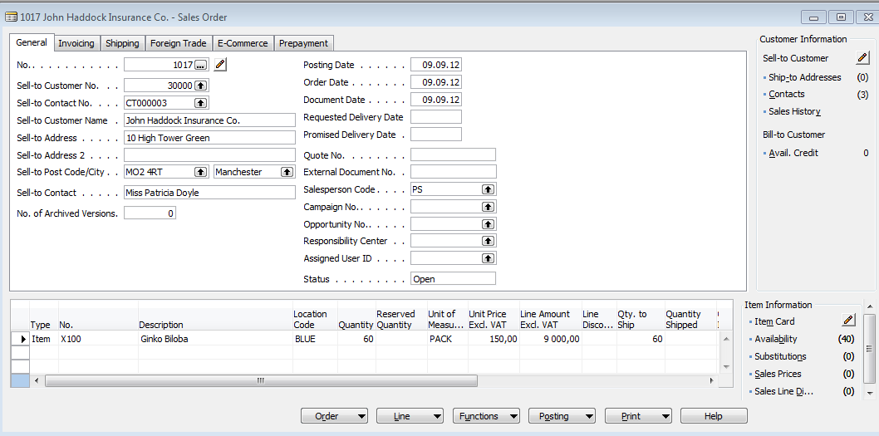
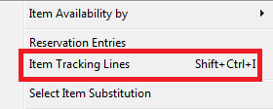
Sales Order

Slide 10
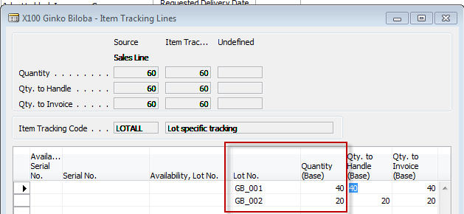
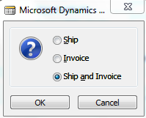
Item tracking lines
Chosen by use of F6 and
stored by ESC

Slide 11
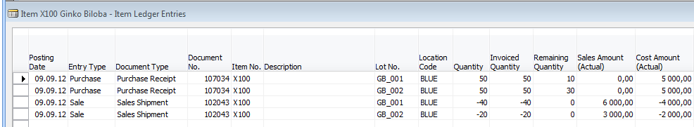
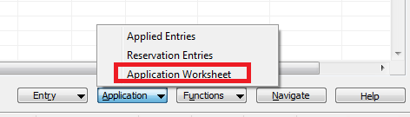
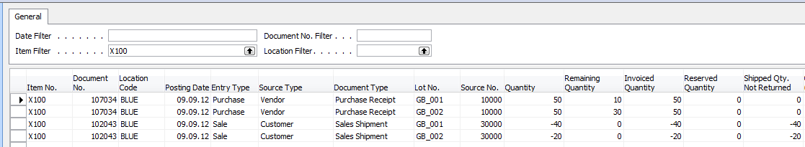
Item ledger entries after SO was posted and Application worksheet
Applications

Slide 12
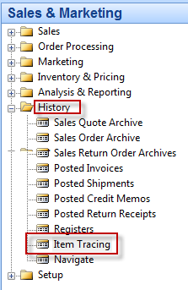
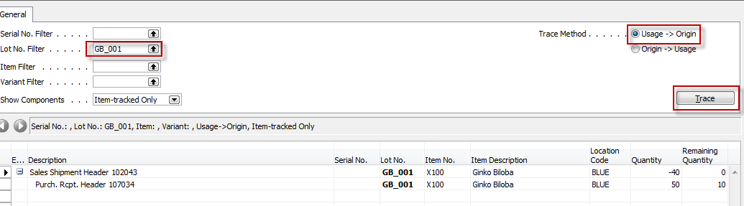
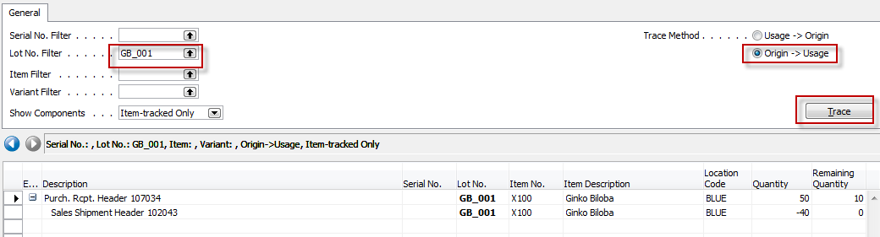
Item Tracing
You can use this window to find the posted documents where an item-tracked item or where a particular lot or serial number was used. You might use this feature for quality control to find which lot a defective component came from or to find all the customers to which a particular lot was sold.

Slide 13

End of the section XV.

