Slide 1
Introduction to MS Dynamics NAV XVI.
Ing.J.Skorkovský,CSc.
MASARYK UNIVERSITY BRNO, Czech Republic
Faculty of economics and business administration
Department of corporate economy

Slide 2
CRM – Customer Relationship Management
PROs
It enables to keep track of all prospective customer (suspects and prospects)
Improve sales and marketing service
Company can promote the work it has done for its customers in order to approach prospects
CONs
CRM software may not integrate well with other email and accounting systems
Another disadvantage to a newly implemented CRM software is the learning curve.

Slide 3
CRM – Customer Relationship Management
Relationship management is a customer-oriented feature with service response based on customer input, one-to-one solutions to customers’ requirements, direct online communications with customer and customer service centers that help customers solve their issues.
Sales force automation
Sales promotion analysis
Advertising
Personal selling
Direct marketing
Public relations
automate tracking of a client’s account history
Use of technology (ERP)
Opportunity Management

Slide 4
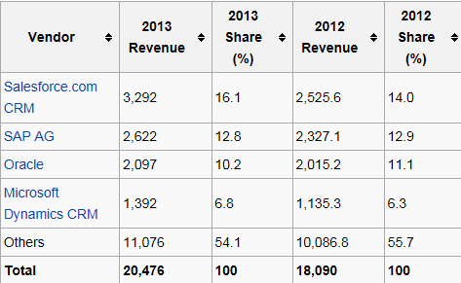
Market leaders
figures in millions of US dollars
Resource:

Slide 5
Vendor
Statistic :
Costs/Revenue
Only Czech course
BPH_PIS2 !!!!
Customer Entries
Customer
Interaction
Log
Entries
Contact
Card
Salesperson
To-Do
Card
Profile (parameters)
(To-Do)
Assigned
activities
Statistics:
Interactions, Stages,
Chances, Values,..
ABC (Pareto)
analysis
Opportunity
Activity
(code)
Sales Cycle
Stage
Partial Activities
Meeting /Telephone call
Interaction Log
Entries
Stage number
Activity

Slide 6
ERP-CRM
20000
70%
Meeting
Task1
Task22
Task p
Opportunity
ERP n
CRM
Customer
Card
QUOTE
ERP 2
ERP 1
Products
Task p+1
Task p+2
Task q
Opportunity
Financial
estimation
Success estimation
in %
Interactions

Slide 7
Contact cards
Contact card- company
Contact card- person
Contact Character– profiles, technologies,..
Interactions
Business Opportunities (estimated close date and value, probability,.. )
Sales Cycles
Customer Card creation from Contact card
Quotes

Slide 8
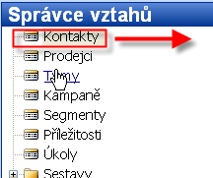
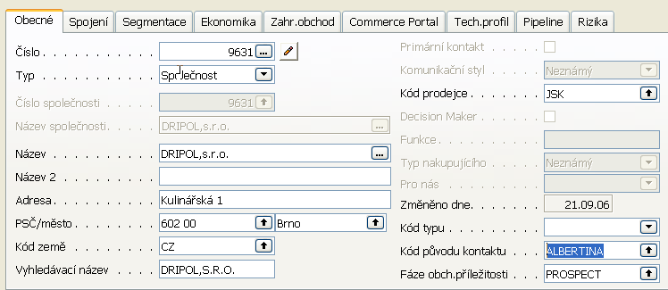
Karta kontaktu- společnost (hlavička karty) I
Only Czech course
BPH_PIS2 !!!!
Kontakty typu
osoba
Jirka Sirka
Jitka Plytká
Jakub Holub

Slide 9
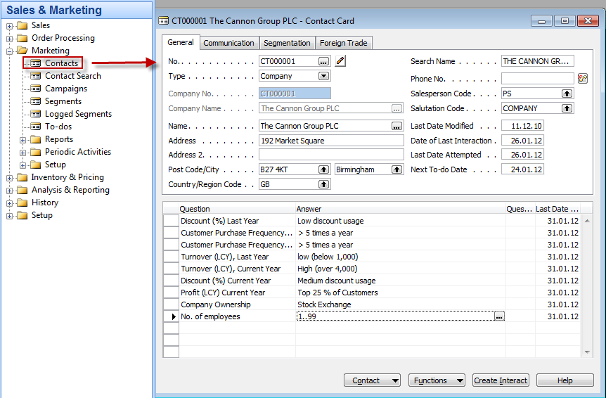
Contact Card

Slide 10
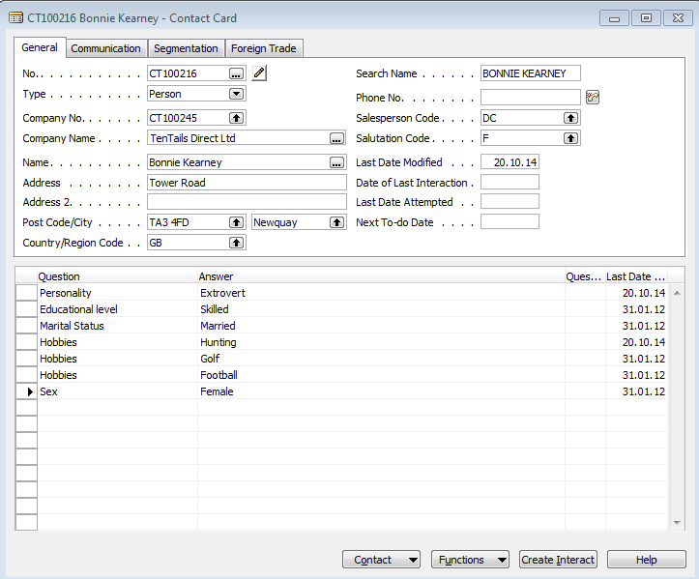
Contact Card- Person
Profile

Slide 11
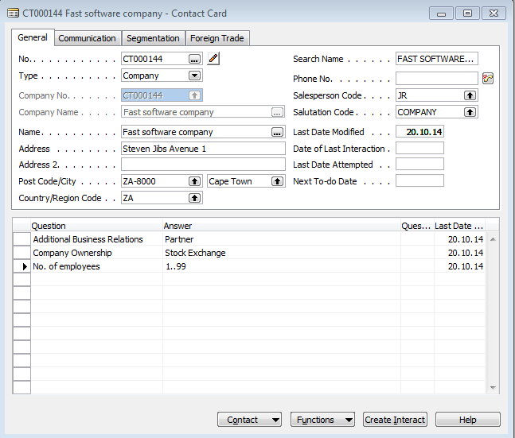
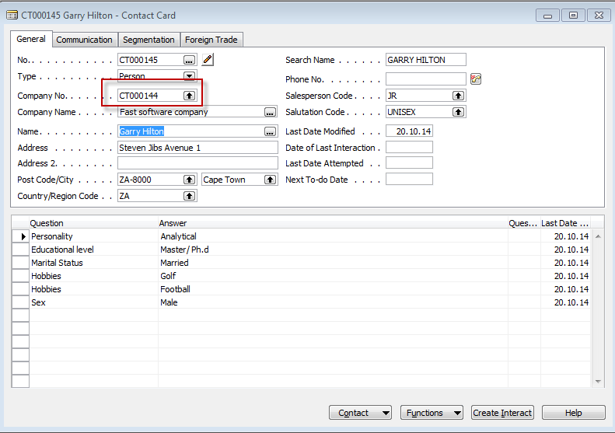
Contact Card- Company-person new

Slide 12
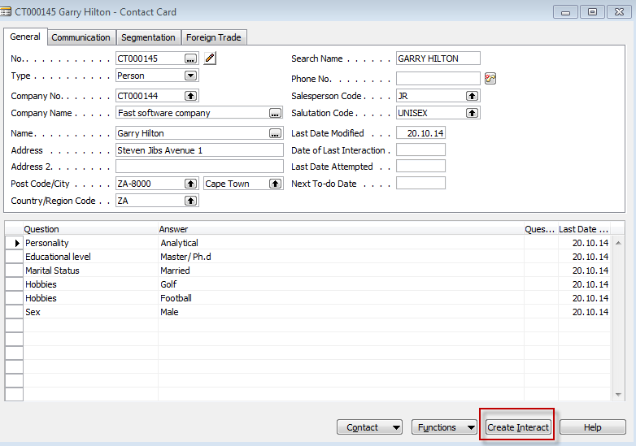
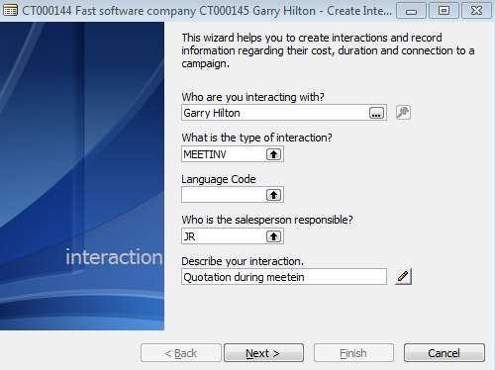
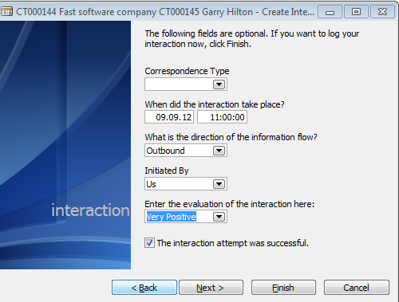
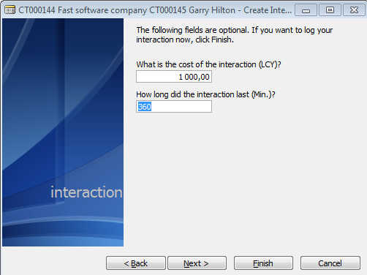
New interaction

Slide 13
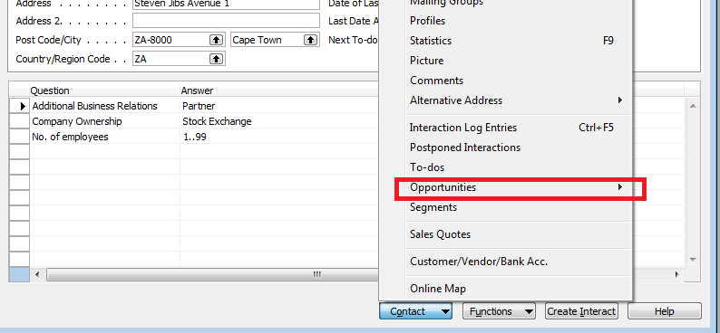
New interaction
Interaction entry
Create new opportunity

Slide 14
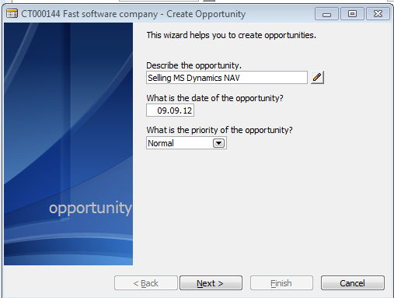
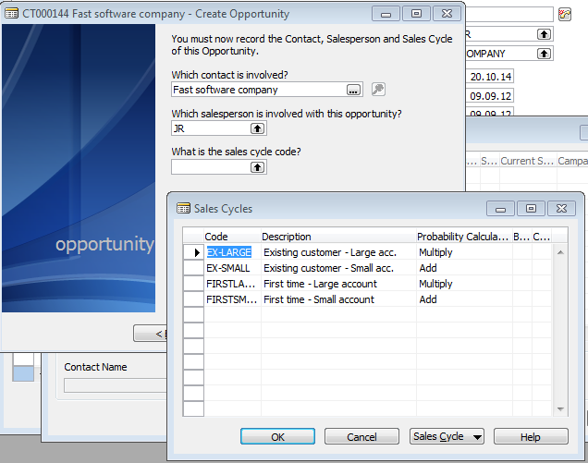
New oportunity

Slide 15
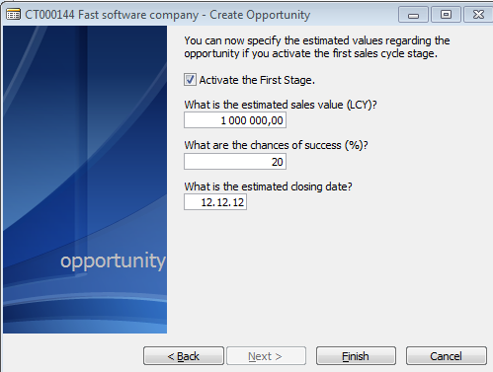
New oportunity

Slide 16
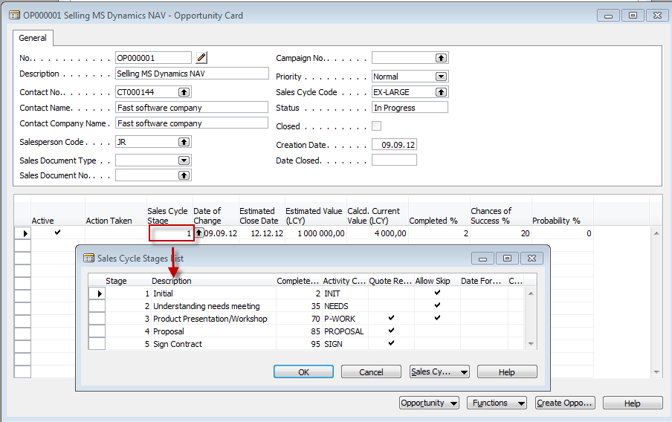
New oportunity
From here you can create various To-Dos and and change Sales Cycle stages

Slide 17
Sales Cycle Stages

Slide 18
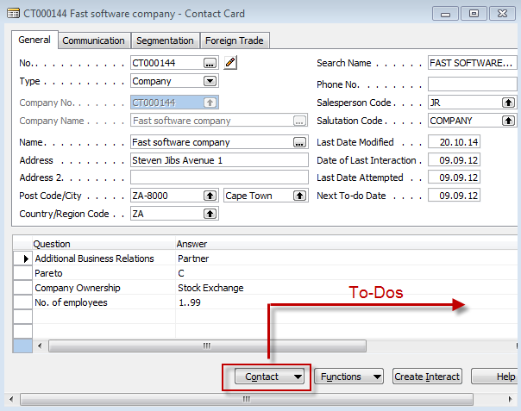
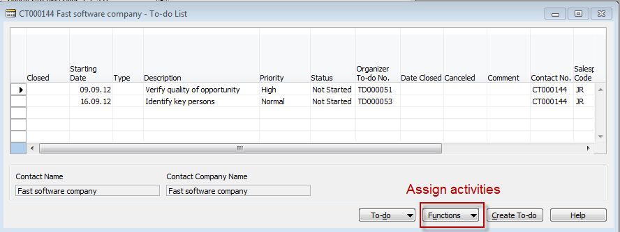
Contact card->To-Dos->Activities
Only Czech course
BPH_PIS2 !!!!

Slide 19
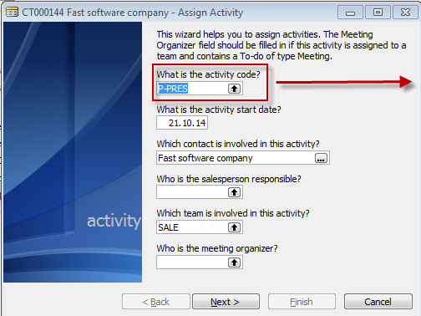
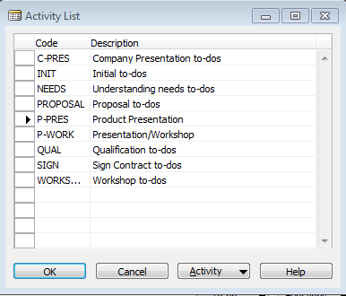
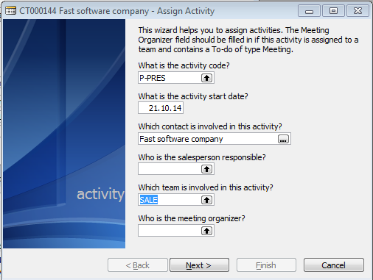
Contact card->To-Dos->Activities
Only Czech course
BPH_PIS2 !!!!

Slide 20
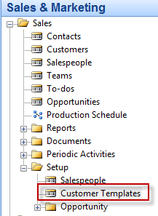
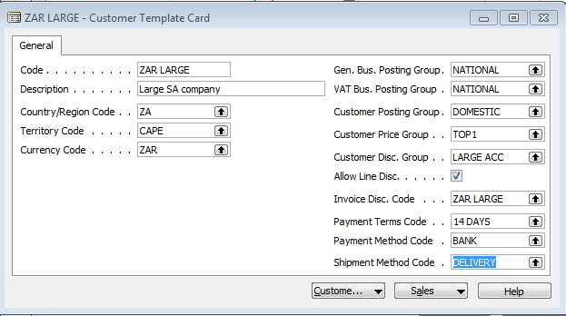
How to create a new customer from contact card
Only Czech course
BPH_PIS2 !!!!
Enter data either by writing
or by use Look-up (F6)

Slide 21
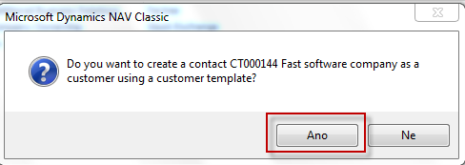
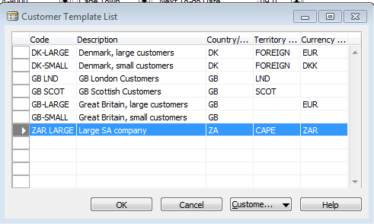
How to create a new customer from contact card
Bottom of the contact card

Slide 22
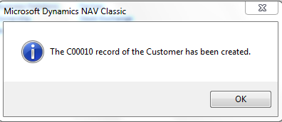
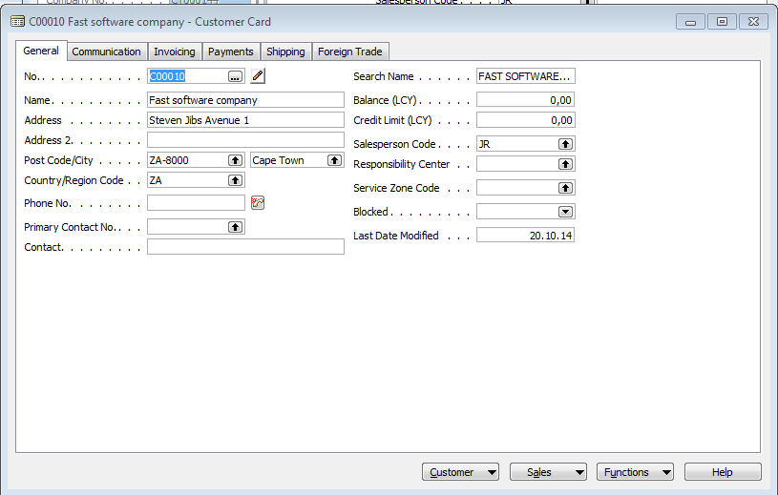
How to create a new customer from contact card

Slide 23
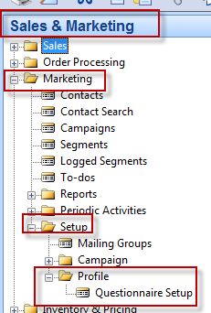
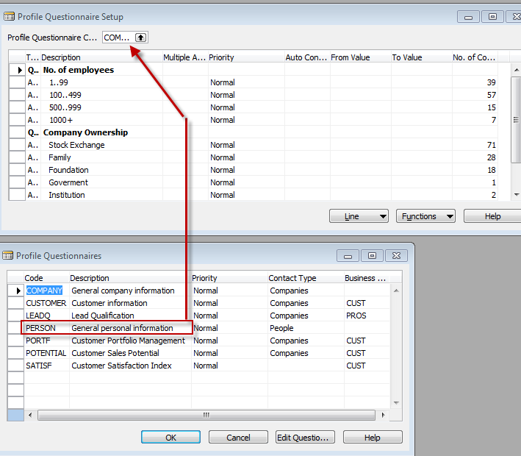
Personal profile creation

Slide 24
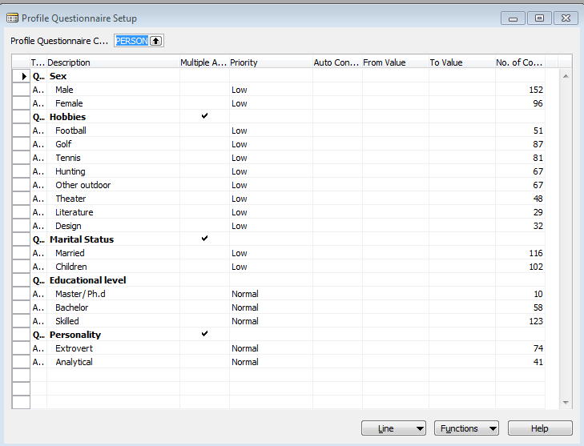
Personal profile creation
Add a new question

Slide 25
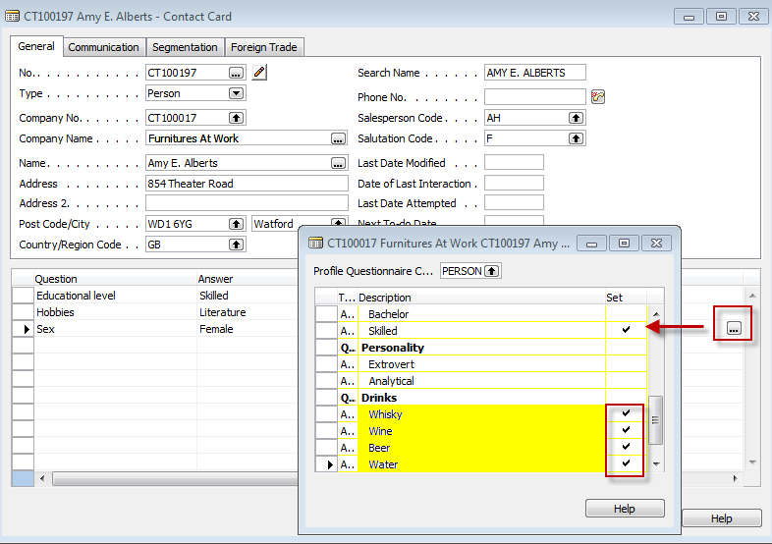
Personal profile creation

Slide 26
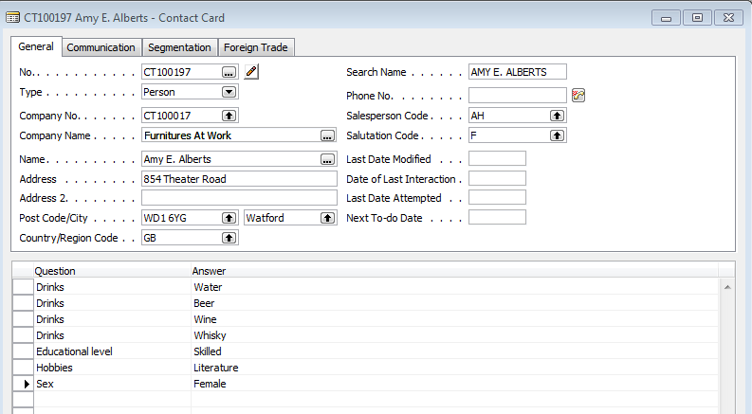
Personal profile creation

Slide 27
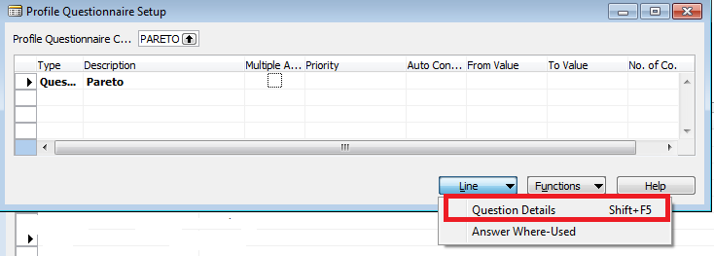
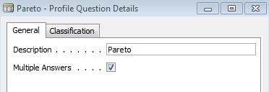
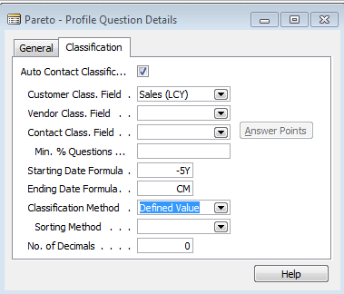
Pareto analysis based on company profile
Only Czech course
BPH_PIS2 !!!!
Add new line
Add Question details

Slide 28
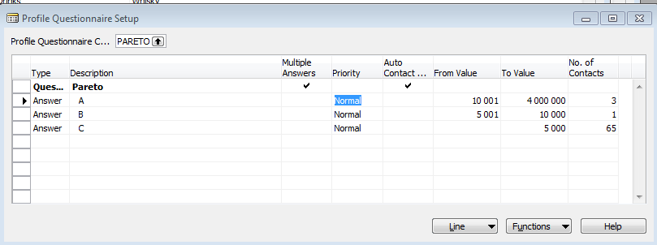
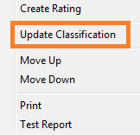
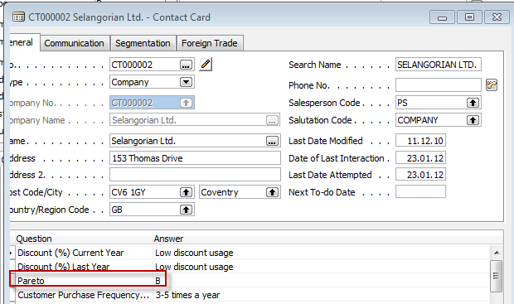
Pareto analysis based on company profile
Only Czech course
BPH_PIS2 !!!!

Slide 29
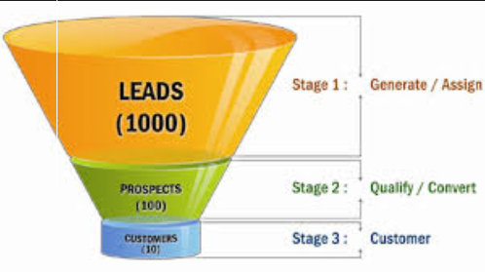
End of the section XVI.

