Slide 1
Public choice and government failures
BPV_APEC Public Economics
Jan Řezáč
21/10/2014

Slide 2
What are we going to talk about?
How does decision making in private and public sectors differ?
How to make good decisions in public sector?
Are there any influences?
Or paradoxes?

Slide 3
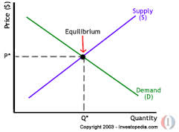
Private Sector
Equilibrium: demand curve and supply curve
Individuals reveal preferences about the private goods by buying them
Price reflects individual’s
preferences

Slide 4
Public Sector
No demand x supply equilibrium
Price is not obvious
Decisions made by public agencies, not „customers“
Individuals vote to elect representatives who vote for public budget
Budget is spent by public agencies
No comparability to private sector

Slide 5
What is public choice?
“Public choice can be defined as the economic study of nonmarket decision making“, “Application of economics to political science” (Mueller, 2009)
Covers:
theory of the state
voting rules
voters behavior
bureaucracy
legislatures
etc.

Slide 6
An easy public choice:
Action | Name | Cost | Benefit | C/B
A | Cycling roads | 500 | 600 | 1,2
B | Recreational center | 290 | 290 | 1
C | Ice hockey hall | 200 | 180 | 0,9
D | Stadium reconstruction | 280 | 350 | 1,25
E | Youth sport support | 240 | 300 | 1,25
Your budget is 800. For every action, the benefit is + 100.
What is the best combination?

Slide 7
Voting in Public Sector
UNANIMITY
Time consuming
Leads to Pareto-preferred situation
Encounters strategic behavior
MAJORITY
Most used
Lower costs
Less time to make decision
Some individuals will be worse off

Slide 8
Majority rules:
Simple majority rule (>50%)
Runoff election (1st round >50% if not best 2 to 2nd round)
Plurality rule (most “popular” wins)
Approval voting (choose more options; most “popular” wins)
Borda count (n choices, give to each option points {1,2,…,n}, most popular n, least popular 1; most points wins)
Hare system (select best; in each round the least popular options leaves until there is only one)
Coombs system (select worse; in each round the least popular options leaves until there is only one)

Slide 9
What can influence the voting?
Personal constrains attitudes
Physical, social, economic, moral, psychological, etc.
External influences
Politics, lobbying, corruption, international relations, legislation, economics, labor unions, etc.
Would you make voting compulsory?

Slide 10
Tactical voting
Compromising (what happens if the country has first-past-the-post election systems?)
Burying - very useful if some party has open primaries
Push-over – Imagine you are a French voter, who likes Sarkozy. Polls for first round say:
Sarkozy 24%, Hollande 18%, Le Pen 17%, lot of other candidates, the Left has a majority.

Slide 11
Condorcet criterion
Used to measure efficiency of choices
Pair-wise comparison of possible outcomes

Slide 12
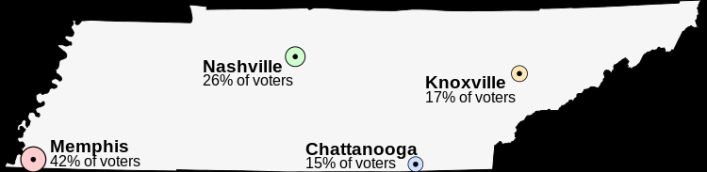
Tennessee needs a new capital, but where?

Slide 13
The preferences of the voters
42% of voters (close to Memphis) | 26% of voters (close to Nashville) | 15% of voters (close to Chattanooga) | 17% of voters (close to Knoxville)
Memphis Nashville Chattanooga Knoxville | Nashville Chattanooga Knoxville Memphis | Chattanooga Knoxville Nashville Memphis | Knoxville Chattanooga Nashville Memphis

Slide 14
Matrix
A
 |  | Memphis | Nashville | Chattanooga | Knoxville
B | Memphis |  | [A] 58% [B] 42% | [A] 58% [B] 42% | [A] 58% [B] 42%
 | Nashville | [A] 42% [B] 58% |  | [A] 32% [B] 68% | [A] 32% [B] 68%
 | Chattanooga | [A] 42% [B] 58% | [A] 68% [B] 32% |  | [A] 17% [B] 83%
 | Knoxville | [A] 42% [B] 58% | [A] 68% [B] 32% | [A] 83% [B] 17%
Ranking: |  | 4th | 1st | 2nd | 3rd

Slide 15
Arrow's impossibility theorem
Voting rule should fulfill:
Universality (all choices are allowed)
Non-dictatorship
Pareto efficiency
Independence of irrelevant alternatives.
But none of the rules does!
In other words: No voting rule is fair.

Slide 16

www.econ.muni.cz
The paradox of voting
■ Also called Downs paradox
■ Individual preferences in a group may lead to
ineffective outcome therefore voting becomes
irrational.
■ Decision of people to cast a vote is led not
only by a human rationality.
BPV_APEC Public Economics: Public Choice

Slide 17
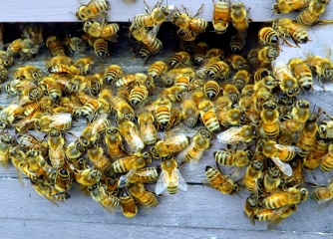
Not only humans vote
The honeybee occasionally needs
Find a new place for a nest.
The swarm sends out scout bees
To look for a new location

Slide 18
What method the bees use?
First the researchers thought bees prefered unanimity.
Then they observed that only a quorum is sufficient – 30 bees out of 75 bees at a potential nest site.

Slide 19
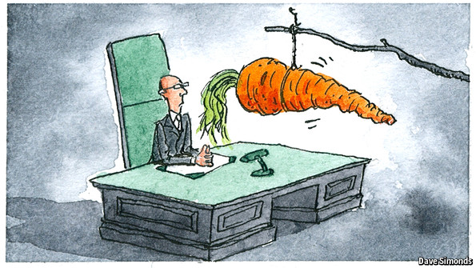
How to reward bureaucrats?

Slide 20
There are huge differences between countries:
Top pay for elite work
Strict seniority
Project management

Slide 21
Can we or governement punish bureacrats if something goes wrong?
Most projects end behind schedule.
Also more expensive and less useful then expected initially.
What exactly would we punish?

Slide 22
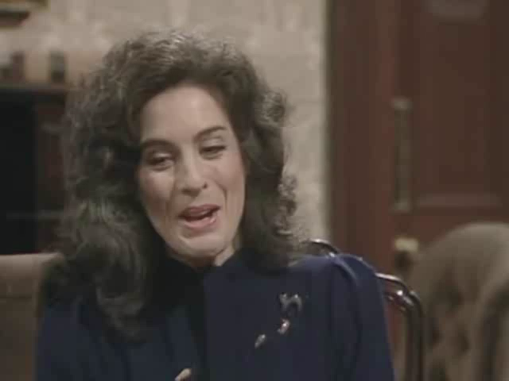
Can we reward bureacrats if they do well?

Slide 23
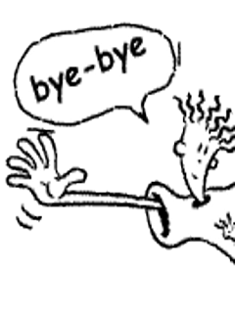
Thank you for your attention

