Slide 1
Financial Investment
Dagmar Linnertová
  Dagmar.linnertova@mail.muni.cz
  Seminars
    Excercises in a seminars evaluated by lecturer (different number of (extra) points)
      Questions as a preparation for final test
      (Seminar paper presentation – 15 points
    2 in-term tests (20 points per each)
    29/10/2014 and 3/12/2014
Final grade
  Final Test: 30 points
  A 92 – 100 and more, B 84 – 91, C 76 – 83 , D 68 – 75 , E 60 – 67, F less than 60 points

Slide 2

Financial Investment
Bodie, Kane, Marcus OSE 1009

Slide 3
Lecture 1 - 2
- The Investment Environment
- Asset Classes and Financial Investments

Slide 4
Economic vs. Financial System
Economic System
  Households, firms, government?
Financial System
  Surplus units, deficit units

Slide 5
Real Assets Versus Financial Assets
The material wealth of an economy is determined by production of the economy
  How many goods and services are its members possible create
This can be produced by using real asset
In contrast to real assets are financial assets
  Sheet of paper or computer entry
  Means by which individuals hold claims on real assets
    Auto plant vs. stock of Toyota

Slide 6
Financial Assets
Essential nature of investment
  Reduced current consumption
  Planned later consumption
Financial Assets
  Claims on real assets
  Allocation of net income along investors

Slide 7
System of markets
Issuance
  Primary vs. Secondary market
Products/ instruments
  Stock, bond, foreign exchange, derivative market, commodity markets, other financial instrument markets (ETFs, mutual funds, passive investment products, etc)
Maturity
  Money vs. Capital market

Slide 8
A Taxonomy of Financial Assets
Three broad types of financial assets
  Fixed income (debt), Equity and derivative securities
1. Fixed income or debt
  Fixed stream of income vs. Determined stream of income (some formula)
    Corporate bonds or floating-rate notes
  Money market instruments
    Bank certificates of deposit, T-Bills, etc.
  Capital market instruments
    Corporate bonds, goverment bonds, etc.

Slide 9
A Taxonomy of Financial Assets cont.
2. Common stock or equity
  Ownership in corporation
  Without promise of regular payment
3. Derivative securities
  Options, futures contracts
  Underlying
  Hedging
  Speculation

Slide 10
Financial Markets and the Economy
1. Information Role
  Investor decides which company live of die
  Bid up or bid down prices
2. Consumption Timing
  Earning more or less than wish to spend
  Store wealth in financial assets
  Shift purchasing power

Slide 11
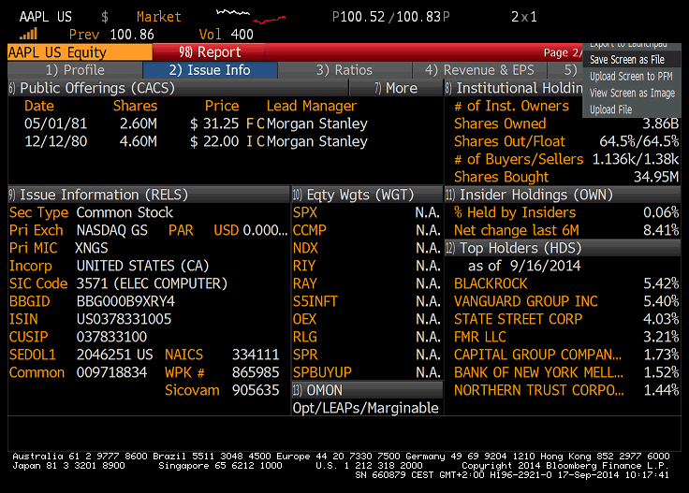

Slide 12
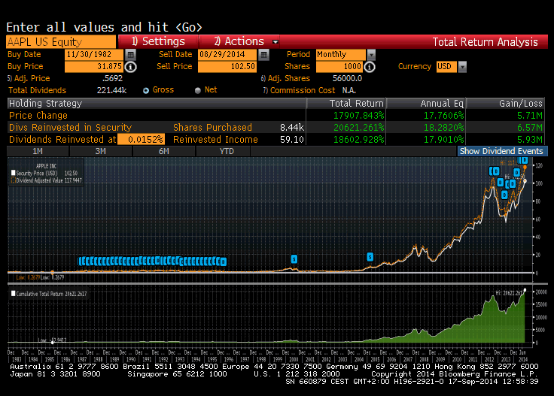

Slide 13
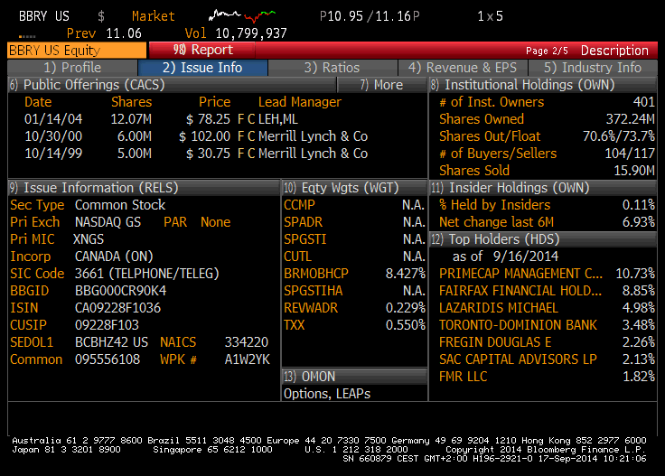

Slide 14
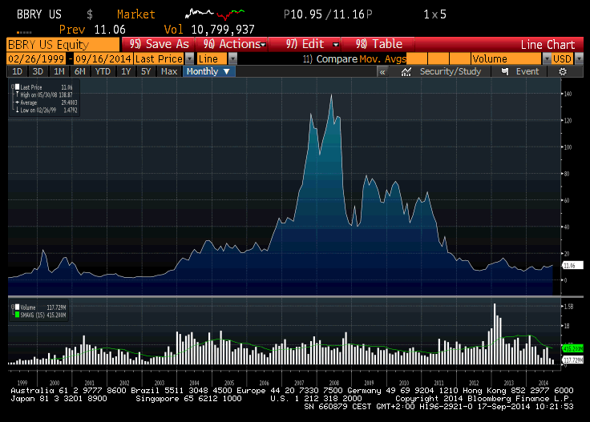

Slide 15
Financial Markets and the Economy cont.
3. Allocation of Risk
  Transformation risk according to investor profile
  Bond vs. stock
  Diversification or insurance or hedging
4. Separation of Ownership and Management
  Companies owned and managed by same individuals
  Agency Issues
    Does management attempt to maximalise firm value?
    Conflict of interest
      Tie managers income to profit of a firm
        Stock options
        Treat of takeover – proxy contest or other firm

Slide 16
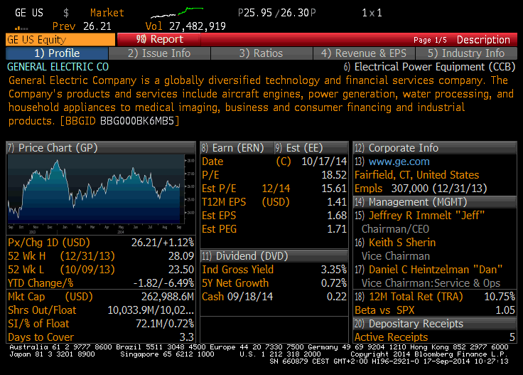

Slide 17
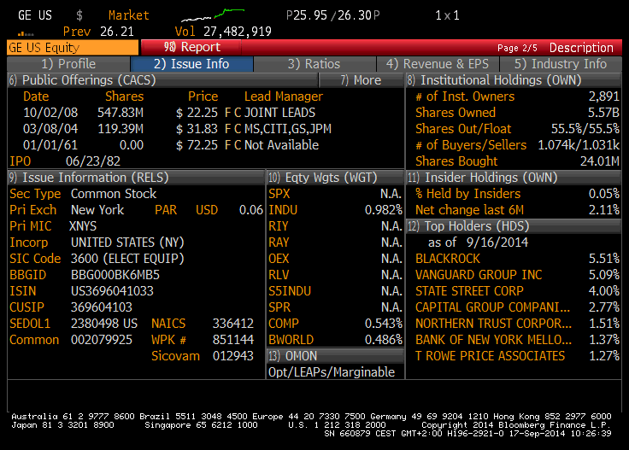

Slide 18
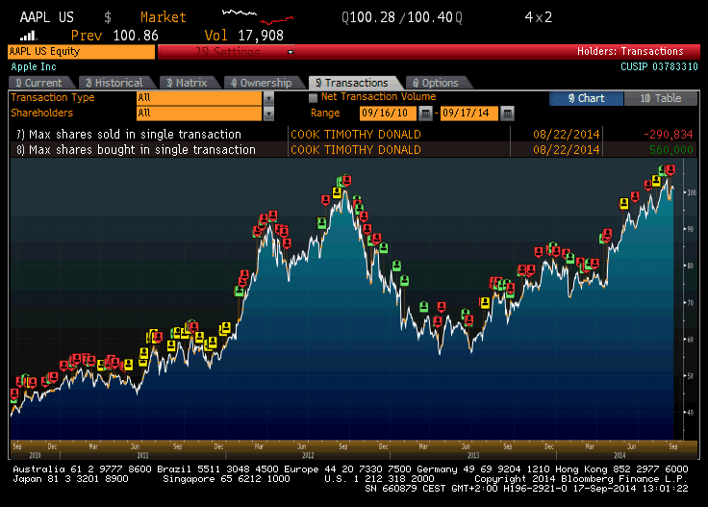

Slide 19
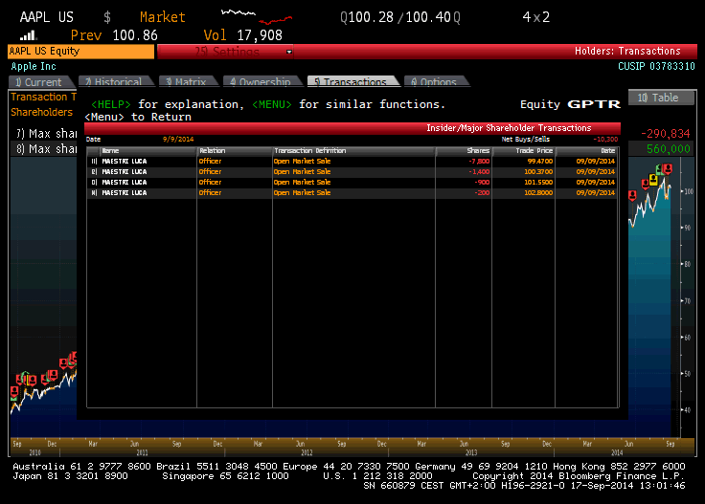

Slide 20
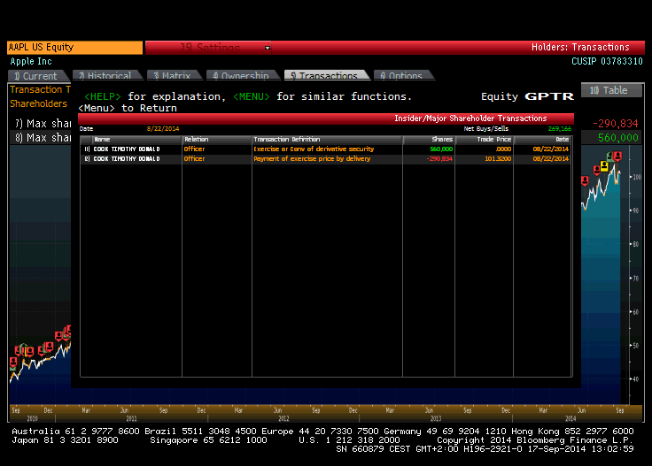

Slide 21
Financial Markets and the
Economy cont.
Corporate Governance and Corporate Ethics
  Financial market play important role in effective allocation of resources
    Transparency of information
  Accounting Scandals x Rating Agency failures
    WorldCom
    Examples – Enron, Rite Aid, HealthSouth
  Auditors—watchdogs of the firms
  Analyst Scandals
    Arthur Andersen
  Sarbanes-Oxley Act
    Tighten the rules of corporate governance
      2002
      Independent directors that are not managers
      Prohibit auditors providing another services

Slide 22
The Investment Process
Saving
  Not spending all on consumption
Investing
  Choosing what assets to hold
    Safe, risky, combination
Investors are making two decisions in creation of their portfolio
1. Asset allocation
  Choice among broad asset classes
2. Security selection
  Choice of which securities to hold within asset class
Security analysis
  Evaluation of assets
Top down portfolio
  Asset allocation
  Security selection
Bottom-up strategy
  Securities that are attractively priced

Slide 23
The Investment Process – decision making
Prediction of future return
  Risk associate with investment (historical or expected data)
Risk-Return Trade-Off
  If all else is equal, investors will prefer investments with the highest expected return
  A vs. B
    Historical risk 5 % vs. 8
    Historical rate of return 3 % vs. 2,5
    Coeffcient of variation
Efficient Markets
  Role of information
Process of diversification
Active Management
    Finding mispriced securities
    Timing the market
Passive Management
    No attempt to find undervalued securities
    No attempt to time the market
    Holding a highly diversified portfolio

Slide 24

Chinese Symbol For Risk
Risk
  Systematic
  Non-systematic

Slide 25
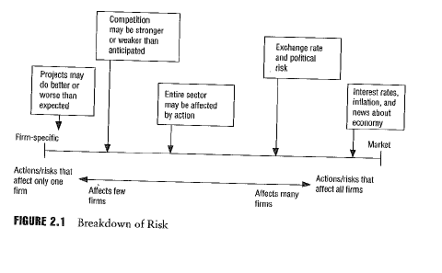
Breakdown of Risk (holding of one asset)

Slide 26
The Players
Business Firms– net borrowers
  Raise capital to pay for investments in plant and from income provides return to investors
Households – net savers
  Purchase securities from firms that need capital
Governments – can be both borrowers and savers
  After WWII mostly borrowers
Role of financial institutions and intermediaries

Slide 27
The Players cont.
Financial Intermediaries
  Investment Companies
  (Investment )Banks
  Insurance companies
  Credit unions

Slide 28
Financial Intermediaries
For the households is direct investment difficult
For small investor is lending money related with transactional costs
Entrance of financial intermediaries
  Bring them together
  Different from another business
    All their liabilities and claims are at most financial
Primary function
  Channelling funds from private to business sector
    Pooling the resources from many small investors to be able to lend considerable sum of money
    Lending to many borrowers
      Diversification and thus can adopt risky project
    Built expertise through volume of business they do
      Economy of scale

Slide 29
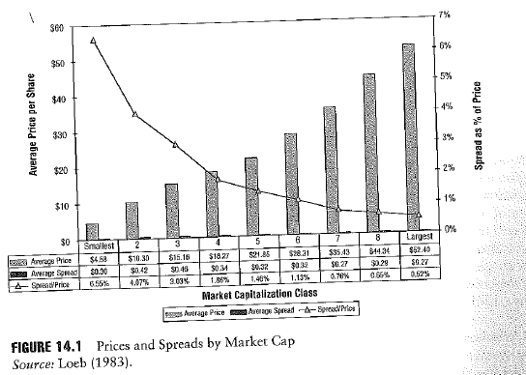
Bid-Ask Spread

Slide 30
The Players Continued
Investment companies
  Pool and manage the money of many investors
    Most household portfolios is not large enough to be spread among a wide variety of securities
      Brokerage fees
      Researcher costs
    Mutual funds
    Portfolios for individual investors
Investment Bankers (separate business till 1999, September 2008 respectively)
  Perform specialized services for businesses
  Markets in the primary market
  Expertise to security issuers
  Assisting in issuing securities
  Key role in IPO
  Universal banks – J.P. Morgan + Chase Manhattan – J.P. Morgan Chase different in Europe (Deutsche Bank, Credit Suisse)
  Laverage 10 to 1 vs. 30 to 1

Slide 31
The end of stand-alone investment bank industry
Investment Bank | Commercial bank
Bear Stearns | J.P.Morgan Chase (merge)
Merril Lynch | Bank of America (acquisition)
Goldman Sachs → | (transformation)
Morgan Stenley → | (transformation)
From March to September 2008
End of independent investment bank industry

Slide 32
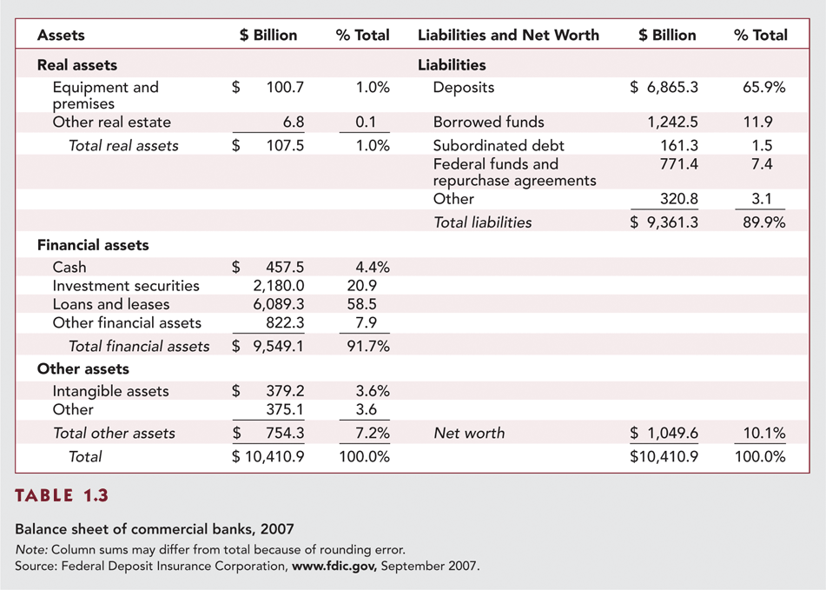
Table 1.3 Balance Sheet of
Commercial Banks, 2007

Slide 33
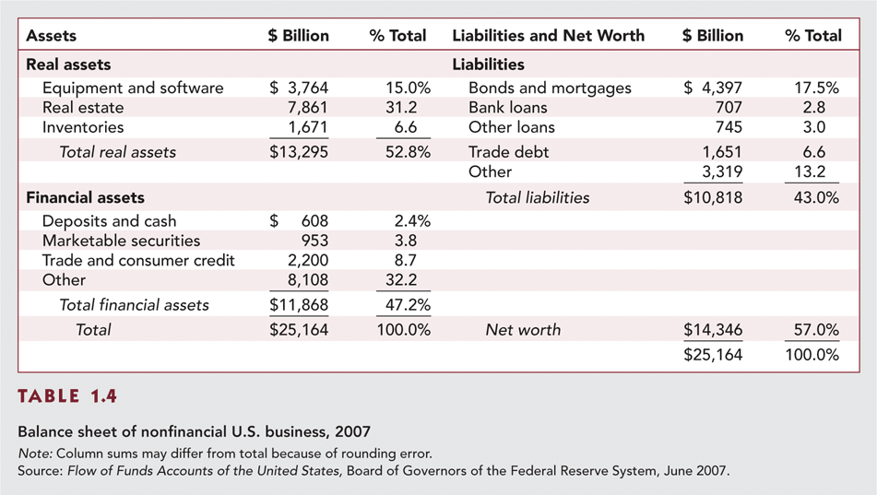
Table 1.4 Balance Sheet of Nonfinancial U.S. Business, 2007

Slide 34
New Trends
Globalization
Securitization
Financial engineering
Information and computer networks

Slide 35
Recent Trends—Globalization
Investor is not limited only to domestic assets
Efficient communication technology and decreasing of regulatory borders
Possible way how to participate in foreign investments opportunities
  Domestically traded securities that represent claim to share of foreign stocks
  Purchase of foreign securities that are denominated in domestic currency
  Buy mutual funds that invest internationally
  Buy derivative securities with payoffs that depend on prices in foreign security market
A giant step toward globalization 1999
  11 European countries adopted euro

Slide 36
Recent Trends—Securitization
Mortgage pass-through securities
  1970 –Government National Mortgage Association or GNMA or Ginnie Mae
  Aggregation of individual home mortgages into homogeneous pool
  This pool works as backed for pass through security
  Investors get share in principal ale payments related with backed securities
  Securitization of mortgages means that mortgages can be traded as securities
Other pass-through arrangements
  Car, student, home equity, credit card loans
Offers opportunities for investors and originators
See Investment (Bodie, Kane, Marcus, p. 14 - 23 )

Slide 37
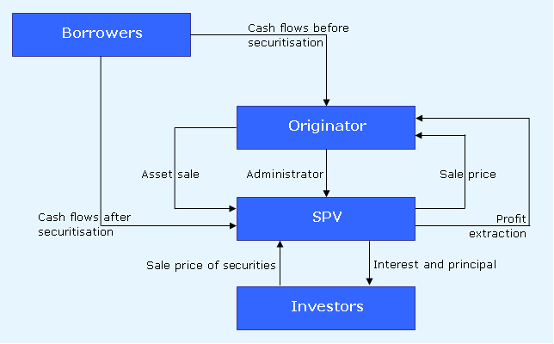
Securitization

Slide 38
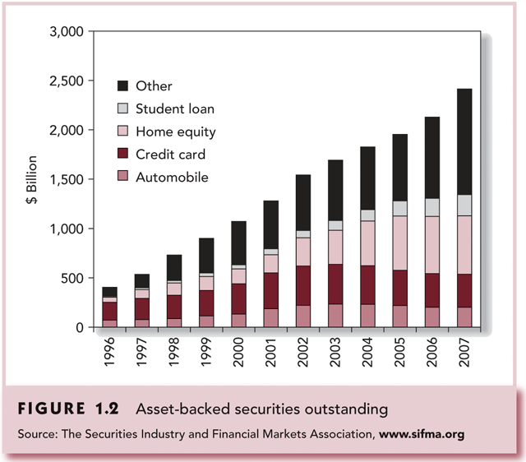
Figure 1.2 Asset-backed Securities Outstanding

Slide 39
Recent Trends—Financial Engineering
Use of mathematical models and computer-based trading technology to synthesize new financial products
  Principal-protected or equity-linked note
    Security that guarantee a minimum fixed return plus an additional amount that depends on the performance of some index
Bundling and unbundling of cash flows
Combination more than one security into a composite security or breaking up and allocation the cash flows from one security to create several new securities
Securities tailored according to investor risk

Slide 40
Recent Trends—Computer Networks
Online trading
  Direct contact between customers and brokerage firm
  Cheaper trading
  Lower commissions
Online information dissemination
Information is made cheaply and widely available to the public
Automated trade crossing,
  Direct trading among investors
    Trading without benefit for intermediaries such security dealers
high frequency trading

Slide 41
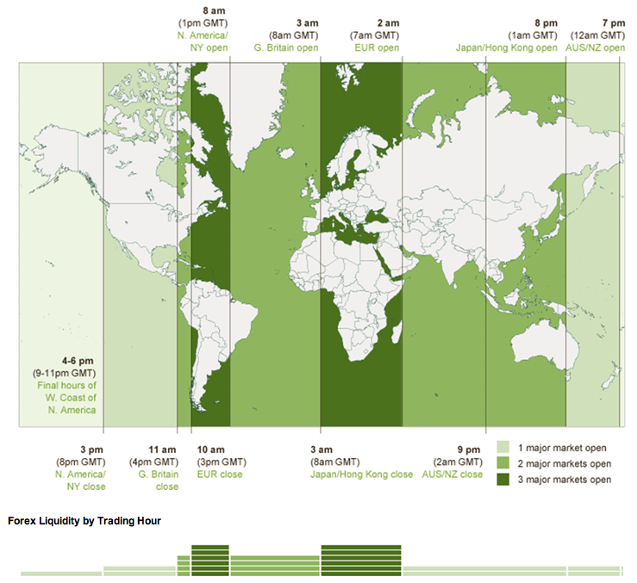


Slide 42
Major Classes of Financial Assets or Securities
Money market instruments
Bond market instruments
Equity Securities
Indexes
Derivative market products

Slide 43
The Money Market
A subsector of the fixed income market
  Short-term debt securities
  Highly marketable
  Traded in large denominations
  Out of reach of individual investors

Slide 44
The Money Market cont.
Treasury bills
  Most market able
  Simple for of borrowing
    Government want to borrow from public
    Investors buy with discount from face value
    Maturities 28, 91 or 182 days
    Individual can buy directly in auction or from government securities dealer
    Highly liquid
  Bid and asked price
  Bank discount method

Slide 45
The Money Market cont.
Certificates of Deposits
  CD time deposit with bank
  Can not be withdraw on demand
  Issued in denominations greater than 100.000 USD
  Are negotiable
Commercial Paper
  Issued by well-know companies rather than using bank loans
  Very often backed by a bank line of credit
    Access to cash that can be used to pay off the paper at maturity
  Issued in multiple of 100.000
  For small investor open only indirectly

Slide 46
The Money Market cont.
Bankers Acceptances
  Order to a bank by bank’s client to pay a sum of money at a future day, typically within 6 months
  Can be traded in secondary market
  It is selling with discount from face value

Slide 47
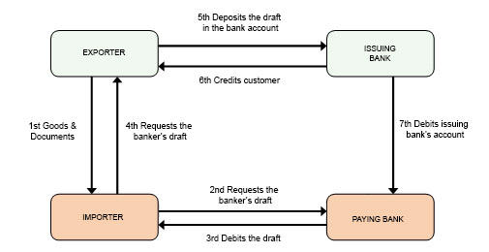
Bankers Acceptances

Slide 48
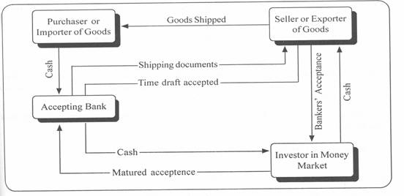
Bankers Acceptances

Slide 49
The Money Market Continued
Eurodollars
  Dollar-denominated deposits at foreign bank

Slide 50
The Money Market Continued
Brokers’ Calls
  Individual who buy securities on margin borrow part of the funds to pay for the stocks from their broker
  Broker may borrow the funds from a bank, agreeing to repay immediately on call if the bank request it
  Price about 1 % higher than the rate on short-term T-bills

Slide 51
The Money Market Continued
Repurchase Agreements (RPs) and Reverse RPs
  It is used by dealers with government securities
  Form of short term borrowing
  Most deposits are in large sum, time deposit less then 6 months
    Overnight
  Dealer sells government securities on an overnight basis with the promise to buy back these securities next day
  Dealer get 1-day loan from the investor
  Securities work as collateral
  Safe in term of credit risk

Slide 52
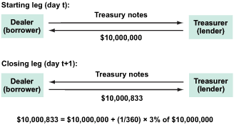
Repurchase Agreements (RPs) and Reverse RPs

Slide 53
LIBOR Market
London Interbank Offered Rate
LIBOR (lend)
  Large banks in London are willing to lend money among themselves
  (Short-term interest rate quoted in European money market
  Reference rate for a wide range of transactions
EURIBOR, HIBOR, MIBOR (2x), SIBOR, etc.
LIBID (borrow)

Slide 54
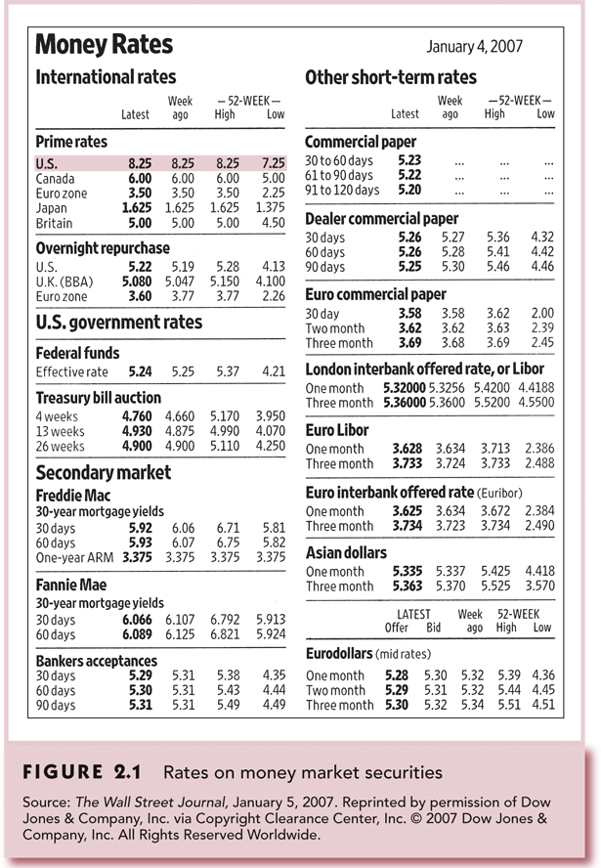
Figure 2.1 Rates on Money Market Securities

Slide 55
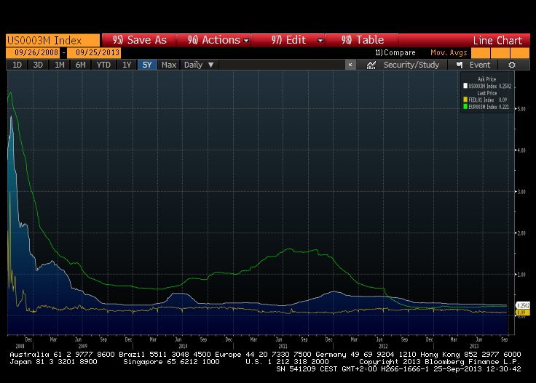

Slide 56
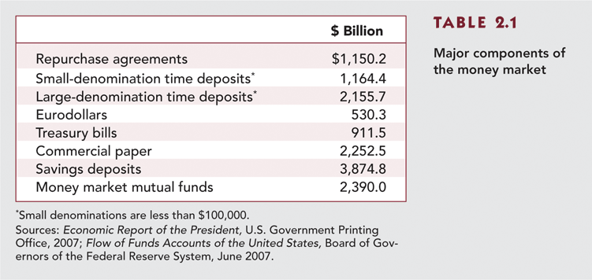
Table 2.1 Major Components of the Money Market

Slide 57
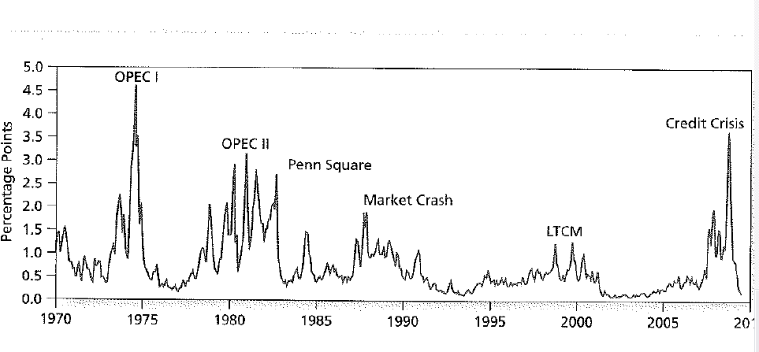
Figure 2.3 The Spread between 3-month CD and Treasury Bill Rates

Slide 58
The Bond Market
Longer term borrowing
Debt instrument that are not traded in money market
Mostly traded with fixed income capital market instruments
  Either fixed stream of income
  Stream of income that is determined from specific formula

Slide 59
The Bond Market
Treasury Notes and Bonds
Inflation-Protected Treasury Bonds
International Bonds
Municipal Bonds
Corporate Bonds
Mortgages and Mortgage-Backed Securities

Slide 60
Treasury Notes and Bonds
Maturities
  Used by government for debt financing
  Notes – maturities up to 10 years
  Bonds – maturities in excess of 10 years
  30-year bond
  Semiannual interest payments called coupon payment
Par Value - $1,000
Quotes – percentage of par

Slide 61
Inflation-Protected Treasury Bonds
Called TIPS
  The principal amount is adjusted in proportion to increase of CPI

Slide 62
International Bonds
Many firms borrow abroad and many investors buy bonds from foreign issuers
In additional to national capital markets, there is a rising international capital market, largely concentrated in London
A Eurobond
  Bond denominated in a currency that is different from country where it is issued
    Eurodollar bond
      E.g. A dollar-denominated bond sold in UK
Many firms also issue bonds in different currency that is same as a currency of a investor
  Yankee bond dollar denominated, sold in US by non-dollar issuer
  Samurai bond yen denominated bond, sold in Japan by non-Japanese issuer

Slide 63
Municipal Bonds
Issued by state and local governments
Types
  General obligation bonds
    Backed by faith and credit of issuer
  Revenue bonds
    Issue to finance commercial project
      Backed by revenues from this project
      Airports, hospitals, etc.
      Riskier than GOB
    Industrial revenue bonds
      Revenue bond to finance commercial enterprises
Maturities – range up to 30 years

Slide 64
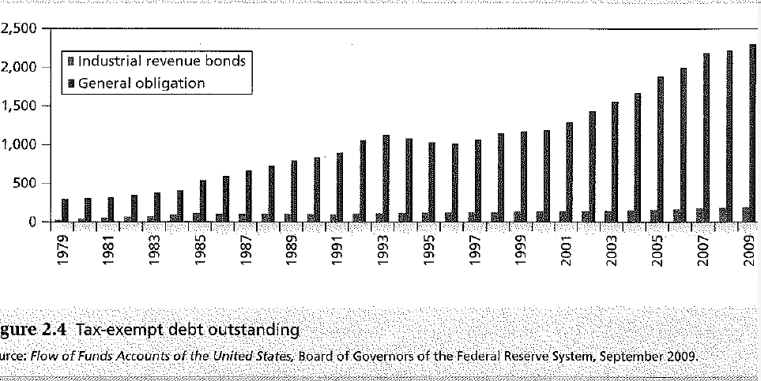

Slide 65
Corporate Bonds
Issued by private firms
  Borrow money directly from public
  In structure almost same as Treasury issues
    Semi-annual coupon
    Return the face value
    But different degree of risk – default risk
Secured bonds – collateral backing them in the event of firm bankruptcy
Unsecured bonds - debentures – no collateral
Subordinate debentures – lower priority claim to firm’s assets
Options in corporate bonds
  Callable – right of issuer to repurchase bond from the holder at a set price
  Convertible - right of issuer to convert bond into a number of shares of stock

Slide 66
Mortgages and Mortgage-Backed Securities
Developed in the 1970s to help liquidity of financial institutions
  Mortgages written for long term 15 – 30 year maturity with fixed interest rate and fixed monthly payments – conventional mortgages
    Difficulties from lenders if interest rate increase
      Adjustable-rate mortgage
Mortgage-Backed Security
  Proportional ownership of a pool or a specified obligation secured by a pool
  Securitization in mortgage market
  Called as a pass-throughs
Market has experienced very high rates of growth

Slide 67
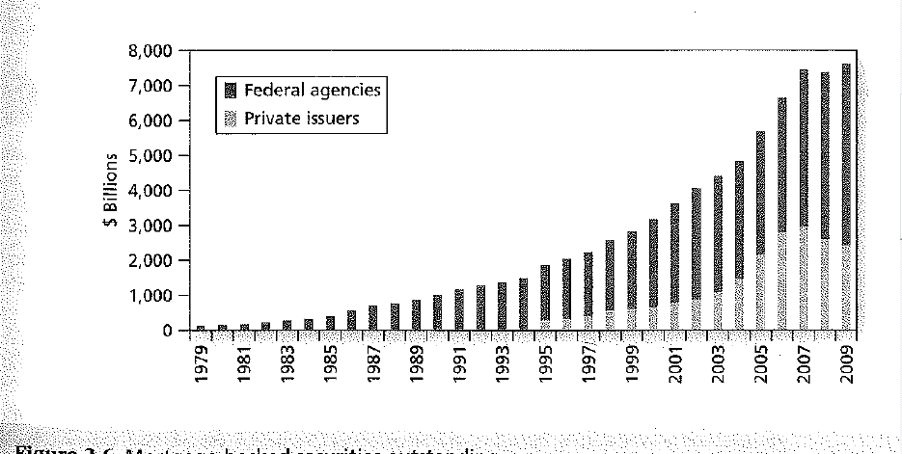
Figure 2.7 Mortgage-backed Securities Outstanding, 1979-2007

Slide 68
Equity Securities
Represent ownership in a corporation
The corporation is controlled by a board of directors that are elected by shareholders
The board that meet only a few time each year selects managers who actually run the corporation on a day-to day basis.

Slide 69
Equity Securities
Common stock
  Residual claim
    The last in line of all those who have a claim on the assets and income of the corporation
    After tax authorities, employees, suppliers, bondholders and other creditors
    If a firm is not in liquidation
      After interest and taxes
  Limited liability
    Shareholders can lose only original investment

Slide 70
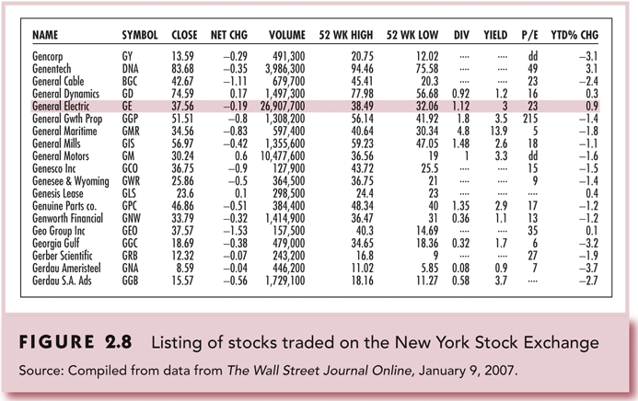
Figure 2.8 Listing of Stocks Traded on the NYSE

Slide 71
Equity Securities
Preferred stock
  Fixed dividends - limited
    Same as infinite-maturity bonds
    No voting rights
  Cumulative preffered stock
    Unpaid dividends are cumulated and must be paid in fully before any other dividends
  Tax treatment
    Are not tax-deductible expenses for the firm
Depository receipts - ADRs
  Certificated that represent ownership in shares of a foreign company
  Traded in U.S. markets

Slide 72
Stock Market Indexes
There are several broadly based indexes computed and published daily
There are several indexes of bond market performance
Price-weighted index vs. Market capitalization weighted index
Others include:
  Financial Times Index

Slide 73
Dow Jones Industrial Average - NYSE
Includes 30 large blue-chip corporations
Computed since 1896
Originally simple average of the stocks included in the index
  Add up prices of the 30 stocks and it is divided by 30
  Percentage change in DJIA is percentage change in average price of the 30 shares
  Holding of portfolio of 30 shares (one share of each stock in the index)
    Value of portfolio is value of 30 shares
Price-weighted average

Slide 74
Standard & Poor’s Indexes
Improvements of DJIA in two ways
- Broadly based index of 500 firms
  Market-value-weighted index
  Calculating the total market value of 500 firms and total market value of those firms in previous day
  The change in the value represent the change in index
  The rate of return of index represent the rate of return of portfolio of investor that hold 500stocks in proportion to their market value
How to invest in index
  Index funds
  Exchange Traded Funds (ETFs)

Slide 75
Other U.S. Market-Value Indexes
NASDAQ Composite
  Index of all NASDAQ listed stocks
    Subindexes – industrial, utility, transportation and financial stocks
  Mode broadly bases than S&P 500
NYSE Composite
Wilshire 5000
  NYSE and Amex stocks plus actively traded NASDAQ stocks
  About 6000 stocks

Slide 76
Foreign and International
Stock Market Indexes
Nikkei (Japan)
FTSE (Financial Times of London)
  ”footsie”
DAX (Germany)
MSCI (Morgan Stanley Capital International)
  International index
    About 50 country indexes and some regional indexes
Hang Seng (Hong Kong)
TSX (Canada)

Slide 77
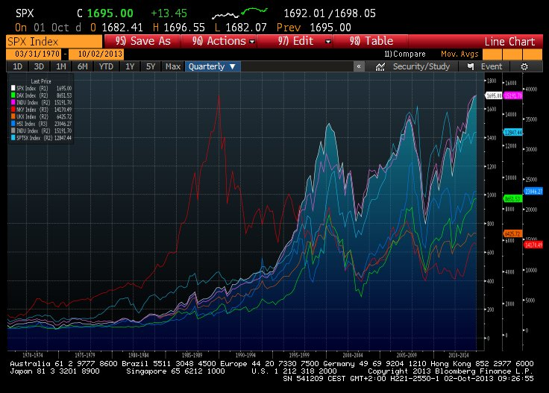

Slide 78
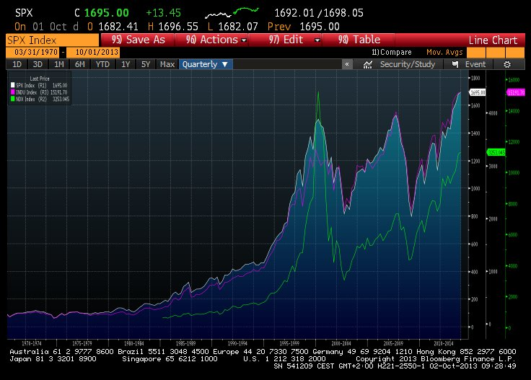

Slide 79
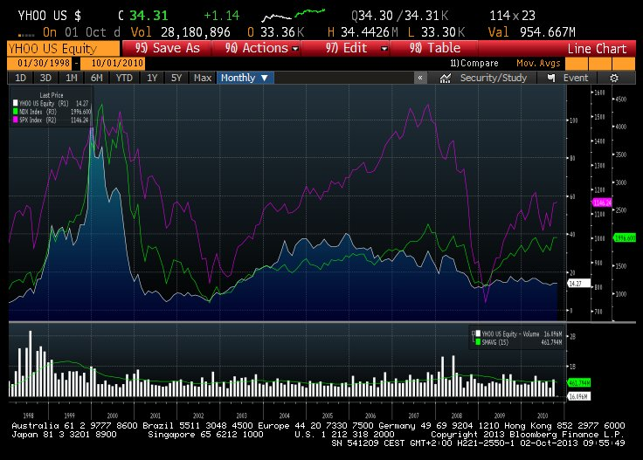

Slide 80
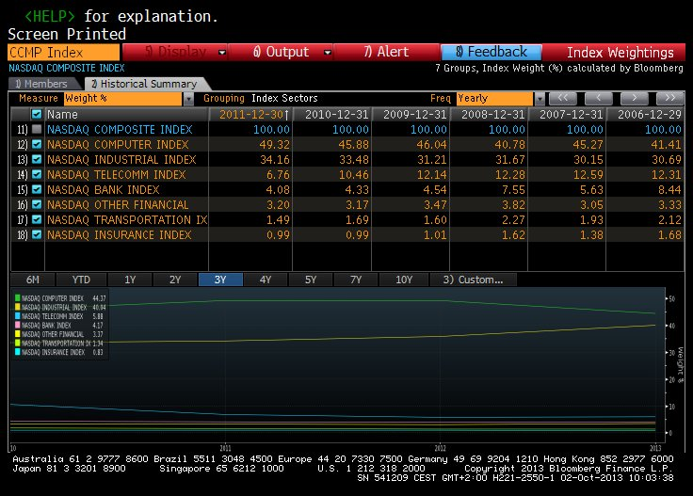
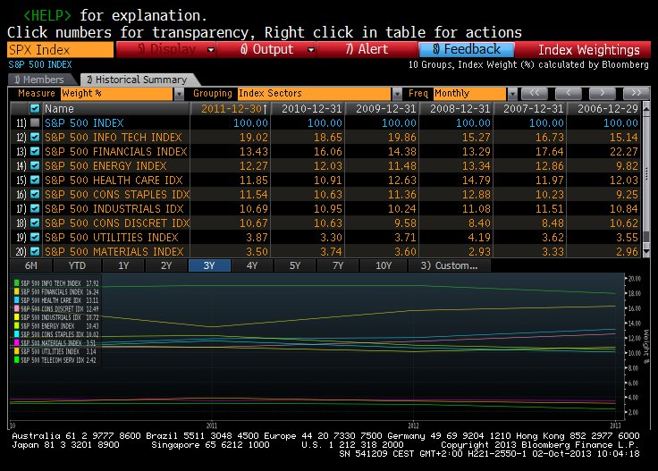

Slide 81
Derivatives Markets
One of the most significant developments in financial markets in recent years
Provide payoffs that depends on development of another assets such commodity prices, bonds, stocks, market indexes, etc.
Derivative assets or contingent claims
  Value derive from or is contingent on the values of another assets

Slide 82
Derivatives Markets
Options
Basic Positions
  Call (Buy)
  Put (Sell)
Terms
  Exercise Price or strike price
  Expiration Date
  Assets
Futures
Basic Positions
  Long (Buy)
  Short (Sell)
Terms
  Delivery Date
  Assets
Notes:
82

Slide 83
Thank you for your attention

