Slide 1
Gartner Magic Quadrant Tool
Ing.J.Skorkovský,CSc.
Department of corporate economy
MASARYK UNIVERSITY BRNO

Slide 2
Prinicples of creation of these kind of matrixes
Company 1
criterions
ERP systém
TECHNOLOGY
Garner matrix
Methodology
Gartner company
R & D
Data
Boston company
Company N
ERP systém
TECHNOLOGY
Boston matrix
Methodology
R & D

Slide 3
Agenda related to MQ Matrix
Positioning Technology Players Within a Specific Market
Giving you a wide-angle view of the relative positions of the market's competitors
Helps to digest how well technology providers are executing against their stated vision
Even if you are not a big fan of Gartner’s MQs though we can respect the fact , that they are widely used by customers as part of the decision making pack.

Slide 4
MQ Matrix
Challengers
Leaders
Ability to execute (project management mastery)
Niche players (gaps in the market)
Visionaries
Completeness of vision

Slide 5
MQ Matrix explanation
Leaders execute well against their current vision and are well positioned for tomorrow (make money now and in the future see TOC admirers).
Visionaries understand where the market is going or have a vision for changing market rules, but do not yet execute well.
Niche Players focus successfully on a small segment, or are unfocused and do not out-innovate or outperform others
Challengers execute well today or may dominate a large segment, but do not demonstrate an understanding of market direction.

Slide 6
MQ Matrix „A“ is better than „B“ and „B“ is better than“C“
Challengers
Leaders
Ability to execute
A
B
Niche players
C
Visionaries
Completeness of vision

Slide 7
MQ Matrix Using colors in order to show progress (Red =bad, Green = good)
Challengers
Leaders
B
A
Ability to execute
B
A
Niche players
C
Visionaries
Completeness of vision

Slide 8
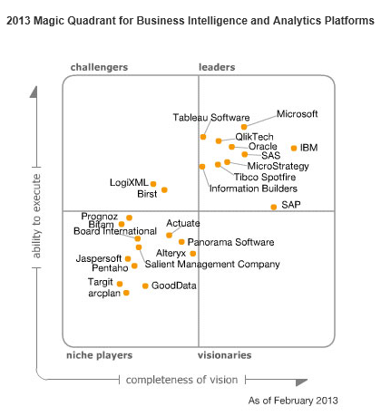
MQ for BI

Slide 9
Leaders specification for BI
Leaders are vendors that are strong in the breadth and depth of their BI platform capabilities and can deliver on enterprise-wide implementations that support a broad BI strategy
BI strategy and pricniples will be presented next session !!!!!

Slide 10
Verdicts
After reading this magic quadrant for BI you should ask one crucial question :
Why customers selected a BI vendor ?????
Ease of Use
Chosen BI application offers an intuitive, visual-based interactive data exploration experience that customers rate highly and that competitors, large and small, try to imitate.” Want to bring in a list of sales numbers from Excel? Easy!!!. How about importing information from an online source? Easy !!!
Data Discovery Capabilities
Ability to create custom table calculations add quick filters and parameters and drill in to specific data points (see e.g. NAV calculated fields)
Cloud & Mobile Based Analytics
Vendors want to simplify a method for end users to access their data from anywhere at any time

Slide 11
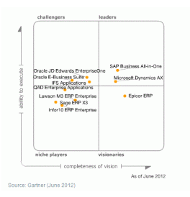
MQ for ERP

Slide 12
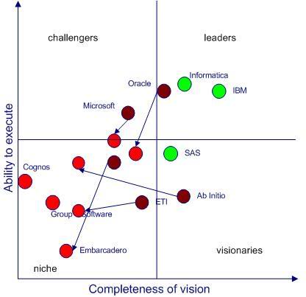
MQ Matrix for IT companies

Slide 13
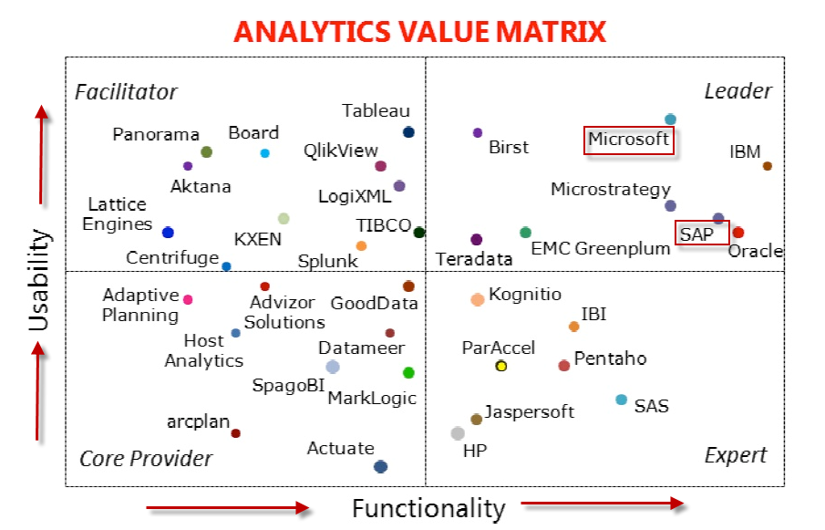
Not all MQs are created equal….

Slide 14
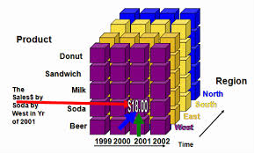
Thanks for your attention

