Slide 1
Instalace MS Dynamics NAV 2009R2
Stručný návod/Installation manual

Slide 2
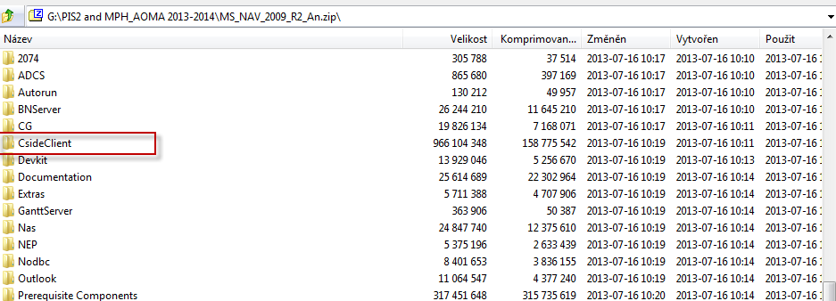
Installation MS Dynamics NAV 2009 R2 (will be used by Czech and English speaking students) I.
https://is.muni.cz/auth/do/econ/sm/42726033/43203933/MS_NAV_2009_R2_An.zip
https://is.muni.cz/auth/do/econ/sm/42726033/43203933/MS_NAV_2009_R2_Cz.zip
After upload of the files (either Czech ar English versions)
You have firstly unwrap CsideClient subdirectory to prepared empty folder or the same one
See next slide

Slide 3
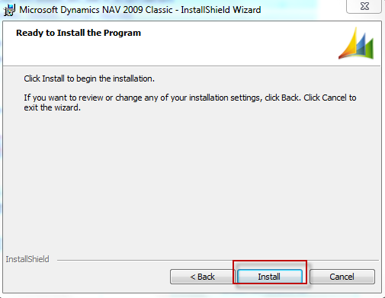
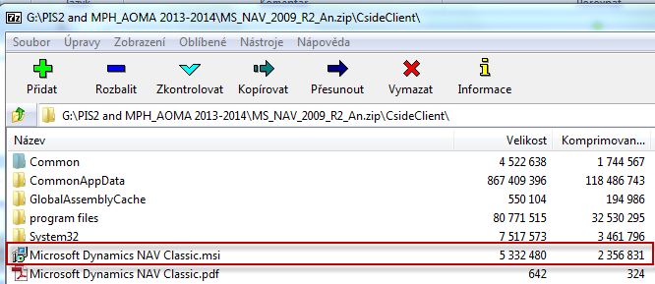
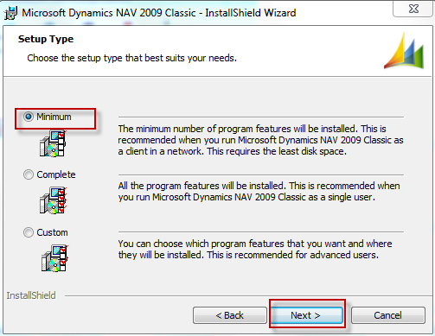
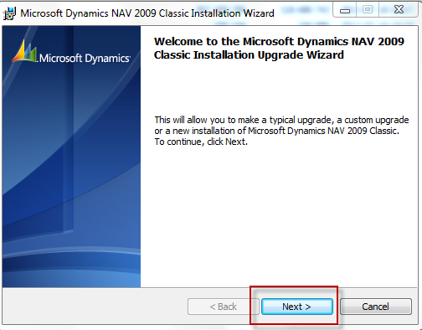
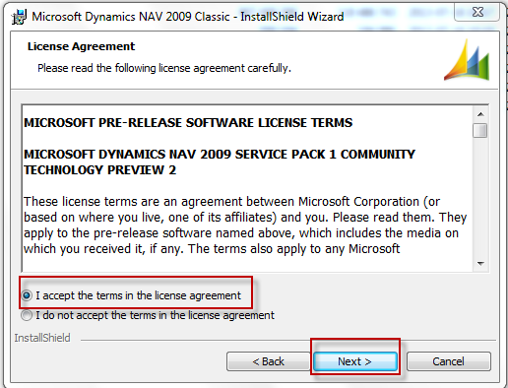
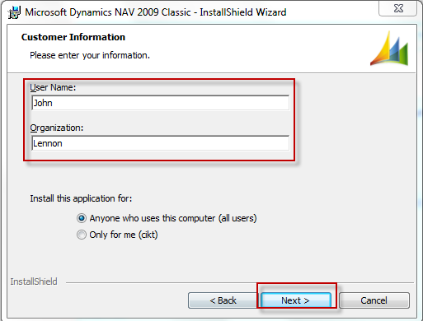
Installation MS Dynamics NAV 2009 R2 (will be used by Czech and English speaking students) II.
Copy of CsideClient in
prepared folder
Option Minimum means Typical

Slide 4
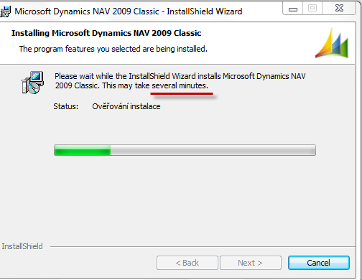
Installation MS Dynamics NAV 2009 R2 (will be used by Czech and English speaking students) III.
Checking installation

Slide 5
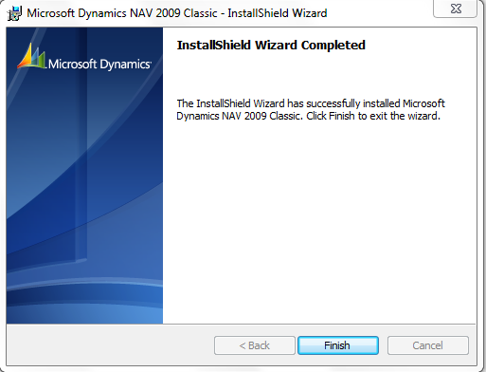
Installation MS Dynamics NAV 2009 R2 (will be used by Czech and English speaking students) IV.

Slide 6
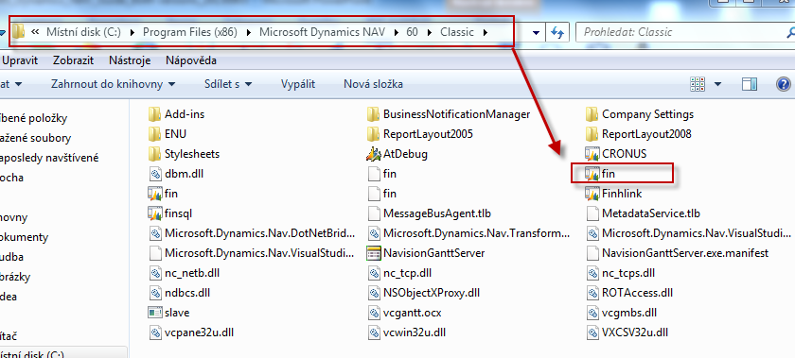
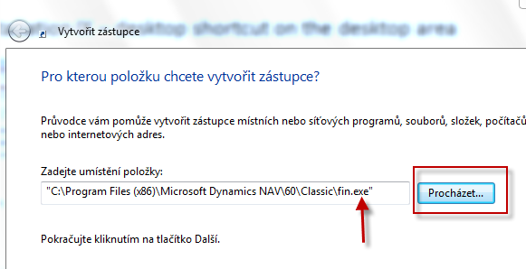
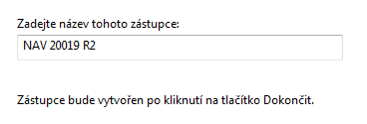
Installation MS Dynamics NAV 2009 R2 (will be used by Czech and English speaking students) V.
Installation IX – desktop shortcut on the desktop area
Right mouse button on desktop area find by browsing fin.exe file specified
Named it
Finish it
Browse

Slide 7
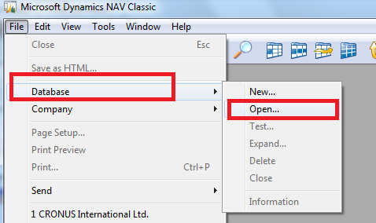
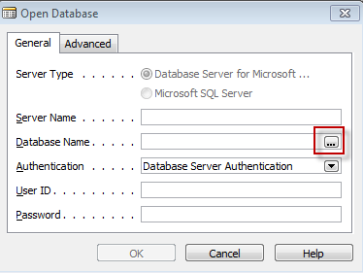
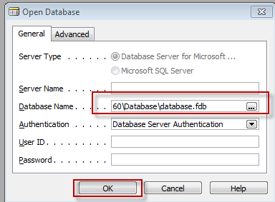
Start MS Dynamics NAV
CsideClient\CommonAppData\Microsoft\Microsoft Dynamics NAV\60\Database\database.fdb

Slide 8
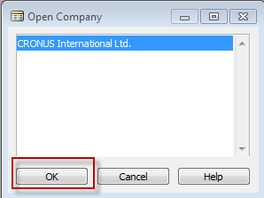
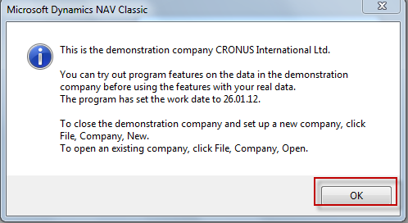
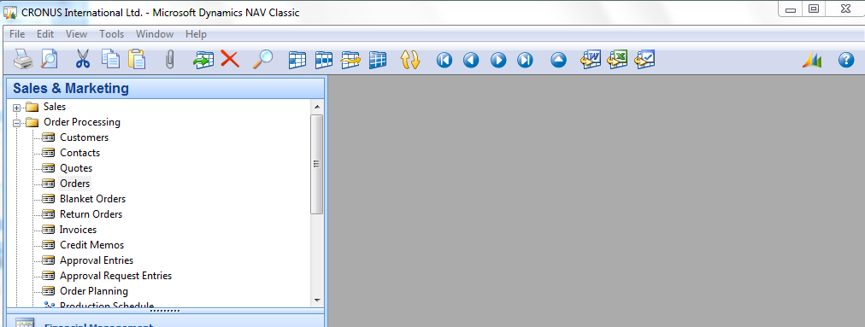
Start MS Dynamics NAV
F12->

Slide 9
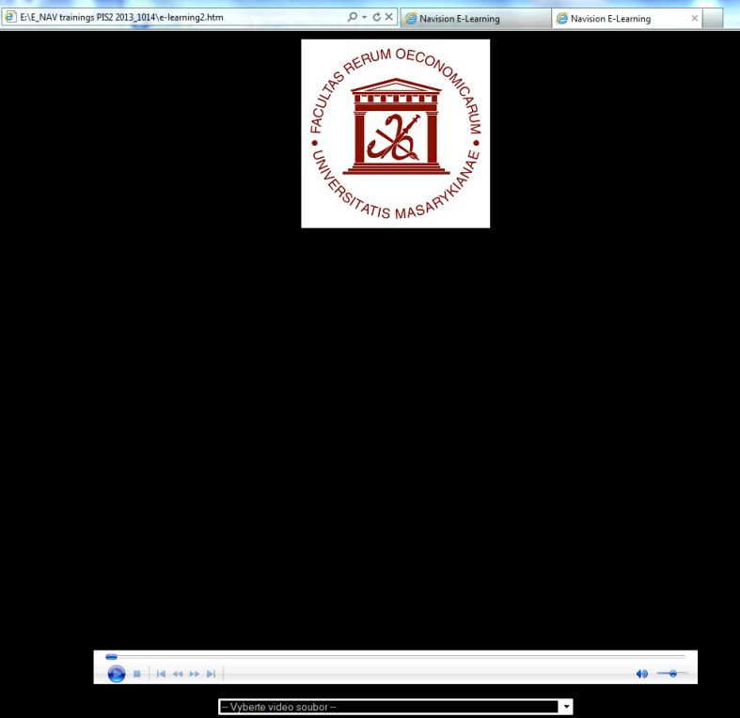
e-Learning NAV Introduction CZ– kde se nachází nástroje a jak e-Learnig NAV Intro spouštět I.
Soubor uložen ve studijních materiálech
Only for Czech and Slovak
speaking students !!!
Jednotlivé lekce se
spouští z dolní lišty

Slide 10
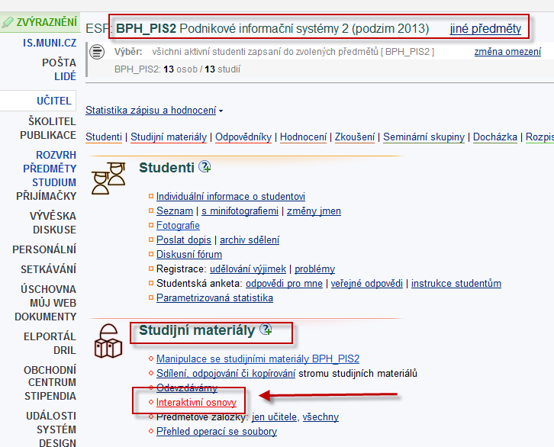
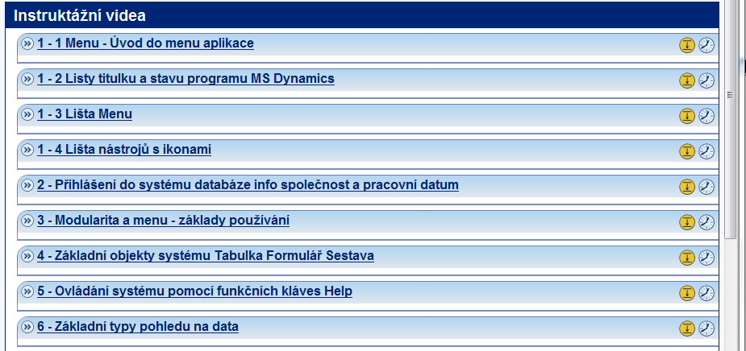
e-Learning NAV Introduction CZ– kde se nachází nástroje a jak e-Learnig NAV Intro spouštět z is.muni II.
Only for Czech asn Slovak
speaking students !!!

