Slide 1
Introduction to MS Dynamics NAV II.
Ing.J.Skorkovský,CSc.
MASARYK UNIVERSITY BRNO, Czech Republic
Faculty of economics and business administration
Department of corporate economy

Slide 2
Basic source tables I.(sales)
Customer
Balance
Credit limit
General Posting group (we will go over it later in this course in section General Ledger setup)
VAT Posting Group (we will go over it later in this course in section General Ledger setup)
Customer Posting Group (we will go over it later in this course in section General Ledger setup)
Allow Line Discount
Payment Term Code
Location Code (inventory)
Fields related to Shipping Agent
Currency Code
Language Code

Slide 3
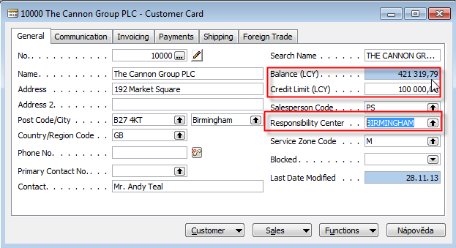
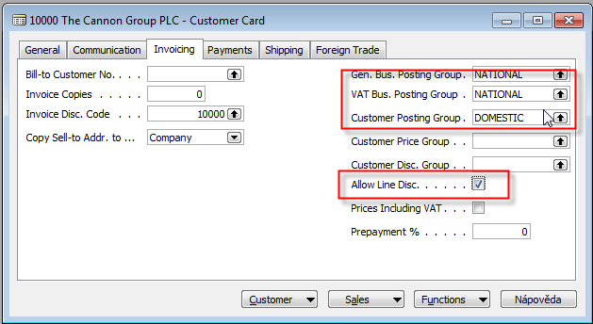
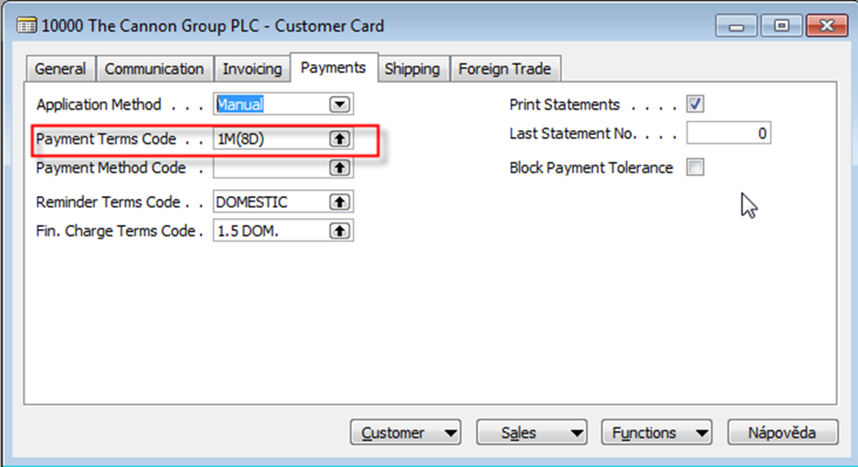
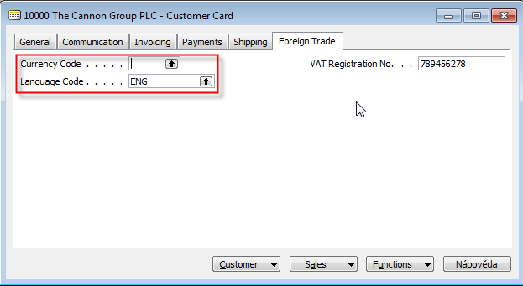

Slide 4
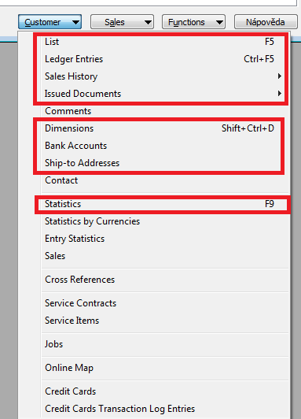
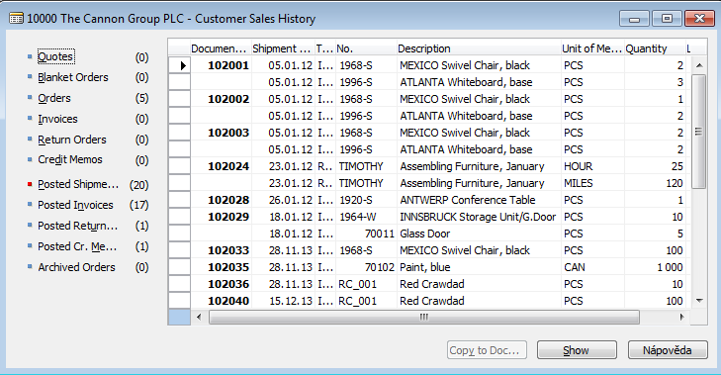
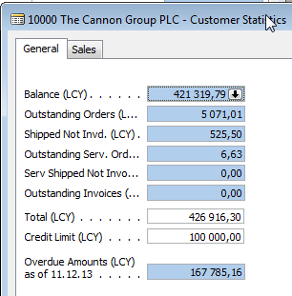
Basic information - buttons (sales)

Slide 5
Basic source tables II.(sales)
Item
Number
Basic Unit of Measure
Item Category Code
Product Group Code
Inventory
Quantity of this item on diverse types of document
Costing method -> see next slide (only basics)
Unit Cost
General Production Posting Group (we will go over it later in this course in section General Ledger setup and Inventory Costing)
VAT Production Posting Group (we will go over it later in this course in section General Ledger setup and Inevntory Costing)
Inventory Posting (we will go over it later in this course in section General Ledger setup and (we will go over it later in this course in section General Ledger setup and Inventory Costing)
Allow Invoice Discount
Replenishment System and Vendor Number
Reordering Policy (we will go over it later in this course in section Requisition worksheet and netting calculation)
Safety Stock Quantity and Reordering point (we will go over it later in this course in section Requisition worksheet and netting calculation)
Item Tracking Code

Slide 6
Costing methods concisely
FIFO : An item’s unit cost is the actual value of any receipt of the item, selected by the FIFO rule. In inventory valuation, it is assumed that the first items placed in inventory are sold first.
Used when business environments where product cost is stable.
Average : An item’s unit cost is calculated as the average unit cost at each point in time after a purchase.
Used in business environments where product cost is unstable. When inventories are piled or mixed together and cannot be differentiated, such as chemicals.

Slide 7
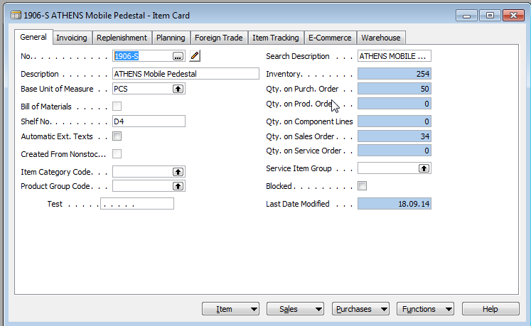
Item card
Some basic information related to the button Item will be presented
on-line during tuition

Slide 8
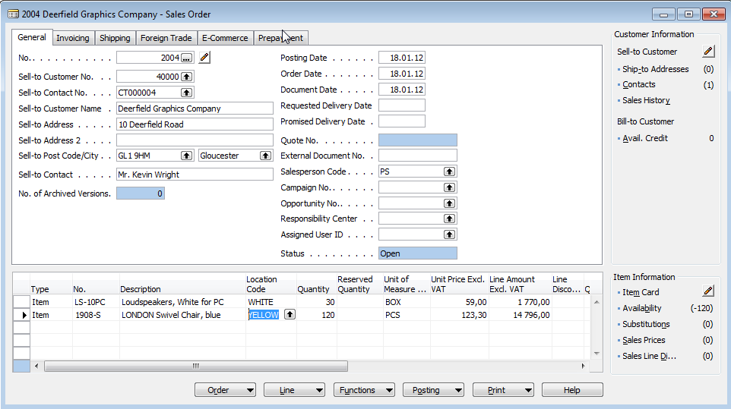
Sales order
Sales Order Header
Customer
Sales Order Lines
Item 1
Item 2

Slide 9
How to create a simple Sales Order
Sales and Marketing menu
Order Processing->Orders
F3 to create new document- by confirming by use of ENTER a new and unique document number is created
Look-up by use of F6 from the field Customer
Chosen Customer must be confirmed by one click on the key Enter
If warning is automatically created due to exceeding Credit Limits or overdue balance, please click OK !!!
Lines->Type Item->from the field No. By use of F6 pick your chosen item ->ENTER to confirm your choice
Enter stock location BLUE and specify Quantity
If warning is again automatically created due to exceeding Credit Limits or overdue balance, please click OK !!!
See Statistics of this document by F9
Button Print->Order Confirmation->Preview
Post it by use of F11
Make a choice (for this first simple sales order model)

Slide 10
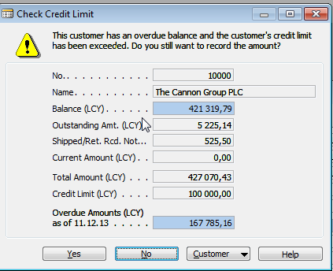
Check credit limit

Slide 11
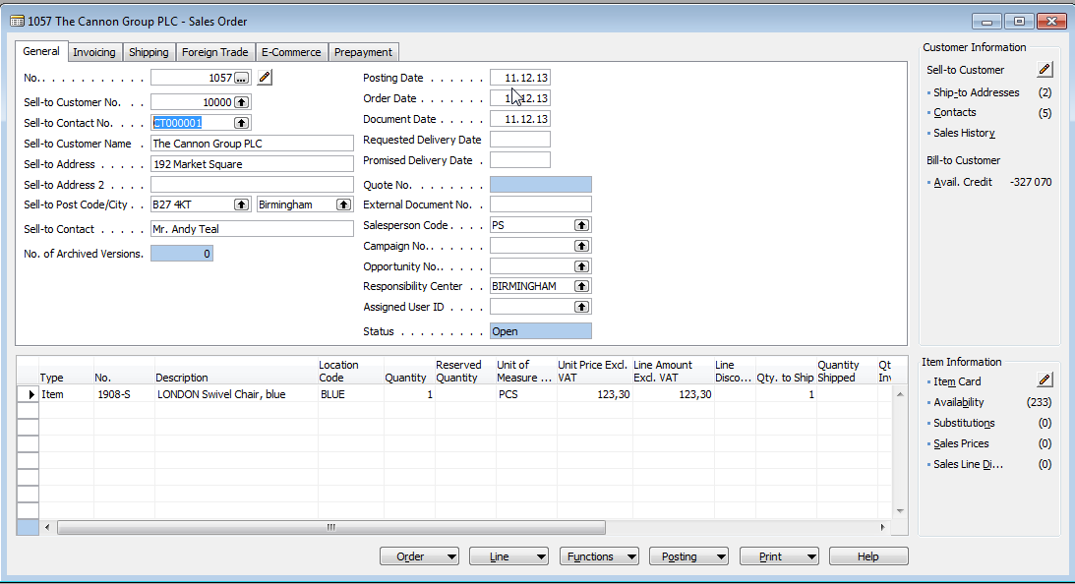
Created Sales Order

Slide 12
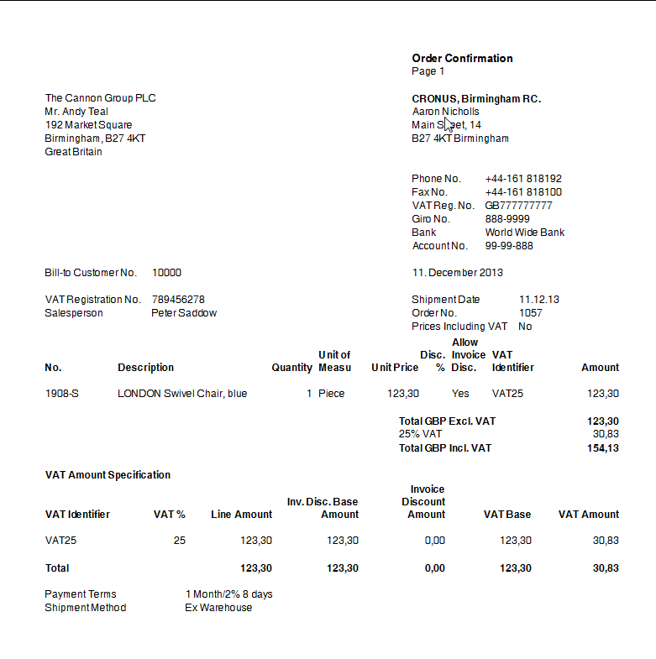
Sales Order confirmation (preview)

Slide 13
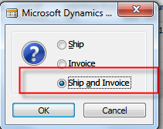
Lower part of the Sales Order form
See next slide

Slide 14
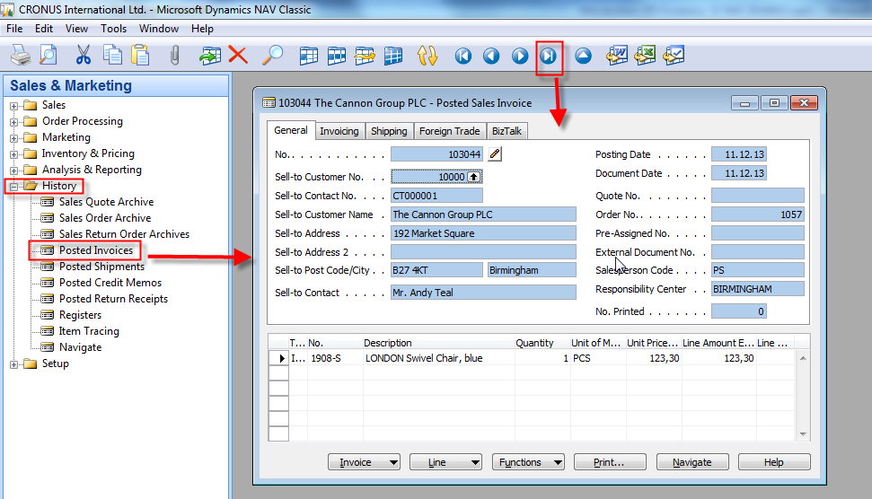
Posted invoice and delivery list

Slide 15
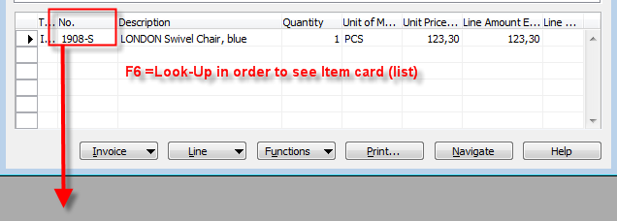
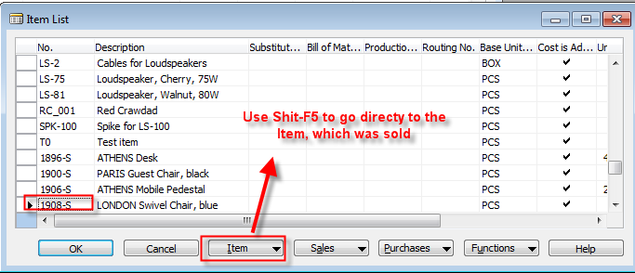
Direct „jump“to the item card from Posted Invoice (F6)
Posted Sales
Invoice Lines
See next slide

Slide 16
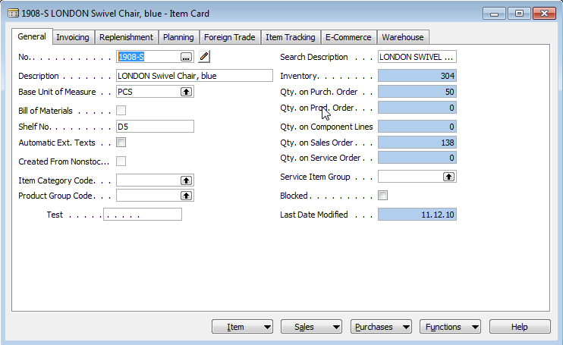
Item card and its entries (Ctrl-F5)
Ctrl-F5

Slide 17
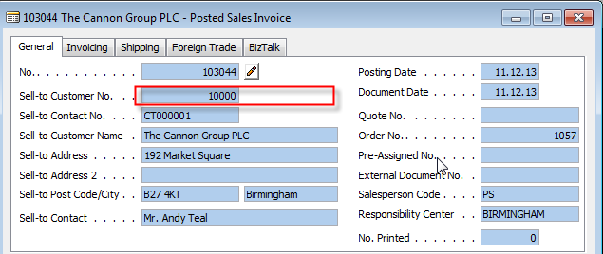
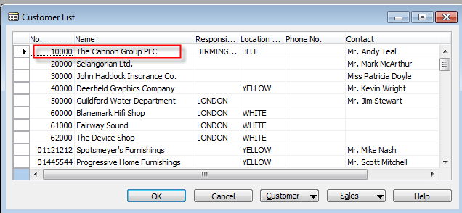
Direct „jump“to the Customer card from Posted Invoice (F6)
Posted Sales
Invoice Header
F6
See next slide
Shift-F5

Slide 18
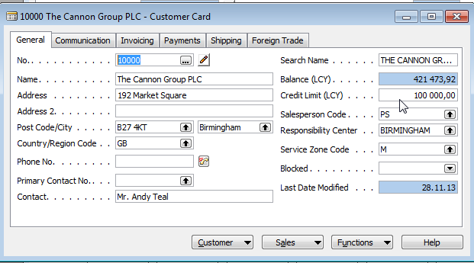
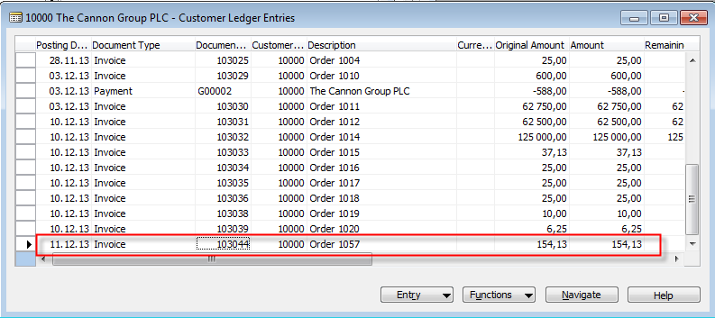
Customer card and its entries (Ctrl-F5)
Ctrl-F5

Slide 19
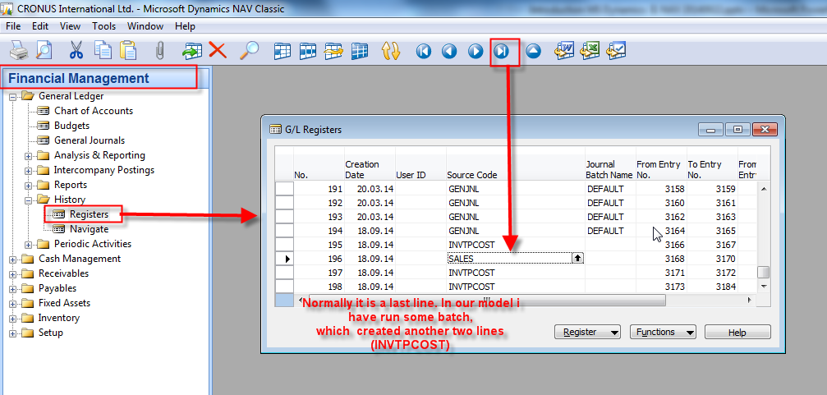
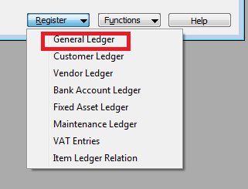
Impacts to G/L

Slide 20
Impacts to G/L (General Ledger Entries)
5610 Sales VAT 25%
30,83
2310 Customer Domestic
154,13
6110 Sales Retail Domestic
123,30

Slide 21
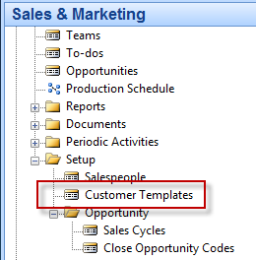
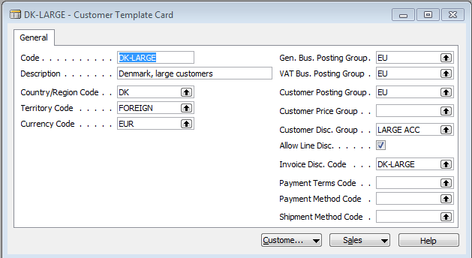
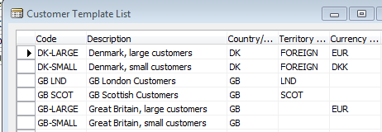
Creation of the brand new customer
Manually – only for NAV expert
By use of Customer template – easier way
By use of F5 (list)
we will get

Slide 22
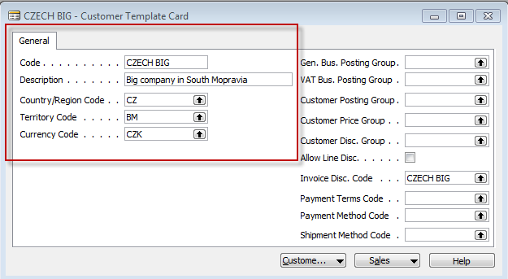
Creation of the new template
F3- enter Name and Description of the template and by F6 (look-up ) we will
Choose Country, Currency and Territory code (if territory code for Brno
is not there, please simply enter by use of keyboard and confirm by Enter.
See partly created template below.

Slide 23
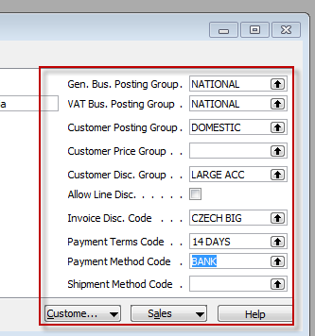
Creation of the new template
The next step is the setup of the template by entering :
General Business Posting Group
VAT Posting Group
Customer Posting Group
Payment condition and other fields
Teacher will explain basics about
Posting groups (see next slide)
Right part of
the template window

Slide 24
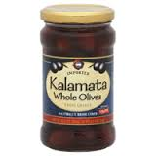
Posting Groups
Customer
Sales Order Header
Sales Order Lines
Item 1
= General Business Posting Group (chosen code=NATIONAL)
= General Product Posting Group (chosen code=Retail)

Slide 25
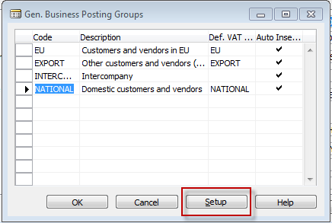
Posting Groups

Slide 26
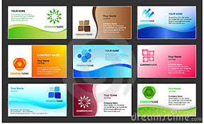
Let´s go to international Brno Fair
We are Greek Olive supplier and you are trying to find new customers in the Czech Republic
Contacts visit your booth (stand) and taste your olives a lot
Some of them will offer a visit card
Data used by marketing department
New Contact Cards are created in MS Dynamics NAV

Slide 27
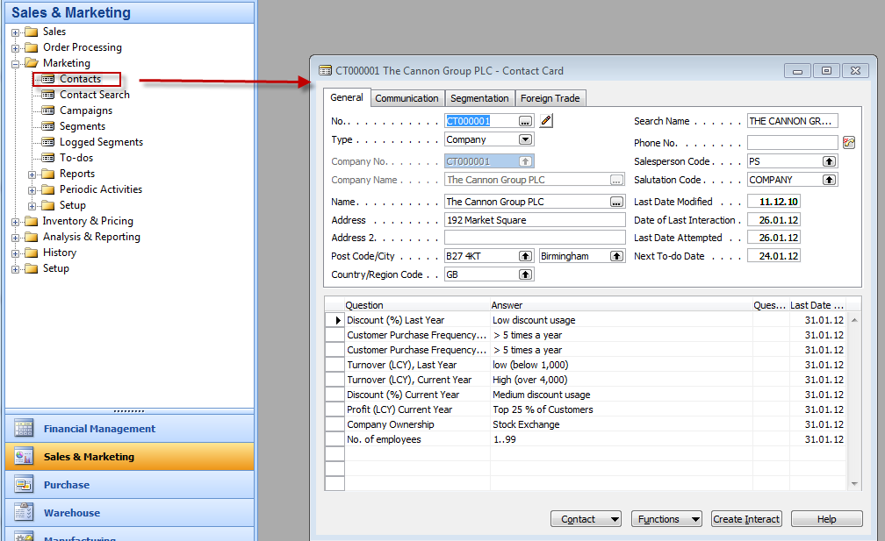
Contact Card

Slide 28
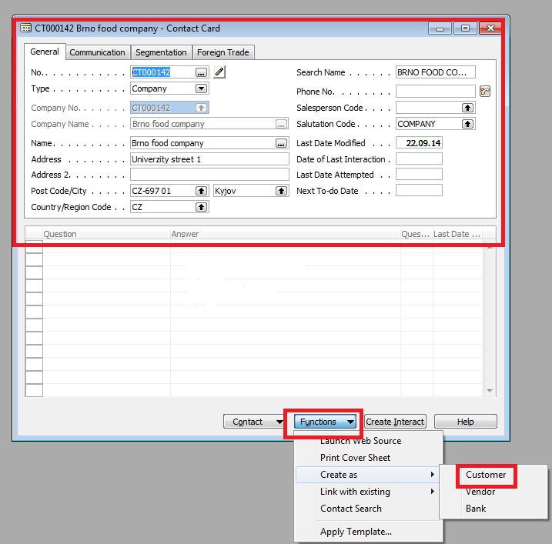
Contact Card-F3 (new)

Slide 29
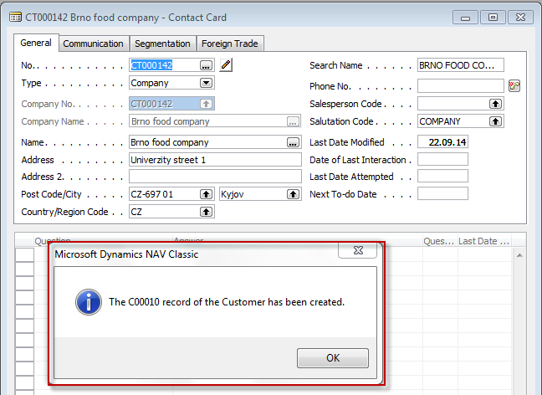
Contact Card-by use your template

Slide 30
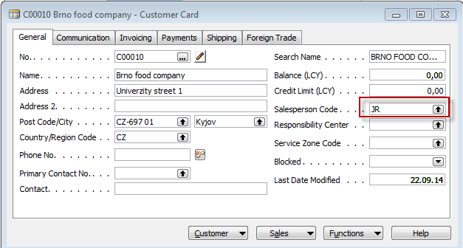
New Customer card

Slide 31
Presented principle
Customer Card
Customer template
Paremeters
Contact card
Marketing activities such as
Interactions, opportunities,
use of sales cycles an profiles will be
presented later in this course

Slide 32
End of the section II.

