Slide 1
Introduction to MS Dynamics NAV IV.
Ing.J.Skorkovský,CSc.
MASARYK UNIVERSITY BRNO, Czech Republic
Faculty of economics and business administration
Department of corporate economy

Slide 2
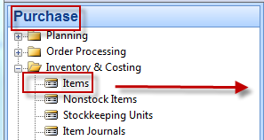
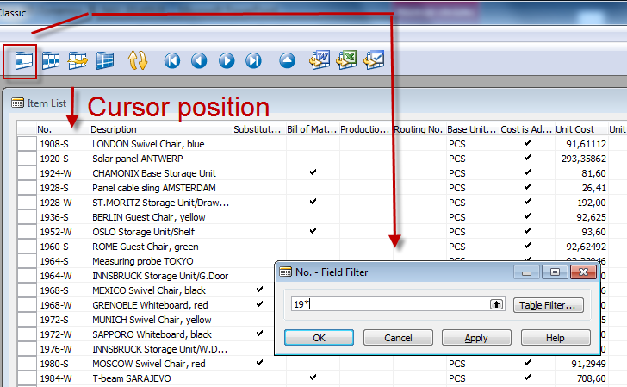
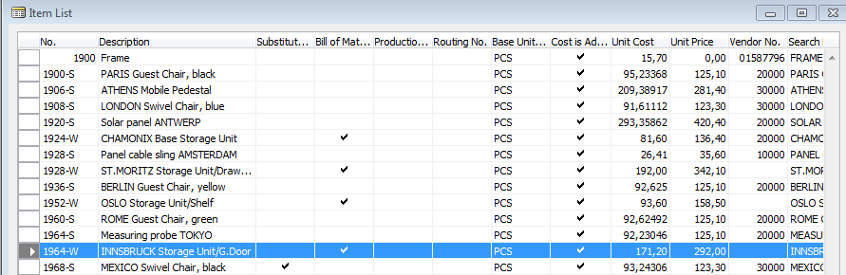
How to create a new Item card
After filter 19* is applied

Slide 3
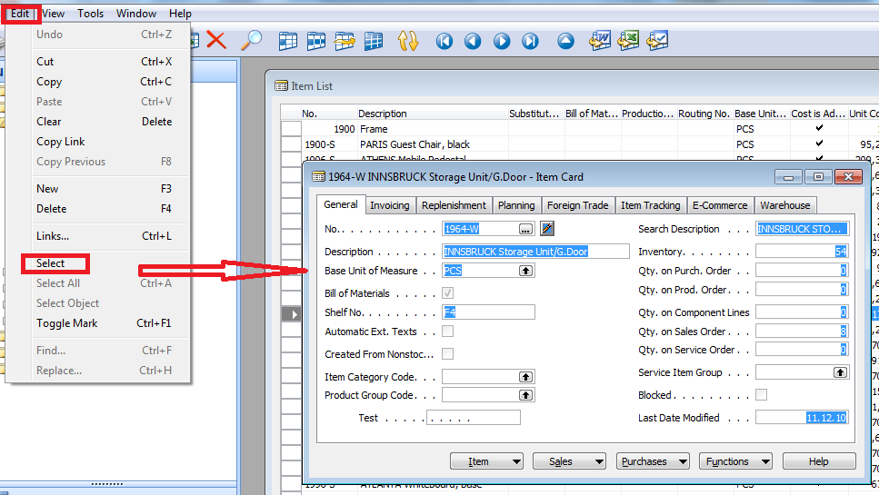
How to create a new Item card
Open chosen card (e.g. 1964-W) by use of keyboard shortcut Shift-F5 and from the menu Edit use Select function and you will get

Slide 4
How to create a new Item card
Ctrl-C (Item card picture is cut into clipboard)
F3 in order to create new card
Ctrl-V (Item picture is pasted from clipboard into new Item card)
You will get message Item card 1964-W already exists
You push OK
You will get another error message Item card could not be pasted . Do not care and make Ok again
Change original number 1964-W to X1 (for instance)
Change name to Component 1 (for instance)
In Unit of Measure field make a choice by use of F6 to Pcs and OK and then ENTER to confirm your choice
Tab Invoice->and change by F6 to Costing method FIFO and confirm by ENTER
Tab Replenishment ->make a choice of you principal Vendor (by use of F6)

Slide 5
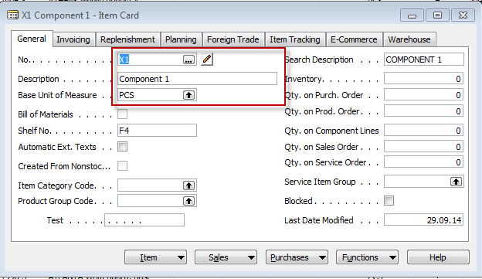
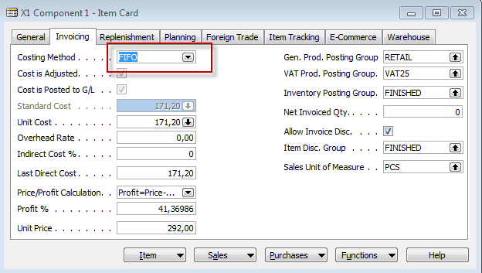
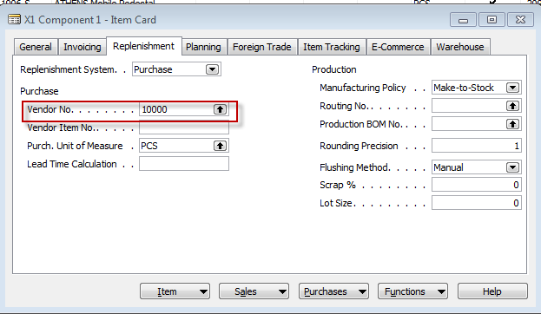

Results
And it's done

Slide 6
How to create a simple Purchase Order
Purchase menu
Order Processing->Orders
F3 to create new document- by confirming by use of ENTER a new and unique document number is created
Look-up by use of F6 from the field Vendor
Chosen Vendor must be confirmed by one click on the key Enter
Lines->Type Item->from the field No. By use of F6 pick your chosen item ->ENTER to confirm your choice (in this Intro section use X1)
Enter stock location BLUE and specify Quantity of the Item
Enter 10 pcs and enter price 1,0
See Statistics of this document by F9
Button Print->Order Confirmation->Preview
Post it by use of F11
Make a choice (for this first simple purchase order model)

Slide 7
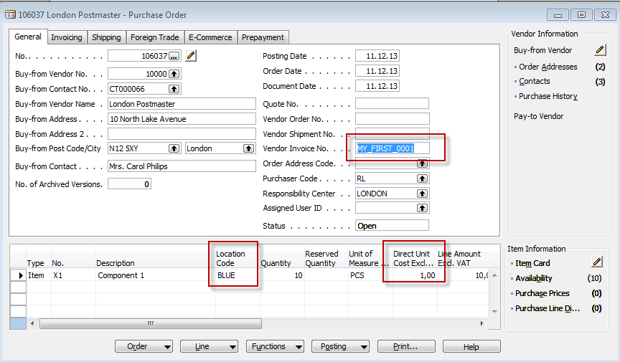
Created first Purchase Order
Use the same steps for posting as it was presented in Introduction III. !!!!! – F11
and use Receive and Invoice .

Slide 8
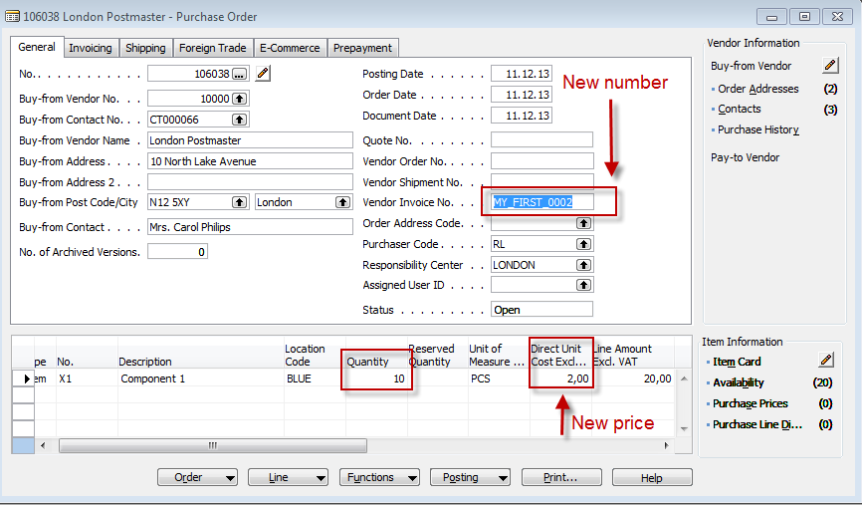
Created second Purchase Order
Use the same steps for posting as it was presented in Introduction III. !!!!! – F11
and use Receive and Invoice . Mind you, that we have changed Vendor Invoice number
and Direct Unit Cost as well !! – Post it by F11 !!!!

Slide 9
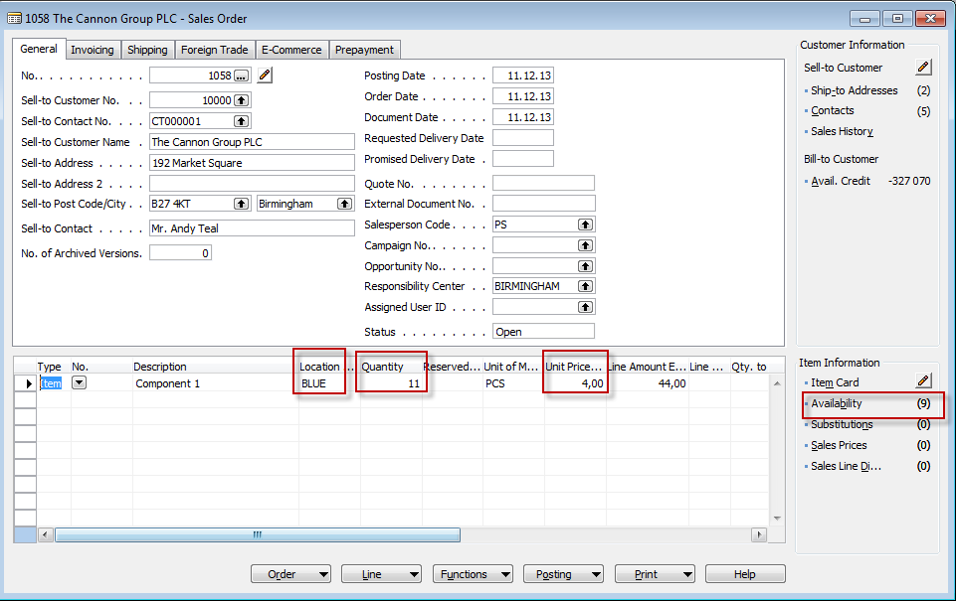
Sales Order (to sell 11 pcs of X1)
Use the same steps to create Sales Order as it was presented in Intro II. !!!!! – F11
and use Receive and Invoice . Enter Units price to 4 ,0 !!!!!

Slide 10
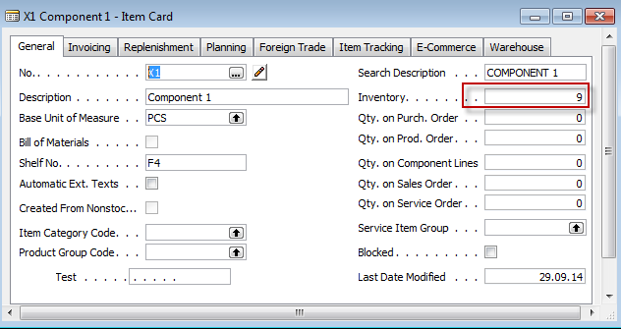
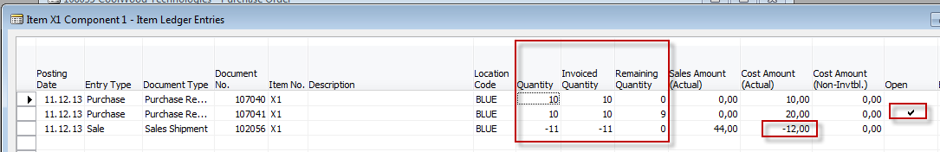
X1 Item Ledger Entries in order to see applications
Cost Amount actual = 12=10x1,0 + 1x2,0
Remaining Quantity =9=20-11
Open=YES (ticked) means, that you
Can still apply 9 pcs from this entry
Ctrl- F5

Slide 11
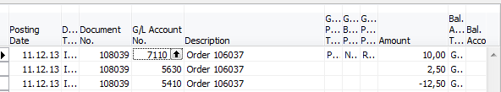
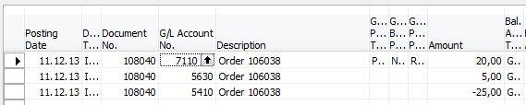
Impacts to G/L (General Ledger Entries)
1st Purchase order
2nd Purchase order
5630 Purchase VAT 25%
2,50
5,00
5410 Vendor Domestic
12,50
25,00
7110 Purchase Retail Domestic
10,00
20,00

Slide 12
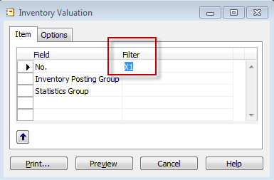
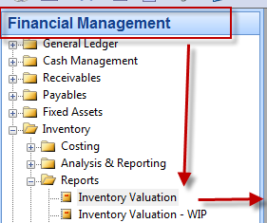
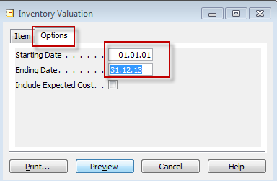
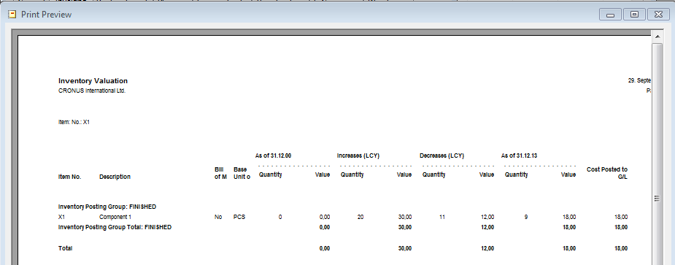
Inventory value

Slide 13
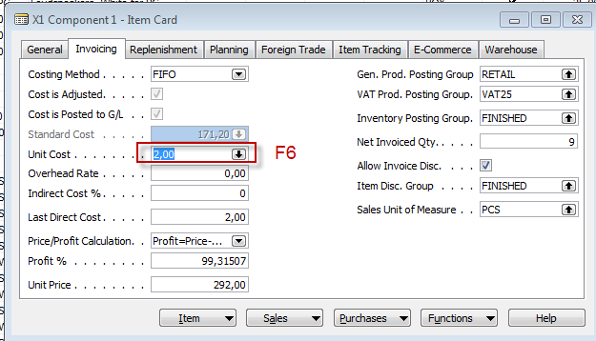
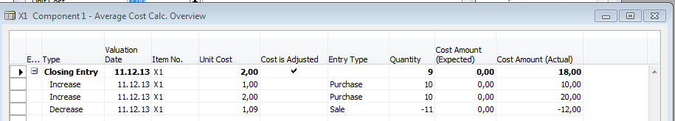
Cost history
Unit Cost=Cost Amount (Actual) /Quantity
Unit Cost
This field is calculated by the program and it shows the average cost for this entry. It is calculated by dividing the sum of the Cost Amount (Expected) and Cost Amount (Actual) fields by the quantity.

Slide 14

End of the section IV.

