Slide 1
MS Dynamics NAV most frequently used hot keys
Ing.J.Skorkovský,CSc.
MASARYK UNIVERSITY BRNO, Czech Republic
Faculty of economics and business administration
Department of corporate economy

Slide 2
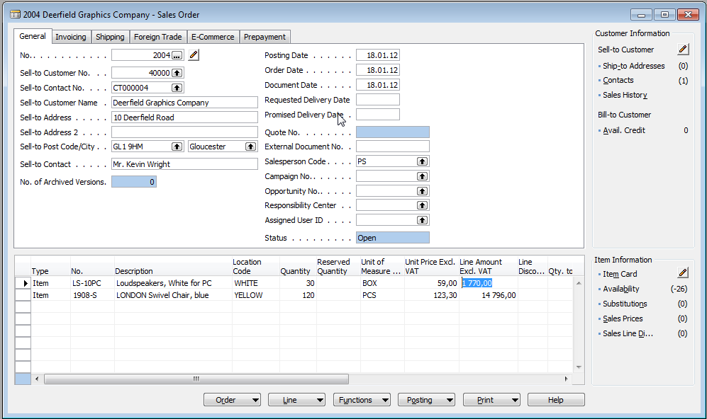
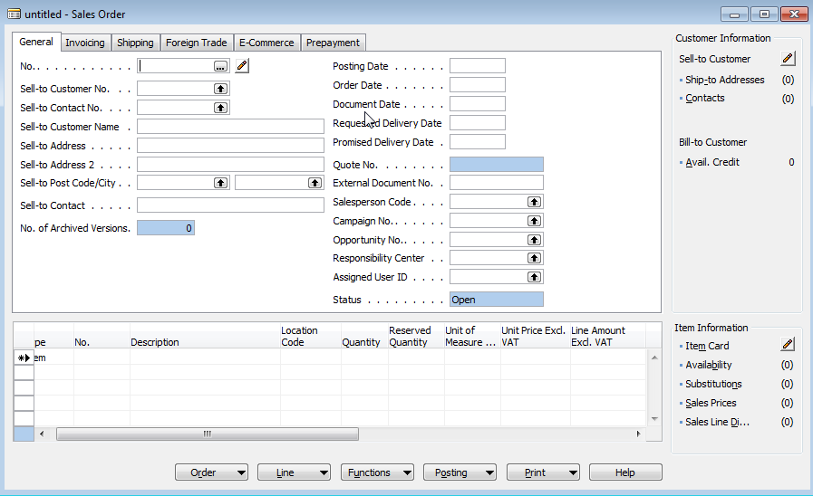
F3 (create new)
Create new object (card, line,…)
Sales Order already created by somebody else.
You have to pout cursor into the header area
and by use of F3 you will get new empty forms.
By subsequent press key Enter you create automatically
new document number

Slide 3
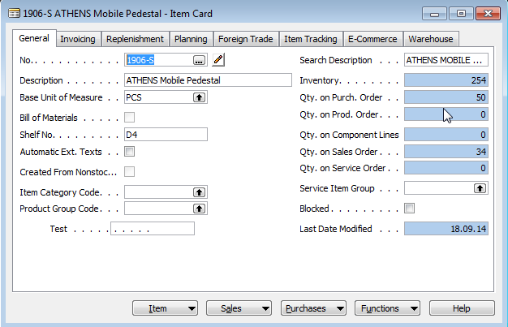
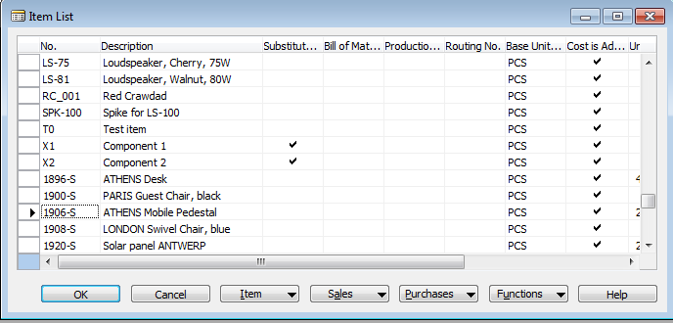
F5-List
You display list of objects such as Item cards, Customers, Vendors, Created documents,…
By use of F5 you will get a list of chosen objects

Slide 4
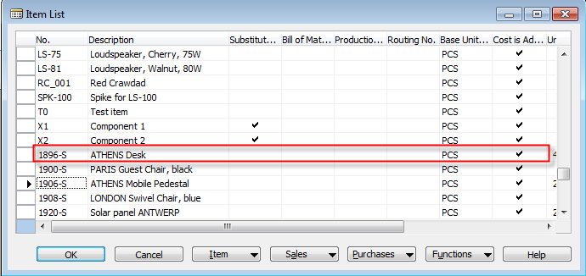
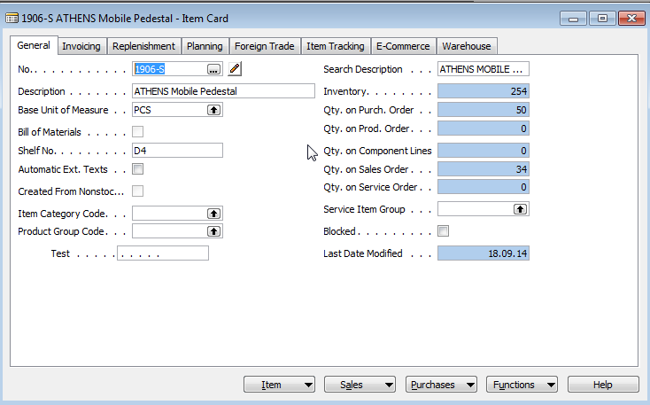
Shift-F5 (from List to Card)
„Jump“ from List to one concrete object which was chosen from the list

Slide 5
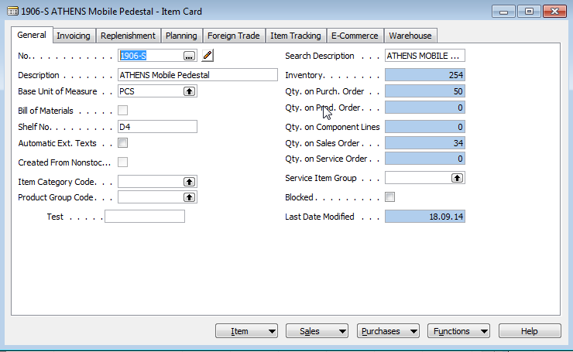
Ctrl-F5 (from Card to Entries)-I.
From chosen objet such as Item, Customer, Vendor, General Ledger Account to Entries (results of posting document by F11)

Slide 6
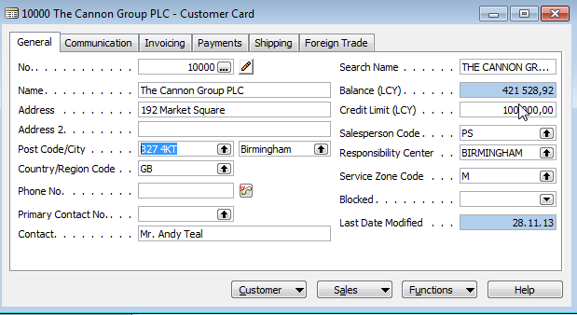
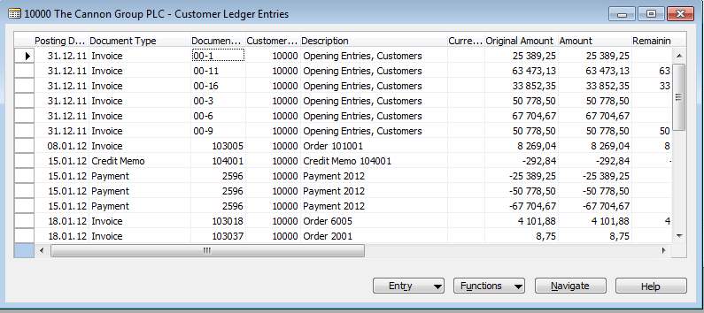
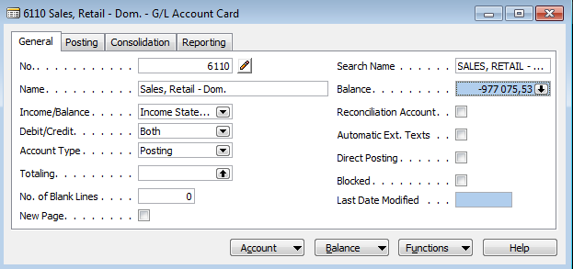
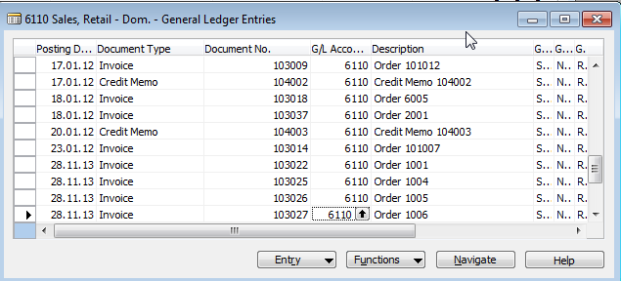
Ctrl-F5 (from Card to Entries)-II.
From chosen objet such as Item, Customer, Vendor, General Ledger Account to Entries (results of posting document by F11)

Slide 7
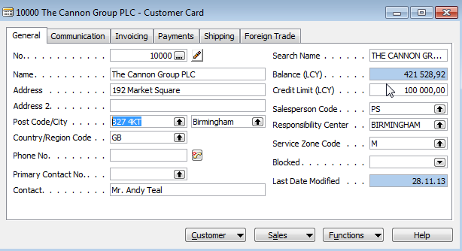
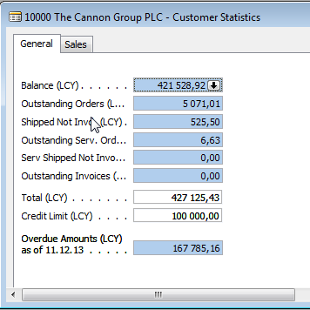
F9 Statistics I.
You can display by F9 Statistics of chosen objet such as e.g. Sales Order, Purchase Order, Customer, Vendor, Item and so on

Slide 8
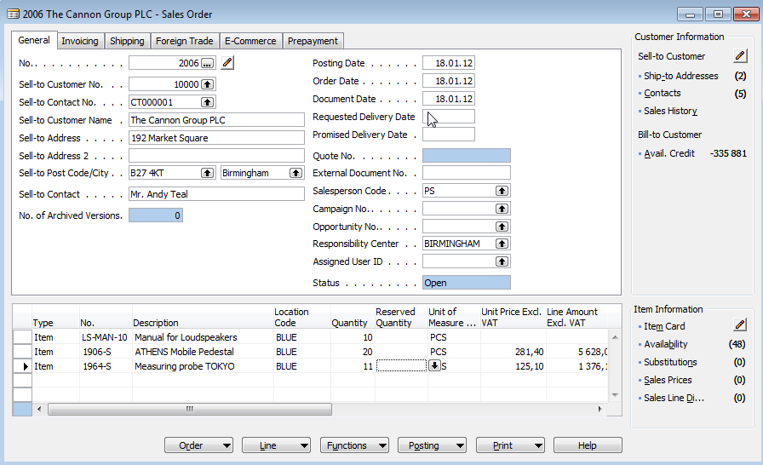
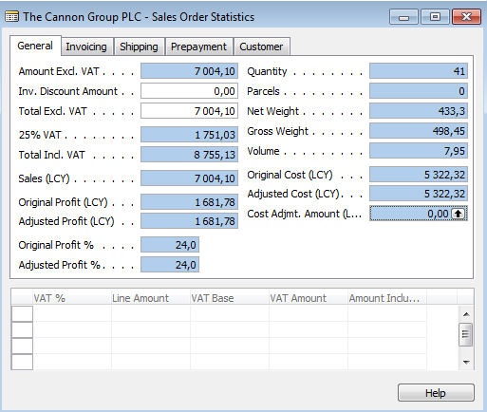
F9 Statistics II.
You can display by F9 Statistics of chosen objet such as e.g. Sales Order, Purchase Order, Customer, Vendor, Item and so on

Slide 9
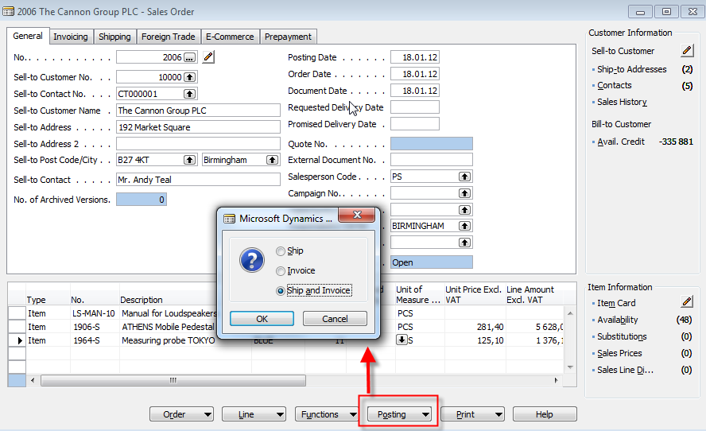
F11-Posting
You can Post chosen objects (Sales and Purchase orders, Credit notes, Transfer orders and so on....
The main impact of F1 is creation of set of entries such as e.g.
Customer Ledger Entry, Item Ledger Entry and G/L Entry

Slide 10
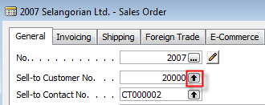
F6-Look up
You can go from field marked by below depicted Icons to the list from where you can chose required object

