Slide 1
Introduction to MS Dynamics NAV VII. (Drop Shipments)
Ing.J.Skorkovský,CSc.
MASARYK UNIVERSITY BRNO, Czech Republic
Faculty of economics and business administration
Department of corporate economy

Slide 2
Drop Shipment
Reasons- benefits
  Direct shipment from Vendor to Customer
  Lower cost of transportation
  Lower costs of warehousing (zero)
  Faster reaction to requirements
  Shorter cash-to-cash cycle (Customer must be invoiced first)->Also Payment condition should be set e.g. like so : PC Vendor >PC Customer (rules) and values :1M>14days

Slide 3
Cash-to-Cash Cycle
Purchase Order
(Invoice)
Sales Order
(Invoice)
Days in stock
Due date
(receivables)
Cash-to-Cash Cycle
Payment to
Vendor
Income from
Customer
Due date
(payables)

Slide 4
Drop Shipment principles I.
Drop Shipment principles I.
Specifies whether your vendor has to ship the items on the line directly to your customer.
You use a drop shipment when an item or group of items is shipped directly from your vendor to your customer and is therefore not physically received in inventory or shipped from there. I reality Drop Shipment results in Item Ledger Entry generation (inbound and outbound operation in one moment)
Vendor
1 | Quote
2 | Sales Order
3 | Purchase Order
4 | Delivery list and delivery itself
5 | Sales invoice
6 | Purchase invoice
3
4
Wholesaler
6
4
2
1
Customer
5

Slide 5
Drop Shipment principles –setup
Drop Shipment setup
First place a check mark in the field to indicate that the item on the sales order is a drop shipment and in the Purchase code field you have to choose Drop Shipment code
Then create a purchase order to order the corresponding items from your vendor. You can create the order directly from the sales order or indirectly from the Requisition Worksheet. In this model we will use direct method
When you set up the purchase order, use the function Drop Shipment, Get Sales Order to link to the relevant sales order. The sales order lines will be copied to the newly-created purchase order. We will not use Item tracking in this model and if yes - > see next clause
You cannot post a drop shipment order that has item tracking unless item tracking is synchronized - serial numbers and lot numbers must be the same between the two orders (our model uses synchronization)

Slide 6
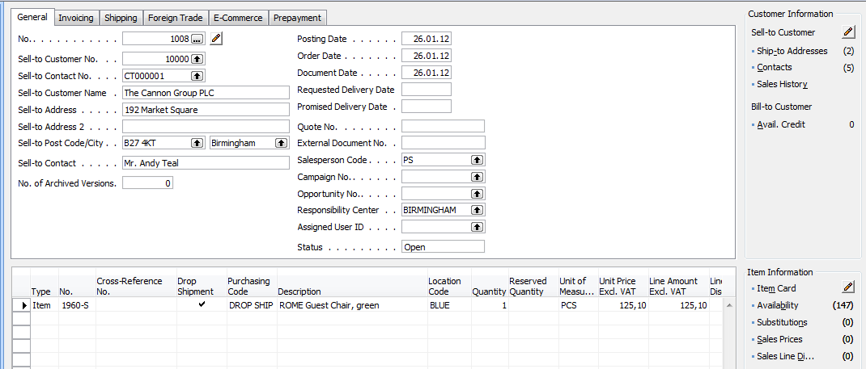
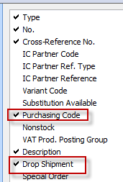
Create new SO and add Drop shipment and Purchase Code

Slide 7
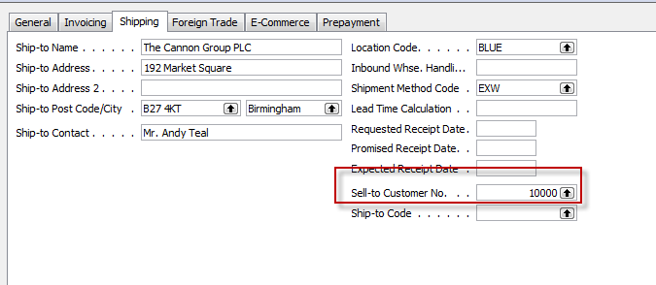
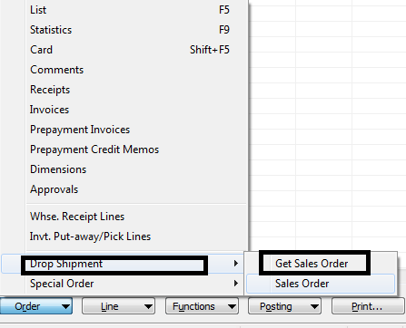
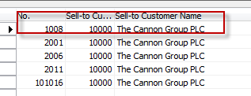
Create new PO
CREATE HEADER WITH Vendor=10000
Tab Shipping ->Sell-to Customer No. -> 10000
Button Order->Drop Shipment->Get Sales order ->see next slide

Slide 8
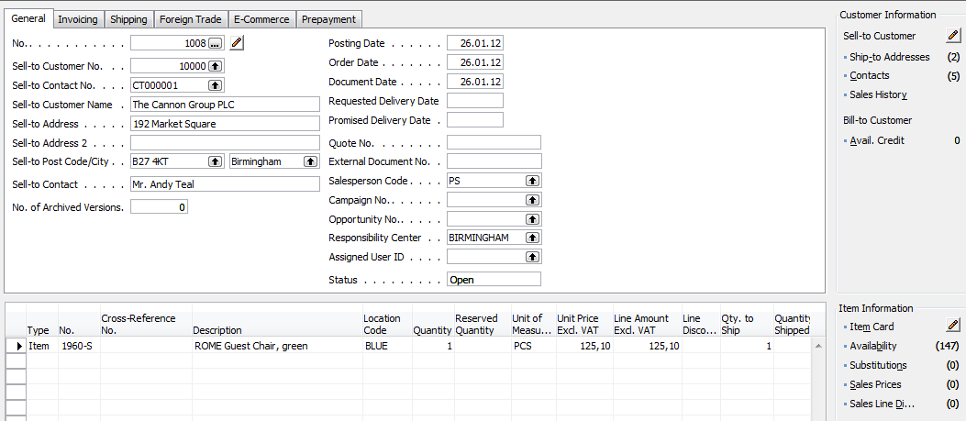
Created PO after Sales lines were transferred to PO lines

Slide 9
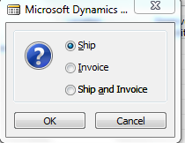

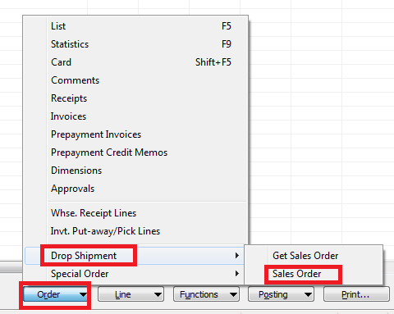
Posting PO (Only Ship)
Purchase line after Ship
Sales line after Ship
automatically creataed
Shipment as well as
Item Ledger Entries

Slide 10
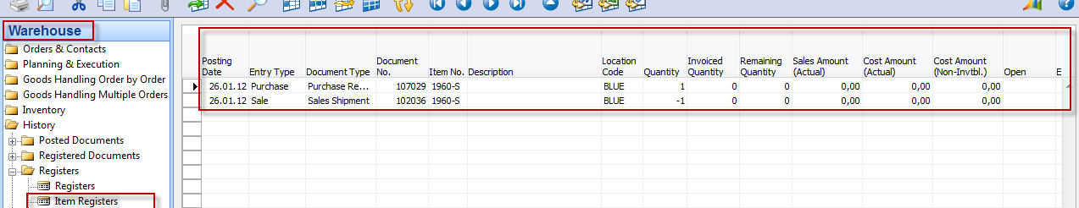
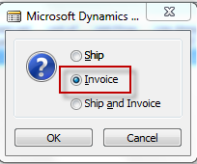
Item Ledger Entries
Next step->post Invoice
on Sales Order

Slide 11
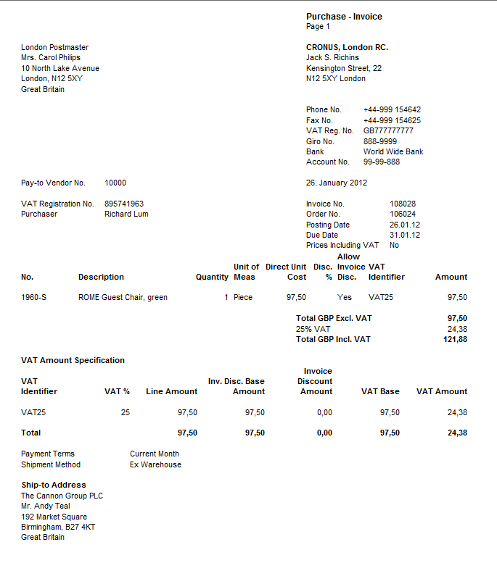
Post PO – only Invoice

Slide 12
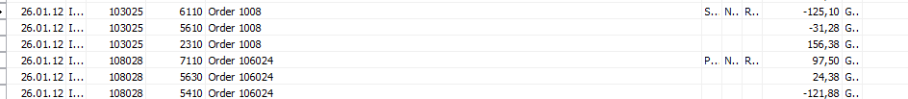
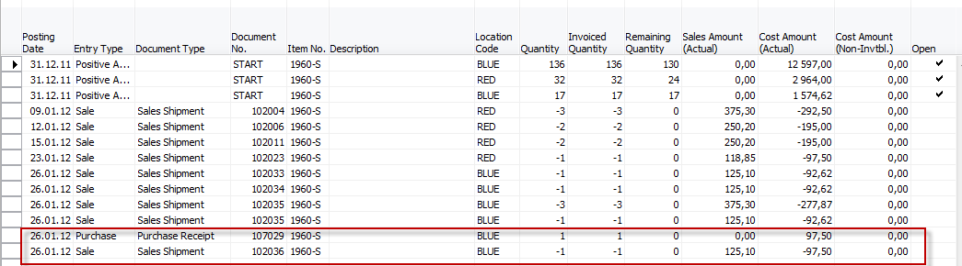
Entries
General Ledger Entries
Item Ledger Entries

Slide 13
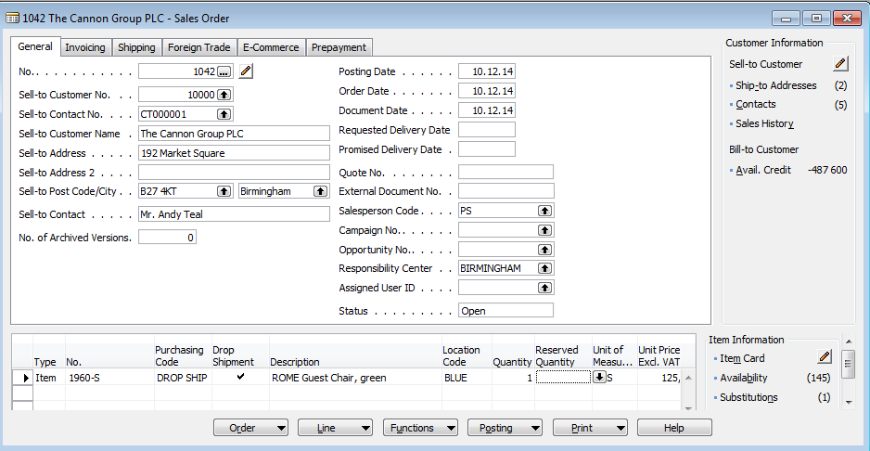
Indirect drop shipment using Requisition worksheet
Sales order where two new columns are shown (Purchase Code and
Drop Shipment)

Slide 14
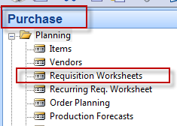
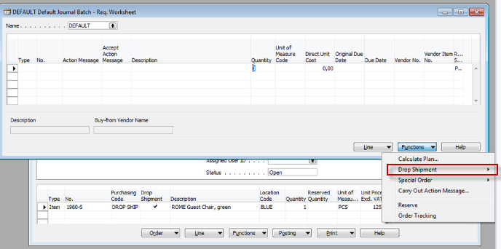
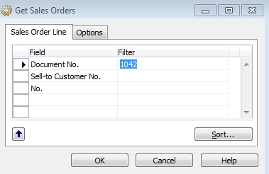

Requisition worksheet (Sešit požadavků- for Czech students)
You have to enter number of sales order in question

Slide 15
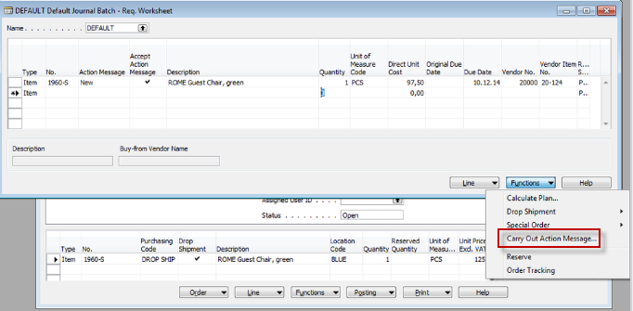
Requisition worksheet (Sešit požadavků- for Czech students)

Slide 16
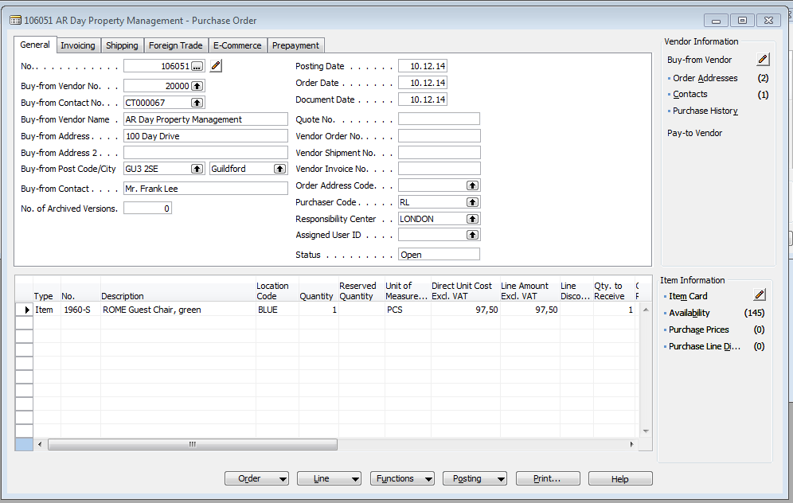
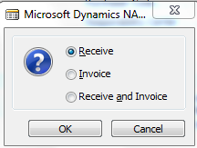
Created Purchase order

Slide 17
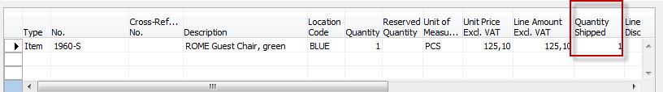
Delivery from Purchase order (PO)
Purchase order line
Sales order line : can be accessed directly from PO- button ->Drop Shipment->Sales order
As you can see, SO lines was automatically updated

Slide 18
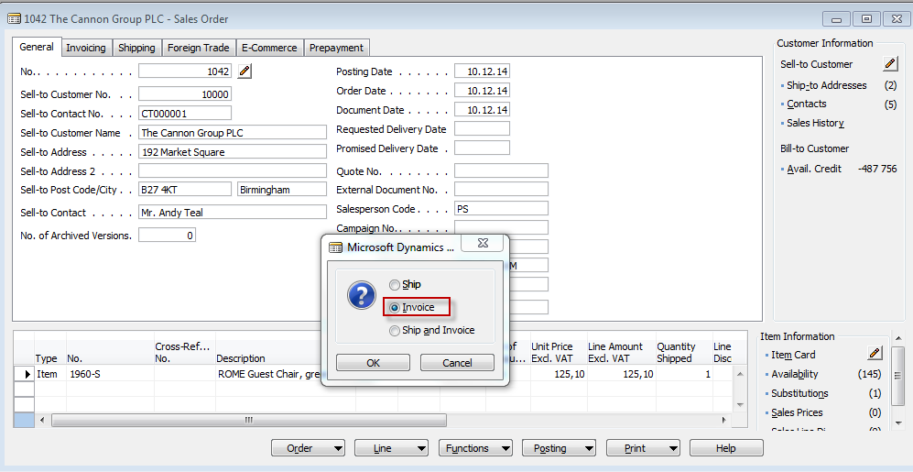
Creation of sales invoice from Sales order (SO)
F11

Slide 19
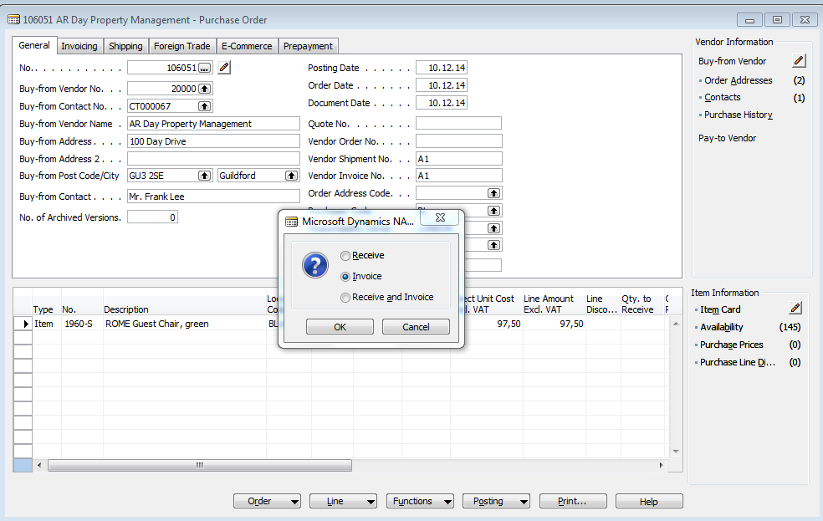
Purchase order

Slide 20

End of the section VII.

