Slide 1
Introduction to MS Dynamics NAV XVII. (Credit Memo)
Ing.J.Skorkovský,CSc.
MASARYK UNIVERSITY BRNO, Czech Republic
Faculty of economics and business administration
Department of corporate economy

Slide 2
Credit Memo
Credit Memo-(Further CM) definition (terminology) and effects
is a commercial document issued by a seller to a buyer. The seller usually issues a credit memo for the same or lower amount than the invoice, and then repays the money to the buyer or sets it off against a balance due from other transactions.
A Credit Memo lists the products, quantities and agreed prices for products or services the seller provided the buyer, but the buyer returned it or did not receive it or received incomplete, damaged, or incorrect.

Slide 3
Business model
Let´s prepare some data in order to show CM basics
Create new item Z100 (Description Lever)
Costing Method : FIFO
Basic Unit of Measure : Pcs
See item card details

Slide 4
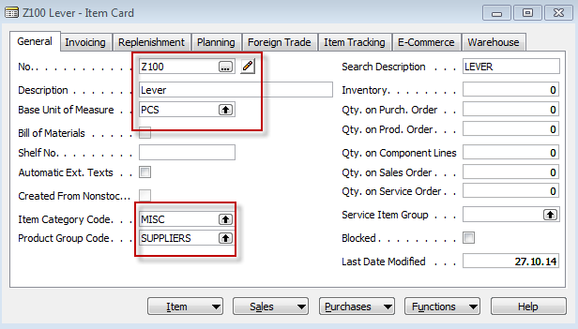
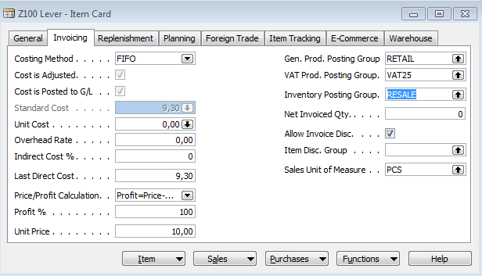
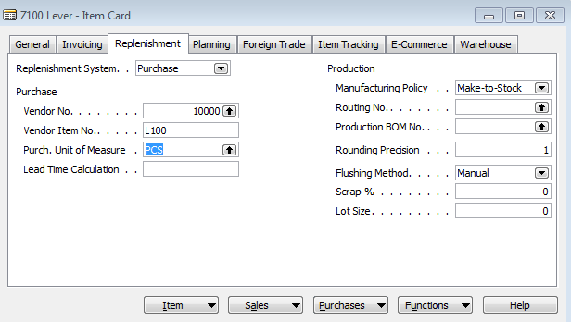
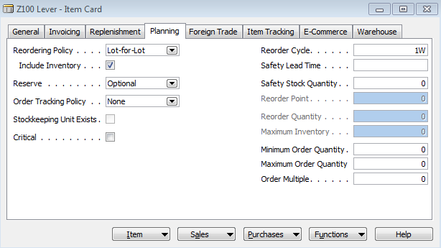
Created Item card (see Intro IV.)

Slide 5
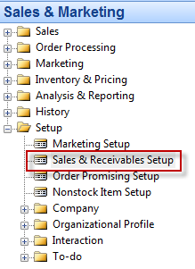
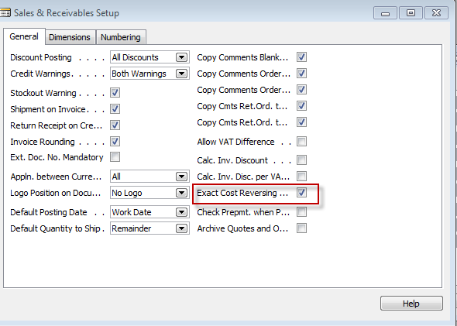
See Sales Setup
A check mark in this field indicates that the program will not allow a return transaction to be posted unless the Appl.-from Item Entry field on the sales order line contains an entry.
This function is used when the company wants to apply an exact cost reversing policy in connection with sales returns. This means that the sales return is valued at exactly the same cost as the original sale when being put back on inventory. If an additional cost is later added to the original sale, the program updates the value of the sales return respectively.

Slide 6
Purchases
Purchase from Vendor 10000
1st Purchase 10 pcs, Direct Unit Cost Excluding VAT= 4,0 and Location=Blue
2nd Purchase 10 pcs, Direct Unit Cost Excluding VAT= 8,0 and Location=Red
See Vendor Ledger Entries
See Item Ledger Entries

Slide 7
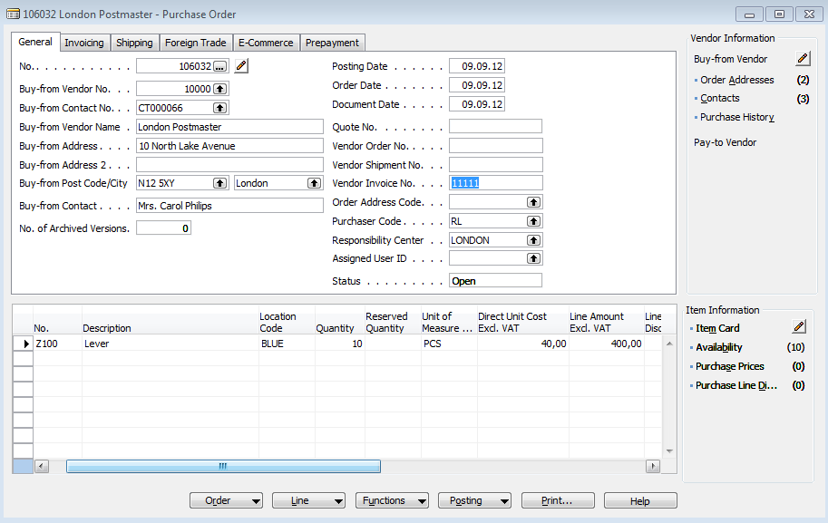
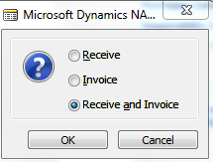
Purchase Order One

Slide 8
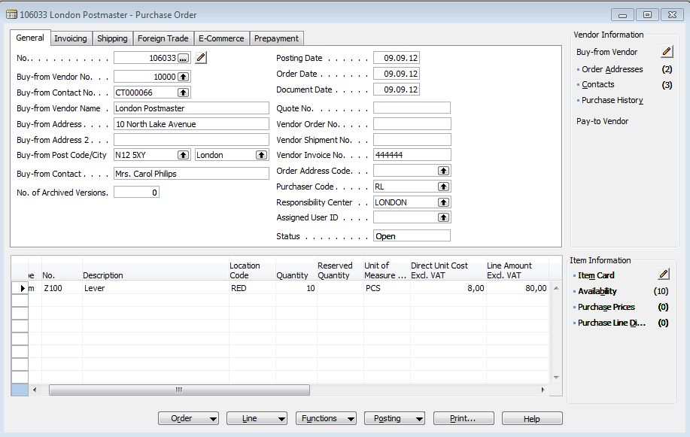
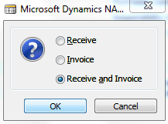
Purchase Order Two

Slide 9
Entries
Item Ledger Entries
VendorLedger Entries
General Ledger Entries

Slide 10
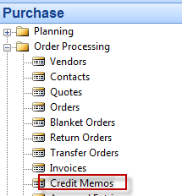
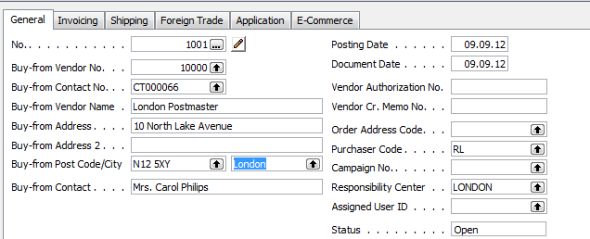
Credit Memo
Credit Memo -Header

Slide 11
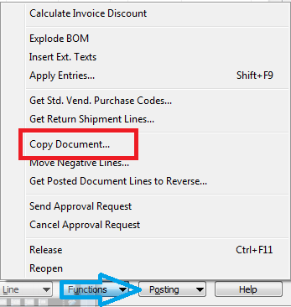
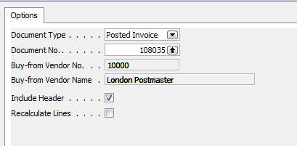
Credit Memo -Lines

Slide 12
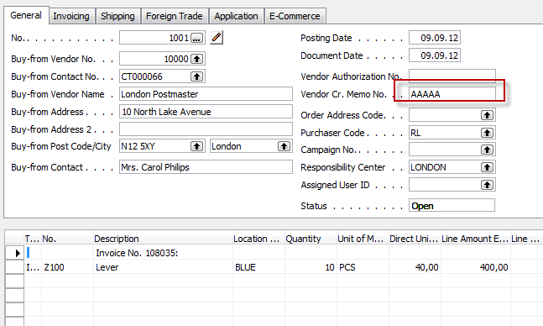
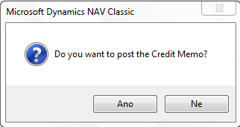
Credit Memo
F11

Slide 13
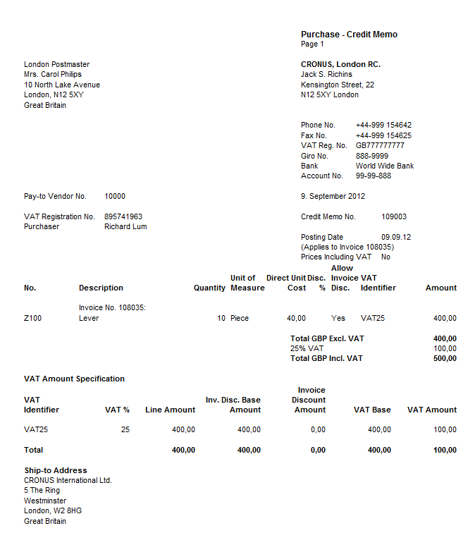
Posted CM

Slide 14
Entries after CM was posted
VendorLedger Entries
Item Ledger Entries

Slide 15
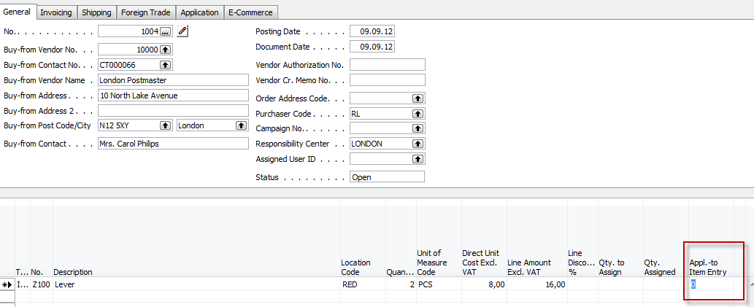
Another method of CM creation
Only Czech course
BPH_PIS2 !!!!
Show field Appl-to Item Entry and by use of F6
make a choice, which entry will be credited.
You have firstly manually enter Item Number ,
Location and quantity

Slide 16
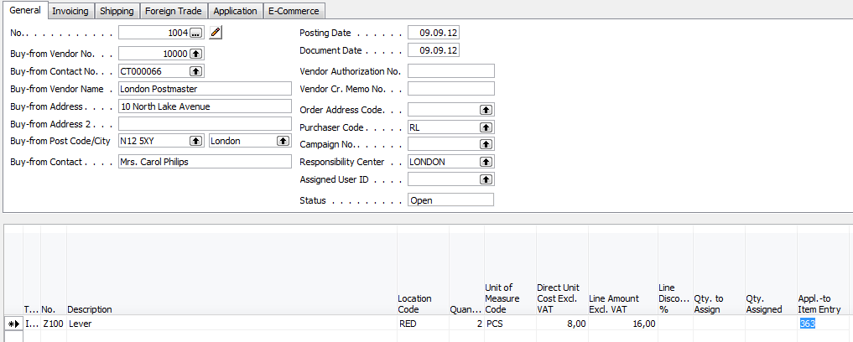
Created CM
Only Czech course
BPH_PIS2 !!!!
Next step is to apply Vendor document by use
of Apply Entries =Shift—F9

Slide 17
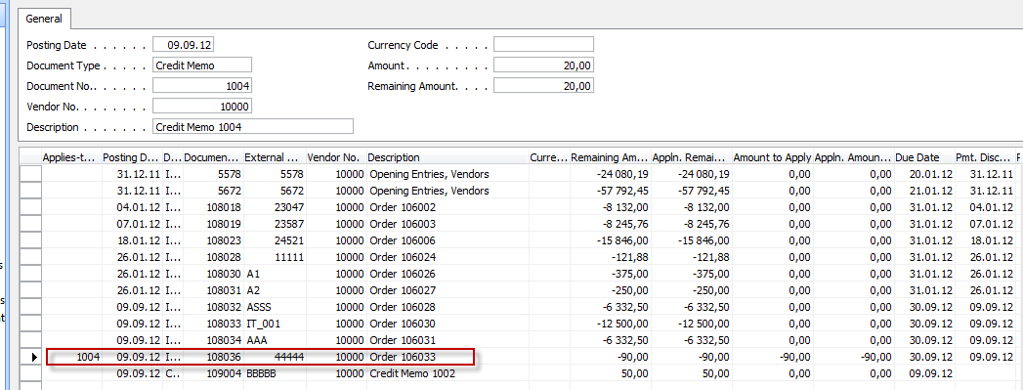
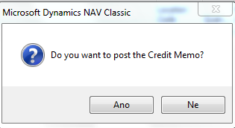
Applied Entries window
Only Czech course
BPH_PIS2 !!!!
OK and thenF9

Slide 18
Entries
Only Czech course
BPH_PIS2 !!!!

Slide 19
End of the section XVII.
Přihlásit se
Používáte-li nástroj pro čtení obrazovky, vypněte Dynamické vyhledávání Google kliknutím sem.
Internet
Obrázky
Videa
Zprávy
Nákupy
Více
Vyhledávací nástroje
Bezpečné vyhledávání
Výsledky hledání
RemixYourHealth Workout Series: The Show Stopper | RemixYourHealth
remixyourhealth.com-940 × 400-Vyhledávání pomocí obrázku
So two weeks ago I introduced you to the ridiculousness that was “The Shredder” workout. Did you try it? How'd it go? If you made it to the end of the ...
Navštívit stránku Zobrazit obrázek
Související obrázky:
Zobrazit další
Na obrázky se mohou vztahovat autorská práva.-Odeslat zpětnou vazbu
Not Dead Yet Radio | Podcast featuring Tommy Bateman & Alex Corolla
www.notdeadyetradio.com-447 × 280-Vyhledávání pomocí obrázku
Tommy starts the show off in an unusual fashion. He announces the show is ending. The time he puts in isn't worth the “rewards” he's getting.
Navštívit stránku Zobrazit obrázek
Související obrázky:
Zobrazit další
Na obrázky se mohou vztahovat autorská práva.-Odeslat zpětnou vazbu
G4 Cancels 'Attack of the Show,' 'X-Play' - Hollywood Reporter
www.hollywoodreporter.com-565 × 318-Vyhledávání pomocí obrázku
Attack of the Show Logo (2) - H 2012
Navštívit stránku Zobrazit obrázek
Související obrázky:
Zobrazit další
Na obrázky se mohou vztahovat autorská práva.-Odeslat zpětnou vazbu

