Slide 1
Introduction to MS Dynamics NAV XV. (Lot numbers and Item Tracking)
Ing.J.Skorkovský,CSc.
MASARYK UNIVERSITY BRNO, Czech Republic
Faculty of economics and business administration
Department of corporate economy

Slide 2
Lot numbers (batches)-Item Tracking
It enables to mark Item Ledger Entries by Lot (Batch) Number, which is part of the batch card. It enables :
  Item tracking from purchase, possible subsequent production , transfers and sales
  It enables to control quality and better specification of rejects (scraps)
  It enables to control warranty and expiration

Slide 3
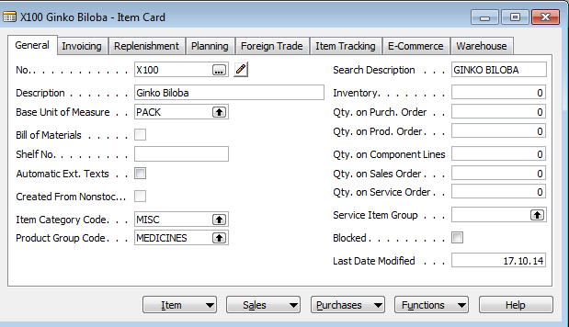
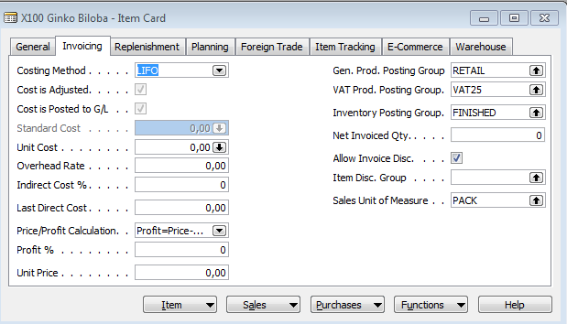
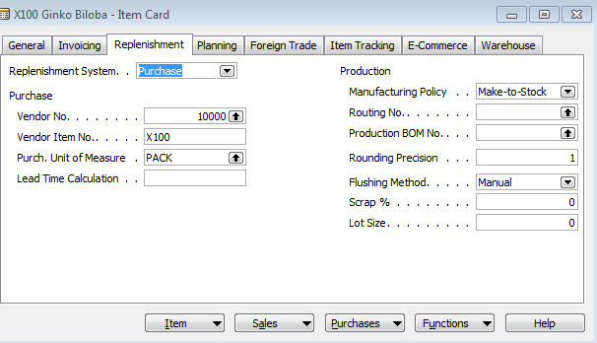
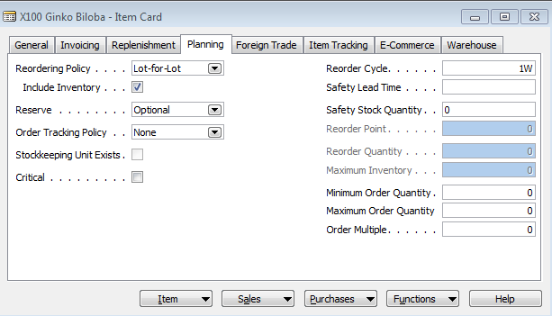
New card creation
(Select one item, Edit, Select , Ctrl-C,F3,Ctrl-V, add basic unit of measure – e.g. gr add Unit price, Reordering policy… Lot-for Lot, Add Tracking Code-LOTALL )
150

Slide 4
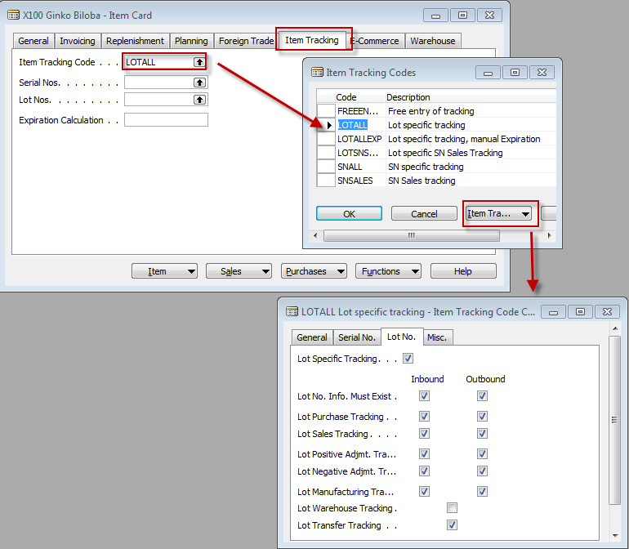
New card creation

Slide 5
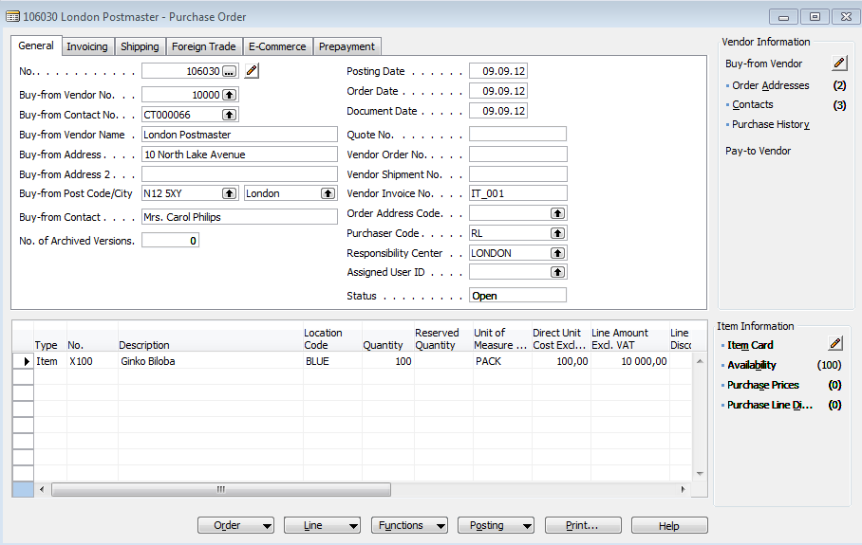
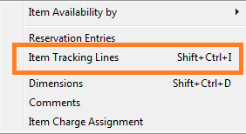
Purchase X100

Slide 6
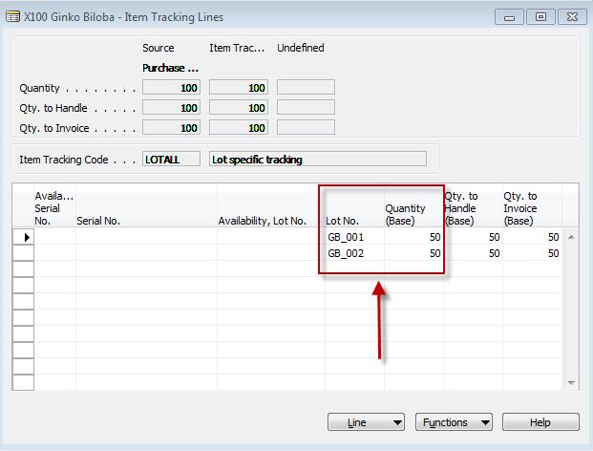

Item tracking lines
Data entered by user

Slide 7
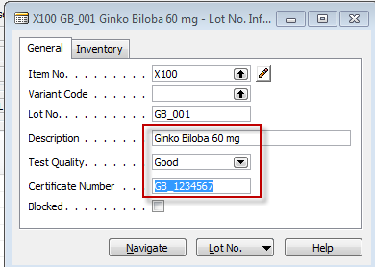
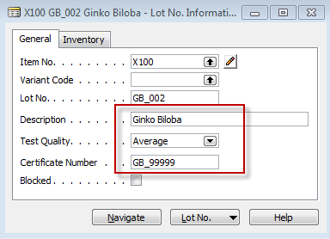
Lot Number Cards
You can use the Navigate function to find where the lot number is used in documents and ledger entries. Will be shown later !!
Lot Number inormation is saved by ESC

Slide 8
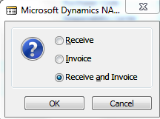
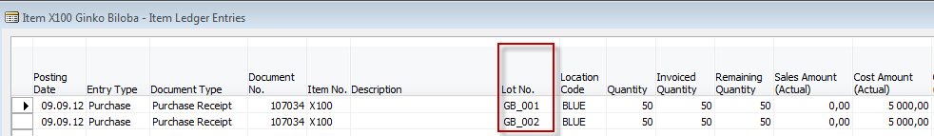
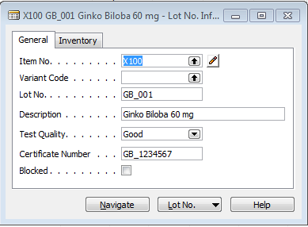
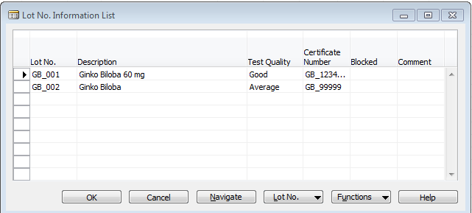
Post PO and Item Ledger Entries

Slide 9
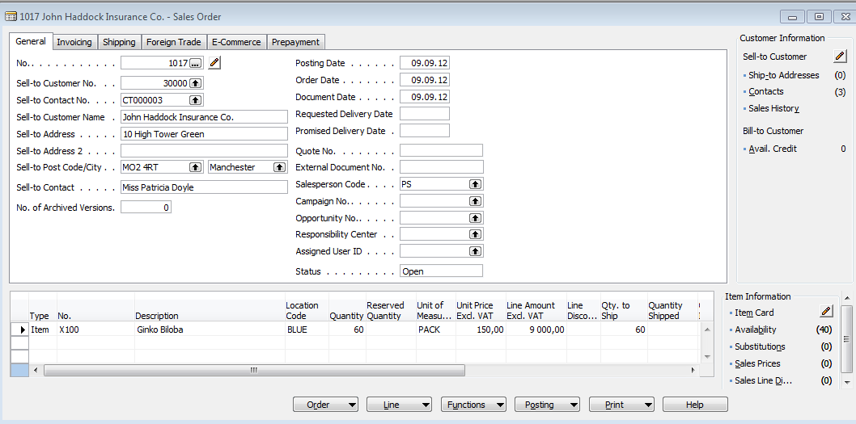
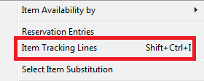
Sales Order

Slide 10
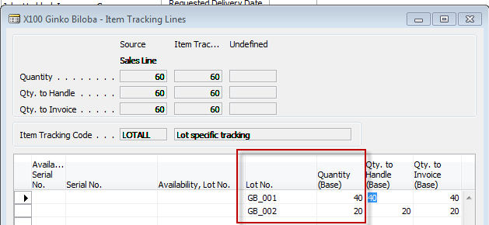
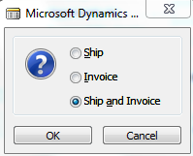
Item tracking lines
Chosen by use of F6 and
stored by ESC

Slide 11
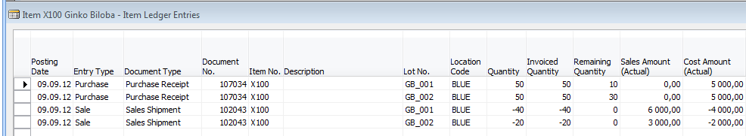
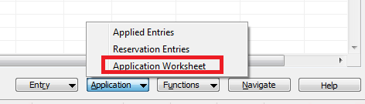
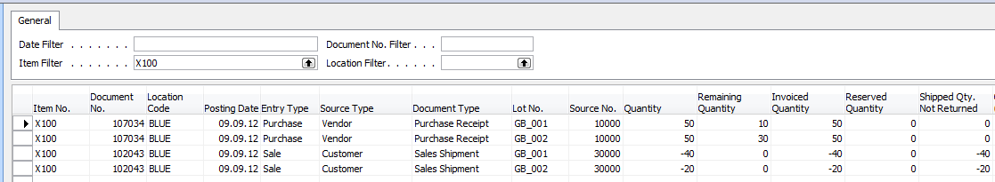
Item ledger entries after SO was posted and Application worksheet
Applications

Slide 12
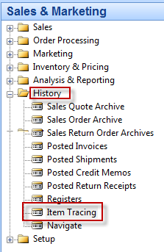
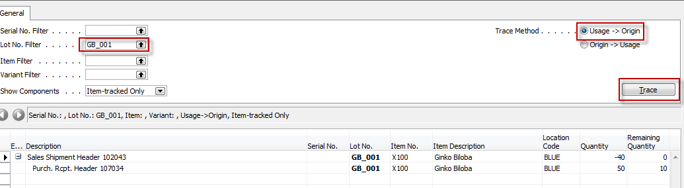
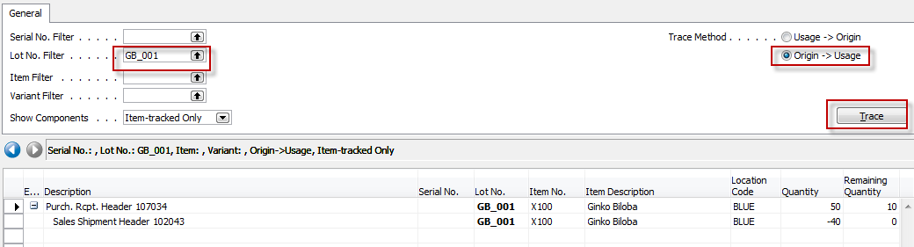
Item Tracing I.
You can use this window to find the posted documents where an item-tracked item or where a particular lot or serial number was used. You might use this feature for quality control to find which lot a defective component came from or to find all the customers to which a particular lot was sold.
You can also open application worksheet from Item card->Item ledger entries->Application->Application worksheet

Slide 13
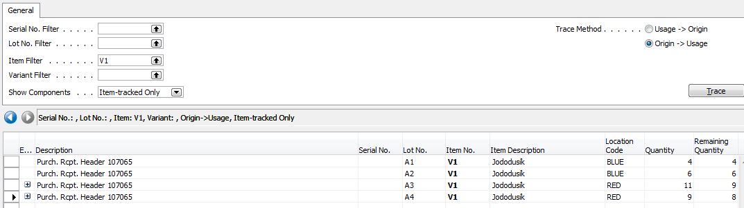
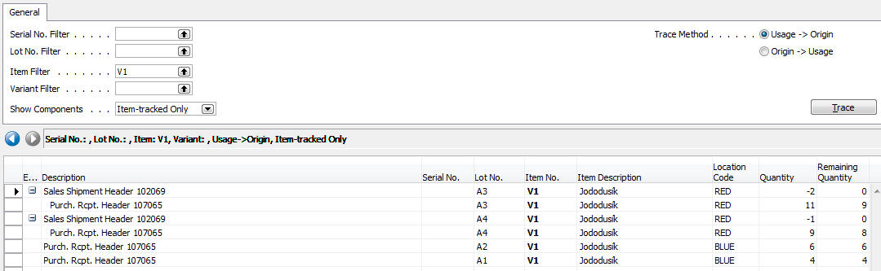
Item Tracing II.

Slide 14

End of the section XV.

