Slide 1
Introduction to MS Dynamics NAV XXVII. (Requisition worksheet)
Ing.J.Skorkovský,CSc.
MASARYK UNIVERSITY BRNO, Czech Republic
Faculty of economics and business administration
Department of corporate economy

Slide 2
Requisition worksheet
(tool for automatic replenishment suggestion)
Impacts of using RW tool
  Lower inventory level
  It balances supply and demand across locations
  Lower inventory and handling cost
  Higher liquidity
  Sufficient service level is maintained-Service level represents the expected probability of not hitting a stock-out. This percentage is required to compute the Safety Stock. Intuitively, the service level represents a trade-off between the cost of inventory and the cost of stock-outs (which incur missed sales, lost opportunities and client frustration among others).

Slide 3
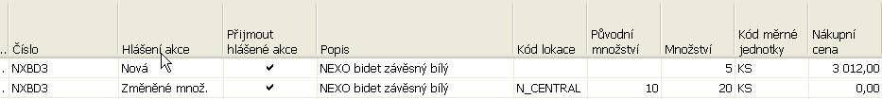
Purchase process
Net Requirement=Gross Requirement –Stock level – Purchase Orders + Sales orders +Safety Stock
Reason for purchase
Replenishment
suggestions
Sales
Order
Purchase
Order
Item
Cardí
Requisition worksheet
10 ks
Minimum=Safety Stock
Quantity
Minium=5
Time
Inventory level for today at lower than Safety Stock

Slide 4
Stock Availability
Reasons for reordering (replenishment)
  Sales Order (CR)
  Production Order
  Transfer Order
  Both of above
Sales
Order
Production
Order
Transfer
Order
Gross
Requirement
(hrubý požadavek)
Components
Item Card
Availability

Slide 5
Parameters controlling RW functions
(you can find them on the Item card, Tab =Planning)
Reorder Policy – It uses the reordering policy to calculate the lot size per planning period, which you define in the Reorder Cycle field
Reorder Cycle - In this field, you enter a date formula that sets the planning time frame for the item.
Safety Stock
Reorder Point - Replenishment is typically triggered when the inventory level hits the Reorder Point, which is also called Reorder Trigger Level.
Reorder Quantity - See Excel file example (resource mentioned there)
Min and Max Order Quantity
Order Multiple

Slide 6
Reorder Policy
(see F1 to get detailed Help concerning Reorder Policy)
Fixed Reorder Qty
Maxium Quantity
Order
Lot-for-Lot

Slide 7
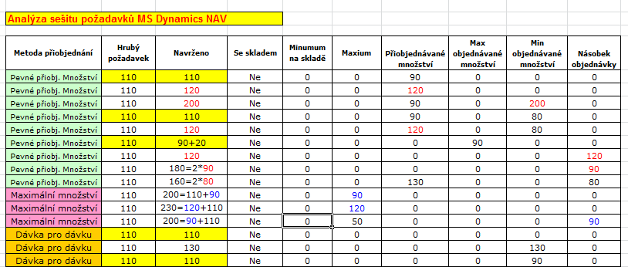
Examples for different setups
(see related Excel file Analýzy sešitu požadavků)
Only for Czech students !!!

Slide 8
Model-test
Creation of the new item card XX1
  Use presented principles from TS 4 (slides 3-5)
  The method and some tiny modifiction of the this procedure is presented in the next few slides
Create new Sales Order with 100 pcs of XX1
  Do not post it !!
Create new Purchase Order with 30 pcs of XX1
  Do not post it !!

Slide 9
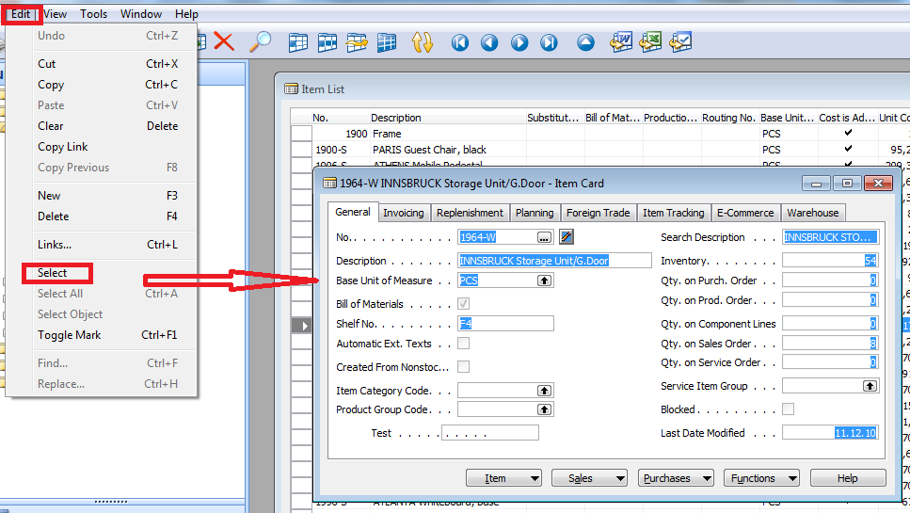
How to create a new Item card
Open chosen card (e.g. 1964-W) by use of keyboard shortcut Shift-F5 and from the menu Edit use Select function and you will get

Slide 10
How to create a new Item card
Ctrl-C (Item card picture is cut into clipboard)
F3 in order to create new card
Ctrl-V (Item picture is pasted from clipboard into new Item card)
You will get message Item card 1964-W already exists
You push OK
You will get another error message Item card could not be pasted . Do not care and make Ok again
Change original number 1964-W to XX1 (for instance)
Change name to Component 1 (for instance)
In Unit of Measure field make a choice by use of F6 to Pcs and OK and then ENTER to confirm your choice
Tab Invoice->and change by F6 to Costing method FIFO and confirm by ENTER
Tab Replenishment ->make a choice of you principal Vendor (by use of F6)
Tab Planning ->Reorded Policy= Fixed Order Quantity

Slide 11
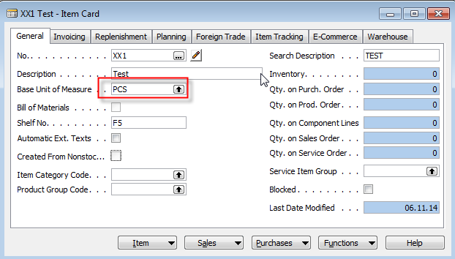
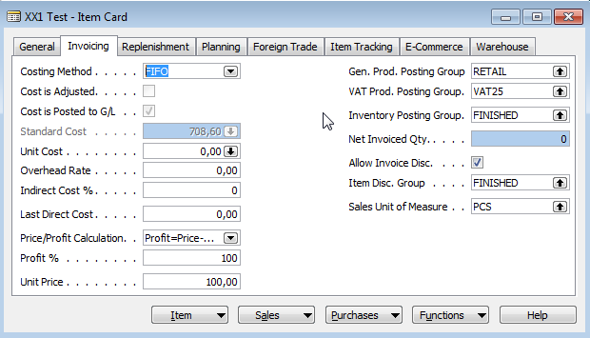
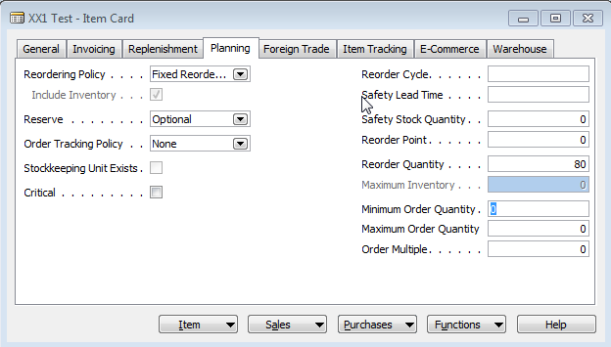

Results 1
And it's done

Slide 12
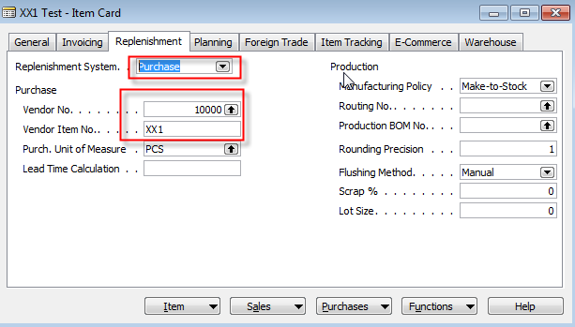
Results 2- Tab Replenishment

Slide 13
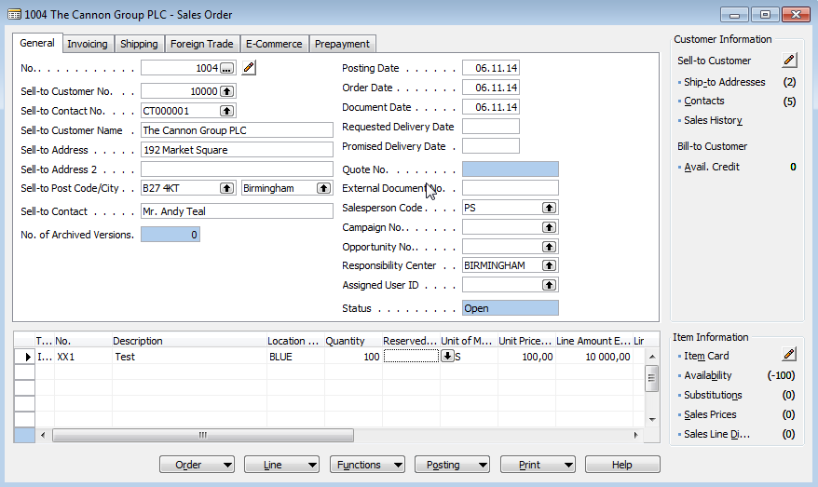
Created Sales Order

Slide 14
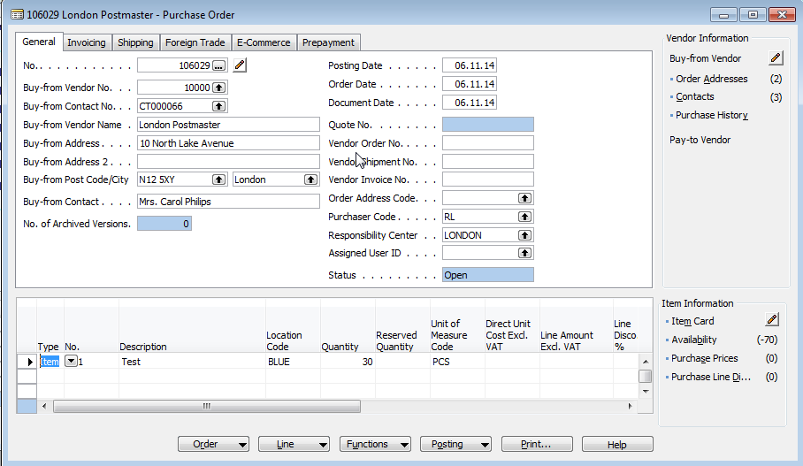
Created Purchase Order

Slide 15
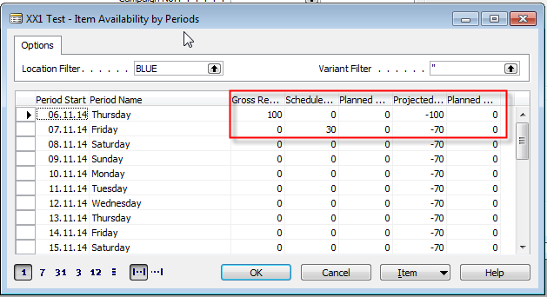
Availability

Slide 16
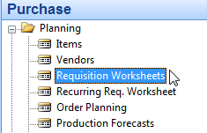
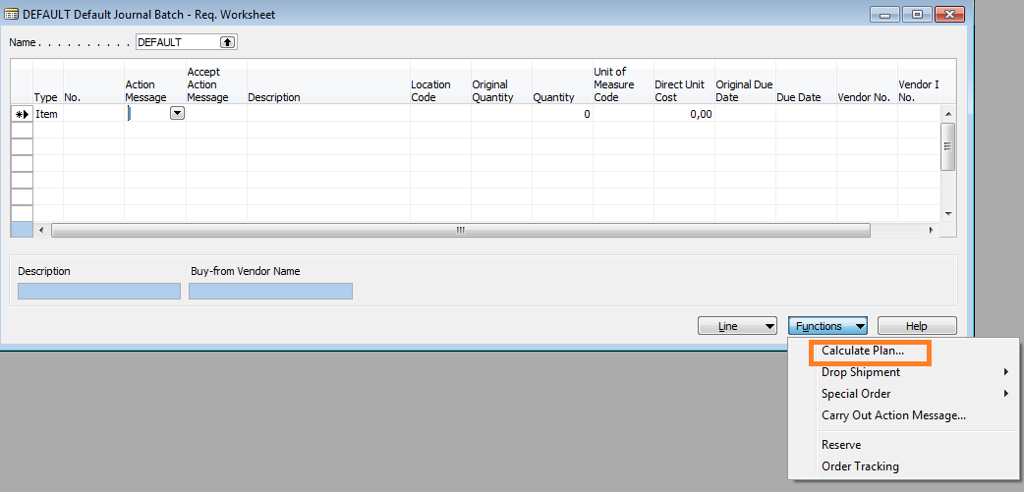
RQWS window and how to start batch job

Slide 17
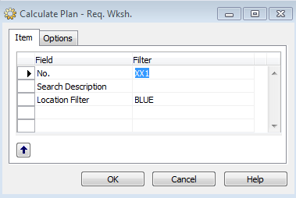
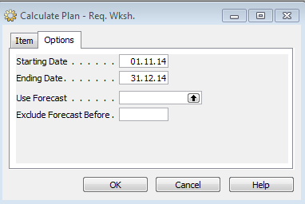
RQWS window and how to start batch job

Slide 18
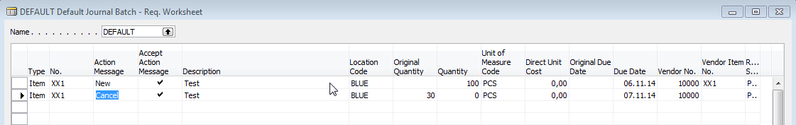
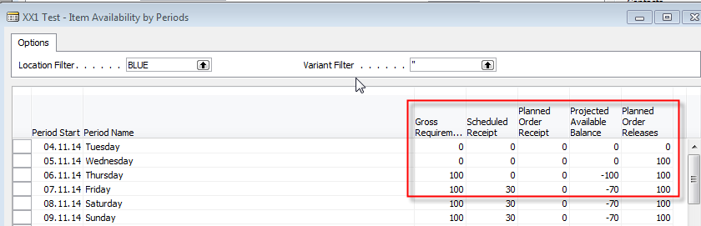
RQWS window and how to start batch job
System suggests to cancel existing Purchase Order (second line) in order to get 100 %
balance . First line will serve as a resource line for second Purchase Order creation.
Availability looks like this (Planned Order Releases represents first line of RQWS) :

Slide 19
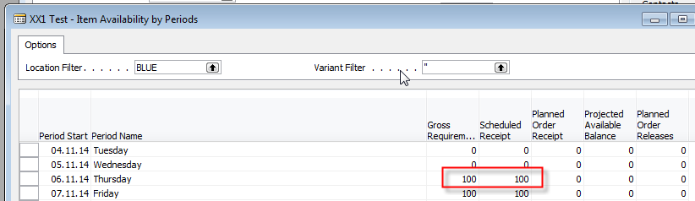
Carry Out Action Messages
After Carry Out Action Messages you will get
First manually created Purchase Order has been deleted and new PO
for 100 pcs of XX1 was created !!!

Slide 20
Modification of the model RQWST
Change policy to Lot-for-Lot
Enter in Tab Planning Reorder cycle 1M
Create another two Sales Order in different dates (+1 week and + 2 weeks)
Start RQWST again
…….

Slide 21
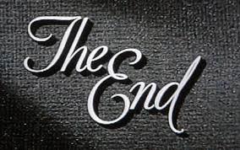
End of the section XXVII.
Přihlásit se
Používáte-li nástroj pro čtení obrazovky, vypněte Dynamické vyhledávání Google kliknutím sem.
Internet
Obrázky
Videa
Zprávy
Nákupy
Více
Vyhledávací nástroje
Bezpečné vyhledávání
Výsledky hledání
I
RemixYourHealth Workout Series: The Show Stopper | RemixYourHealth
remixyourhealth.com-940 × 400-Vyhledávání pomocí obrázku
So two weeks ago I introduced you to the ridiculousness that was “The Shredder” workout. Did you try it? How'd it go? If you made it to the end of the ...
Navštívit stránku Zobrazit obrázek
Související obrázky:
Zobrazit další
Na obrázky se mohou vztahovat autorská práva.-Odeslat zpětnou vazbu
Not Dead Yet Radio | Podcast featuring Tommy Bateman & Alex Corolla
www.notdeadyetradio.com-447 × 280-Vyhledávání pomocí obrázku
Tommy starts the show off in an unusual fashion. He announces the show is ending. The time he puts in isn't worth the “rewards” he's getting.
Navštívit stránku Zobrazit obrázek
Související obrázky:
Zobrazit další
Na obrázky se mohou vztahovat autorská práva.-Odeslat zpětnou vazbu
G4 Cancels 'Attack of the Show,' 'X-Play' - Hollywood Reporter
www.hollywoodreporter.com-565 × 318-Vyhledávání pomocí obrázku
Attack of the Show Logo (2) - H 2012
Navštívit stránku Zobrazit obrázek
Související obrázky:
Zobrazit další
Na obrázky se mohou vztahovat autorská práva.-Odeslat zpětnou vazbu

