Slide 1
Basic production algorithms and its main concepts
Ing.J.Skorkovský,CSc.
and various listed resources
Department of Corporate Economy

Slide 2
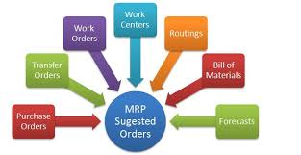
Main concepts
MRP=Material Requirements Planning (push)
MRP_II=Manufacturin Resource Planning (push)
APS = Advanced Planning and Scheduling
JIT = Just In Time (pull)
TOC (Drum Buffer Rope) (push-pull->combined) – will be prezeneted in another session of this course

Slide 3
BOM=Bill Of Material (structure of the product)
Component
0
A
B
Product|Semiproduct
500
1
200
0,1,2,,..Low Level Codes
100
100
600
2
300
300
400
3
300
400
Independent demand for products and semi-products and dependent for components
Planning backwards from production schedule (independent) to dependent- demand components -without statistically calculated Reorder Point (ROP)– see next lesson and next slide as well
IF ROP is not taken into consideration – MRP is PUSH system -> it computes schedule of what should be started (pushed) into system, that authorize production as inventory is consumed (ROP will be explained later in this session)

Slide 4
Push system
Purchase orders
Forecast
MRP|ERP
Operation 1
Operation 2
Operation 3
Operation 4
Supplier1
WIP
WIP
Customer 1
ROUTING
Supplier 2
Component
warehouse
FG warehouse
Customer 2
Take it !
WIP

Slide 5
PUSH and PULL
PUSH : production jobs (production orders) are scheduled: MRP and MRP_II= Manufacturing Resource Planning
often not feasible plans are generated and problems are often detected too late (rejects, lack of components,..)
used fixed lead times=LT (see next slide) do not depend on capacity utilization
Having in mind , that production is random process, Lead Time is very pessimistic constant
PULL : production jobs (production orders) starts are triggered by completion of another job (JIT-see later in this session)
Black box
t=start of the job
t+LT=end time of the job (where LT=constant)

Slide 6
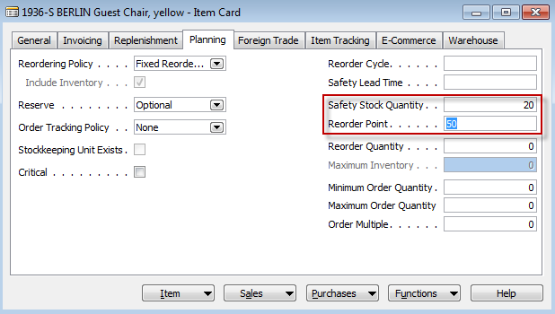
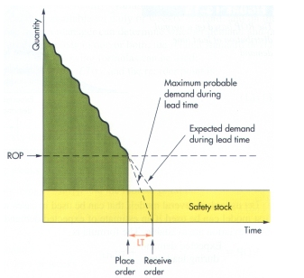
Determination of the Reorder Point (ROP)
ROP=expected demand during lead time + safety stock
Expected demand=30
50-20=30
50=ROP
20
LT =Lead time

Slide 7
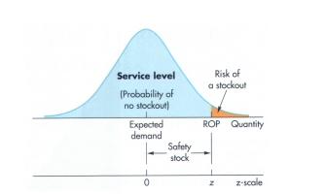
Determination of the Reorder Point (ROP) (home study)
ROP = expected demand during lead time + z* σ_{dLT}
where z = number of standard deviations and
σ_{dLT =} the standard deviation of lead time demand and z* σ_{dLT} =Safety Stock
aan

Slide 8
Example (home study- also Pareto analysis and ABC model simplified- PWP will be shown later)
The manager of a construction supply house determined knows that demand for sand during lead time averages is 50 tons.
The manager knows, that demand during lead time could be described by a normal distribution that has a mean of 50 tons and a Standard Deviation of 5 tons (σ_{dLT )}
The manager is willing to accept a stock out risk of no more than 3 percent

Slide 9
Example-data (home study)
Expected lead time averages = 50 tons.
σ_{dLT} = 5 tons
Risk = 3 % max
Questions :
What value of z (number of standard deviations) is appropriate?
How much safety stock should be held?
What reorder point should be used?

Slide 10
Example-solution (home study)
Service level =1,00-0,03 (risk) =0,97 and from probability tables you will get z= +1,88
See next slide with probability table

Slide 11
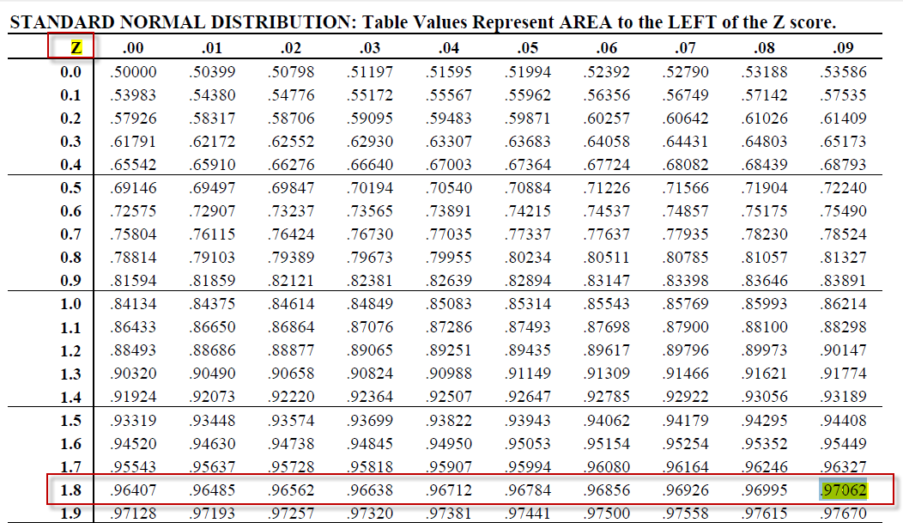
Probability table

Slide 12
Example-solution (home study)
Service level =1,00-0,03 =0,97 and from probability tables we have got : z= +1,88
Safety stock = z * σ_{dLT} = 1,88 * 5 =9,40 tons
ROP = expected lead time demand + safety stock = 50 + 9.40 = 59.40 tons
For z=1 service level =84,13 %
For z=2 service level= 97,72 %
For z=3 service level = 99,87% (see six sigma)

Slide 13
Schematic of MRP
BOM
On-hand inventory
Scheduled receipts
MPS
MPS=Master Production Schedule
Netting – Lot Sizing –Time Phasing –BOM Exploding
Production
Orders (jobs)
Purchase
orders
Exception and change notices
Net requirement =Gross requirement – Stock in hand – Purchases + Sales + Safety Stock
Lot sizing= divide netted demand into appropriate lot sizes to form jobs (see LLC) and EOQ PWP show (later)
Time Phasing = offset the due dates of the jobs with lead times to determine start times
(Due Date-Lead time = Start of the job)

Slide 14
MRP matrix calculation (see related xls file in study material)
Parameters
Gross requirements
Derivied from Master Production Scheduled or Planned order releases of the parent BON (finished good)
Scheduled receipts
On order (issued) and scheduled to be received
Projected on hand
Anticipated quantity on hand at the end of the period
Net requirement
Net requirement =Gross requirement – Stock in hand – Purchases + Sales + Safety Stock
Planned order receipts
When order need to be received (documents are not issued)
Planned order releases
When order need to be placed to be received on time

Slide 15
MRP matrix example 1
(home study)
MRP basic calculations |  | Lot-for lot - ordering exact quntity needed
 |  | Lead Time =1 - time to get item from the moment the purchase order is issued or to make it
Master Production Schedule
Part A | Projected on hand | 1 | 2 | 3 | 4 | 5
Gross Requirements |  | 85 | 95 | 120 | 100 | 100
MRP
Part A |  | 1 | 2 | 3 | 4 | 5
Gross Requirements |  | 85 | 95 | 120 | 100 | 100
Scheduled Receipts | Is already issued | 175
Projected on hand (POH) | 25 | 115 | 20 | 0 | 0 | 0
Net requirements |  | 0 | 0 | 100 | 100 | 100
Planned order receipts |  |  |  | 100 | 100 | 100
Planned order releases |  |  | 100 | 100 | 100
 |  | Period | Action
 |  | 1 | 25+175-85=115=POH
 |  | 2 | POH=115-95=20
 |  | 3 | Cannot cover GR, so we have to release one PO for 100 one period earlier in order to get it in period 3
 |  | 3 | Net req=120-20 =100, POH in period 3=120-20-100=0
 |  | 4 | Net req =100-0=100-POH=100, so we heave to release one PO one period earlier in order to cover demand in period 4
 |  | 5 | Similar to period 4
period
period

Slide 16
MRP matrix example 2
(home study)
MRP
Part A |  | 1 | 2 | 3 | 4 | 5 | 6 | 7 | 8
Gross Requirements |  | 20 | 30 | 50 | 50 | 60 | 90 | 40 | 60
Scheduled Receipts | Is already issued |  | 50
Projected on hand (POH) | 40 | 20 | 40 | 40 | 40 | 30 | 0 | 10 | 0
Net requirements |  |  |  | 10 | 10 | 20 | 60 | 40 | 50
Planned order receipts |  |  |  | 50 | 50 | 50 | 60 | 50 | 50
Planned order releases |  | 50 | 50 | 50 | 60 | 50 | 50
 |  | Period | Action
 |  | 1 | Can be covered from POH and new POH=40-20=POH-GR=20
 |  | 2 | In period 2 GR can be covered by POH and SR, but next period where GR=50 will be not covered, so POR must be released in per 1 (LT=2)
 |  | 3 | We have got 50, POH=40, so altogether we have 90 nad after demand is covered only 90-50=40=POH
 |  | 3 | Net req=50-40=10 in order to cover demand in period 4, but we can released only 50 or more, so in period 2 another 50 is released
 |  | 4 | Demand is covered by receipt 50 and POH =10 but for the next period net req=60-40=20
 |  | 5 | Net req= 60-40=20, so demand in period 5 can be covered by POH=40+ quantity X, which have to be ordered 2 period earlier
 |  | 5 | Quantity X can 50 or more. So take it 50 as sufficient quantity, and POH =30=40+50-60
 |  | 6 | To cover demand in period 6 we need at least 90 and we have only 30 in POH, so 90-POH=90-30=60 have to ordered 2 period earlier
 |  | 6 | POH-90-60-30=0; Ner req=90-30=GR-POH=60 , which is reason why we have ordered 60 two period earlier
 |  | 7 | Net req= 40 because 40-0=GR-POH=40. To cover it we have to order two period earlier 50
 |  | 8 | and so on

Slide 17
Benefits of MRP
Low levels of in process inventories
The Ability to keep track of material requirements
A means of allocating production time
The ability to easily determine inventory usage by backflushing (see explanantion below) Process of determining the number of parts that must be subtracted from inventory records. This number is computed by referring to the number of parts withdrawn from the inventory (and delivered to the shop-floor) and the number of parts assumed (according to the BOM) to have been consumed in a manufacturing line at one or more deduct points.

Slide 18
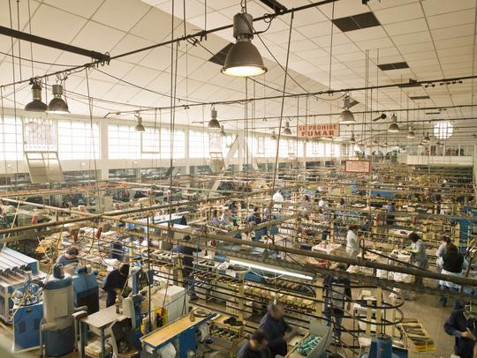
MRP_II =MRP + resource capacity planning
Rough-cut capacity planning
MPS
Demand
management
BOM
MRP
Intermediate-range
planning
Scheduled
receipts
Job
pool
Capacity requirement planning
Job release
Routings
(operations)
Short term
control
(Shop floor)
Job
dispatch

Slide 19
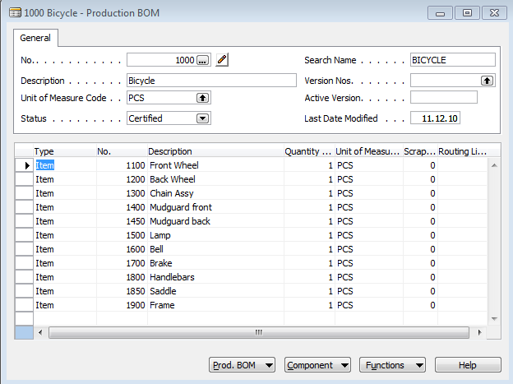
BOM in MS Dynamics NAV

Slide 20
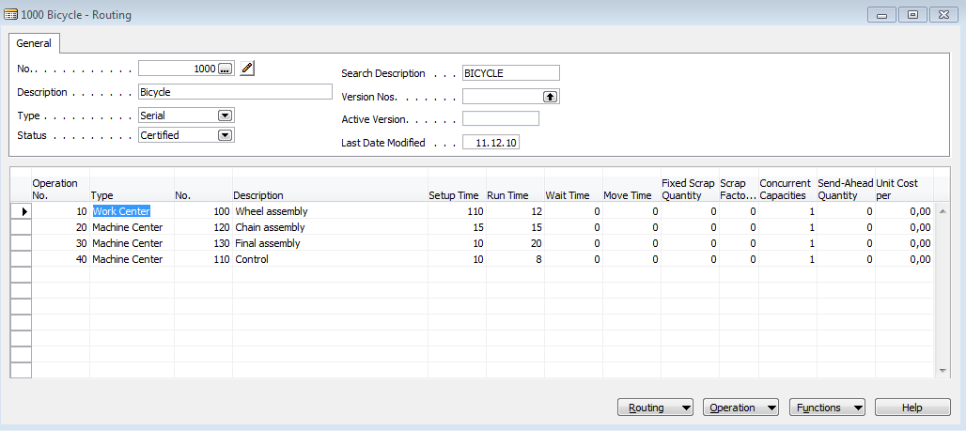
Routings in MS Dynamics NAV

Slide 21
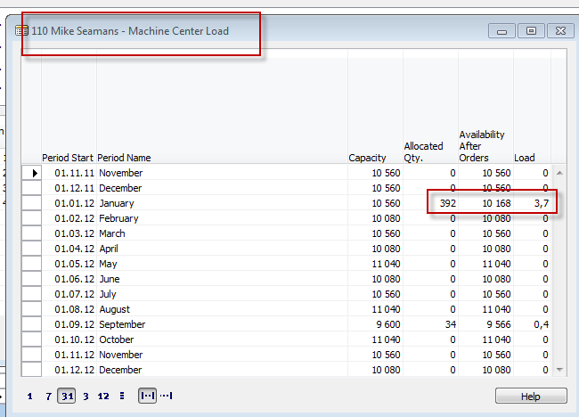
Capacity of resources in MS Dynamics NAV

Slide 22
JIT=Just In Time
Toyota Motors and Taiichi Ohno
Production based only on demand
Lower inventory costs
The concept behind it is that a company can save money on parts and components---by not have having to store them--- if they are delivered to the assembly line just in time to be installed on the car as it is being built.

Slide 23
JIT=Just In Time
Components for Job N needed…
1 (kanban = card=signal)
2
Demand
Operation (Job1)
Operation (Job2)
Operation (JobN)
Components for Job N produced and
Supplied (pulled)
UPSTREAM
Authorization
to start Job 2
DOWNSTREAM
1
=kanban
Controlling parameter
Production
The number of kanban cards in the system determines the WIP levels in the plant

Slide 24
JIT (manufacturing philosophy)
Kanban is not JIT !!!
JIT encompasses :
kanban cards (kan=card, ban=signal)
total quality control (TQM) – e.g. scrap loss not tolerated….
setup reduction
worker participation
lean production (low level of waste)
Advantages of JIT philosophy :
reduced WIP (Work in Progress)->higher Throughput (see Little´s law- will be presented later)
shorter production times
lower production costs
greater customer responsiveness

Slide 25
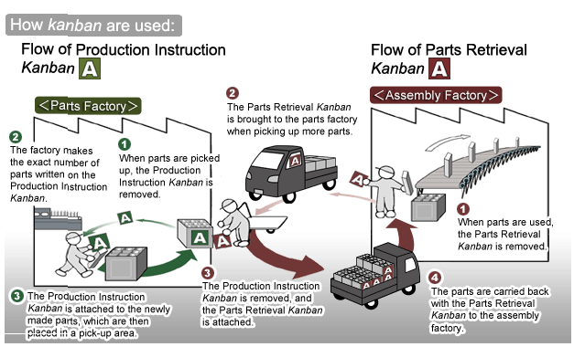
Kanban principle
(home study)
Resource :

Slide 26
Some units
(not for BPH_PIS2)
Will be presented later in sections such as :
Little´s law (LT=WIP*CT=WIP/Throughput)
Theory of Constraint…
Cycle Time (CT)– time to complete task (time/unit)
Takt Time (TT) – rhythm in which we have to produce in order to satisfy customer demand (demand is 240 toaster ovens and we can produce these in 480 minutes ->TT= 480/240=2
Lead Time (LT) – Number of minutes, hours, or days that must be allowed for the completion of an operation or process, or must elapse before a desired action takes place –see next slide
Comment : CT<>LT !!

Slide 27
Lead time
(not for BPH_PIS2)
The lead time is the time and not the effort. You may have a lead time of 100 days and only have to work 1 hour to fix the bug. Sometime you start working on the bug. The cycle time is the time from the start of the work until the bugfix is live.
Priority of the task
is set
Cycle time
Lead time
Request
(bug reported)
Start work
Bug solved

