Slide 1
Bureaucracy
& Inequality
BPV_APEC Public Economics
Miloš Fišar

Slide 2
Lecture outline
Bureaucracy in Weber (normative)
Bureaucracy in Niskanen (descriptive)
(In)equality in the world

Slide 3
Where does a bureaucracy come from?
Vincent de Gourmay (1765)
  Bureaucracy suggest routinized and constrained behavior, and inefficiency.
  French bureau + Greek κράτος (kratos)
Webster’s dictionary:
  „large group of people who are involved in running a government but who are not elected“
  „system of government or business that has many complicated rules and ways of doing things“
Political science:
  Governance through public offices, that consists of appointed, but not elected officials, hierarchically structured and dependent on legitimate authority

Slide 4
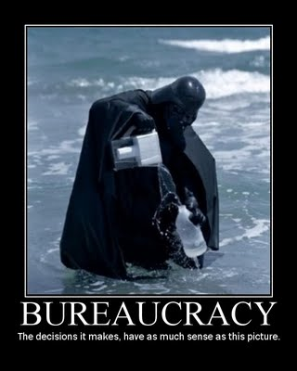

Slide 5
What is a bureaucracy?
way of organization and management of public service
continuous task fulfilling according to objective rules (no matter what political party governs)
hierarchic structure
subordination & superiority
public offices behave like “non profit organizations”
financed by a stable structure of subsidies

Slide 6
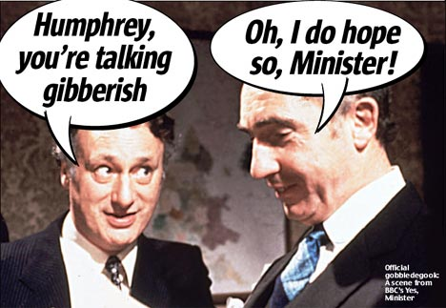
The empty hospital - Yes Minister - BBC
http://youtu.be/Eyf97LAjjcY

Slide 7
Max Weber (1864-1920)
German sociologist, philosopher and political economist
Well know for the influence on social theory and theory of state
Gave baseline to modern theory of bureaucracy

Slide 8
Weber – social actions
Affectionate action
  based on emotions
  used by charismatic authority
Traditional action
  based on habits
  traditional authority
Rational action
  clear perception of targets
  rational-legal authority and structure = bureaucracy

Slide 9
Weber‘s bureaucracy
Bureaucracy is described as:
  hierarchic organization
  with almost military discipline
  follows precise and detailed inter rules, which also guarantee accurate and regular function

Slide 10
Weber‘s bureaucracy
Decision making based on:
Rigid definition of functions and responsibility
Stable rules and procedures
Formal accuracy in details
Top-down delegation of power

Slide 11
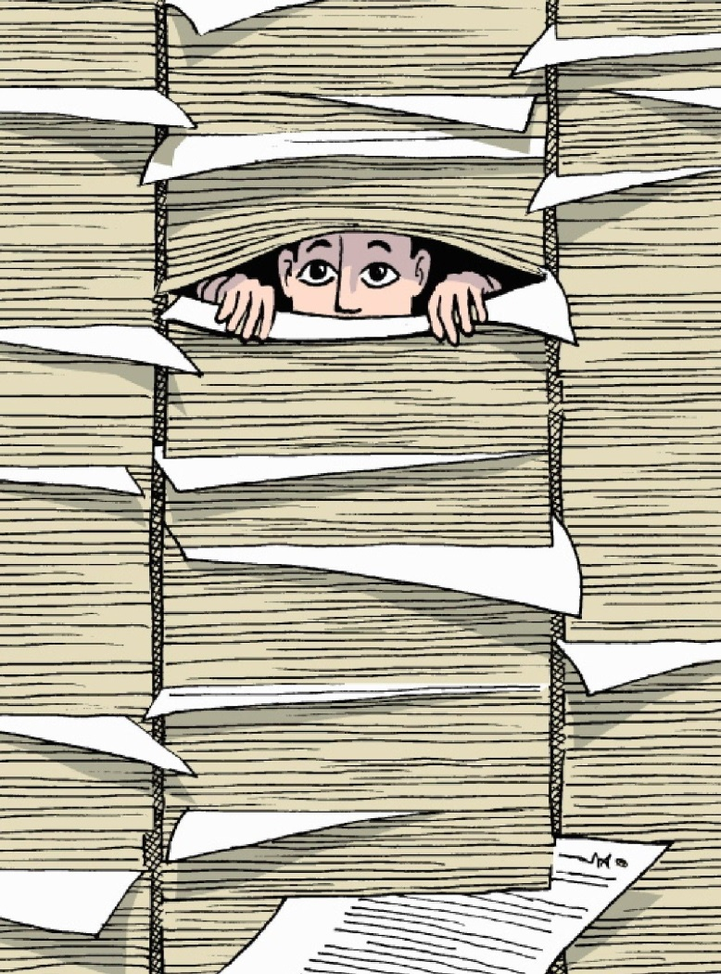
Weber‘s bureaucracy
Optimal bureaucrat behavior
  Follow contemporary rules and orders
  Rules and orders are crucial for efficiency and success of the bureaucracy

Slide 12
Weber‘s bureaucracy – sum up
Bureaucracy is hierarchic organization rationally coordinating work of many individuals among large scale of administrative tasks.
Bureaucracy, according to Weber, is ideal rational management.
Is based on precise objective rules, which cannot be influenced by a political power.

Slide 13
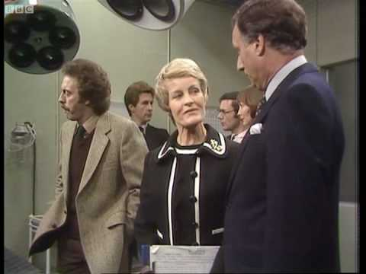
Check on „ideal rational management“
„At any one time some agencies are expanding and others stagnating. New agencies will set up in competition with established bureaus. And complex hierarchical battles between agencies are constantly in progress.“
Get some patients - Yes, Minister - BBC
http://youtu.be/x-5zEb1oS9A

Slide 14
William A. Niskanen (1933-2011)
American economist
One of the creators of Reaganomics
1971: Bureaucracy and Representative Government

Slide 15
Niskanen’s bureaucracy
Bureaucrat is a rational individual, like everyone else.
Maximizing his utility
f(U) = {income, reputation, number of subordinates, social status, budget size, benefits and delights}
For bureaucracy is typical effort for continues growth of influence and size of the bureau

Slide 16
Bureau characteristics - Niskanen
Officials cannot use the difference between income a spending for themselves – no motivation for cost minimization.
Income of the bureau is not based on demand and supply.
The outcome of the bureau is difficult to measure and compare.

Slide 17
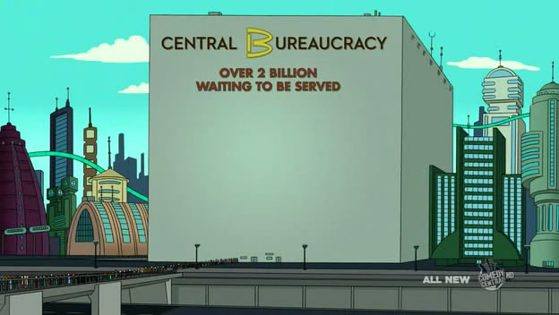

Slide 18
Government failures
Limited information
  Consequences of many actions are difficult to foresee
  Often the government doesn’t have information it needs
Limited control over private responses to its actions
Limited control over the bureaucracy
  The government issues decisions but it’s up to government agencies (bureaucrats) to implement them
  Have you heard of any examples of sabotage?
Limitations imposed by political processes
  Influence of interest groups

Slide 19
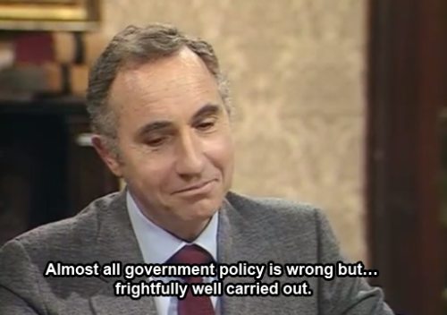
If the right people don't have power - Yes, Prime Minister - BBC
http://youtu.be/gmOvEwtDycs

Slide 20

Capital in the 21st Century
Written by Thomas Piketty
700 pages long book filled with statistics
An unlikely bestseller

Slide 21
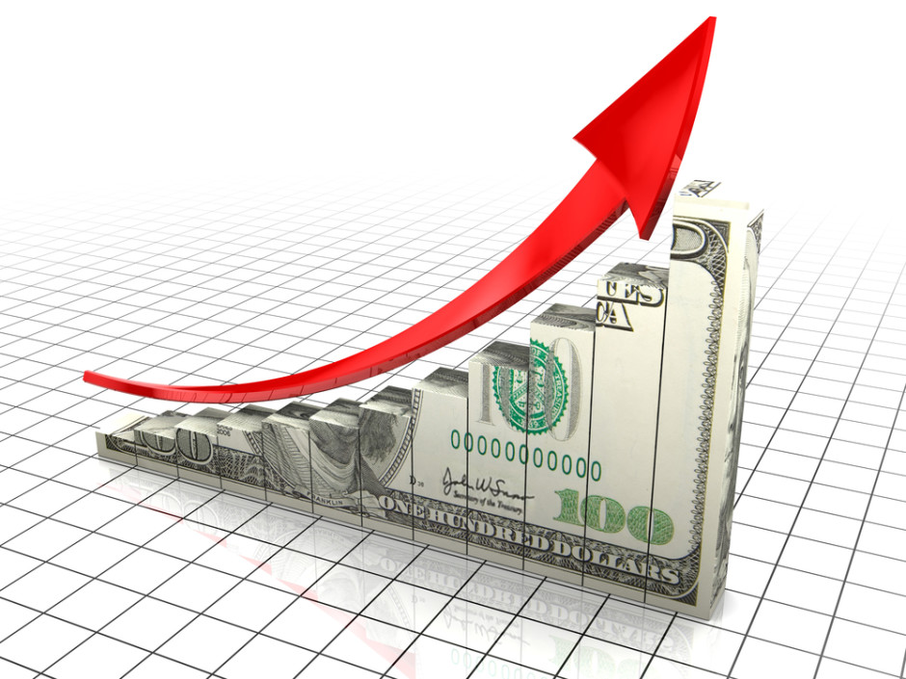
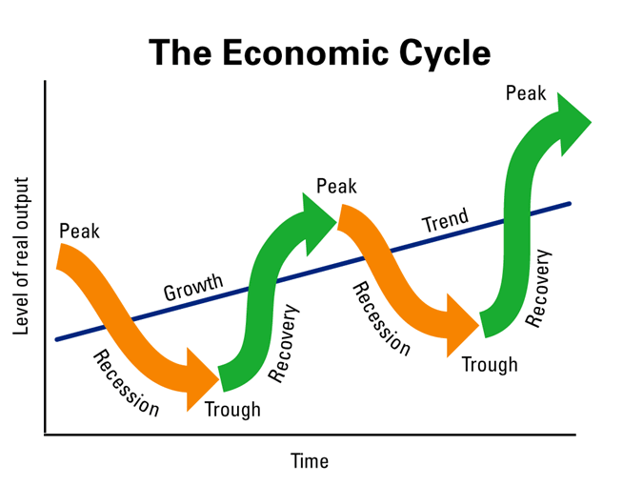
R or G?
r = return on wealth
g = economic growth

Slide 22
What is higher? R, or g?
In the period 1914 – 1970, g was substantially higher.
But in the long term, the period around two world wars seems like an exception.
Piketty argues for r > g

Slide 23
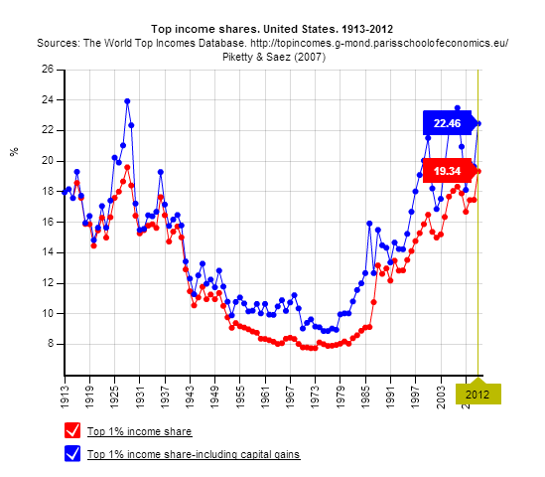
If r is higher than g, what are the implications?
Rich get richer.
Inequality on the level of the 19th century

Slide 24
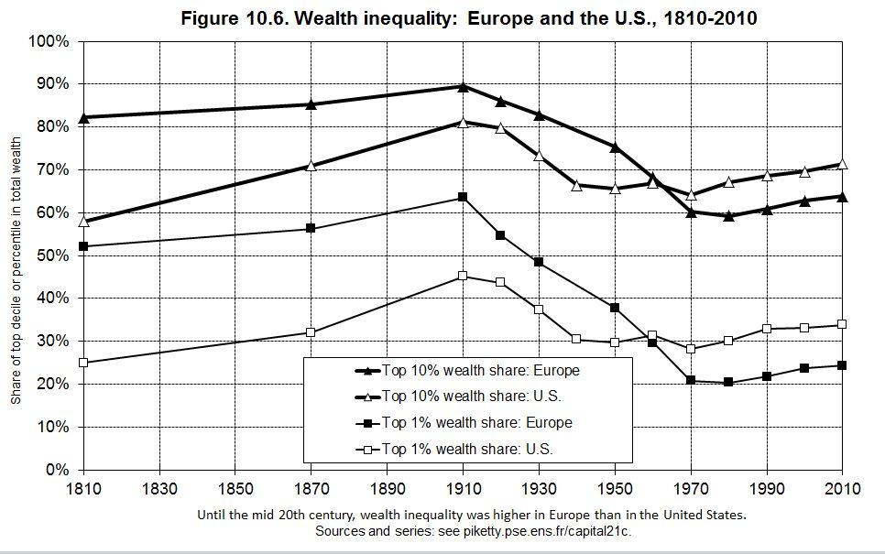

Slide 25
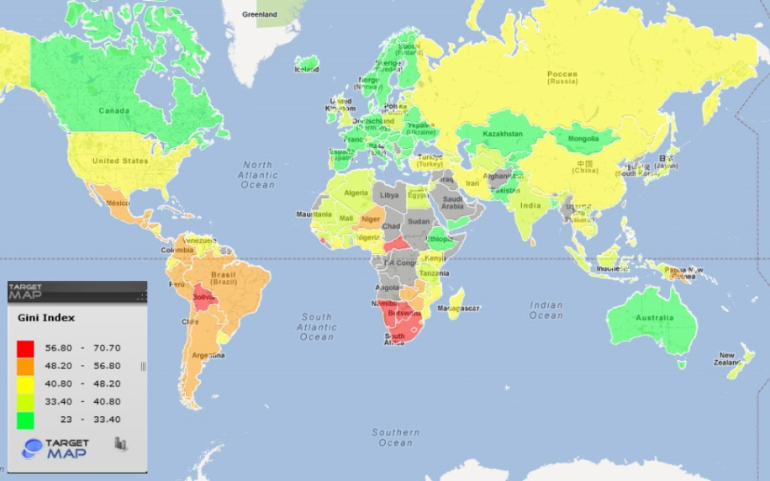
Gini coefficient / index
Represents income distribution of households
Measures wealth inequity in society
The lower number the better
http://data.worldbank.org/indicator/SI.POV.GINI
http://www.compareyourcountry.org/inequality?cr=oecd&lg=en&page=0

Slide 26
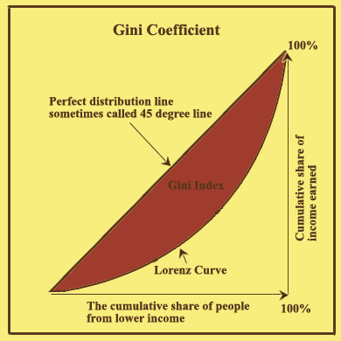
Lorenz Curve
Graphical illustration of cumulative distribution of household revenues.
  Cumulative distribution of wealth and income
  Cumulative share of people from lowest income to highest

Slide 27
Thank you for your attention.

