Slide 1
Game Theory
Miloš Fišar
course BPV_APEC Public Economics - 29/9/2015

Slide 2
When do we play a game?
Decide what is a game or not:
Driver maneuvering in a heavy traffic.
Bargain-hunters bidding on eBay.
A firm and a union negotiating next year’s wage.
Candidates choosing their platforms in an election.
The owner of a grocery store deciding today’s price for corn flakes.
A GAME IS BEING PLAYED
WHENEVER HUMAN BEINGS INTERACT.
driving game
auctioning game
bargaining game
political game
economic game

Slide 3
Game Theory Application
Game theory might be applied to predict how people play any game of social life.
But game theory can’t solve all of the world problems.
Game theory only works when people play rationally.

Slide 4
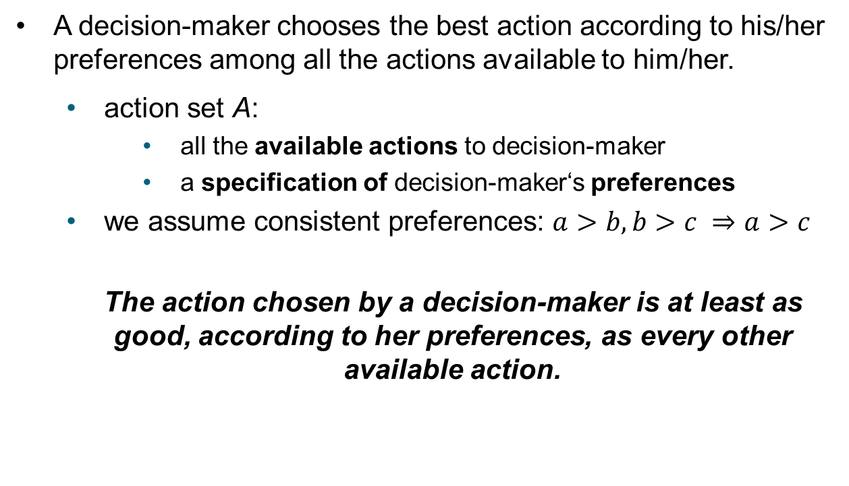
The theory of rational choice
A decision-maker chooses the best action according to his/her preferences among all the actions available to him/her.
  action set A:
    all the available actions to decision-maker
    a specification of decision-maker‘s preferences
  we assume consistent preferences: $a>b, b>c ⇒a>c$
  The action chosen by a decision-maker is at least as good, according to her preferences, as every other available action.

Slide 5
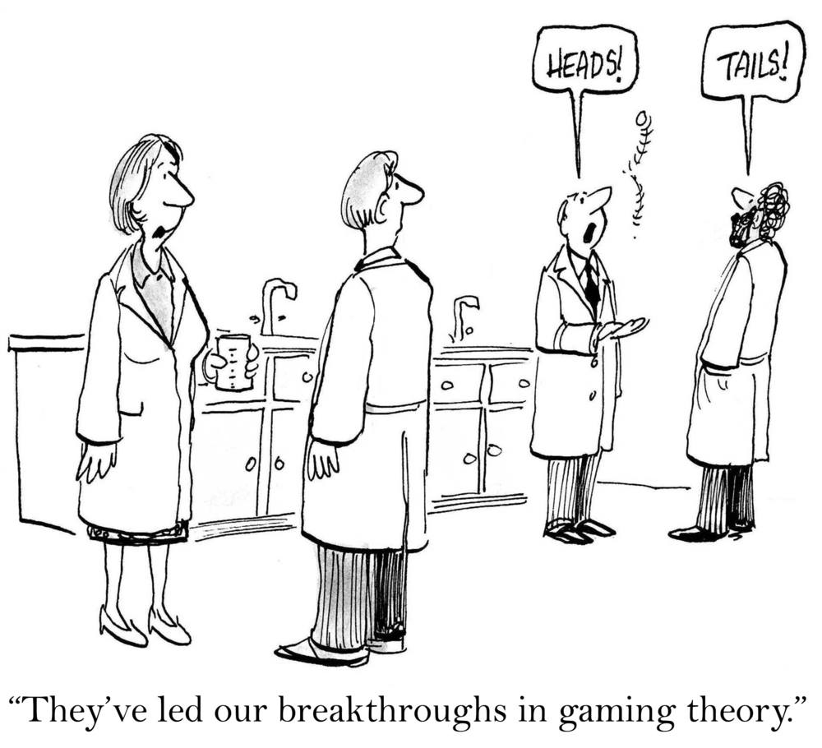
let’s play some games
Matching Pennies
Prisoner’s Dilemma
Battle of the Sexes

Slide 6
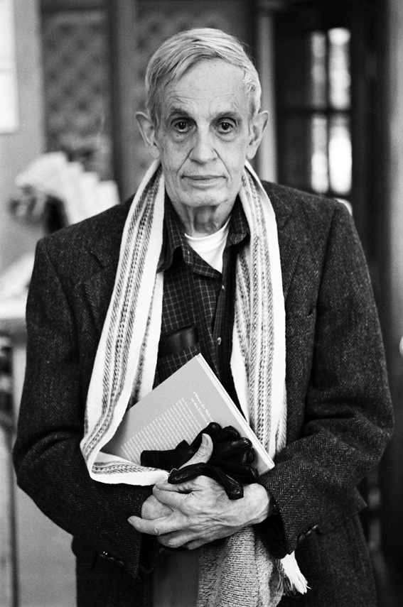
Nash Equilibrium
Occurs when all players are simultaneously making a best reply to the strategy choices of the others.

Slide 7
Matching Pennies
Alice and Bob each show a coin.
Alice wins if both coins show the same face.
Bob wins if they show different faces.
 | BOB
Alice |  | heads | tail
 | heads |   |  
 | tails |   |  
 | BOB
Alice |  | heads | tail
 | heads | +1 -1 | -1 +1
 | tails | -1 +1 | +1 -1

Slide 8
Traditional Prisoner’s Dilemma
Alice and Bob are Gangsters in Chicago.
The District Attorney knows that they are guilty of a major crime, but is unable to convict either unless one of the confesses.
He offers each a following deal:
  If you confess and your accomplice fails to confess, then you go free.
  If you fail to confess but your accomplice confesses, then you will be convicted and sentenced to maximum term in jail (10 years).
  If you both confess, then you will both be convicted, but the maximum sentence will not be imposed (9 years).
  If neither confesses, you will both be framed on a tax evasion for which conviction is certain (1 year).

Slide 9
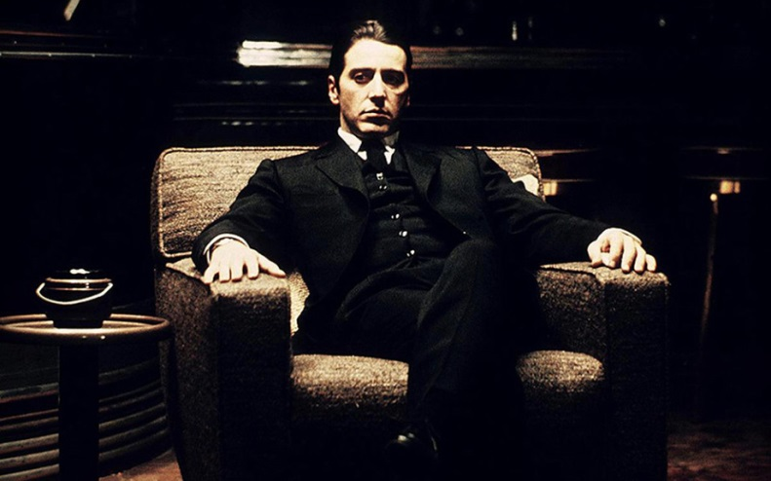
Traditional Prisoner’s Dilemma
 | BOB
Alice |  | defect | cooperate
 | defect | -9; -9 | -10; 0
 | coop. | 0; -10 | -1; -1

Slide 10
upgraded
Prisoner’s Dilemma
Alice and Bob have access to a pot of money.
Both are independently allowed to give their opponent $2 from the pot, or put $1 into their pocket.
 | BOB
Alice |  | give | take
 | give | $2; $2 | $0; $3
 | Take | $3; $0 | $1; $1

Slide 11
Nash Equilibria of Prisoner’s dilemma game
 | BOB
Alice |  | defect | cooperate
 | defect | -9; -9 | 0; -10
 | coop. | -10; 0 | -1; -1
 | BOB
Alice |  | give | take
 | give | $2; $2 | $0; $3
 | take | $3; $0 | $1; $1

Slide 12

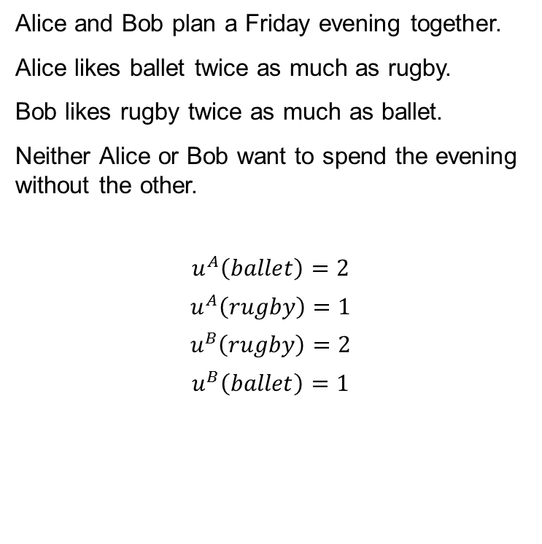
Battle of the sexes
Alice and Bob plan a Friday evening together.
Alice likes ballet twice as much as rugby.
Bob likes rugby twice as much as ballet.
Neither Alice or Bob want to spend the evening without the other.
$$u^{A}\left(ballet\right)=2$$
$$u^{A}\left(rugby\right)=1$$
$$u^{B}\left(rugby\right)=2$$
$$u^{B}\left(ballet\right)=1$$

Slide 13
Battle of the sexes
 | BOB
Alice |  | ballet | rugby
 | ballet
 | rugby.

Slide 14
Battle of the sexes
 | BOB
Alice |  | ballet | rugby
 | ballet | 2 ; 1 | 0 ; 0
 | rugby. | 0 ; 0 | 1 ; 2

Slide 15
What types of games there are?
Cooperative/Non-cooperative
Symmetric / Asymmetric
Zero-sum / Non-zero-sum
Simultaneous / Sequential
Perfect information / imperfect information
Discrete and continuous games
Infinitely long games

Slide 16
Games
Matching Pennies
  simple game, no Nash equilibria
Prisoner’s Dilemma
  cooperation game, strong Nash equilibria
Battle of the Sexes
  coordination game, two pure (but unfair) Nash equilibria

Slide 17
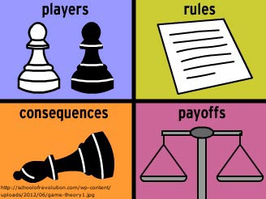
Why to use game theory?
I hope you know the answer ☺

Slide 18
Literature
Binmore, Ken. Game theory: a very short introduction. Oxford University Press, 2007.
Binmore, Ken. Playing for Real Coursepack Edition: A Text on Game Theory. Oxford University Press, 2012.
Osborne, Martin J. An introduction to game theory. Vol. 3. No. 3. New York: Oxford University Press, 2004.

