Slide 1
Introduction to
Public finance
Iveta Štarhová
322996@mail.muni.cz

Slide 2
Introduction to public finance
Public finance
Public expenditure
Governement functions
Public revenues
Trends in public finance

Slide 3
Introduction to public finance
Public finance
    Financial operations between public institutions and other subjects (citizens, households, companies, non-profit organizations etc.)
    Yet not any united definition

Slide 4
Public finance X Public sector
Public Finance
    Financial operations, relations and its tools
Public sector
    Part of national economy
    Financed from public budgets
    How to measure
    the size of public sector?

Slide 5
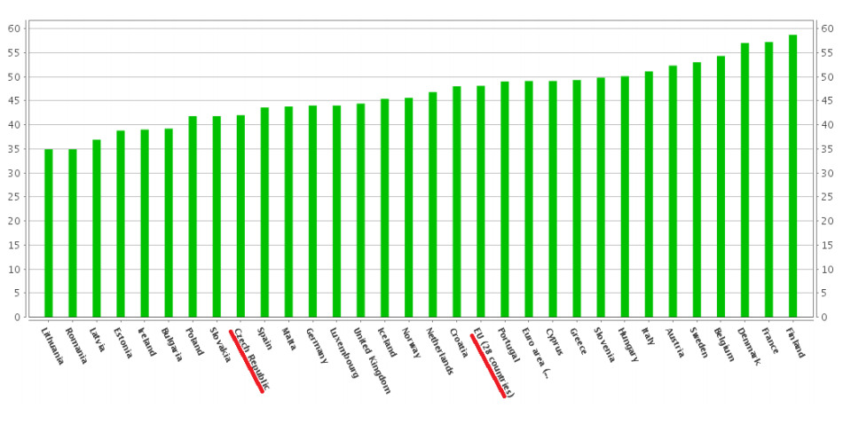
Public expenditure in Europe (2014, % GDP)

Slide 6
Growth factors of the public sector
geographic factors (floods, hurricanes, volcanic activity, ...)
demographic factors (population boom influence priorities within public expenditure)
urban factors (urbanization – higher demand on social and technical infrastructure)
technical and technological factors (state assistance for implementation of significant discoveries - eg. linking technology)
social factor (form of the welfare state and its changes)

Slide 7
Growth factors of the public sector
inflation (↑ share of public expenditure/ GDP, growth of relative prices of public goods in comaprison with private goods)
demonstration effect (citizens "want" what they see abroad)
fiscal illusion (overconsumption, inefficiency)
Other influences especially political and social (social justice,ideology)

Slide 8
Principles of public finance
Non-recovery principle – nobody has claim to return expenditure in some specific form (eg. Social transfers, public goods etc.)
Non-equivalency principle – the purpose of paid tax is not known in advance
Non-voluntarily principle – taxpayers are forced to pay taxes (nobody want to pay voluntarily)

Slide 9
Public expenditures
Part of the GDP which is related to realization of government functions
Part of the GDP which is consumed rather collectively than privately
Several levels:
  State budget expenditures
  Government expenditures (including governmental organizations)
  Public expenditures (including local budget)

Slide 10
Public expenditure - two main categories
Government purchases (eg. Labour force, consumer goods etc.) and capital expenditure (eg. Investment to highway, education, hospitals etc.) – purchase of input from the public sector side
Transfers expenditures (Pensions, social benefits, Interest on debt, etc.) – to ensure redistribution function of public sector, public sector is only mediator

Slide 11
Mandatory and quazi-mandatory expenditures
Mandatory expenditures
    expenditures, which has to be paid and can’t be changed (are determined by law or arising from commitment)
    e.g. retirments, social benefits
    About 60% of public expenditures
Quazi-mandatory expenditures
    Are not determined by law, but goverment is highly expected to pay them
    e. g. salaries of state employees
    About 20% of public expenditures

Slide 12
Mandatory expenditure
Monitored:
the amount of mandatory expenditure to GDP
the amount of mandatory expediture to total public expediture
The amount of mandatory expediture to total public revenues
 | 2005 | 2006 | 2007 | 2008 | 2009 | 2010 | 2011 | 2012 | 2013 | 2014* | 2015*
GDP (billion CZK) | 2984 | 3222 | 3535 | 3689 | 3628 | 3667 | 3814 | 3 846 | 3 884 | 4 061 | 4 216
Share of mandatory expenditure | 15,8 | 16,2 | 15,7 | 15,8 | 17,1 | 17,1 | 17,1 | 17,0 | 17,3 | 17,3 | 17,0
Share of quasi-mandatory expenditure | 6,9 | 6,7 | 6,2 | 5,8 | 6,3 | 5,9 | 5,3 | 5,3 | 5,3 | 5,1 | 5,1
Share of total mandatory expenditure | 22,7 | 23,0 | 21,9 | 21,6 | 23,5 | 23,0 | 22,4 | 22,3 | 22,6 | 22,4 | 22,1
State budget expenditure (billion CZK) | 923 | 1021 | 1092 | 1084 | 1167 | 1157 | 1191 | 1 152 | 1 173 | 1211 | 1218
Share of mandatory expenditure | 51,1 | 51,3 | 50,8 | 53,7 | 53,3 | 54,3 | 56,5 | 56,7 | 57,2 | 58,1 | 58,7
Share of quasi-mandatory expenditure | 22,3 | 21,3 | 20,1 | 19,9 | 19,6 | 18,7 | 17,7 | 17,7 | 17,5 | 16,9 | 17,6
Share of total mandatory expenditure | 73,4 | 72,5 | 70,9 | 73,6 | 72,9 | 73,0 | 74,2 | 74,4 | 74,7 | 75,0 | 76,3
State budget revenues (billion CZK) | 866 | 923 | 1026 | 1064 | 975 | 1000 | 1013 | 1051 | 1091 | 1099 | 1118
Share of mandatory expenditure | 54,4 | 56,7 | 54,0 | 54,7 | 63,8 | 62,8 | 64,5 | 62,1 | 61,5 | 64,0 | 63,9
Share of quasi-mandatory expenditure | 23,8 | 23,5 | 21,5 | 20,3 | 23,5 | 21,6 | 20,2 | 19,4 | 18,8 | 18,7 | 19,1
Share of total mandatory expenditure | 78,2 | 80,2 | 75,5 | 75,0 | 87,3 | 84,4 | 84,7 | 81,5 | 80,3 | 82,7 | 83,0

Slide 13
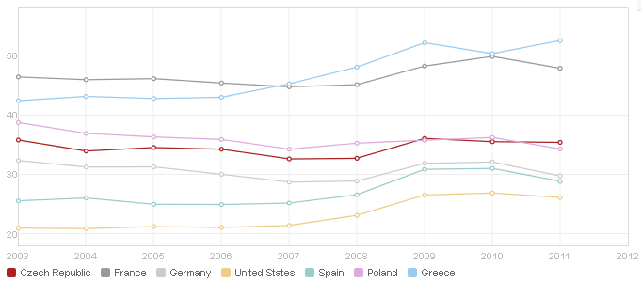
Public expenditures
Indicitors of size of the public expenditures
  percentage of public expenditures on GDP (source: worldbank)
  percentage to the increase of other economic indicators etc…
Notes:
Worldbank: http://data.worldbank.org/indicator/GC.XPN.TOTL.GD.ZS/countries/CZ-FR-DE-US-ES-PL-GR?display=graph

Slide 14
Government functions
Allocation
Stabilization
Redistribution

Slide 15
Allocative function
    Providing services in situations where private sector does not generate sufficient quantity or quality of these services
    This function is associated with remedying market failures
    Which market failures you know?

Slide 16
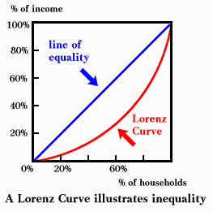
Redistributive function
Peforming by using tax and transfers (main tools)
„Fair“ allocation of sources
Lorenz curve measures income distribution income in the society
Gini coefficient
  - 0 (total equality)
  - 1 (total inequality)

Slide 17
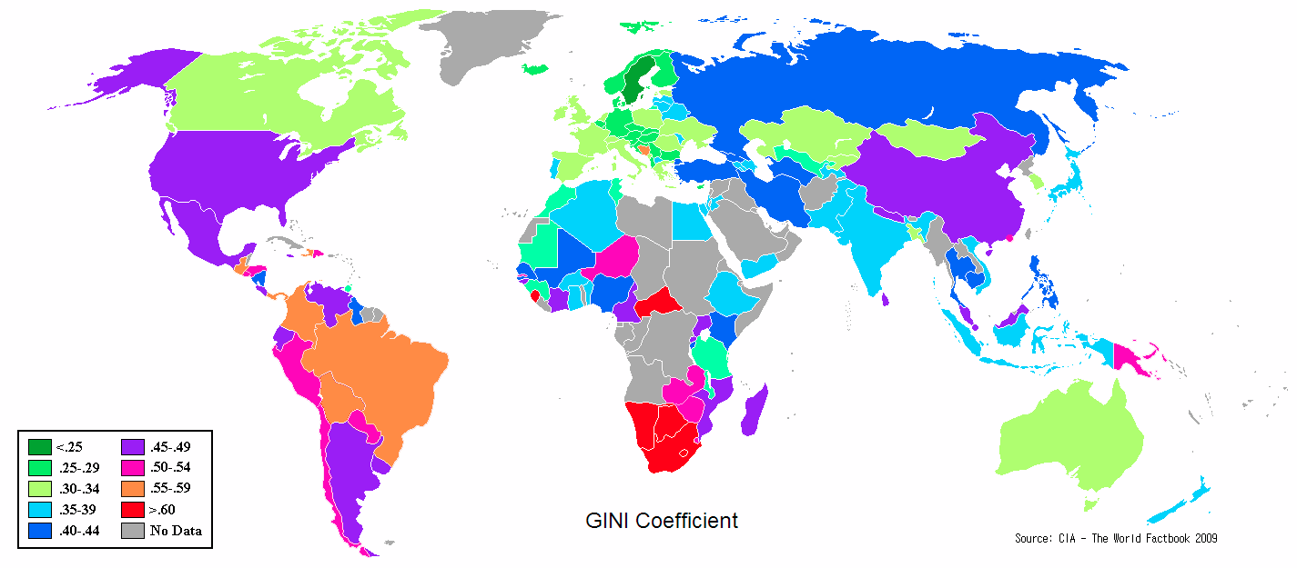
Gini keoficient

Slide 18
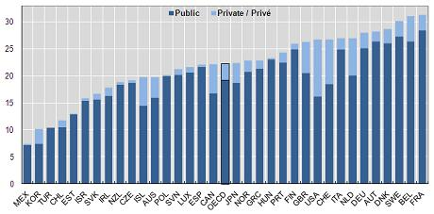
Social expenditures
Public and private social expenditures 2007
Source: oecd
Notes:
CZ has really small part of private social expenditure, almost all social expenditure are paid by public sector

Slide 19
Redistributive function
Tools
    Revenues (Taxes – e. g. Progressive taxes)
    Expenditures
        Subsidies
        Transfers

Slide 20
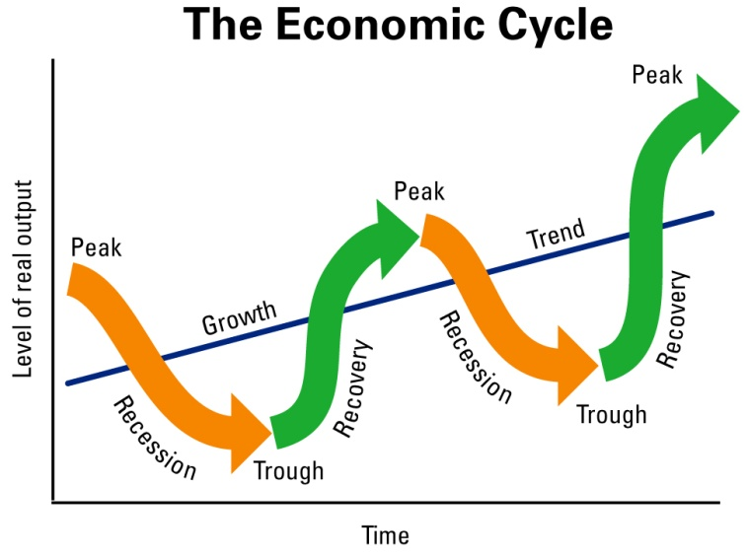
Stabilization
Tools
  Monetary (at national level - central banks)
    Discount rate (interest rates of national banks)
    Reserve requirements
    Open market operations
  Fiscal
    Public expenditures
    Public revenues (taxes)
    Budgeting of deficit

Slide 21
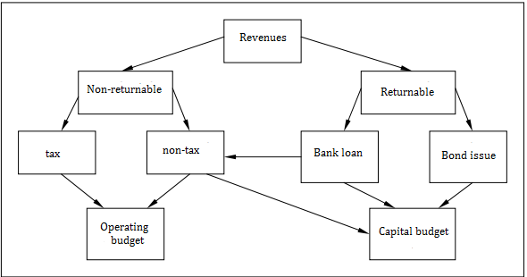
Public revenues - types

Slide 22
Public revenues – main categories
Tax revenues
Capital revenues
Subsidies
Other

Slide 23

Tax revenues
Taxes (direct and indirect taxes)
Fees
Customs duty
Social security and health insuarance

Slide 24
Categories of taxes
Direct taxes
Indirect taxes
Income tax
VAT (value added tax)
Corporate tax
Excise duty
Service tax
Wealth tax
CST (central sales tax

Slide 25
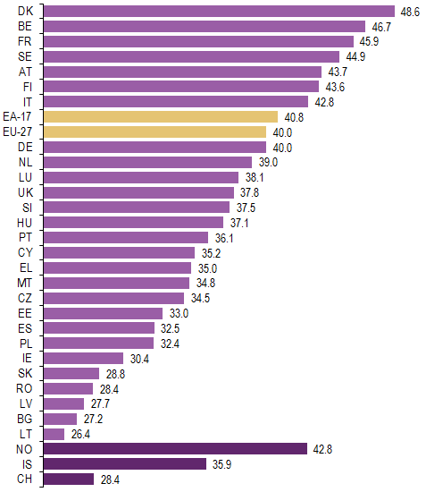
Tax revenues – tax quota
Tax revenues as a percentage of GDP = tax quota
(simple, compound)
Eurostat (Year 2011)
Worldbank
Source: Eurostat
Notes:
Eurostat: http://epp.eurostat.ec.europa.eu/statistics_explained/index.php/Tax_revenue_statistics
Worldbank: http://data.worldbank.org/indicator/GC.TAX.TOTL.GD.ZS/countries/CZ-FR-DE-US-ES-PL-GR?display=graph

Slide 26
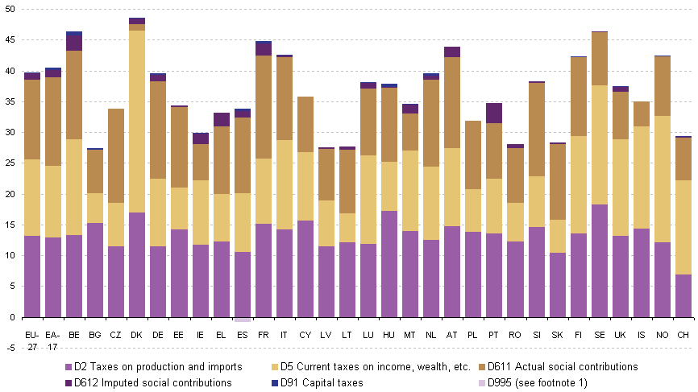
Structure of tax revenues
Source: Eurostat
Notes:
http://epp.eurostat.ec.europa.eu/statistics_explained/index.php/Tax_revenue_statistics

Slide 27
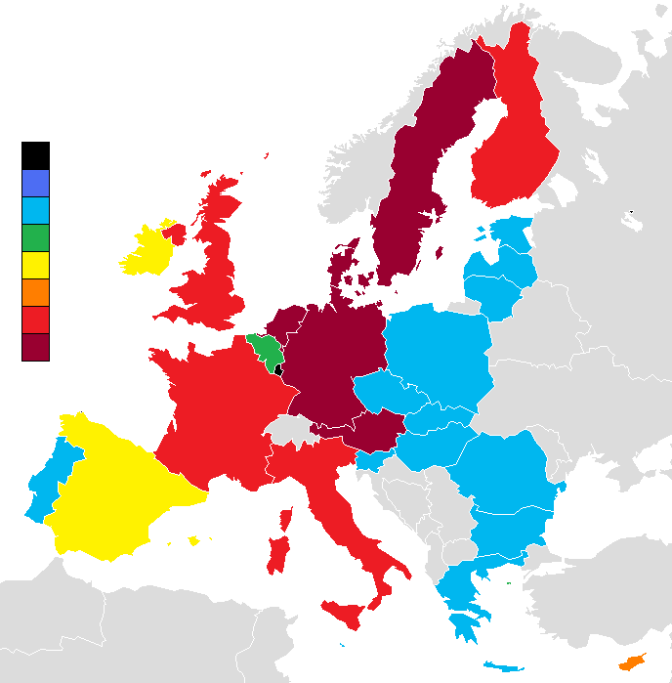
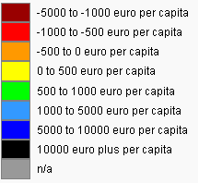
Subsidies
e. g. from European Union
Total budget expenditure in euros for the whole period 2007-2013 per capita (2007 population figures) are given below. Negative numbers indicate net contributors, positive numbers indicate net recipients.
Source: http://www.openeurope.org.uk

Slide 28

Capital revenues
Revenues from selling state property
Mostly quite small amounts
Irregular, one-time revenue

Slide 29
Other revenues
Revenues from services provided to public (e. g. Highways)
Penalties
Revenues from selling non-capital property
…

Slide 30
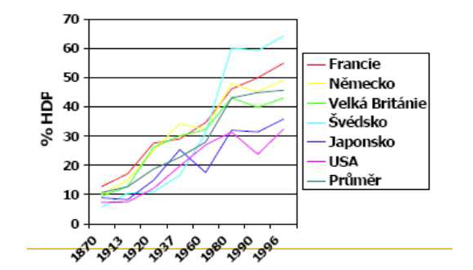
Trends in public expenditures

Slide 31
Trends in public finance
Alfred Wagner – 1890
  „Togother with growing income in economics grows the size of public sector“
Why?
  Technological changes (e. g. health care)
  Social and demographic factors
  Threshold effect (wars, floods…)
  Political reasons

Slide 32
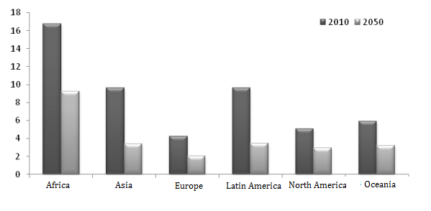
Changes in population
Changes in population (ageing, low fertility rate)–> why does it affect government spending?
The number of people in productive age (15-64 years) per person in post-productive age (65 +)
Source: International Data Base (2011)

Slide 33
Economic growth x government size
Negative relationship
diminishing returns
crowded-out effect to private investment
inefficient expenditure => distorted allocation of resources
space for corruption
Positive relationship
insurance function to private property
encourage private investment
Improve the investment environment

Slide 34
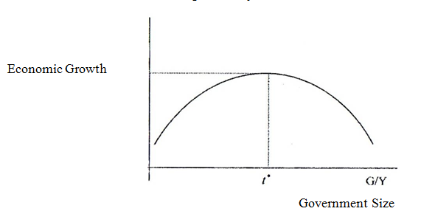
Relationship between Economic Growth and Government Size

Slide 35
Factors affecting the growth of government spending
Demographic changes (ageing, low fertility)
Increasing labour productivity and related growth of income (higher tax revenues -> higher expenditures)
Increasing living standards
Increasing unemployment rate
Technological progress (higher claims on financial resources)
Inflation
Politic and social influences (level of welfare state, populism, bureaucracy)
Demonstration effect and the related effort to cope with living standrads of neighboring countries

Slide 36
Political reasons – welfare state
Greece…
Czech republic – social security system, health care system, free education…
Your country…?

Slide 37
...thank you for your attention

