Slide 1
Budgetary Deficit and
Public Debt
Public Economics
Iveta Štarhová

Slide 2
Fiscal imbalance
What does it mean generally ?
Which factors influence it ?
Task: You have your own budget (R – E = FI)
- do you reach positive / negative FI ?
- why do you reach them ?
    Planning
    Risk (under)estimation and evaluation
    Ability to manage expenditures
    Ability to predict unexpected situations

Slide 3
Types of fiscal imbalance
Short-term FI = budget revenues differ from the budget expenditures in the certain period (budget/calendar year):
1. revenues > expenditures → surplus
2. revenues < expenditures → deficit
Long-term FI = accumulation of public deficits or surpluses and other liabilities of government → increasing or decreasing of public debt

Slide 4
Something to think about
Are public deficits bad and surpluses good ?
Does it mean that state which has public debt is not able to manage budget in proper way?

Slide 5
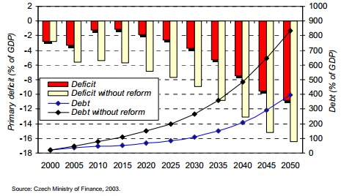

Slide 6
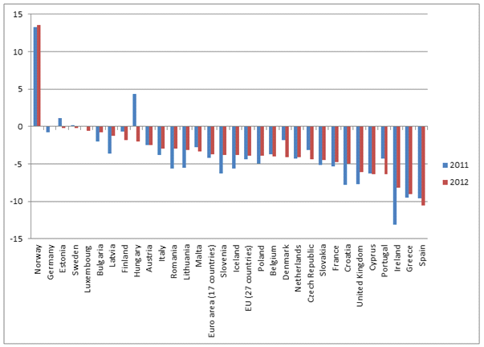

Slide 7
Formation of fiscal imbalance
Fiscal imbalance is not result only of government actions but of other factors and thus we have to identify all possible influencing factors and divide the deficit according to relevant causes.
Try to identify some factors:
1.
2.
3.

Slide 8
Formation of fiscal imbalance
Types and components (1):
Passive (Cylical) - related to the development of economic cycle (higher level of unemployment, lower public revenues, higher public expenditure)
Active (Structural) - related to the development of long-term governemnt financial management. Associated with government actions and policies.
Total budget deficit is equal to the sum of the structural (active) deficit and the cyclical (passive) deficit.

Slide 9

Components of fiscal imbalance in Czech Republic
Source: Ministry of Finance CR (2012) Fiscal Outlook

Slide 10
Formation of fiscal imbalance
Types and components (2):
Primary deficit – net deficit after deducting the interest payments from the total deficit.
Public debt interests – related to the existence of debt and associated with holding of debt.
Total budget deficit is equal to the sum of the primary deficit and interests of public debt.

Slide 11
What affects the amount of interest costs, or the interest rate, for which the state borrows the debt ?
Who lends money to the state?

Slide 12
Public debt
Long-term fiscal imbalance (negative).
Two views:
1. accumulation of deficits or surpluses
2. total sum of liabilities

Slide 13
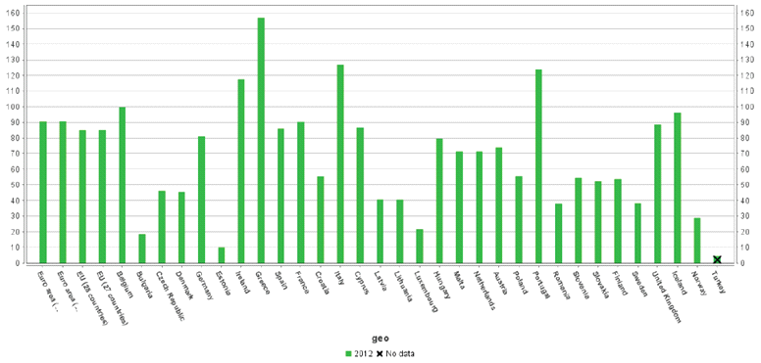
Public debt - comparison

Slide 14
Types of debt
Internal = residents lend money to the state
+ redistribution
+/- creating debt for future generations
- displacing private investments
+ creation of low-risk assets
External = foreigners lend money to the state
- national currency impacts
- exchange rates risks
- transfer

Slide 15
Types of debt
In national currency
= debt is held in domestic currency
In foreign currency
= debt is held in foreign currency
Czech Republic case:
http://www.mfcr.cz/cs/verejny-sektor/hospodareni/rizeni-statniho-dluhu/dluhova-statistika/struktura-a-vyvoj-statniho-dluhu

Slide 16
Czech debt holders
Non-financials companies 1,42 %
Financial institutions 60,01 %
Government institutions 3,75 %
Households 4,33 %
Non-profit organizations 0,26 %
Non-residents 10,48 %
Foreign bond issues 19,75 %
        Source: www.mfcr.cz

Slide 17
How to manage state debt ?
Passively
- favorable ratio of the rate of economic growth and interest rates (1+r/1+y < 1)
- not anticipated inflation
- foreign grants and aid
Actively
- budget solutions (raising taxes, cutting public spending, …)
- sale of state assets – privatization
- extraordinary tax
- monetization of debt
- political-administrative solutions (postponement of debt repayment, non-recognition of the debt)

Slide 18
International aspects of state debts
- state debt is not a local issue, there are potential impacts and implications around the world (international impacts)
- bad debt management may result in state bankruptcy (example in Argentina has led to cancel 75% borrowed funds, drastic budget cuts, growing level of unemployment, barter...)
- tendencies for external control of state finances (EU fiscal rules)

Slide 19
Thank you for your attention :-)

