Slide 1
1. TRANSPORT ECONOMICS

Slide 2
1.1. Organization

Slide 3
Course
Transportation Economics explores the efficient use of society’s scarce resources for the movement of people and goods.
This course carefully examines transportation markets and standard economic tools, how these resources are used, and how the allocation of society resources affects transportation activities.

Slide 4
Method
This course is unique in that it uses a detailed analysis of econometric results from transportation literature to provide an integrated collection of theory and applications.
Its numerous case studies illustrate the economic principles, discuss testable hypothesis, analyze econometric results, and examine each study’s implications for public policy.
These features make this a well-developed introduction to the foundations of transportation economics.

Slide 5
Lectures and seminars (2/0 + 0/2)
Transport economics
Transportation demand – the divisible goods case
Transportation demand – the discrete goods case
Firm production and cost in transport – the long run
Firm production and cost in transport – the short run
Competition, concentration and market power in transport

Slide 6
Empirical Project
The major task will be to write an empirical project in transport economics.
Deadlines:
30th October …. Proposal
30th December ….. Project

Slide 7
Structure of proposal (recommended)
A concise statement of the problem
Comments on the information that is available with one or two key references
A description of the research design that includes
a) an economic model
b) the econometric estimation and inference methods
c) data sources
d) estimation, hypothesis testing and prediction
The potential contribution of the research

Slide 8
Structure of project (recommended)
Statement of the problem
Review of literature
The economic model
The econometric model
The data
The estimation and inference procedures
The empirical results and conclusions
Possible extensions and limitations of the study
Acknowledgements
References

Slide 9
Exam
Evaluation:
20% - seminar’s activity
40% - defense of empirical project
40 % - exam from transport economics

Slide 10
Contact
Zdeněk Tomeš
tomes@econ.muni.cz

Slide 11
1.2. Transport and the Economy

Slide 12
What is transport economics?
Transport economics is an applied area of economics that is concerned with the efficient use of society’s scarce resources for the movement of people and goods from an origin to a destination.

Slide 13
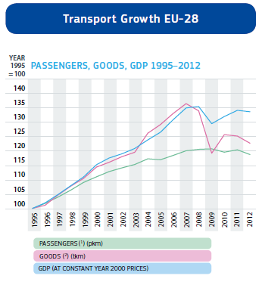
Transport and GDP
Decoupling of economic and transport growth
Freight and passenger traffic growth
The impact of world recession

Slide 14
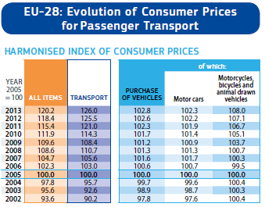
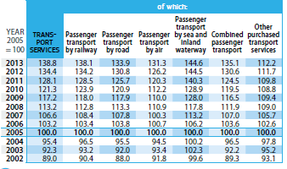
Transport and Prices
Do transport prices grow more quickly than other prices in the economy?
Why?

Slide 15
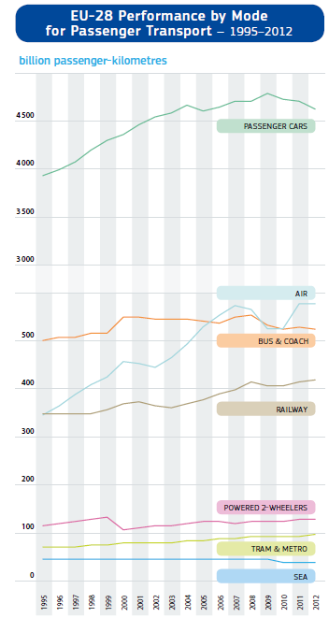
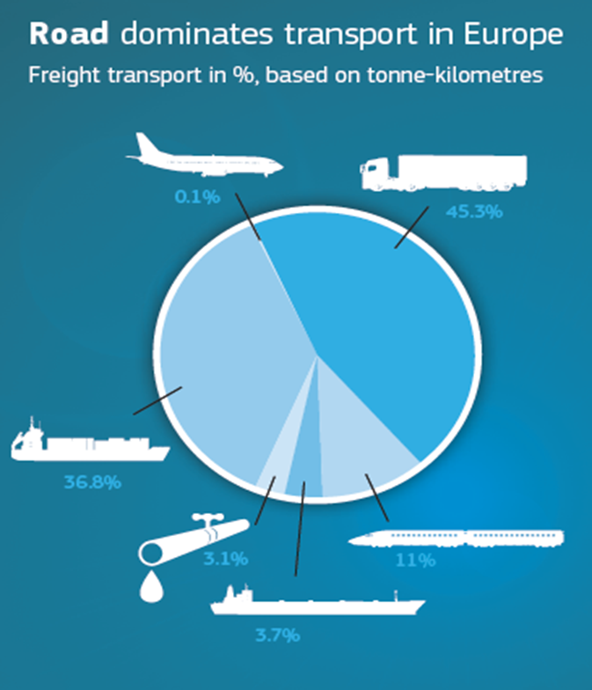
Transport Performance

Slide 16
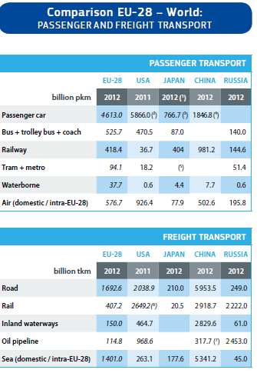
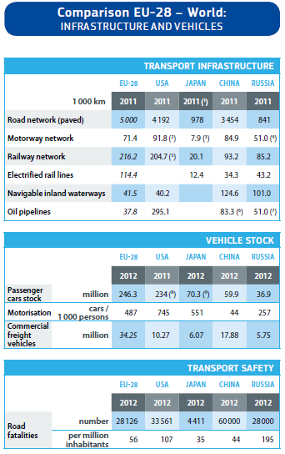
World Comparison

Slide 17
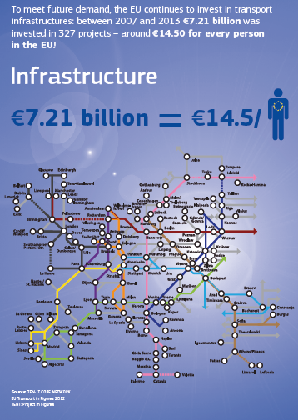
Transport Infrastructure
The state must provide the needed physical capital in the way of roads, rail trackage, airports, ports and other infrastrucutre in order to facilitate the movement of people and goods across space.

Slide 18
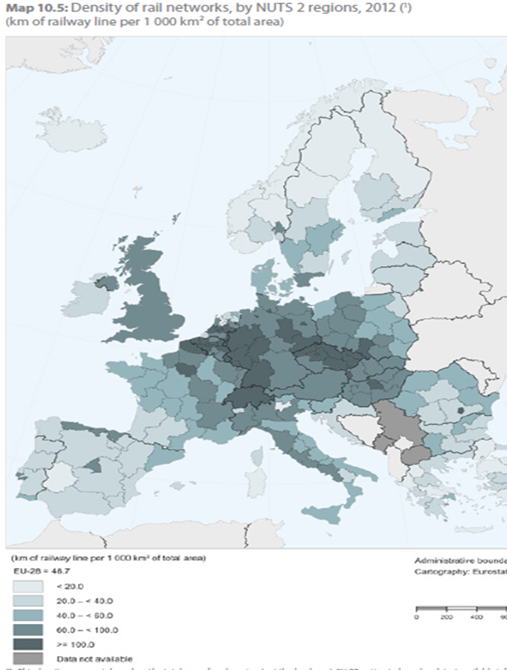
Quality of transport infrastructure
How extensive are these networks and are they keeping up with the transport demands of the public?
How well is the nation’s transportation network meeting the performance needs of shippers and travelers?
Are users receiving safe and reliable service or is the system providing deteriorating services?

Slide 19
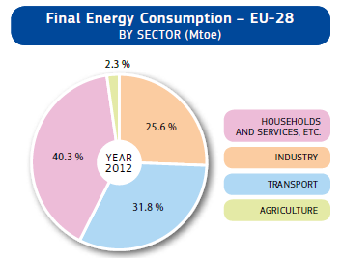

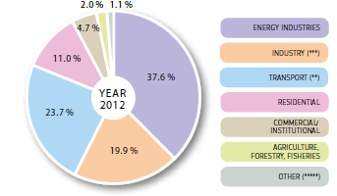
Transport and Energy
In addition to its impact upon the economy and employment, transportation is a major user of energy
Although transportation is a huge consumer of fuels, there have been dramatical technological imrovements in energy efficiency

Slide 20
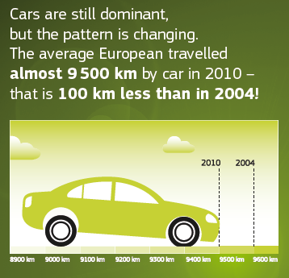
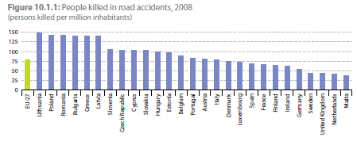
Transport Challenges
Safety
Mobility
Economic growth and trade
The human and natural enviroment

Slide 21
1.3. The statistical analysis of economic relations

Slide 22
Economic model
Economic model – simplified description of behavior which purports to identify primary cause and effect relationships between economic variables
Economic models are:
      Explanatory
      Representative
      Qualitative
Models are useful in formulation of policy because they identify the important causal linkages between economic variables.

Slide 23
Econometric model
An econometric model is a statistical specification of an economic model that enables the analyst to quantify the economic relationships identified in the theoretical framework.

Slide 24
An Econometric Model of Airline Demand
To illustrate the relationship between an economic and econometric model, consider the following economic model of the demand for airline passenger miles:
Miles = f(Price per Mile, Per Capita Income)
= β₁ + β₂ Price Per Mile + β₃ Per Capita Income + ε

Slide 25
Least Squares Regression
The method of obtaining parameter estimates by minimizing the sum of squared residuals is referred to as the method of least squares.
The least squares estimator is the formula that is used to produce the least squares estimate.
OLS estimator is unbiased, consistent and efficient

Slide 26
Estimating the Demand for Airline Travel
Hypotheses:
All else constant, an increase in Price per Mile is expected to reduce the quantity of passenger miles demanded
All else constant, an increase in Per Capita Income is expected to increase the demand for airline travel
OLS estimation:
Miles = 15.7 - 8.7 Price Per Mile + 0.031 Per Capita Income

Slide 27
Confidence Intervals
Each estimated coefficient is a random variable that has an associated probability distribution
A standard method that is used for determing how close each coefficient estimate is to the true parameter values is to construct a confidence interval around our estimate

Slide 28
t statistics
It can be shown that statistics (β_{i} – β_{i})/s_{βi} has a t- distribution with degrees of freedom equal to the sample size minus the number of parameters estimated.
s_{βi} is the square root of the estimated sample variance and is referred to as the standard error of the estimate.
If we want to construct a 95% confidence interval, than we want to identify lower and upper bound numbers for the true parameter value

Slide 29
Confidence Intervals for Airline Travel
Miles = 15.7 - 8.7 Price Per Mile + 0.031 Per Capita Income
(1.0) (0.0013)
Confidence intervals:
Price per Mile (-10.80; -6.60)
Per Capita Income (0.0284; 0.0337)

Slide 30
Hypothesis tests
A major objective of many empirical studies is to test hypothesis regarding the relationship between the dependent and independent variables.
The methodology for hypothesis testing first requires that we identify two hypotheses, a null hypothesis (H_{o}) and an alternative hypothesis (H_{a})
H_{o}: β = 0
H_{a}: β ≠ 0

Slide 31
Issues in hypotheses testing
One tail and two tail tests
Type I and Type II error
Significance level (1%; 5%; 10%)
Reject x Not reject null hypothesis

Slide 32
Goodness of fit and R2
In addition to examining whether our estimated model is consistent with the implications of economic theory, it is of interest to know how well model fits the data.
R2 = goodness of fit = the statistics that gives the proportion of variation in the dependent variable that is due to all of the explanatory variables in the model

Slide 33
Cross section and time series data
Cross section data reflect observation on individuals, households, firms, countries, or some other unit of analysis at a given point of time. Usual problem: heteroscedasticity → solution: robust standard errors.
Time series data are different because each observation corresponds to a different time period. Problem (1): autocorrelation → solution: robust standard errors. Problem (2): unit roots → risk: spurious regression → solutions: trend inclusion; differencing, cointegration.

Slide 34
Model specification
A time trend is a variable that is included in time series models to capture the influence of factors that are correlated with time but are excluded from the model because they are either unquantifiable or the data are unavailable. A time trend is often use to reflect technological change.
A dummy variable is a variable that either has a value of 0 or a value of 1. It is often use for analysis of structural changes.

Slide 35
Functional Form

Slide 36
Marginal effects

Slide 37
Elasticity measures

Slide 38
The Airline Demand Model Revisited

Slide 39
The Airline Demand Model Revisited

Slide 40
Elasticity measures

Slide 41
1.4. Summary

Slide 42
Summary (1)
An economic model identifies the most important factors that explain the behavior of some underlying economic variable of interest. Economic models are explanatory, generally characterize average behavior, and identify the qualitative relationships between variables.
An econometric model is a statistical model that enables one to quantify the casual relationships identified in an economic model. Econometric models are used to make statistical inferences on the importance of “explanatory variables” in explaining the variation in the “dependent” variable.

Slide 43
Summary (2)
A common method for estimating parameters in an econometric model is the method of least squares. The “least-squares estimates” are estimates of an empirical model’s parameters obtained by minimizing the sum of squared errors from a sample of observations. Least-squares estimators are unbiased, consistent, and efficient.

Slide 44
Summary (3)
Hypothesis tests are used to statistically determine whether variation in an explanatory variable explains at least part of the variation in a dependent variable. All hypothesis tests involve a null hypothesis, which identifies an hypothesized true value of the parameter, and an alternative hypothesis. If the alternative hypothesis specifies a two-sided effect (positive or negative), the hypothesis test is two-tailed; if the alternative hypothesis specifies a one-sided effect, the hypothesis test is one-tailed.

Slide 45
Summary (4)
In regression models, t-statistics are used to test hypotheses on the statistical significance of the explanatory variables. In large samples (more than 120 degrees of freedom), if the calculated t-statistic under the null hypothesis was greater than 1.960 (2.576) in absolute value, then we would reject the null hypothesis at a 0.05 (0.01) level of significance. On a one-tail test, we would reject the null hypothesis at a 0.05 (0.01) level of significance if the calculated t-statistic was greater than 1.645 (2.326) in absolute value.

Slide 46
Summary (5)
A regression model’s goodness of fit gives the proportion of variation in the dependent variable which is “explained” by explanatory variables included in the empirical model.
Cross-section and time series data are common forms of sample information used to estimate empirical models. Cross-section data provide information on observations units at a point in time. Time series data provide information on an observation unit over a period of time.
Common statistical specifications for estimating empirical models are testing hypotheses on economic relationships include the linear model, the log–linear model, the linear–log model, and the double–log model.

