Slide 1
4. FIRM PRODUCTION AND COST IN TRANSPORTATION
The long run

Slide 2
4.1. Theory

Slide 3
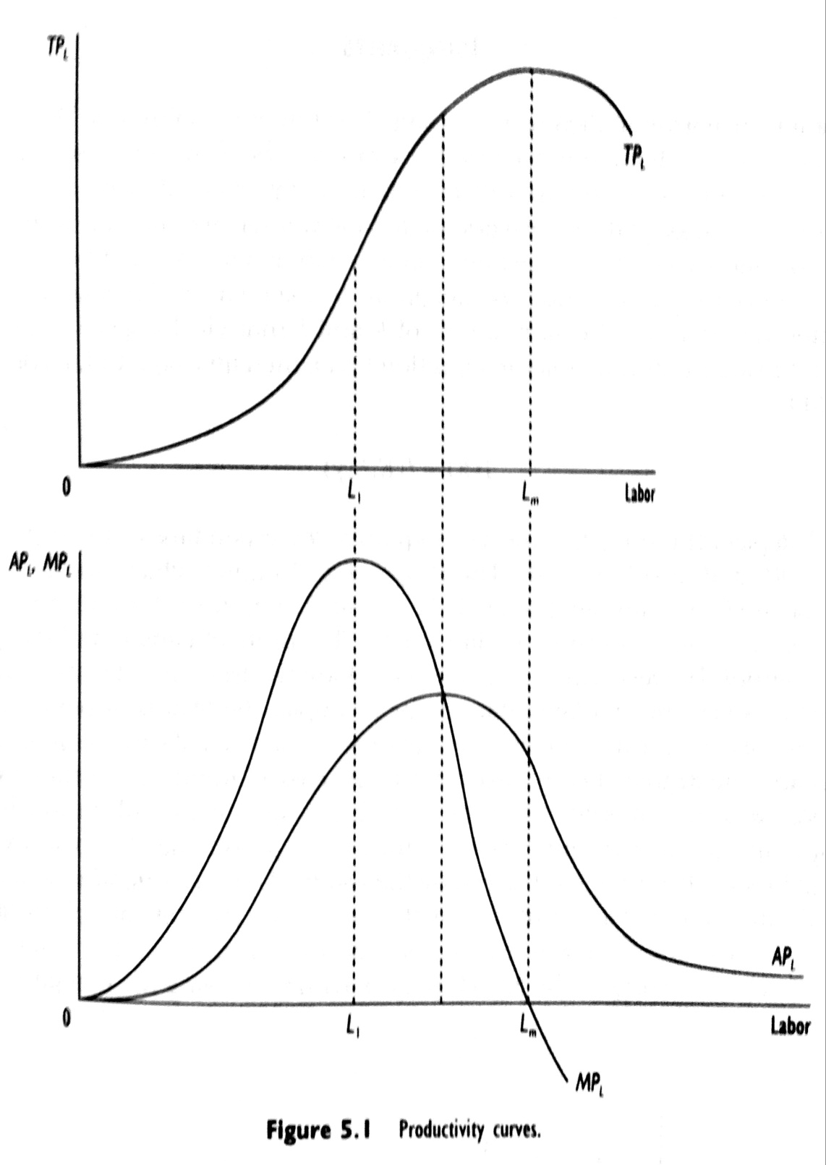
Productivity curves

Slide 4
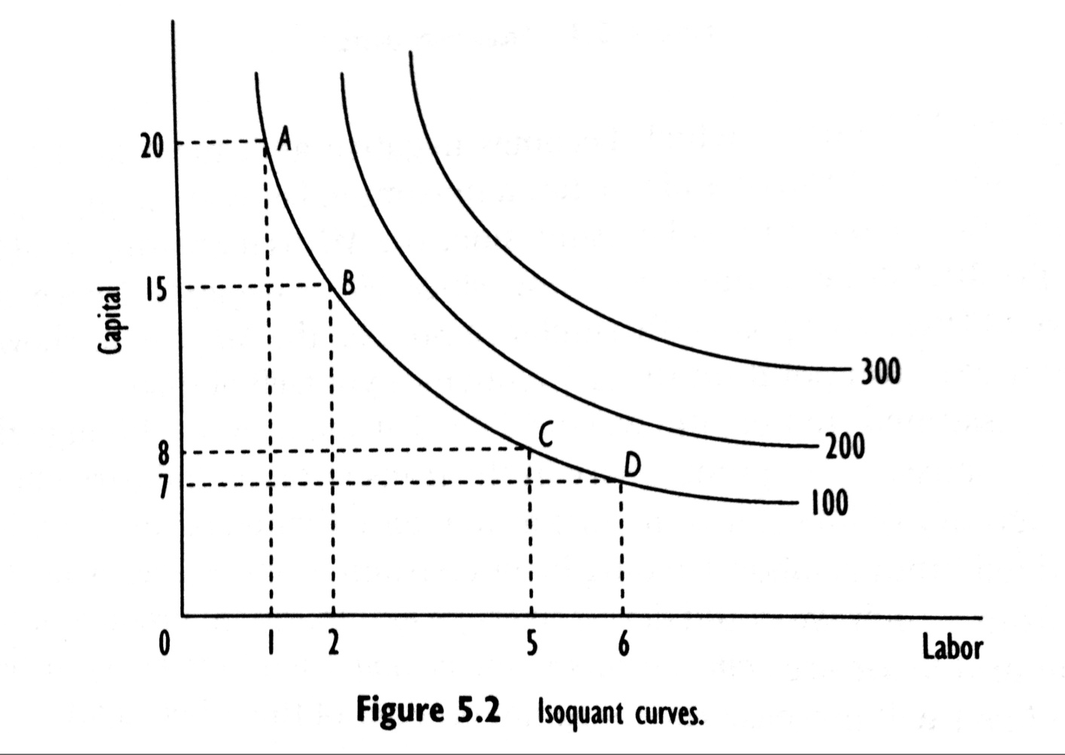
Isoquants

Slide 5
Elasticity of substitution
The elasticity of substitution is defined as:
and interpreted as the percentage change in he capital/labor ratio that results from a 1% increase in the marginal rate of technical substitution.

Slide 6
Returns to scale
sT = MP_{L}L + MP_{K}K
where s is a return to scale parameter (RTS). For s=1, the firm is operating under constant RTS; s >1 implies increasing RTS and s < 1 decreasing RTS.
s = MP_{L}(L/T) + MP_{K}(K/T) = MP_{L}/AP_{L} + MP_{K}/AP_{K} = E_{T,L} + E_{T,K}
RTS in production is the summation of individual output elasticities with respect to labor and capital.

Slide 7
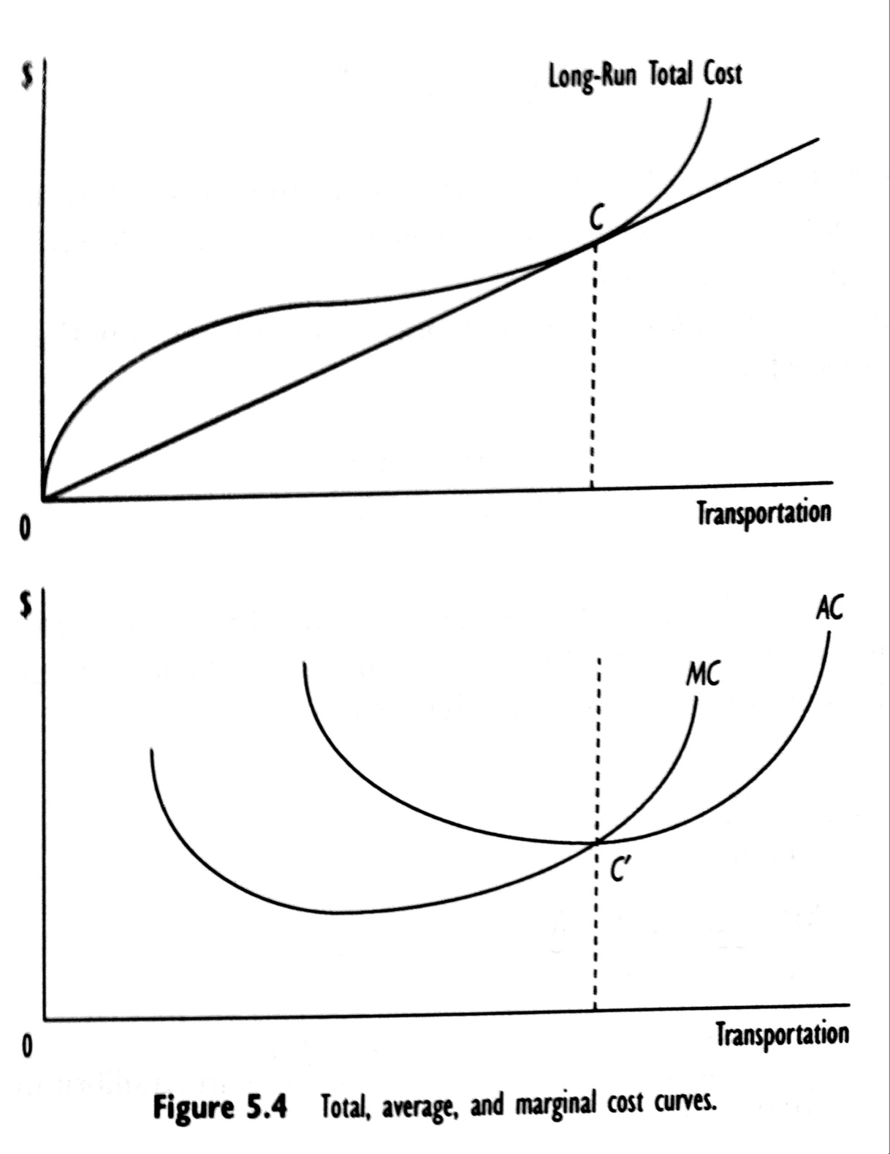
Long run costs curves

Slide 8
Returns to scale and long run costs
where E_{C,T} is the elasticity of total cost with respect to output E_{C,T} = ∆C/∆T * T/C

Slide 9
The relationship between economies of scale and cost elasticity
Former equation tells us that, for constant input prices, there is an inverse relationship between production RTS and elasticity of total cost with respect to output:
Therefore, analysis of firm cost s provides economically relevant information on a firm’s production technology without having to separately estimate a firm’s production function.

Slide 10
Input demands and Shephard’s lemma

Slide 11
Elasticity of substitution and long run costs
In equlibrium, the marginal rate of technical substitution equals the input price ration. Thus the elasticity of substitution between capital and labor $σ_{KL}$ can be expressed as:

Slide 12
Alternative measures of cost elasticities in transport
Economies of scale
Economies of capital stock utilization
Economies of traffic density and generalized economies of scale

Slide 13
The long run market supply function
Assuming that there are F firms in the industry and summing over each of these firms gives the long run market supply function:

Slide 14
Changes in long run market supply

Slide 15
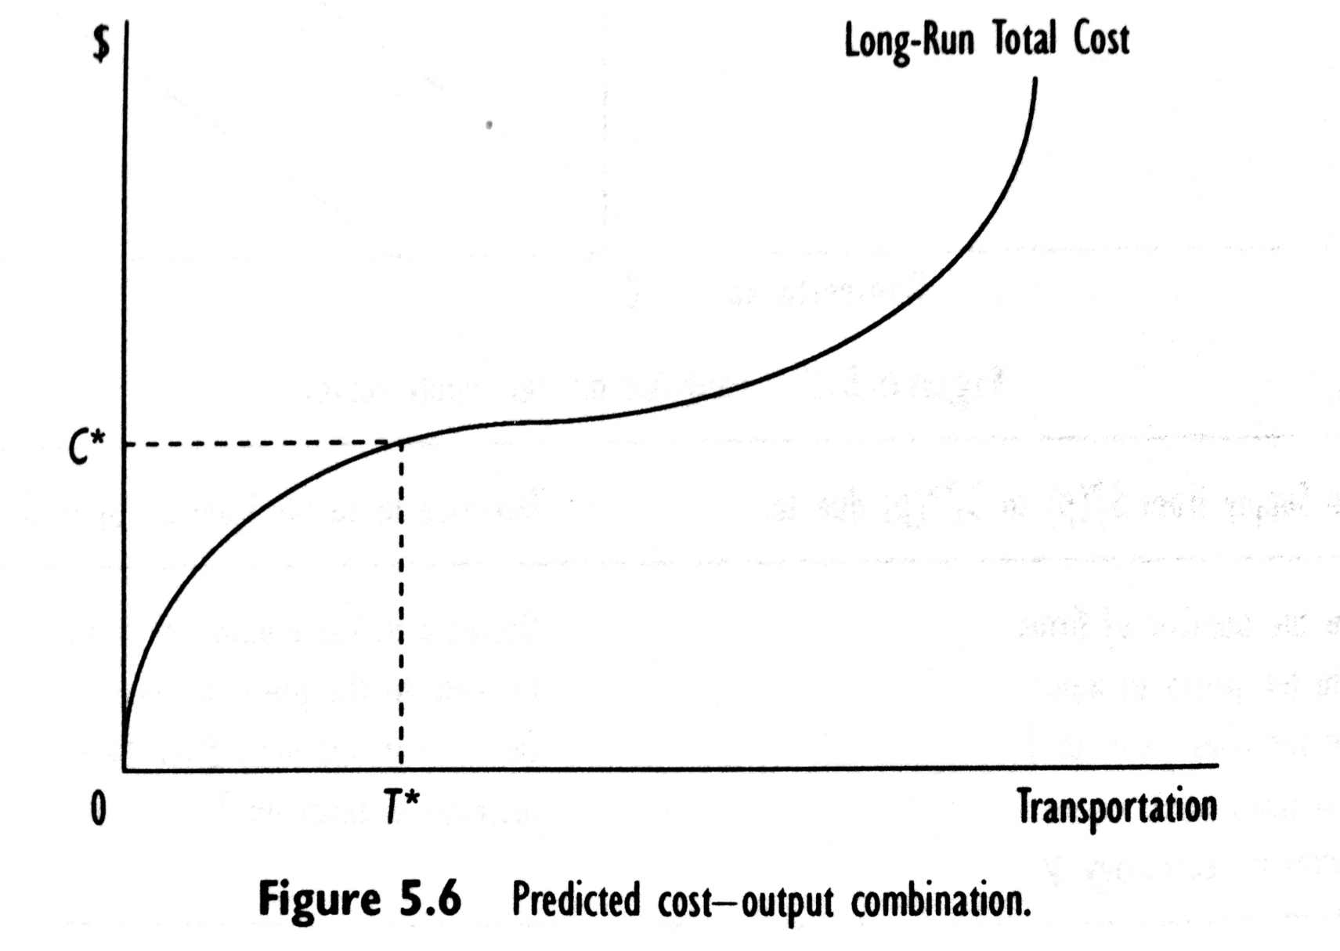
Estimating long run cost functions

Slide 16
Leontif (fixed proportions) cost function

Slide 17
Cobb Douglas cost function

Slide 18
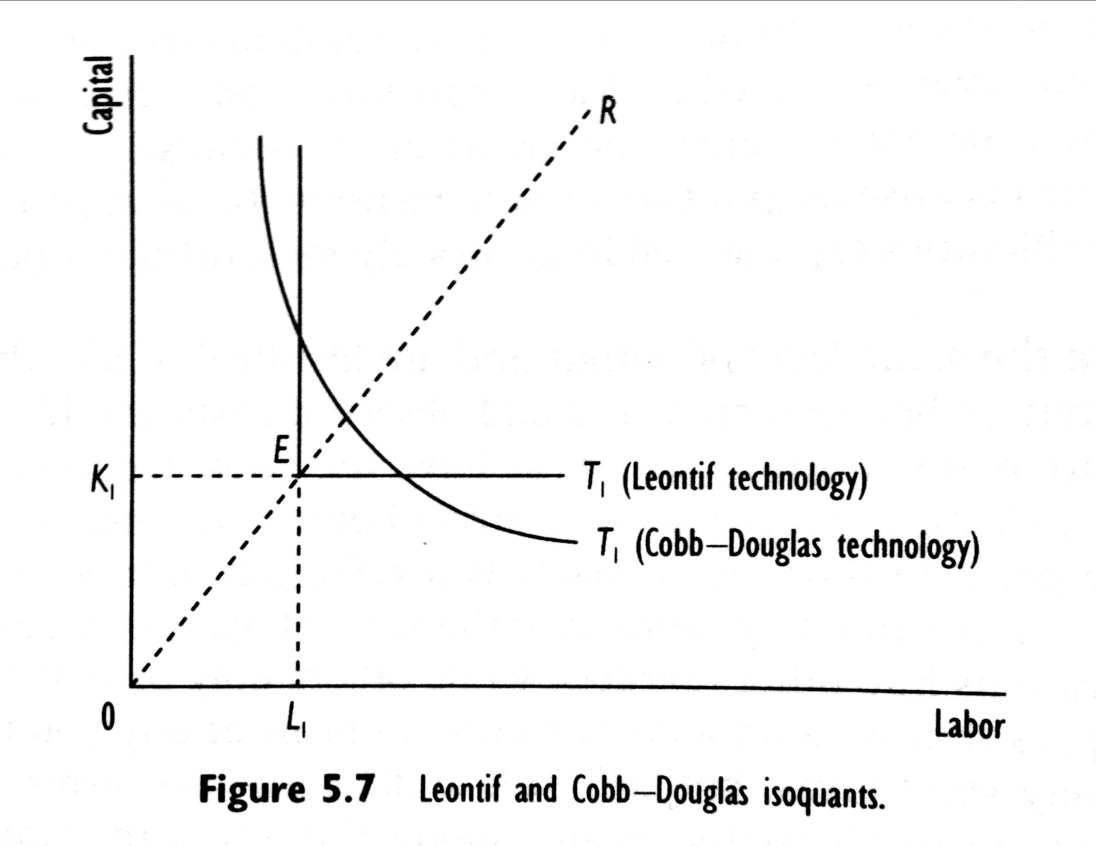
Leontief and Cobb-Douglas isoquants

Slide 19
Flexible cost functions (translog)

Slide 20
Flexible cost functions (translog)

Slide 21
Intercity freight movements in the US

Slide 22
Motor carriers costs and production technology under regulation
Economic regulation of motor carrier activities during 1935 – 1980
Two types of cargo: truckload (TL) carriers and less than truckload carriers (LTL)
LTL find it advantageous to invest in terminal facilities (no need in TL sector)
Underlying technologies and costs different in TL and LTL sector
Two analyses of motor carrier cost and technology in regulated environment.
The first study focus upon TL sector, while the second upon LTL sector

Slide 23
4.2. Regulated truckload carriers

Slide 24
Specification
McMullen and Stanley (1988) estimated a translog flexible cost function for specialized commodity (TL) motor carriers. In abbreviated form, their empirical cost function is:

Slide 25
Hypotheses
The truckload sector operates under constant returns to scale → α₁ = 1
An increase in the price of any input increases all else constant, long-run total costs. Thus, we expect: α₂ > 0; α₃ > 0; α₄ > 0; α₅ > 0. From Shephard’s lemma: α₂+α₃+α₄+α₅ = 1
Average load per vehicle reflects increased capacity utilization; longer hauls are expected to have lower costs and higher insurance is a proxy for high value or perishable goods. Therefore we expect: α₆ < 0; α₇ < 0; α₈ > 0.

Slide 26
Estimation results

Slide 27
Estimation results

Slide 28
Interpretation
Firms are operating under increasing rather than constant RTS
Each of the price coefficients is positive and significant.
The results for firm operating characteristics are mixed.

Slide 29
Elasticities

Slide 30
Discussion
What are long-run total costs?
Increasing RTS under regulation and constant RTS after deregulation?
The elasticities of substitution are neither equal to zero or one, therefore use of flexible cost function is appropriate (unlike Leontif or Cobb-Douglas)
The relationship between output and long run total cost reflects a movement along the long run total cost curve. Changes in any of the other variables reflects change in the location of the curve.

Slide 31
4.3. Regulated general freight carriers

Slide 32
Introduction
The results presented for the TL sector characterize specialized commodity motor carriers firms as operating under increasing RTS and whose underlying technology enables firms to substitute between their owned inputs and purchased transportation.
Would we expect to see similar cost and technological characteristics for general freight services? – No, since general freight services require a network of origin and destination terminals.

Slide 33
Hypotheses
H₀: LTL and TL motor carriers have identical cost structures and production technologies
H₁: LTL and TL motor carriers have different cost structures and production technologies

Slide 34
Estimation results

Slide 36
Interpretation
In contrast to specialized commodity carriers, firms in the LTL sector operate under constant RTS
What is the effect of deregulation?
The share of labor is much higher in LTL sector due to more handling
Operating characteristics in both sectors have same signs but different magnitudes

Slide 37
Elasticities

Slide 38
Final comments
At the sample mean, the TL sector operated under increasing RTS, whereas LTL sector under constant RTS.
On average capital, fuel and purchased transportation were more important in the production of TL than LTL transportation services. On the other hand, labor played a more important role in providing LTL services.
For both sectors, all inputs were substitutes in production. However demand for purchased transportation was more elastic in TL, whereas labor, capital and fuel were more easily substitutable in LTL.
Technological differences reflected by firm operating characteristics differed between the two sectors.

Slide 39
4.4. Airline cost and production under regulation

Slide 40
Introduction
After WWII, rapid growth in airline passenger traffic
From the beginning of government involvement in the airline industry, an explicit aim was to foster the industry’s growth
The main provision of the regulation dealt with market access, route restrictions, rate-setting and subsidization.

Slide 41
Control of entry/exit
The regulators tightly controlled entry into and exit from the market
The carriers that provided intercity air service in 1938 were granted operating authority and between 1938 – 1975 there was no new allowance to entry
Exit from the industry was as difficult as entry because air carriers were mandated to provide adequate service
Over time firms found, that mergers were the quickest way to effectuate entry and exit.
Of the 16 trunk lines granted authority, 11 remained at the beginning of 1970.

Slide 42
Route and rate restriction
The regulation aimed to stabilize the indsutry by equalizing profitability across firms.
There was a regulation of non-stop services and opening new markets (new routes)
Rates were requied to be just, reasonable and non-discriminatory
Rates were deemed to be too high if they led to inordinately high rates of return on investment and unjustly low if they affected the financial health of a competing carrier.

Slide 43
Subsidization
Although the regulation severely restricted entry and exit into the major trunkline routes, it experimented with entry info feeder markets, giving temporary operating authority to local carriers to provide subsidized short-haul service from smaller communities to the larger markets served by the trunk carriers
During time, temporary authority became permanent and sometimes overlapped with the more profitable trunkline routes in order to stem the growing level of subsidies paid to local carriers.
As a result, in the period after permanent certification, local carriers evolved into a group of larger regional carriers that competed with trun carriers.

Slide 44
US providers of air transport services, 1970

Slide 45
Specifications of costs for regulated air carriers
Becuse differences in the markets, the size if aircraft used, average stage length and average load, local carriers may face different cost strucutres, and hence technologies, than trunk carriers
Consistent with this is the belief that the trunk carriers operate under constant RTS, whereas the local carriers operate under increasing RTS.
If true, the implicationis that larger size of operations of trunk carriers gives them competitive advantage and that local carriers will be able to reduce unit costs if allowed to increase their scale of operations.

Slide 46
Specification
Caves, Christiansen and Tretheway (1984) estimated a general model of total airline costs based upon trunk and local carriers operating from 1970 through 1981, a total of 208 observations.
The empirical cost model is a flexible translog model which includes translog transformations of Output, Prices of inputs, operating characteristics and network characteristics.

Slide 47
Hypotheses
Air carriers operate under constant RTS
There exist increasing returns to traffic density where the size of the carrier’s network is held fixed.
The coefficients of the input prices will be positive.
It is expected that increases in Average Stage Length and Average Load will decrease long run total costs.

Slide 48
Estimation results

Slide 49
Estimation results

Slide 50
Elasticities

Slide 51
Trunks versus local carriers under regulation

Slide 52
Policy implications
It is possible for the smaller local carriers to compete with the much larger trunk carriers?
The uit costs of local carriers are 44% higher than those of trunk carriers.
The reasons are density of service and stage length.
The implication from these results is that local carriers want to exploit economies of traffic density and economies of distance.

Slide 53
4.5. Summary

Slide 54
Summary (1)
Given the existing technology, a firm‘s production function is the maximum amount of output that a firm can produce from a given quantity of inputs. If all inputs to the firm are variable, the firm is in the long run; if some inputs are fixed, the firm is in the short run.
The elasticity of substitution, defined as the percentage change in an input ratio due to a percentage change in the marginal rate of technical substitution, reflects the ease with which a firm can substitute among inputs in the production process. If a proportional increase in all variable inputs raises output (less than, more than) proportionately, then the firm is operating under constant (decreasing, increasing) returns to scale.

Slide 55
Summary (2)
A firm minimizes its cost of production by using inputs up to the point at which the marginal rate of technical substitution equals the input price ratio. A firm‘s total cost function is the minimum cost necessary to produce a given amount of output. A firm‘s minimum efficient scale is that level of output corresponding to the minimum point on a firm‘s average cost curve. At this point, the firm is operating under constant returns to scale.

Slide 56
Summary (3)
Knowing a firm‘s cost function provides information on the firm‘s underlying production technology. The inverse of the elasticity of total cost with respect to output measures a firm‘s economies of scale. By Shepard‘s lemma, the elasticity of total cost with respect to input price is the conditional optimal share of the input‘s expenditures in total costs. The long-run total cost function also provides information on the elasticity of substitution among inputs.
In addition to economies of scale, transportation firms also experience economies of traffic density, economies of capital utilization, and economies of network size.

Slide 57
Summary (4)
Empirically, there exist several cost function models to characterize transportation activities. The most restrictive is the Leontif cost function model, which assumes constant returns to scale and no substitutability among inputs. The Cobb-Douglas cost function model allows for nonconstant returns to scale and input substitutability, but the elasticity of substitution is constrained to equal one. The least restrictive cost function model is the translog cost function, which allows for nonconstant returns to scale and places no restrictions on substitutability among inputs.

Slide 58
Summary (5)
The motor carrier industry comprises two basic sectors, the truckload or specialized commodity carrier and the less-than-truckload or general freight carrier sector. By having to consolidate and break-bulk shipments, the less-than-truckload sector has a different production technology than the truckload sector.
Economic regulation of the motor carrier industry began with the Motor Carrier Act of 1935, which regulated firm entry, rates, routes, and goods carrier. Many of these regulations were significantly relaxed in the Motor Carrier Act of 1980.

Slide 59
Summary (6)
A case study of the truckload sector of the motor carrier industry under economic regulation found that truckload firms operated under increasing returns to scale, which is inconsistent with the competitive nature of this sector but consistent with regulatory-based economies of network size. This sector was less labor intensive and relied more on purchased transportation. Input demands for labor, capital, and fuel in this sector were inelastic. But the demand for purchased transportation was elastic. The elasticities of substitution indicated that all inputs were substitutes. The greatest opportunities for input substitution occurred with purchased transportation.

Slide 60
Summary (7 – 1/2)
A case study of the less-than-truckload sector under regulation confirms that differences in production technology exist between this sector and the truckload sector. Less-than-truckload firms operated under constant returns to scale, holding network size constant. However, there was also evidence of generalized returns to scale in this sector, which indicated that a proportional increase in output and network size increased costs less than proportionately. This sector was more labor intensive than the truckload sector and relied much less on purchased transportation. Firms’ costs in this sector were sensitive to shipment size, length of haul, and value of commodity shipped. (…)

Slide 61
Summary (7 – 2/2)
(…) Factor demands, including purchased transportation, were inelastic. Similar to the truckload sector, all inputs were substitutes. However, in contrast to the truckload sector, there were greater substitution possibilities among fuel, capital, and labor inputs, but fewer opportunities for substitution between each of these inputs and purchased transportation.
Economic regulation of the US airline industry began with the Civil Aeronautics Acts of 1938, which controlled firm entry and exit, route operating authority, and fares. Economic regulation continued until passage of the Airline Deregulation Act in 1978

Slide 62
Summary (8)
A case study of trunk and local airline costs during the 1970s indicated that air carriers operated under economies of density. Further, during this period, air carriers operated under general constant returns to scale; that is, a proportional increase in output and network size, all else constant, increase costs proportionately. Air carrier operations were relatively capital intensive, with 48 % of total cost expended on capital. In the form of lower costs, air carriers benefited from high average loads and longer stage lengths. Factor inputs were price inelastic, and relatively few possibilities appeared to exist for input substitution between capital and labor or capital and fuel. Labor and fuel were complements in production.

Slide 63
Summary (9)
A comparison of trunk and local air carriers during the transition to deregulation indicated that local carriers experienced unit costs that were more than 40 % higher than those of trunk carriers. This can be attributed to significant differences in traffic density between the two sectors, as well as to the longer stage length of the trunk carriers.

