Slide 1
5. Firm Production and Cost in Transportation – The Short Run

Slide 2
5.1. Theory

Slide 3
Short run – level of capital fixed
In the short run at least one factor of production is fixed (we assume capital)
In the short run, a discussion of returns to scale is no longer relevant, since all inputs cannot change in the same proportion.
Adding more workers to a fixed amount of capital reduces MP_{L} = law of diminishing returns.

Slide 4
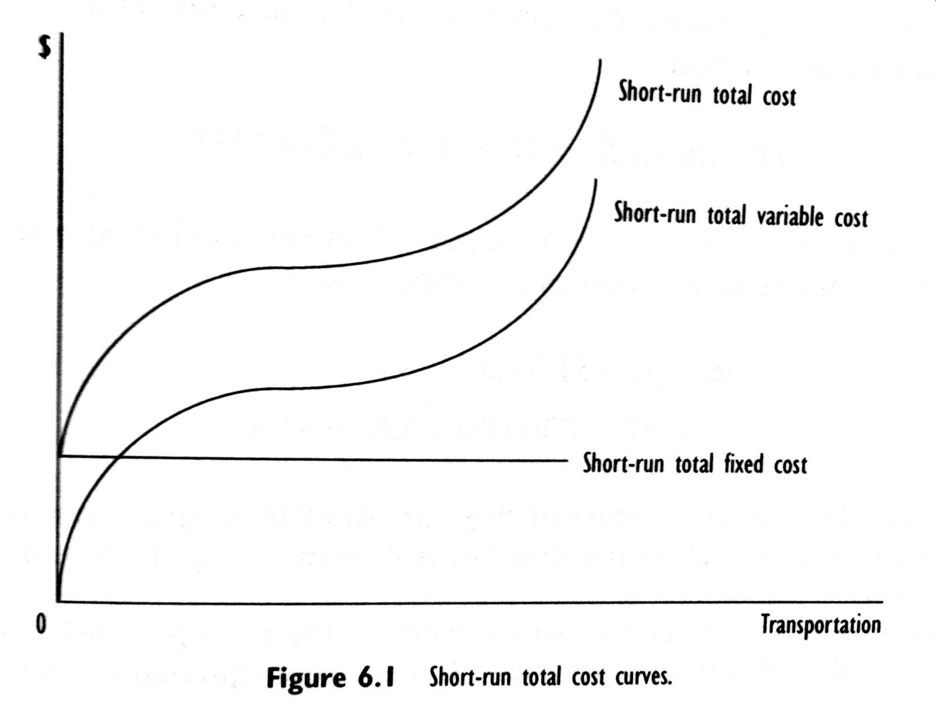
Short run cost curves

Slide 5
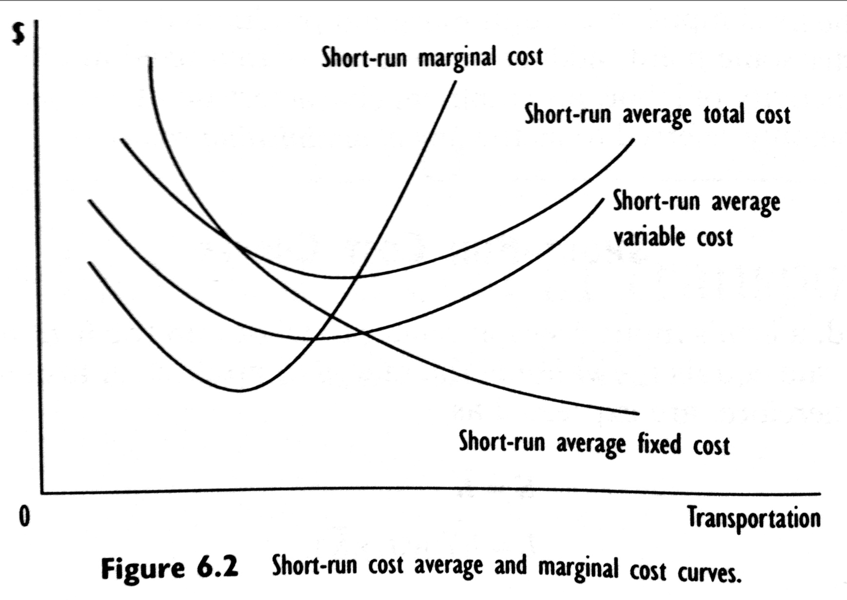
Short run cost curves

Slide 6
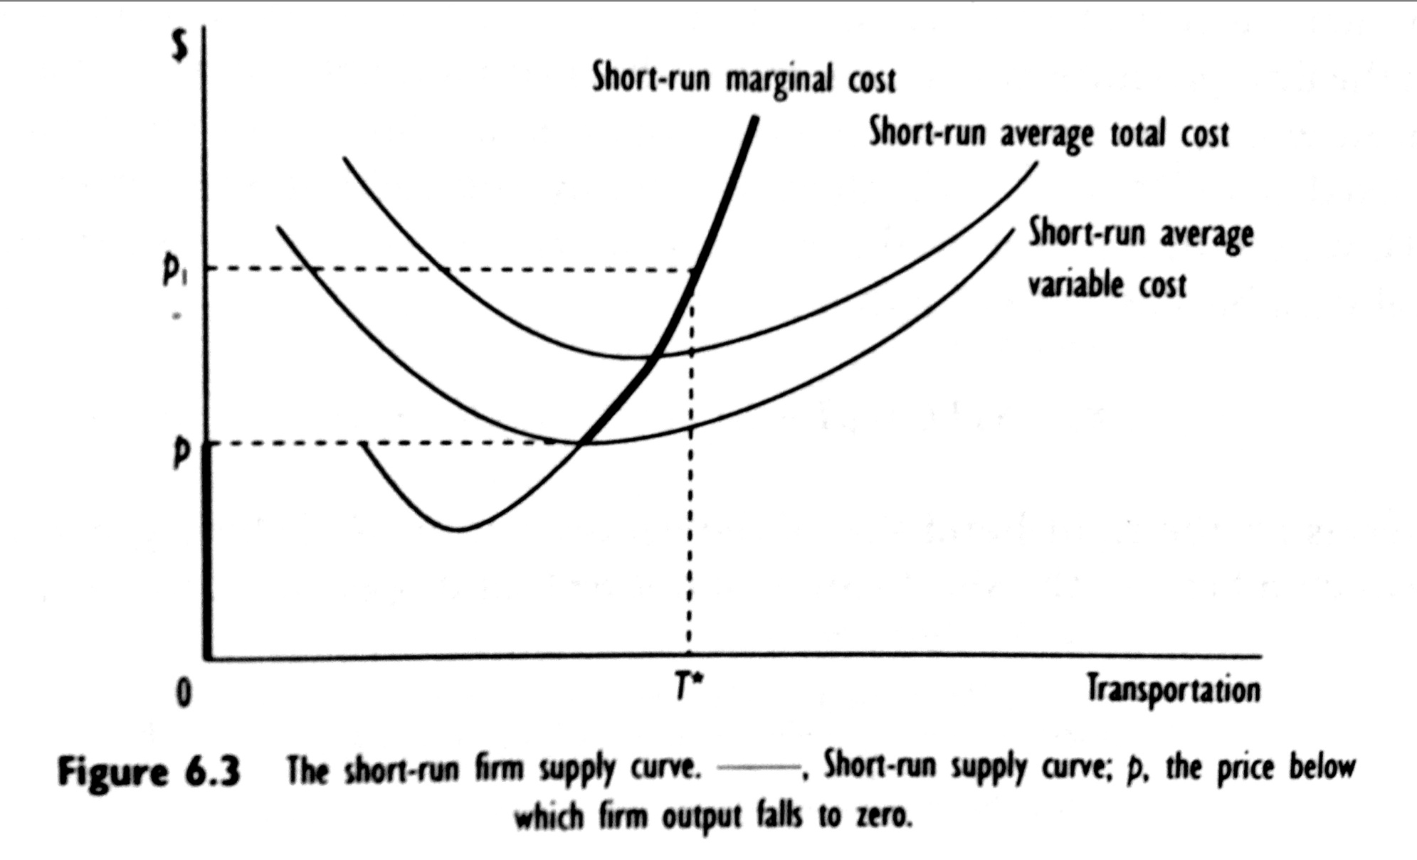
Short run market supply

Slide 7
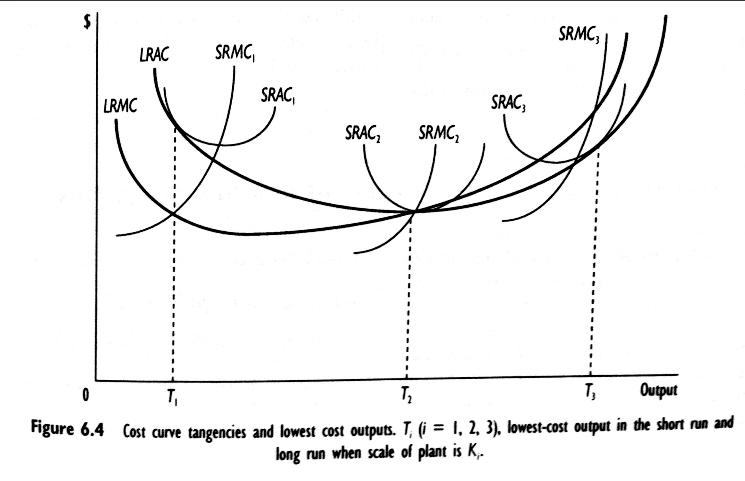
The relationship between short run and long run costs

Slide 8
5.2. Short run variable costs in the railroad industry under regulation

Slide 9
Rate setting
Railroad regulation in the USA after 1887 required railroads to charge just and reasonable rates and specifically banned a variety of pricing practices (discrimination tariffs, preference tariffs, long hails tariffs, pooling).
All rates and fares had to be publicly available
Regulator: Interstate Commerce Commission (ICC)

Slide 10
Research questions
The presence of large fixed costs leads to an important question regarding a railroad’s optimal strategy for competing with other intercity modes for freight traffic.
Is the railroad industry characterized by short-run increasing returns to density and, if so, can railroads significantly reduce their average variable costs by more efficiently utilizing fixed factors of production?
Braeutigam et al. (1984) explored these and some other questions in a study on the short-run cost structure for a large Class I railroad during a 35-month period from January 1976 through November 1978.

Slide 11
Specification
The short run total variable costs depend upon output, input prices, the fixed factor of production, and technology. In their analysis of rail costs, Braeutigam et al. (1984) specified the following translog empirical total variable cost model:

Slide 12
Definition of variables
Output – this is measured as the Number of Carloads of freight that the rail carrier moved each month.
Input prices – in the short run, the variable factors of production are fuel (f), labor (l) and equipment (e).
Operating characteristics – the only operating characteristic included in this model is Average Speed of service (o_{spd}).
Fixed factors of production – among the various factors of production – including track, switches, land and buildings – that are fixed in rail operations, miles of track is the largest component and is used in this study to measure the diverse fixed factors.

Slide 13
Hypotheses
Rail firm technology is expected to exhibit increasing returns to capital stock utilization: ε_{o/k} > 1 → α₁ = 1/ε_{o/k} is positive and less than one.
An exogenous increase in Average Speed will decrease total variable costs. α_{5,} therefore, is expected to be negative.
Cost minimization imply: 0 < α_{i} < 1 (i = 2, 3, 4) and α₂ + α₃ + α₄ = 1
An increase in Effective Miles of Track, the fixed factor of production is expected to reduce total variable costs, which implies that α₆ will have a negative sign.

Slide 14
Estimation results

Slide 15
Short-run Elasticities

Slide 16
Comments
The identified translog empirical cost function does not include a constant term.

Slide 17
5.3. Profit margins in the airline industry

Slide 18
Introduction
In their work on the US airline industry, Morrison and Winston (1985) developed and estimated an empirical model of airline carrier short-run profitability, measured by annual rate of return for the period 1970-88. Their empirical model is given as follows:

Slide 19
Specification

Slide 20
Hypotheses
An increase in input costs reduces profitability. Thus is expected that α₂ > 0, α₃ < 0, α₄ < 0, α₅ < 0.
It is expected that more hub enplanements and development of computer reservation system (CRS) will increase profitability. CRS may not impact profitability immediately, but will do so over time. It is expected, that: α₆ > 0, α₇ > 0, α₈ > 0, α₇ < α₈.
Average Length of Haul, Average Load Factor and Route Density are expected to increase efficiency. It is expected: α₉ > 0, α₁₀ > 0, α₁₁ > 0.
The last set of variables reflects the characteristics of top management. The coefficients on each of these variables are expected to be positive.

Slide 21
Estimation results

Slide 22
Estimation results

Slide 23
Comments
The results indicate that a carriers network, rather than its size is more important to financial success.
Management matters in a carrier’s profitability.

Slide 24
5.4. Urban bus transportation cost and production

Slide 25
Introduction
An often stated economic argument for the justification of a single bus system, a market structure that chracterizes most urban mass transit systems in the USA, is the presence of large economies of scale.
Source of scale economies: costs of administrative staff, economies of capital stock utilization, traffic density and generalized economies of scale.
Viton (1981) analyzed the cost and production structure of bus systems operating in the United States and Canada

Slide 26
Specification
Viton specified a translog empirical cost model in which short-run total variable cost was assumed to depend upon a bus system’s produced output, defined as vehicle/miles (millions), input prices for labor (p_{l}) and fuel (p_{f}) and a fixed factor of production (buses), which is defined as the number of buses in the bus system. Specifically, the empirical cost model is:

Slide 27
Hypotheses
Bus transit systems operate under increasing returns to capital utilization → α₁ < 1.
α₂ > 0, α₃ > 0 α₂ + α₃ = 1
An increase in a bus system rolling stock is expected to decrease short-run total variable costs: α₄ < 0.

Slide 28
Estimation results

Slide 29
Utilization economies

Slide 30
Optimal bus fleet size

Slide 31
Long run economies

Slide 32
Comments
In the short run bus companies will have trouble covering their variable costs of service.
Bus systems in general appear to be overcapitalized.
Even with optimal fleets, smaller bus systems require subsidies.

Slide 33
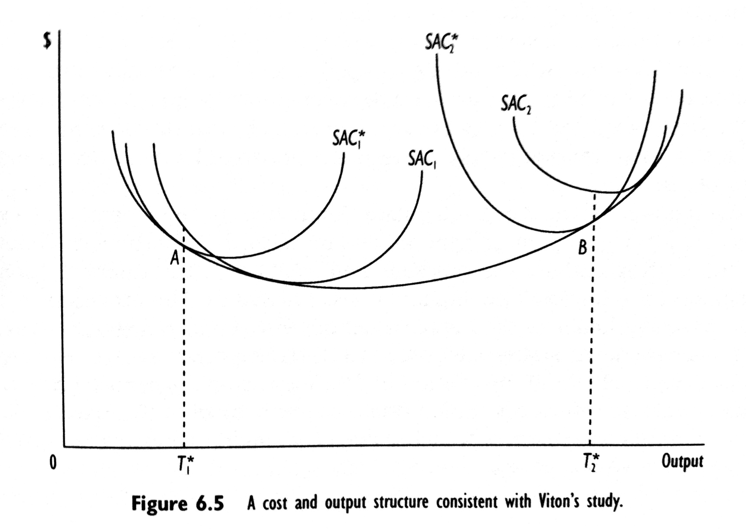
Short-run and long-run cost curves

Slide 34
5.5. Summary

Slide 35
Summary (1)
Given the existing technology, a firm's production function is the maximum amount of output that a firm can produce from a given quantity of inputs. If all inputs to the firm are variable, the firm is in the long run; if some inputs are fixed, the firm is in the short run.

Slide 36
Summary (2)
The elasticity of substitution, defined as the percentage change in an input ratio due to a percentage change in the marginal rate of technical substitution, reflects the ease with which a firm can substitute among inputs in the production process. If a proportional increase in all variable inputs raises output (less than, more than) proportionately, then the firm is operating under constant (decreasing, increasing) returns to scale.

Slide 37
Summary (3)
A firm minimizes its cost of production by using inputs up to the point at which the marginal rate of technical substitution equals the input price ratio. A firm's total cost function is the minimum cost necessary to produce a given amount of output. A firm's minimum efficient scale is that level of output corresponding to the minimum point on a firm's average cost curve. At this point, the firm is operating under constant returns to scale.

Slide 38
Summary (4)
Knowing a firm's cost function provides information on the firm's underlying production technology. The inverse of the elasticity of total cost with respect to output measures a firm's economies of scale. By Shephard's lemma, the elasticity of total cost with respect to input price is the conditional optimal share of the input's expenditures in total costs. The long-run total cost function also provides information on the elasticity of substitution among inputs.

Slide 39
Summary (5)
In addition to economies of scale, transportation firms also experience economies of traffic density. economies of capital utilization, and economies of network size.

Slide 40
Summary (6)
Empirically, there exist several cost function models to characterize transportation activities. The most restrictive is the Leontif cost function model, which assumes constant returns to scale and no substitutability among inputs. The Cobb—Douglas cost function model allows for nonconstant returns to scale and input substitutability, but the elasticity of substitution is constrained to equal one. The least restrictive cost function model is the translog cost function, which allows for nonconstant returns to scale and places no restrictions on substitutability among inputs.

Slide 41
Summary (7)
The motor carrier industry comprises two basic sectors, the truckload or specialized commodity carrier and the less-than-truckload or general freight carrier sector. By having to consolidate and break-bulk shipments, the less-than-truckload sector has a different production technology than the truckload sector.
Economic regulation of the motor carrier industry began with the Motor Carrier Act 1935, which regulated firm entry, rates, routes, and goods carried. Many of these regulations were significantly relaxed in the Motor Carrier Act of 1980.

Slide 42
Summary (8)
A case study of the truckload sector of the motor carrier industry under economic regulation found that truckload firms operated under increasing returns to scale, which is inconsistent with the competitive nature of this sector but consistent with regulatory-based economies of network size. This sector was less labor intensive and relied more on purchased transportation. Input demands for labor, capital, and fuel in this sector were inelastic. But the demand for purchased transportation was elastic. The elasticities of substitution indicated that all inputs were substitutes. The greatest opportunities for input substitution occurred with purchased transportation.

Slide 43
Summary (9 – 1/2)
A case study of the less-than-truckload sector under regulation confirms that differences in production technology exist between this sector and the truckload sector. Less-than-truckload firms operated under constant returns to scale, holding network size constant. However, there was also evidence of generalized returns to scale in this sector, which indicated that a proportional increase in output and network size increased costs less than proportionately (…)

Slide 44
Summary (9 – 2/2)
(…) This sector was more labor intensive than the truckload sector and relied much less on purchased transportation. Firms’ costs in this sector were sensitive to shipment size, length of haul, and value of commodity shipped. Factor demands, including purchased transportation, were inelastic. Similar to the truckload sector, all inputs were substitutes. However, in contrast to the truckload sector, there were greater substitution possibilities among fuel, capital, and labor inputs, but fewer opportunities for substitution between each of these inputs and purchased transportation.

Slide 45
Summary (10)
Economic regulation of the US airline industry began with the Civil Aeronautics Acts of 1938, which controlled firm entry and exit, route operating authority, and fares. Economic regulation continued until passage of the Airline Deregulation Act in 1978.

Slide 46
Summary (11 – 1/2)
A case study of trunk and local airline costs during the 1970s indicated that air carriers operated under economies of density. Further, during this period, air carriers operated under general constant returns to scale; that is, a proportional increase in output and network size, all else constant, increased costs proportionately. Air carrier operations were relatively capital intensive, with 48% of total costs expended on capital. (…)

Slide 47
Summary (11 – 2/2)
(…) In the form of lower costs, air carriers benefited from high average loads and longer stage lengths. Factor inputs were price inelastic, and relatively few possibilities appeared to exist for input substitution between capital and labor or capital and fuel. Labor and fuel were complements in production.

Slide 48
Summary (12)
A comparison of trunk and local air carriers during the transition to deregulation indicated that local carriers experienced unit costs that were more than 40% higher than those of trunk carriers. This can be attributed to significant differences in traffic density between the two sectors, as well as to the longer stage length of the trunk carriers.

