Slide 1
6. COMPETITION, CONCENTRATION AND MARKET POWER IN TRANSPORT

Slide 2
6.1. Theory

Slide 3
Introduction
What determines the level at which a transport firm actually does produce?
The lecture has three objectives:
to combine supply and demand, in order to characterize market equilibrium price and quantity in perfectly competitive markets;
to move away from the perfectly competitive model and conside alernative market structures;
to illustrate teh underlying concepts empirically.

Slide 4
Perfectly competitive market structure
Under perfect competition there are assumed to be:
Large number of firms
Producing virtually identical or homogenous products
Resources are perfectly mobile
Relevant information for consumption and prodution decisions is readily available
There is freedom of entry and exit
No interdependencies in consumption and production

Slide 5
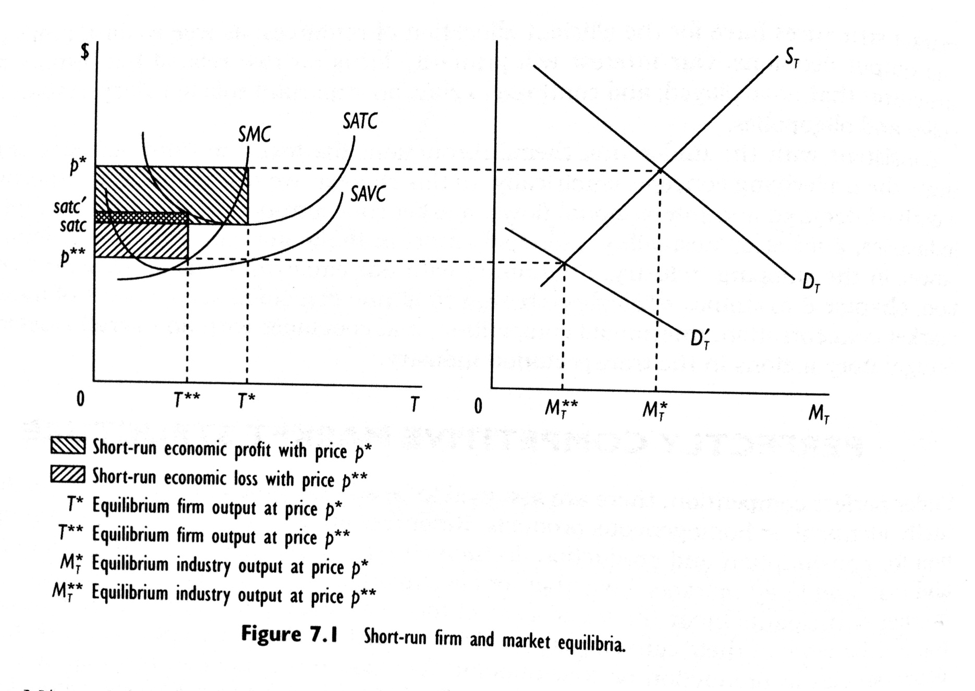
Short run market equilibrium

Slide 6
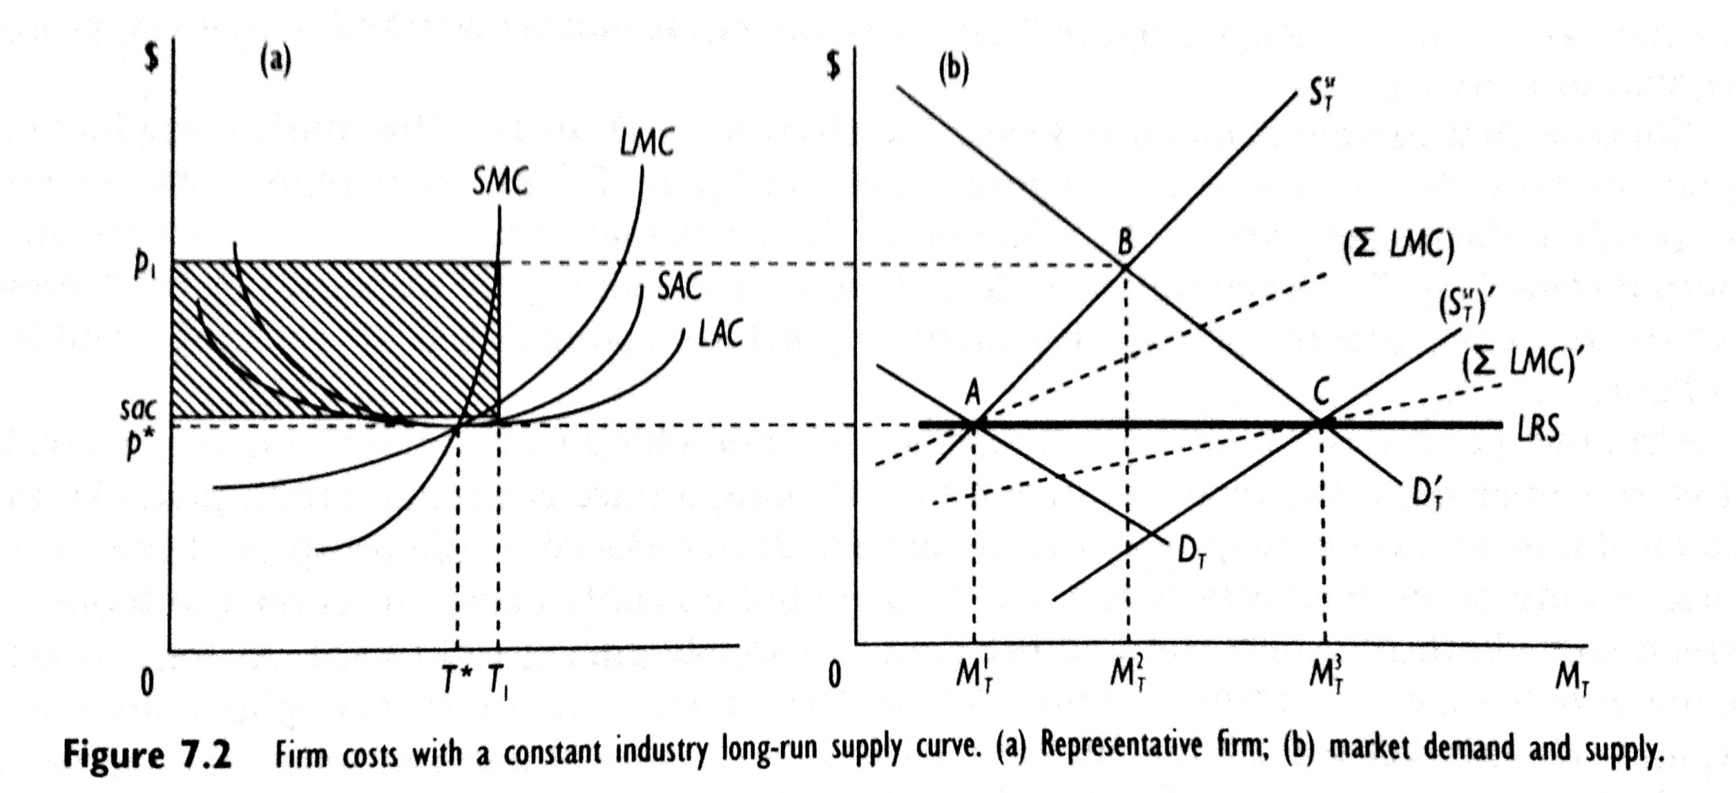
Long run market equlibrium

Slide 7
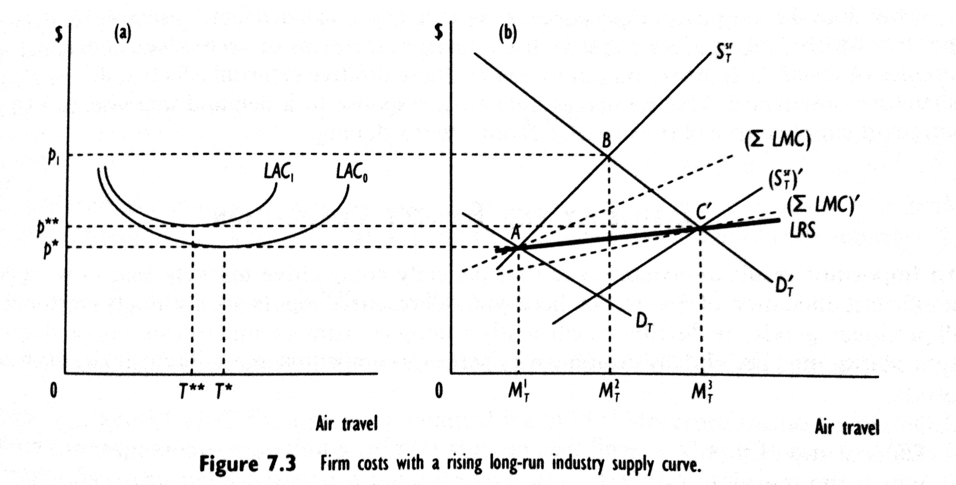
Long run supply and external effects of scale

Slide 8
Efficiency and perfect competition
The perfectly competitive markets lead to an optimal or efficent allocation of resurces whereby:
All resource inputs are optimally employed
All produced goods are distributed effieciently among consumers
Society produces the right output mix

Slide 9
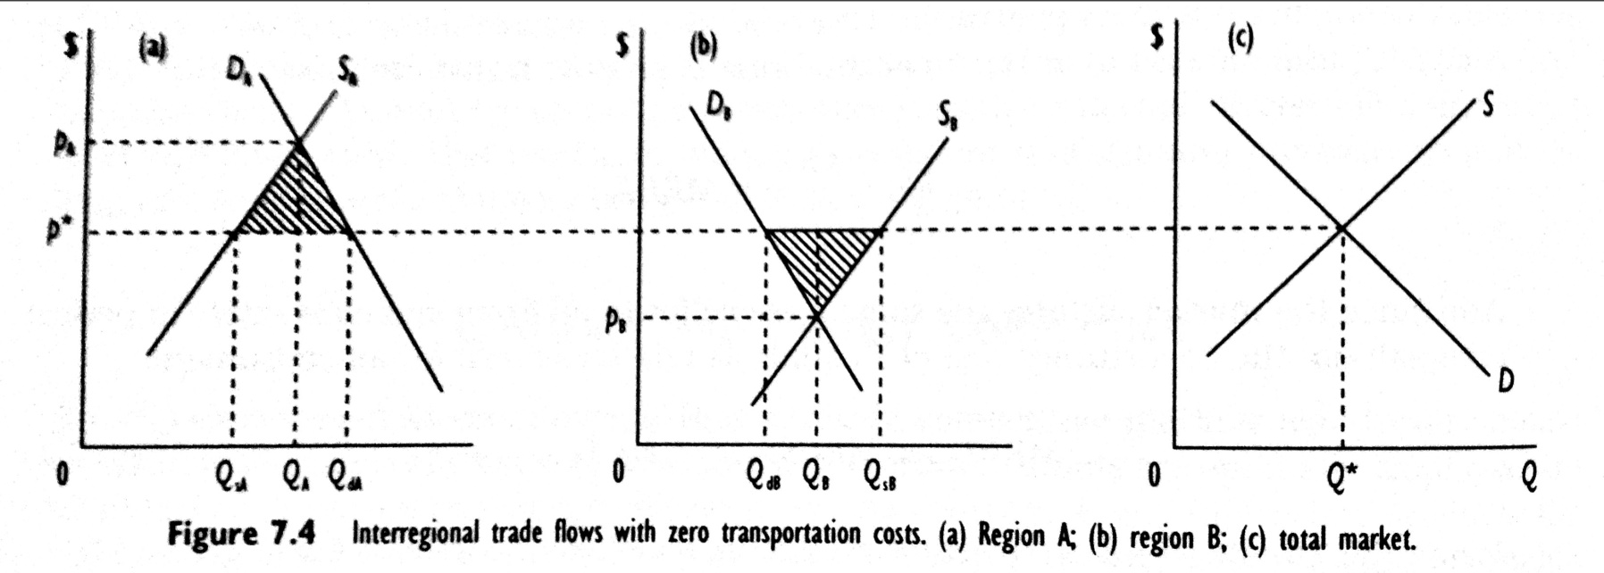
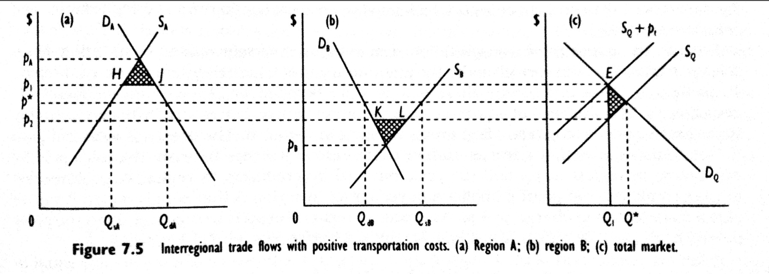
Transport flows as interregional trade

Slide 10
Case study – an empirical model of interregional freight flows
In an analysis of interregional trade flows for manufactured goods, Friedlaender and Spady (1981) hypothesized the following general relationship between commodity flows and economic variables:

Slide 11
Variables

Slide 12
Results

Slide 13
Results

Slide 14
Elasticities

Slide 15
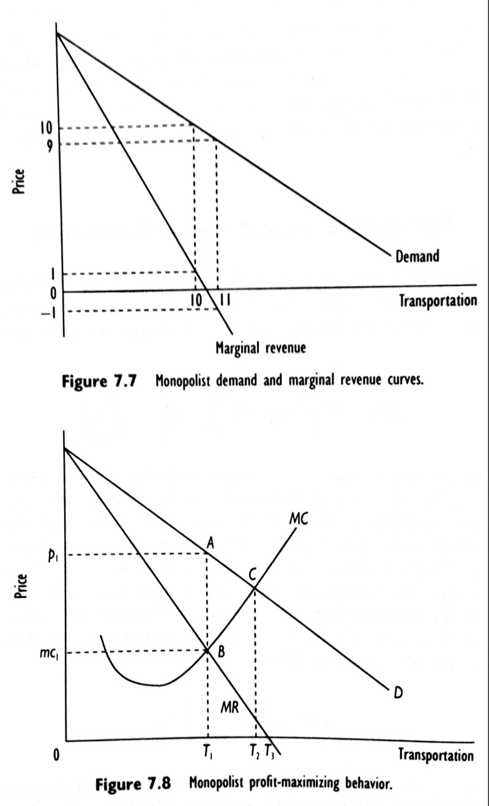
Equlibrium output for monopolist

Slide 16
Price elasticity of demand and total revenue

Slide 17
Market power

Slide 18
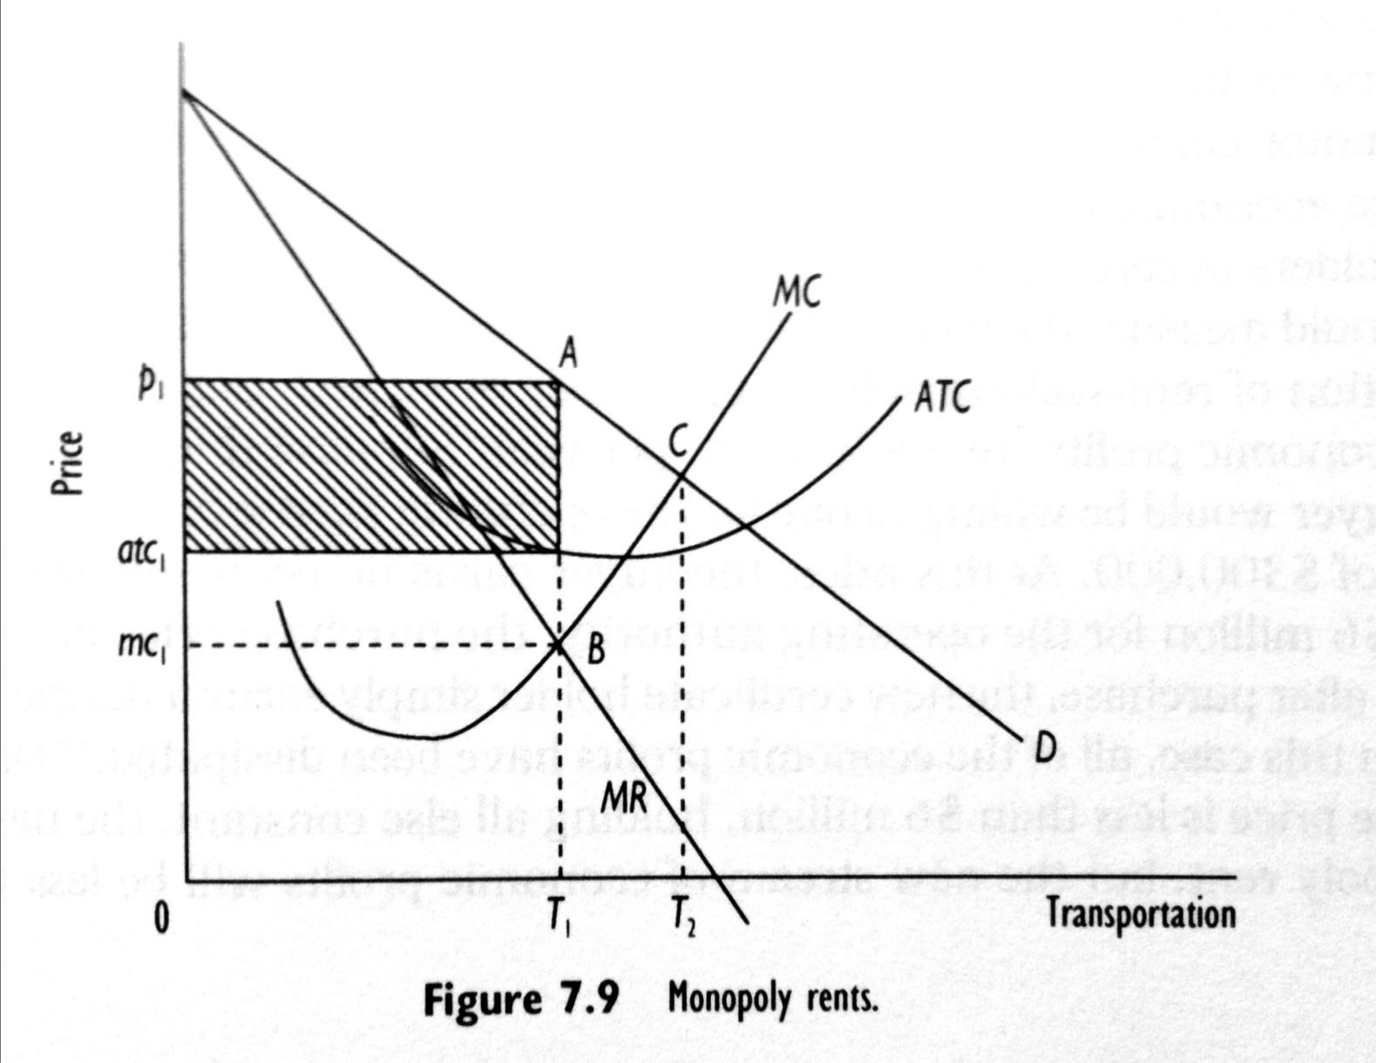
Monopoly rents

Slide 19
Monopoly rents and price discriminations

Slide 20
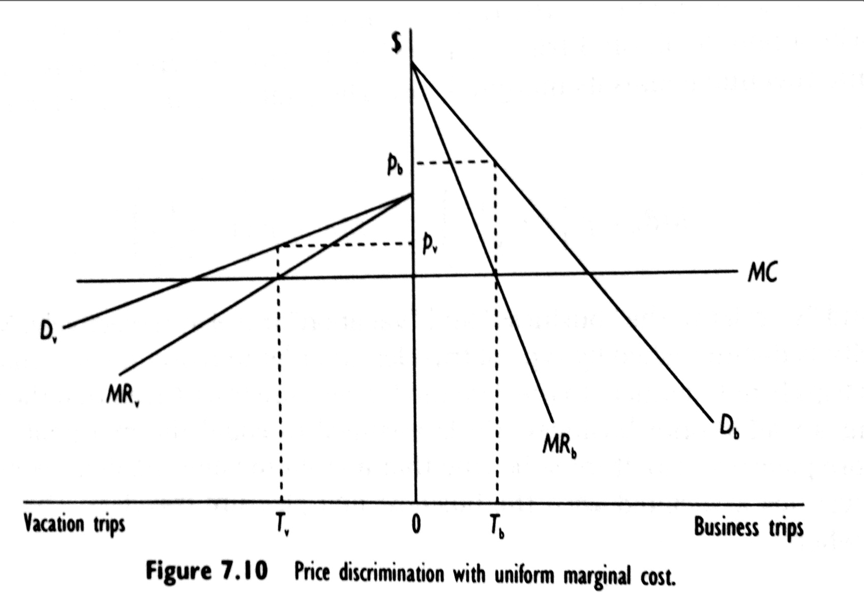
Monopoly rents and price discriminations

Slide 21
Monopoly rents and barriers to entry
Government policy
Control over critical inputs
Scale economies

Slide 22
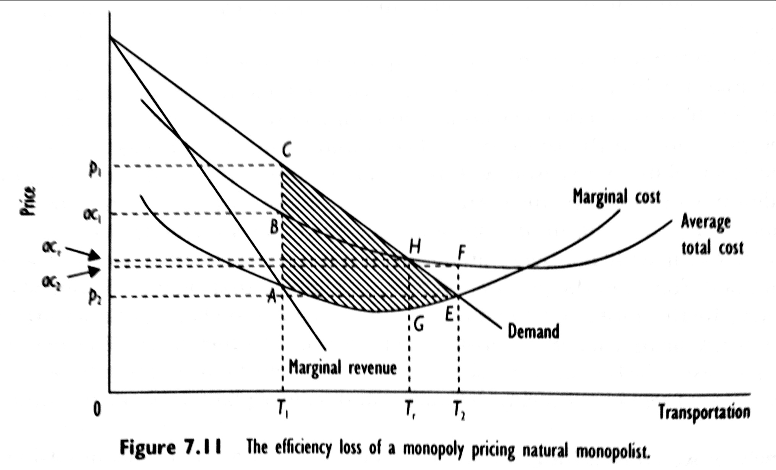
Natural monopoly

Slide 23
Governemnt responses to monopoly behaviour
Marginal cost pricing with subsidy
Rate of return regulation
Governemnt operation

Slide 24
6.2. Measuring market concentration

Slide 25
Measuring market concentration

Slide 26
Case study: Concentration in the LTL motor carrier sector
Table: Concentration ratios in the LTL motor carrier indsutry, 1990

Slide 27
Case study: Concentration in the US airline industry
Table: Concentration ratios in the domestic passenger airline industry, 1977-90

Slide 28
Case: Concentration in the US airline industry
Table: Average city-pair Hirschman-Herfindahl indices in the domestic passenger airline industry, 1984-90.

Slide 29
6.3. Contestable market theory

Slide 30
Theory
Contestable markets are primarily concerned with competition for the market, not with competition among incumbent producers.
It is the markets that are contested and, as a result, potential competitors rather than actual competitors play prominent roles in discipling the behaviour of incumbent firm
Assumption: there are no barriers to entry or exit from the market, there must be a pool of potential entrants .

Slide 31
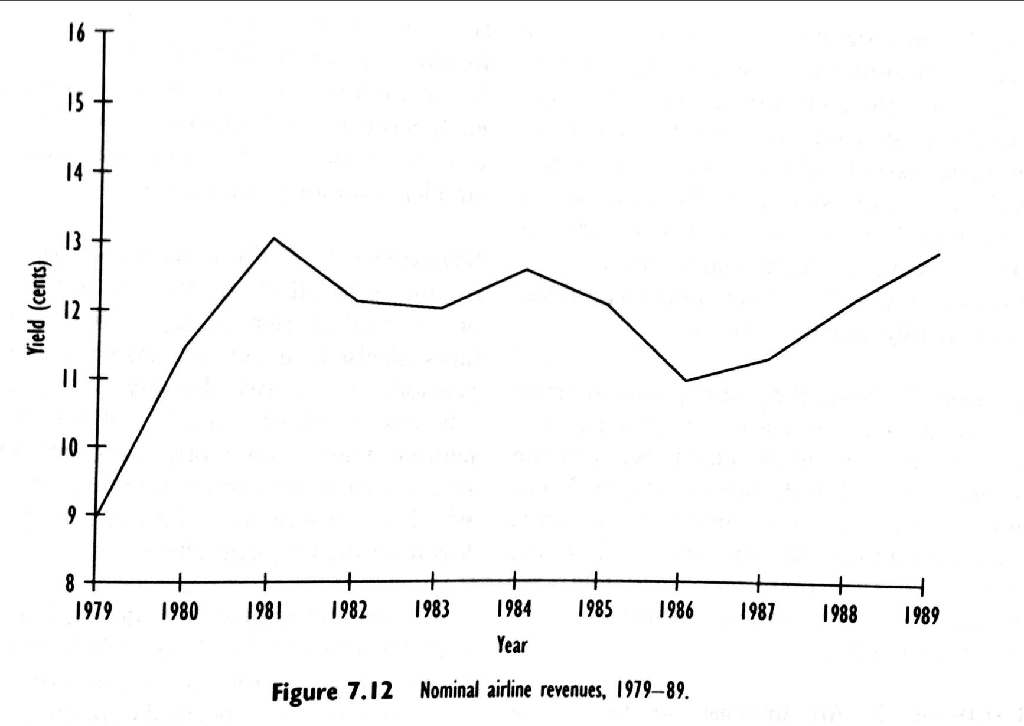
Case: Competition and contestability in the US airline industry

Slide 32
Case: Competition and contestability in the US airline industry
The rise in air fares in the latter part of the 1980s prompted governmental concern, among other issues, over whether hubbing had contributed to the nominal price rise.
This raises a basic question of the roles tht actual and otential competition play in price behaviour over time.
From a sample of 18573 routes between 1978 and 1988, Morrison and Winston (1990) invetsigated the importance of actual competitors versus potential competitors in determing nominal airline prices.

Slide 33
Variables
In their analysis, Morrison and Winston assume, that airline fares depend upon five basic determinants:
the distance (in miles) between the airports on a route
the number of effective competitors on routes at fixed-slot airports
the number of effective competitors on routes at nonfixed-slot airports
the minimum number of effective competition at route’s endpoints
the number of potential carriers

Slide 34
Hypotheses
The coefficient of Distance is expected to be positive
An increase in actual competition will reduce fares → coefficients of number of competitors are expected to be negative
It is expected that the effects of actual competition will be greater in the long run than in the short run.
If the market for airline routes is contestable, then an increase in the number of potential carriers is expected to reduce air fares.

Slide 35
Results

Slide 36
Interpretation
Are the results consistent with contestable markets? Yes a and no.
The finding that actual competition induces price reduction implies that airline routes are not perfectly contestable.
But the results do indicate that these markets are imperfectly contestable.
The increase in the number of potential carriers leads to price reductions, however this effect is relatively small.

Slide 37
6.4. Monopoly rents in the motor carrier industry

Slide 38
Introduction
Monopoly power leads to monopoly rents.
In motor carrier industry, government policy conferred monopoly power.
We want to quantify the extent to which economic regulation (after 1935) created monopoly rents, as well as examining what factors most contributed to these rents.

Slide 39
Case
Moore (1978) considered the question of how restriction market entry conferred monopoly rents on firms that possessed operating certificates.
Regulation has led to a situation, that by 1974, existing firms in the industry did possess market power and would be expected to have earned some monopoly rents.
Can we empirically quantify these economic rents? Yes.
For the years 1975 and 1976, Moore obtained 23 cases where only operating rights were purchased.

Slide 40
Results

Slide 41
Extension
Frew (1981) extended this study and found out that:
Population and retail sales (a measure of disposable income) had significant positive effect upon the certificate value.
Annual revenue (as proxy for route network) increased a certificate’s value.

Slide 42
Case study monopoly rent sharing in the motor carrier industry
Rose (1987) examined the extent to which labor shared in motor carrier monopoly rents
The drivers are heavily unionized and the union leadership negotiates wage contracts with transport carriers.
This gives the union some market power that it can use to extract a portion of economic rents earned by the carriers.

Slide 43
Specification

Slide 44
Hypotheses
Membership in union increases wage level → β_{1a} and β_{1b} are each expected to be positive.
Less restrictive market entry requirements reduce union wages and union premia → β_{1a} > β_{1b}.
Education and experience are expected to increase one’s earning power.

Slide 45
Results

Slide 46
Comments
Rose estimated that labor captured between 65% and 75% of total monopoly rents in the indsutry.
Because of data limitations, Rose could not include information on firm characteristics that may tend to overstate the union wage premium.
Rose’s analysis focus upon money wages and does not include benefits.

Slide 47
6.5. Market power, shipping cartels and the Shippig Act of 1984

Slide 48
Background
The 1984 legislation increased the potential for market power while simultaneously increasing the support for a competitive enviroment.

Slide 49
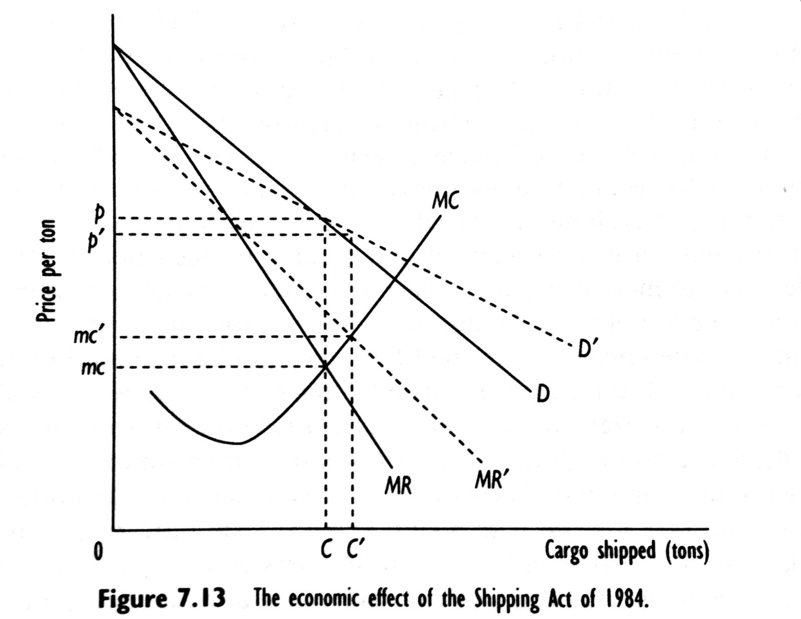
Case study: The economic effect of the Shipping Act of 1984

Slide 50
Profit maximization for the cartel

Slide 51
Study
Wilson and Casavant (1991) examined the economic impact of 1984 Shipping Act on market equlibrium prices for westbound traffic from the West Coast of the United States to the Pacific Rim.
Based on time series data 1978-1987, Wilson and Casavant analyzed shipments from West Coast to Jpan for four groups of commodities: fries, hay, onions and lumber.

Slide 52
Specification

Slide 53
Hypotheses
β₁ < 0
Fuel price and Capacity affect the opportunity costs faced by carriers. Thus we expect β₂ > 0 and β₃ < 0
β₄ < 0

Slide 54
Results

Slide 55
6.5. Summary

Slide 56
Summary (1)
In a perfectly competitive market structure, buyers and sellers are price-takers; firms produce a homogenous product; there is freedoom of entry and exit; and all relevant information is available to market participants. Whereas positive, zero, and negative economic profits are consistent with short-run equilibrium, only zero economic profits or a normal return on investment is consistent with long-run equilibrium. In perfectly competitive markets, inputs are optimally employed, goods are optimally distributed, and society is producing the socially efficient output mix.

Slide 57
Summary (2)
The demand for transportation is derived from the demand for goods and services that are produced in locations separate from their points of comsumption. Inter-regional passenger and freight flows reflect differences in the opportunity costs of producing goods and services at various locations. In an empirical model of inter-regional goods’ flows, the demand for transportation generally depends upon the delivered price, income at the destination, and the price of substitutes.

Slide 58
Summary (3)
A monopolistically competitive market structure is similar to a perfectly competitive market structure, except that firms produce a heterogeneous product, so that its demand curve is slightly downward-sloping. Although these firms have some monopoly power, in the long run monopolistically competitive firms make zero economic profits. An oligopoly has few competitors, and the distinguishing characteristic of this market structure is that each competitor will behave strategically, making own decisions in light of competitors’ expected responses.

Slide 59
Summary (4)
In a monopolistic market structure, one firm faces the full downward-sloping market demand curve which gives the monopolist market power; that is, the ability to price above marginal cost of production. In long-run equilibrium, monopolists make pure economic profits – that is, economic rents – and society suffers an efficiency loss from too few goods coming on to the market. Over time, rent-seeking behavior, rent-sharing, capitalization, and reduced incentives to innovate cause monopoly rents to dissipate.

Slide 60
Summary (5)
Price discrimination occurs when a monopolist charges different prices in different markets for goods that cost the same to produce, or charges an uniform price for goods that have different costs of production. In each case, a profit-maximizing monopolist will set a price for the good that is inversely related to the good’s price elasticity of demand.

Slide 61
Summary (6)
When production of a good is subject to economies of scale so large that the optimal number of firms in the industry is one, the resulting market structure is a natural monopoly. Actions taken by the government to deal with natural monopolies are marginal cost pricing combined with subsidizing the firm’s losses, rate of return regulation, and government operation.

Slide 62
Summary (7)
The four-firm concentration ratio, the eight-firm concentration ratio, and the Hirschman-Herfindahl index are three commonly used measures to evaluate the extend to which a market is concentrated. Although by these measures, the less-than-truckload motor carrier industry is moderately concentrated, competition form freight forwarders and brokers prevents these firms from exploiting their market power.

Slide 63
Summary (8)
The passage of the 1978 Airline Deregulation Act led to a hub-and-spoke passenger distribution network. Empirical evidence presented suggests that an effect of the Act was to decrease concentration at the hub airports for all flights. However, increased concentration was observed for direct flights in comparison with flights that involve a change of plane.

Slide 64
Summary (9)
Under perfect competition, the level of actual competition disciplines competitors’ pricing behavior. Under perfect contestability, the threat of entry disciplines incumbents’ pricing behavior. Empirical evidence suggests that contestability in the airline market is imperfect. Although potential competitors play a positive role disciplining the pricing behavior of incumbents, the effect of actual competitors on a firm’s pricing behavior is stronger.

Slide 65
Summary (10)
Under regulation, motor carriers in general and the less-than-truckload sector in particular characterized a monopoly market structure with positive economic profits. Empirical studies indicate that operating certificates had a positive value, consistent with making economic profits, and that the value of these certificates depended upon the level of demand, and on cost-related operating characteristics. Consistent with economic theory, motor carrier economic profits were partially dissipated through rent-sharing with labor.

Slide 66
Summary (11)
The equilibrium price in imperfect competition depends upon demand- and cost- related factors and the regulatory environment. To reduce market power and lower prices, it is important to introduce changes in the regulatory environment that have net pro-competitive effects on the industry. This is borne out in an empirical model of shopping conferences, where a regulatory change included competitive provisions and anticompetitive provisions. The equilibrium price fell (rose) when the regulatory change resulted in a more (less) competitive environment.

