Slide 1
Change Management
Ondřej Částek

Slide 2
Content
Need for change
Barriers in change implementation
Reengineering
PDCA, Kaizen
Getting support for a change

Slide 3
Need for change
Changes in external environment
Changes in internal environment
(= need for external and internal environment analyses)

Slide 4
Barriers in change implementation
The resistance to changes comes out from
the need to invest effort for adaptation to new state
the fear of losing position or job
the attitude „if it worked until now, why should it not continue working“
„Better the devil you know than the devil you don't know“

Slide 5
Resistance to changes (Kubíčková, Rais)
Fear of unknown
Interruption of stereotypes and customs
Sense of being manipulated
Unclear objective of the change
Fear of failure
Benefits from the change implementation will not compensate the invested effort
Undue satisfaction with the current state
The change proposer dose not have respect of subordinates
The change means higher personal involvement
Traditions are valued = permanence

Slide 6
Business process reengineering (BPR)
“fundamental”, “radical”, “dramatic”, “on a greenfield site”
focuses on a workplace, a process or whole company
started in 1990, boom in ’90s, decline later
founding authors: Hammer, Champy, Davenport
Notes:
On a greenfield site = from scratch

Slide 7
BPR: Reasons of BPR adoption (Thorton, G.)
Reason | %
Cost cutting | 84
Quality increase | 79
Speed (throughput) increase | 62
Overtaking the competition | 50
Change of organizational structure | 35
Other | 9

Slide 8
Typical characteristics of BPR
Top-down
Greenfield (from scratch)
Reduction of tasks, workplaces, and staff
Creating of reengineering teams

Slide 9
BPR failure factors
Some sources state that may be more than 50 % of reengineering project fail. Reasons are:
Too ambitious goals
Insufficient involvement of top management
Insufficient communication to affected parties
Failure to engage the middle management
The project takes too long

Slide 10
Critique of BPR
Too mechanistic thinking – re-introduction of Talorism
Too focused on staff reduction
Loss of knowledge base due to middle management reduction

Slide 11
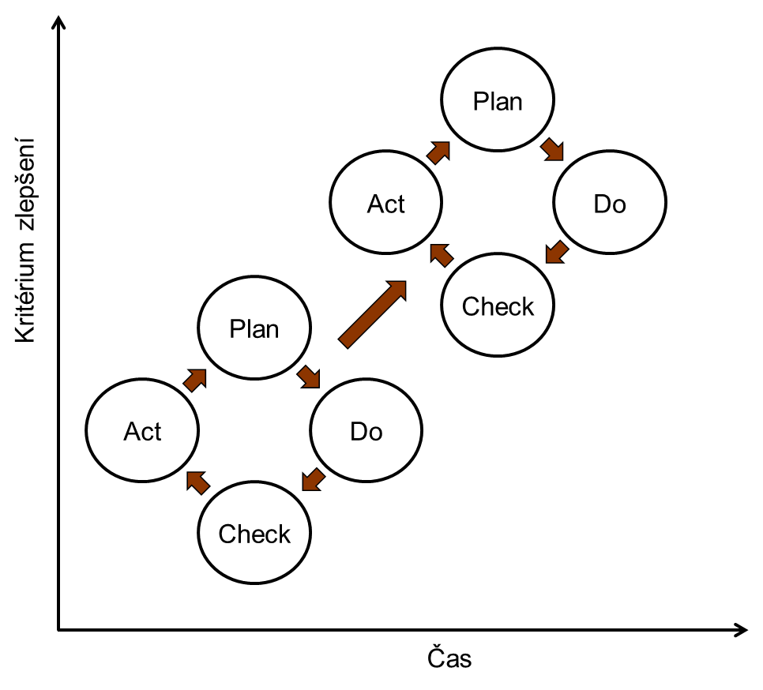
Continuous improvement - PDCA
Indicator to be improved
Time

Slide 12
PDCA more detailed (another example here)
Plan | 1 | Define an improvement opportunity
 | 1.1 | Identify the process
 | 1.2 | Identify the customers and resources of the process
 | 1.3 | Identify other interested parties
 | 1.4 | Describe the current process
 | 2 | Visualize the current process
 | 2.1 | Describe the ideal output
 | 2.2 | Identify differences
 | 2.3 | Construct (map of) real and ideal diagrams of inputs and outputs
 | 2.4 | Find key start events of tasks and processes
 | 3 | Measure the current process
 | 3.1 | Ask questions
 | 3.2 | Collect data
 | 3.3 | Describe variability at chosen check points of the process
 | 3.4 | Describe patterns in the observed variability
 | 4 | Plan the change
 | 4.1 | Propose an improvement
 | 4.2 | Summarize the proposed changes
 | 4.3 | Suggest person responsible for carrying out the changes
 | 4.4 | Suggest a plan of the improvement project

Slide 13
PDCA more detailed
Do | 5 | Carry out the plan
 | 5.1 | Implement the improvement project according to the plan
 | 5.2 | Monitor the implementation
Check | 6 | Verify the achieved results
 | 6.1 | Verify the methods of collecting data about the new process
 | 6.2 | Study the effect of executed changesStudujte dopad provedených změn
Act | 7 | Act based on the findings
 | 7.1 | Update documentation
 | 7.2 | Build next sequence based on the implemented improvement: was the change successful, keep it, was it not successful, reject it. Will you build another PDCA cycle based on this change or not? Can be this change implemented elsewhere in the company?
 | 7.3 | Standardise successful change

Slide 14
Six Sigma, DMAIC
Sigma = standard deviation
Six sigma = situation, when it is achieved a quality level of 3.4 defects per million opportunities (so called DPMO)
In other words, the variability of the process compared to set requirements on the process (e. g. quality of the process output) is so low, that twelve standard deviation of the measured characteristic still meets the requirements on this characteristic.

Slide 15
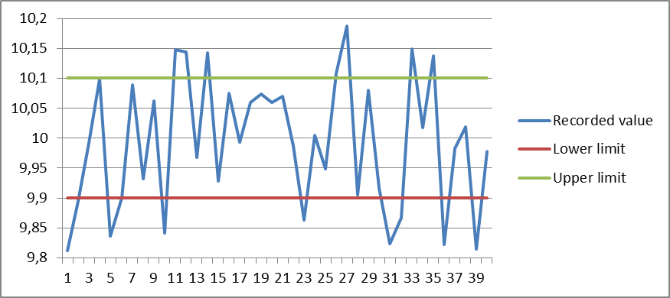
Variability in a process
Requirement = 10,0 Real average = 9,9933
Upper limit = 10,1 Standard deviation = 0,109
Lower limit = 9,9 Result?

Slide 16
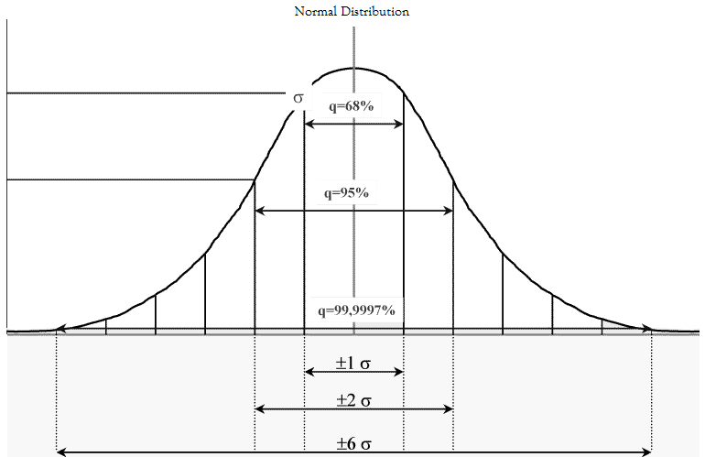
Normal distribution and standard deviation

Slide 17
DMAIC methodology
Define
Measure
Analyze
Improve
Control

Slide 18
Kaizen
A method or a philosophy?
Continuous improvement
Originated in Japan
Involves all employees at all levels
The goal is to reduce waste of time or material, that means besides other things to reduce defective work

Slide 19
Kaizen – selected tools
Quality circles
Stopping the production (line) in case of abnormality
Rewards for implemented proposals

Slide 20
Advantages of Kaizen
Changes implemented in the kaizen spirit are better accepted, because:
those, who are affected by the change, did mostly initiate it (down-top)
the changes are small, therefore they do not create such high stress
the changes are continual (allegedly, human brain gets used to it)

Slide 21
Disadvantages of Kaizen
Disadvantages can be seen in difficult implementation of this system, if the organizational culture is not suitable. For example, consider different typical situations in:
Japan
USA
CZ

Slide 22
Comparison
A comparison of continuous improvement methods and radical changes methods (Řepa, V., extended)
Level of Change | Continuous | Radical
Starting point | existing process | from scratch
Frequency | one-time/continuous | one-tim
Time needed | short | long
Participation | bottom-up | top-down
Typical extent | limited, inside one functional area | broad, between functions
Risk level | middle | high
Primary tool | classic – statistical control | information technologies
Type of change | cultural | cultural/structural
Acceptance | high | low

Slide 23
Gaining support for a change
Analysis of impact, attitudes, and support (stakeholder analysis)
Communication
Involvement of affected groups (like in Kaizen)

Slide 24
Methods of gaining support for a change (Kubíčková, Rais)
active involvement
participation
bargaining
consultation
communication
awareness

Slide 25
Sources
ŘEPA, Václav. Podnikové procesy: procesní řízení a modelování. 2., aktualiz. a rozš. vyd. Praha: Grada, 2007, 281 s. ISBN 9788024722528.
THORNTON, Grant. Motivations to Reengineer. NCMS Focus, September, 1994.
DuBRIN, Andrew. Essentials of Management. 8th edition, 2009, Cengage Learning. 630 s.
HAMMER, M., CHAMPY, J. A. Reengineering the Corporation: A Manifesto for Business Revolution, Harper Business Books, New York, 1993. ISBN 0-06-662112-7.
KUBÍČKOVÁ, L., RAIS, K. Řízení změn ve firmách a jiných organizacích. Grada, Praha, 2012, 136 s.

