Slide 1
Introduction to MS Dynamics NAV XIII. (General Journal and its use)
Ing.J.Skorkovský,CSc.
MASARYK UNIVERSITY BRNO, Czech Republic
Faculty of economics and business administration
Department of corporate economy

Slide 2
General Journals and its use in G/L
It enables to post and apply payment to „open“ invoices
It enables to post an amount from one account to another
Recurring operations (periodic posting of similar transactions) are much more easier

Slide 3
General Journals and its use in G/L
You can use the General Journal window to post transactions to G/L, bank, customer, vendor and fixed assets accounts. In a general journal, you enter the relevant information for the transaction, such as the posting date, amount and the accounts you want to post to. The information you enter in a journal is temporary and can be changed as long as it is in the journal.
If you often use the general journal to post the same or similar journal lines, for example, in connection with payroll expenses.

Slide 4
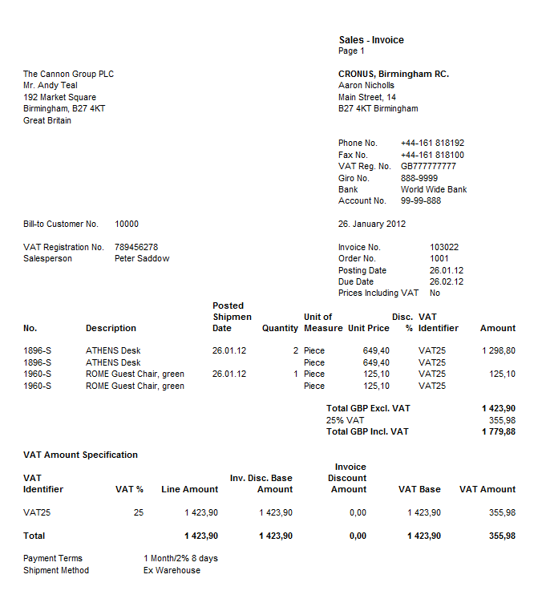
Applying principle
Apply
From customer 10000 by Ctrl-F5
If opne, thus not applied with payment

Slide 5
Impacts to G/L (General Ledger Entries)
5610 Sales VAT 25%
2920 Bank Account
2310 Customer Domestic
30,83
602000 Tržba
6110 Sales Retail Domestic
154,13
154,13
154,13
123,30

Slide 6
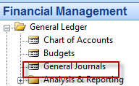
Setup of General Journal
Enter a new line by F3 and batch name
e.g. Classic and add balancing Banking Account with code NBL
and then click OK !!!!
Enter two new fields by right mouse click on the GJ bar. The name of the fields
are specified by red rectangle above. Then click OK.

Slide 7
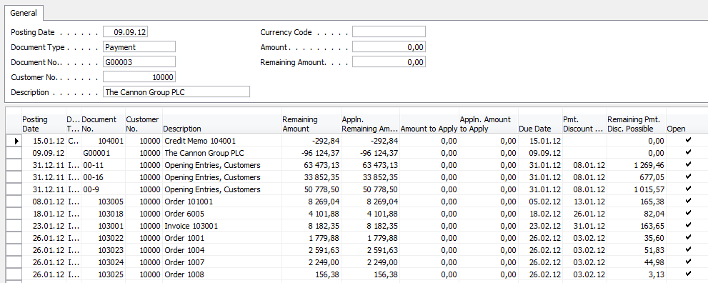
Entering data to G/L and Apply
F6
Customer number 10000 represents also
G/L account number 2310 – see tab invoicing and Customer Posting Group=Domestic
List of all open invoices

Slide 8
Entering data to G/L and Apply
Make a choice of one of them and enter OK

Slide 9
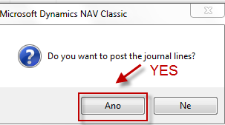
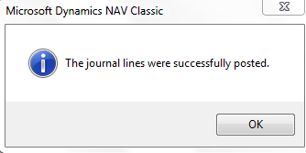
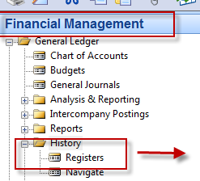
Post GJ with correct data by F11
See next slide

Slide 10
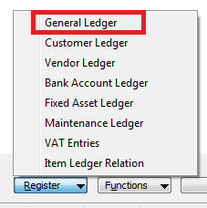
Results in General Ledger
2920 Bank Account
2310 Customer Domestic
156,38
156,38
156,38

Slide 11
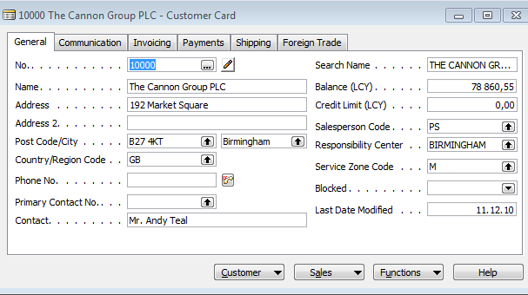
Results in Customer Ledger Entry
Find appropriate
Customer Card and CTRL-F5
See next slide

Slide 12
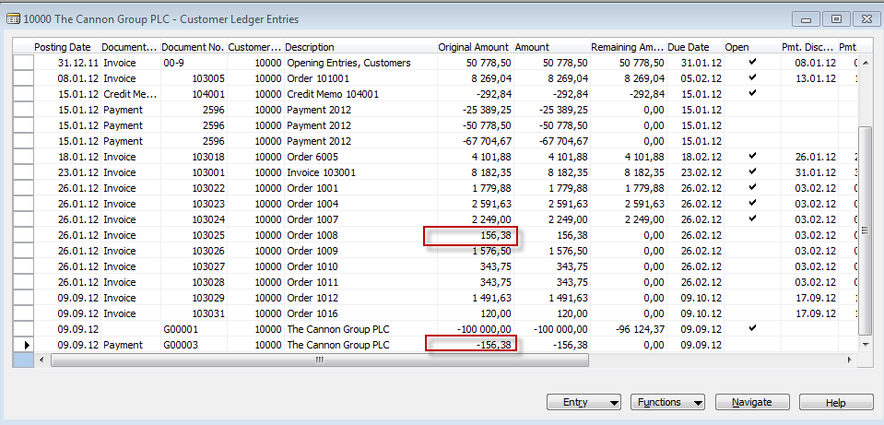
Results in Customer Ledger Entry
= Application

Slide 13
Unapply in Customer Ledger Entry

Slide 14
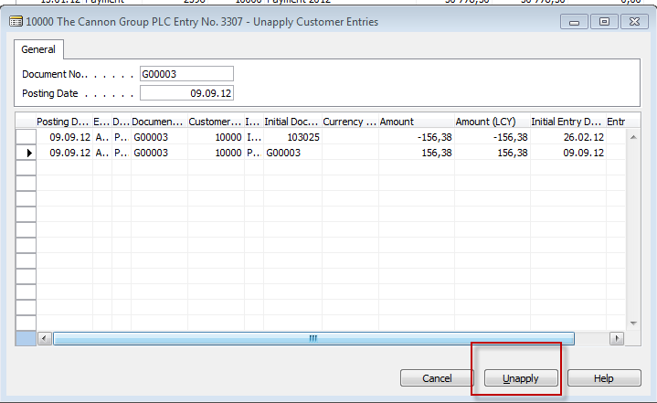
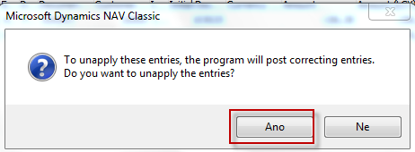
Unapply in Customer Ledger Entry
See next slide

Slide 15
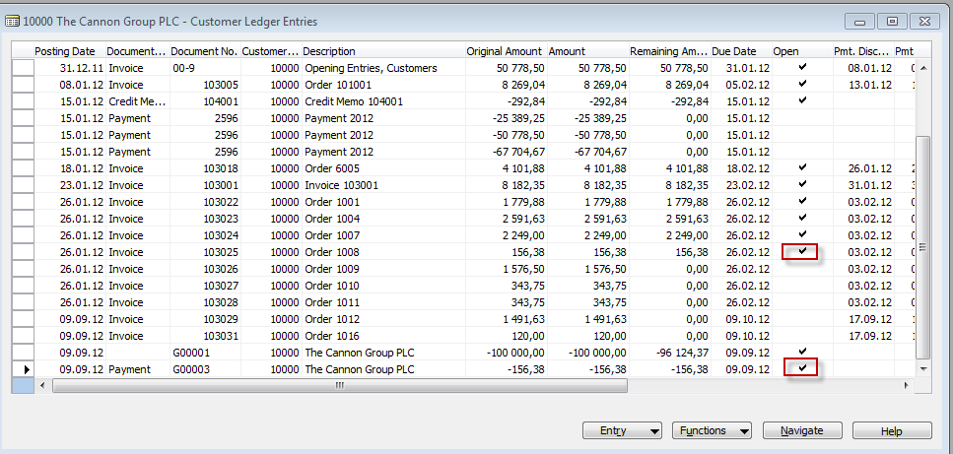
Unapply in Customer Ledger Entry
Both entries are open again !!!!

Slide 16
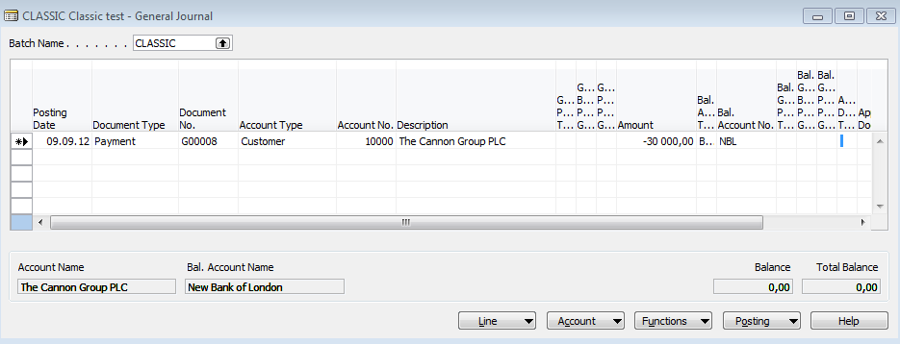
Apply Entries by use of Shift-F9
Shit-F9 Apply Entries
See next slide

Slide 17
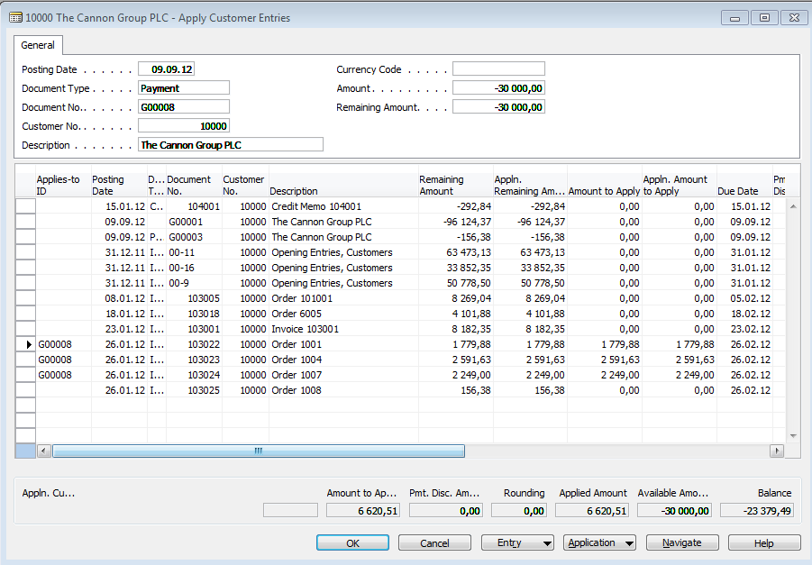
Apply Entries by use of Shift-F9
in Czech language
By use of toggle switch (key) F9 and OK

Slide 18
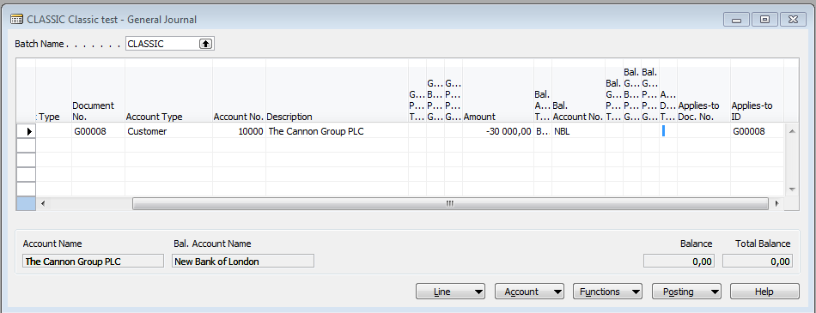
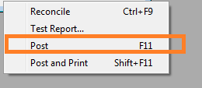
Apply Entries by use of Shift-F9

Slide 19
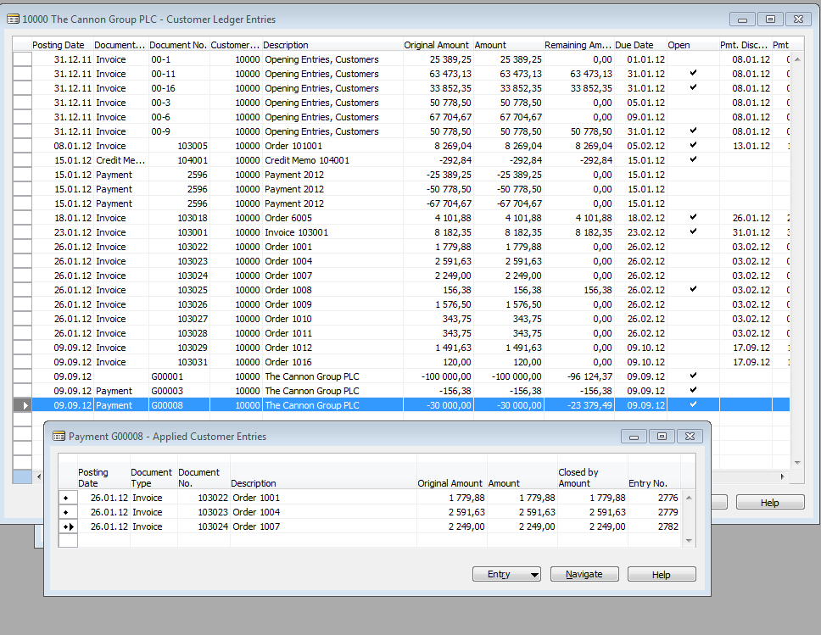
Apply Entries from Customer Card by use of Ctrl-F5 and Applied Entries

Slide 20
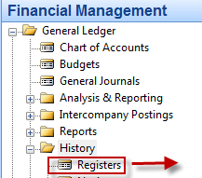
Amount transfer from one account to another one and Reverse
Account 2910 must have Direct Posting ticked
This represents transefr of 1000 from bank to cash account after F11
F11

Slide 21
Reversing cerated G/L entry
F11

Slide 22
End of the section XIII.

