Slide 1
Introduction to MS Dynamics NAV X. (Discounts)
Ing.J.Skorkovský,CSc.
MASARYK UNIVERSITY BRNO, Czech Republic
Faculty of economics and business administration
Department of corporate economy

Slide 2
Discounts
Use of discounts:
  Support of „Sales“ actions->lower stock value and better liquidity
  Support of marketing ->new clients
  Basic incentives for any type of client
  In order to differentiate between clients (based on sales in last period or other criteria
  Types :
  Price ->modificatioon of Unit Price
  Line ->change final price in %
  Invoice Discount ->based on level of invoiced amount

Slide 3
Basic Blocks
Customer
Discount Group
Window used
for Invoice Discount
Customer
Allow Line
Discount
Sales Button
Window used
for Price Discount sestup
Sales
header
Sales line
Window used
for Line Discounts setup
ITEM
Item Discount
Group
Unit Price
Allow Invoice
Discount
Can be access either from
Customer Card or Item Card
Sales Button

Slide 4
Window used for Line Discounts Setup (%)
Sales Type | Sales Code | Type | Code | Unit of Measure | Minimum | Line discount % | Starting date | Ending date
Customer | 10000 | 70102 (Item number) |  | PCS | 10 | 2
Customer Discount Group | Large Account | Item Discount Group | RESALE |  | 20 | 4
All Customers |  |  |  |  | 5 | 1
Campaign | Spring Campaign | Item Discount Group | BOOKS |  | 3 | 7

Slide 5
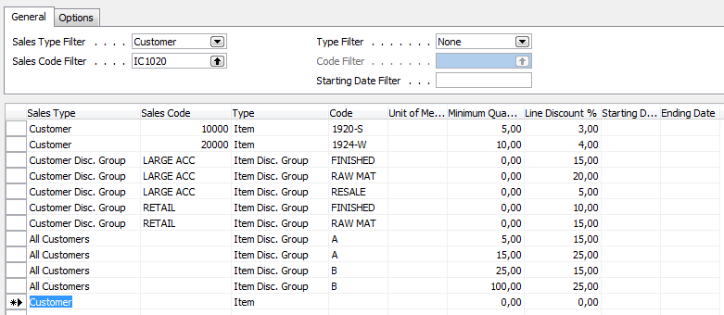
Window used for Line Discounts Setup (%)

Slide 6
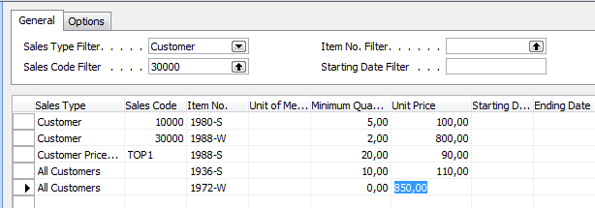
Window used for Sales Price Discounts Setup

Slide 7
Discount combination
Price reduced from 100 to 90
Discount % =10
Final price after discounts were applied = 90*0,9=81

Slide 8
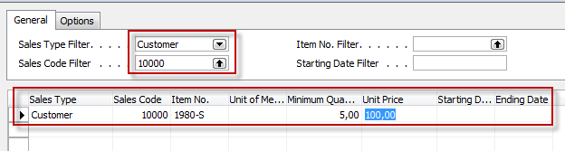
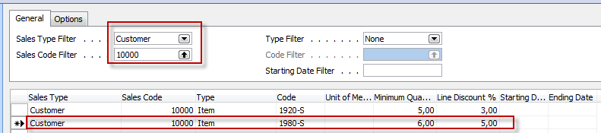
Simple example setup

Slide 9
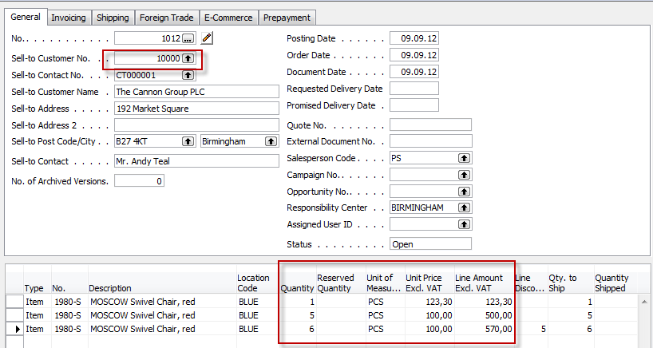
Simple example- Sales Order
Where 570=6*100 *0,95

Slide 10
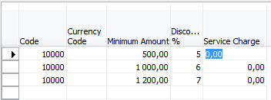
Invoice Discount Setup

Slide 11
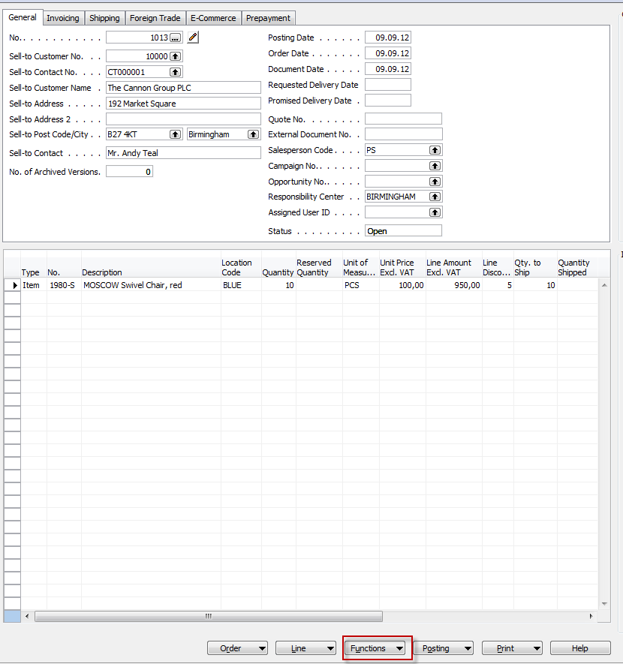
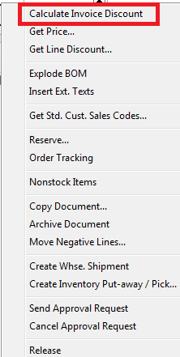
SO and when invoice discount is applied

Slide 12

End of the section X.
This is the end
Beautiful friend
This is the end
My only friend, the end…

