Slide 1
MARKETING RESEARCH PROCESS. RESEARCH DESIGN
SECONDARY DATA RESOURCES.
AND Bacardi and PHILIPS LIGHTING CASE STUDY
Sources: Smith, Albaum, An Introduction to Marketing Research, 2010
Burns, Bush, Marketing research, Prentice Hall, 2010
Resor, Marketing research overview, PPT presentation

Slide 2

What is research process and what activities(phases) it can involve?
TASK
Try to think about the answer to the question

Slide 3
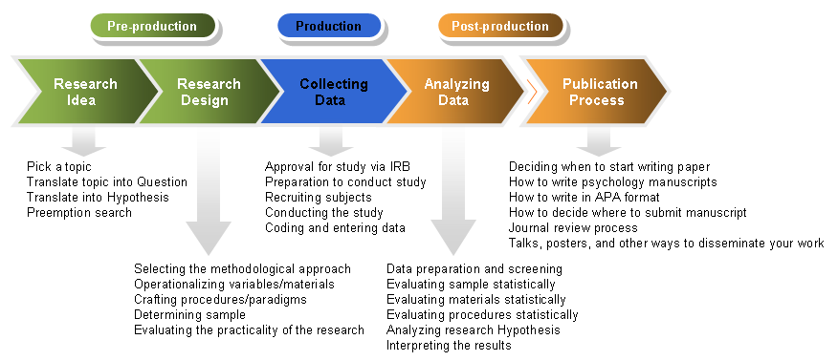
RESEARCH PROCESS – one aproach

Slide 4
Research process – another approach

Slide 5
Research process – one more approach

Slide 6
Research process – another approach
MANAGEMENT PROBLEM
MARKETNG RESEARCH PROBLEM
RESEARCH DESIGN
Exploratory, Descriptive, Causal
Primary/Secondary data
DATA COLLECTION
DATA ANALYSIS
RESEARCH REPORT
Notes:
6

Slide 7
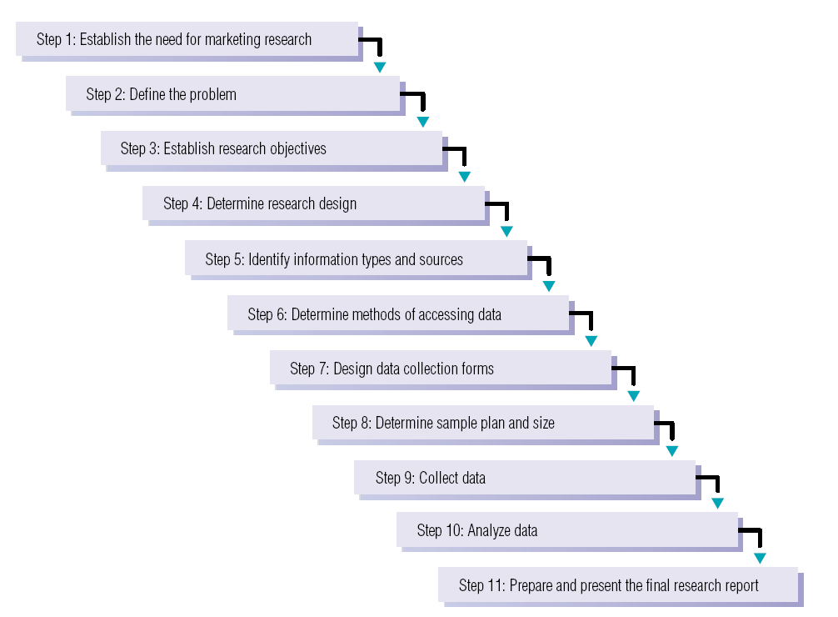
And one more example

Slide 8
Step 1: Establish the Need for Marketing Research
Is there a real need for marketing research?
Research takes time and costs money.
Marketing research is not always needed.
When is marketing research not needed?
  The information is already available.
  Decisions must be made now.
  We can’t afford research.
  Costs outweigh the value of marketing research.

Slide 9
Step 2: Define the Problem
This is the most important of the 11 steps.
If the problem is incorrectly defined, all else is wasted effort.
Problems may be either specific or general.
Problems stem from gaps between what is supposed to happen and what did happen and gaps between what did happen and what could be happening.
From the researcher’s point of view, problem formulation means translating the management problem into a research problem. The researcher must understand the origin and nature of management’s problem and then be able to rephrase it into meaningful terms from an analytical point of view.
An accurate problem formulation specifies the types of information needed to help solve the management problem. In short, quality thinking about a problem prior to data collection largely determines the quality of data collection, analysis and problem solving.

Slide 10
examples

Slide 11
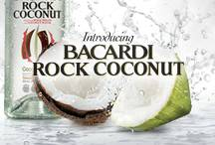
Which management and which research problems can Bacardi and Bron Forman have?
“Jacques” Daniels
Sales of U.S. distilled spirits declined over the last 10 to 15 years as more Americans turn to wine or beer as their beverage of choice. As a result, companies like Bacardi and Brown-Forman, producers of Jack Daniels, pursued market development strategies involving increased efforts to expand into international markets. The Brown- Forman marketing budget for international ventures includes a significant allocation for marketing research.

Slide 12
Step 3: Establish Objectives
Research objectives, when achieved, provide the information necessary to solve the problem identified in step 2.
Research objectives state what the researchers must do or what they should look for and try to find, ascertain, confirm.
Objectives are usually framed in the form of research questions and hypothesis (typical for quantitative research). Questions identify the probable direction of the research project and limit the boundaries of it. Prior to hypotheses proposition as a statement about observable phenomena (concepts) that may be judged as true or false can be formulated. When a proposition is formulated for empirical testing, we call it a hypothesis. As a declarative statement about the relationship between two or more variables, a hypothesis is of a tentative and conjectural nature.
Hypotheses have also been described as statements in which we assign variables to cases. A case is defined in this sense as the entity or thing the hypothesis talks about. The variable is the characteristic, trait, or attribute that, in the hypothesis, is imputed to the case.

Slide 13
Hypotheses
Descriptive Hypotheses - They state the existence, size, form, or distribution of some variable. Researchers often use a research question rather than a descriptive hypothesis. For example:
Research Question:
What is the market share for our potato chips in Detroit?
Descriptive Hypothesis
In Detroit (case), our potato chip market share (variable) stands at 13.7 percent.
The descriptive hypothesis format has several advantages:
• It encourages researchers to crystallize their thinking about the likely relationships to be found.
• It encourages them to think about the implications of a supported or rejected finding.
• It is useful for testing statistical significance.

Slide 14
Relational Hypotheses
These are statements that describe a relationship between two variables with respect to some case.
For example, “Foreign (variable) cars are perceived by American consumers (case) to be of better quality (variable) than domestic cars.”
In this instance, the nature of the relationship between the two variables (“country of origin” and “perceived quality”) is not specified. Is there only an implication that the variables occur in some predictable relationship, or is one variable somehow responsible for the other?
The first interpretation (unspecified relationship) indicates a correlational relationship; the second (predictable relationship) indicates an explanatory, or causal, relationship.

Slide 15
One type of rel. hyp. is:
Correlational hypotheses - state that the variables occur together in some specified manner without implying that one causes the other. Such weak claims are often made when we believe there are more basic causal forces that affect both variables or when we have not developed enough evidence to claim a stronger linkage. Here are two sample correlational hypotheses:
Young women (under 35 years of age) purchase fewer units of our product than women who are 35 years of age or older.
The number of suits sold varies directly with the level of the business cycle.
By labeling these as correlational hypotheses, we make no claim that one variable causes the other to change or take on different values.

Slide 16
Or….
With explanatory (causal) hypotheses, there is an implication that the existence of or a change in one variable causes or leads to a change in the other variable. The causal variable is typically called the independent variable (IV) and the other the dependent variable (DV). Cause means roughly to “help make happen.” So the IV need not be the sole reason for the existence of or change in the DV. Here are two examples of explanatory hypotheses:
An increase in family income (IV) leads to an increase in the percentage of income saved (DV).
Loyalty to a particular grocery store (IV) increases the probability of purchasing the private brands (DV) sponsored by that store.

Slide 17
The Role of the Hypothesis
In research, a hypothesis serves several important functions:
• It guides the direction of the study.
• It identifies facts that are relevant and those that are not.
• It suggests which form of research design is likely to be most appropriate.
• It provides a framework for organizing the conclusions that result.

Slide 18
In other words….
Problem formulation is much easier when specific components of the research problem are defined:
Specify the Research Objectives
The Environment or Context of the Problem - the identification of environmental variables, that can affect the design of the research investigation.
3. The Nature of the Problem
Every research problem may be evaluated on a scale that ranges from very simple to very complex. The degree of complexity depends on the number of variables that influence the problem. Understanding the nature of the problem helps a researcher ensure that the right problem is being investigated and that a marketing plan can be developed to solve the problem.

Slide 19
4. Alternative Courses of Action - This involves:
1. Determining which variables affect the solution to the problem
2. Determining the degree to which each variable can be controlled
3. Determining the functional relationships between the variables and which variables are critical to the solution of the problem.
5. The Consequences of Alternative Courses of Action
A set of consequences always relate to courses of action and even to the occurrence of events not under the control of the manager. One of the manager’s primary jobs is to anticipate and communicate the possible outcomes of various courses of action that may result from following the research.
6. Degrees of Uncertainty
Most marketing problems are characterized by a situation of uncertainty as to which course of action is best. The decision-making manager should assign various “likelihoods of occurrence” to the various possible outcomes of specific courses of action.

Slide 20

TASK
Try to propose/formulate some research objectives and descriptive and relational hypothesis for Bacardi

Slide 21
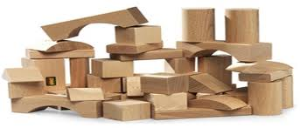
Step Four: RESEARCH DESIGN
Research design is a set of advanced decisions that make up the master plan specifying the methods and procedures for collecting and analyzing the needed information.
We will continue with this topic later

Slide 22

Step 5: Identify Information Types and Sources
Primary information: information collected specifically for the problem at hand
Secondary information: information already collected

Slide 24
Secondary Data
Data gathered and recorded by someone else prior to and for a purpose other than the current project.
Is often:
Historical
Already assembled
Internal to corporation
ADVANTAGES
Inexpensive
Obtained Rapidly
Needs no access to subjects or respondents (convenient)
Information is not Otherwise Accessible
Can Provide Insights into problem during exploratory phase
Can provide background data on trends etc. which lends credibility to the report
Notes:
24

Slide 25
Disadvantages of Secondary Data
Lack of Availability (e.g. new products; image)
Uncertain Accuracy
Data Not Consistent with Needs (not relevant)
Inappropriate Units of Measurement
Time Period Inappropriate (Dated)
Notes:
25

Slide 26
Evaluating Secondary Data
Does the data help to
answer questions
set out in the
problem definition?
Applicability
to project
objectives
Does the data apply to
the time period of
interest?
Does the data apply to
the population of
interest?
Notes:
26

Slide 27
Evaluating Secondary Data (continued)
Do the other terms
and variable
classifications
presented apply?
Applicability
to project
objectives
Are the units of
measurement
comparable?
If possible, go to the
original source of the
data?
Accuracy
of the data
Notes:
27

Slide 28
Evaluating Secondary Data (continued)
Is the cost of data
acquisition worth it?
Accuracy
of the data
Is there a possibility
of bias?
Can the accuracy of
data collection be
verified?
Notes:
28

Slide 29
Internal Data
Accounting information
Sales information
Backorders
Customer complaints ….
DATA MINING - The automated extraction of hidden predictive information from large databases
data mining is used to discover patterns and relationships in the data in order to help make better business decisions.
Data mining can help spot sales trends, develop smarter marketing campaigns, and accurately predict customer loyalty.
EXAMPLES:
Market basket analysis - Understand what products or services are commonly purchased together; e.g., beer and diapers.
Trend analysis - Reveal the difference between a typical customer this month and last.
Notes:
29

Slide 30

External Data
Created, recorded, or generated by an entity other than the researcher’s organization.
SOURCES:
Libraries
The Internet
Vendors
Producers
Books and periodicals
Government
Trade associations
Newspapers and journals
Notes:
30

Slide 31

TASK
You have decided to open a new retail store in suburbs of Prague that will sell furniture.
What information do you need to help you determine where to locate?
What secondary data could be available to help you decide where to locate the store?
Notes:
31

Slide 32
Step 6: Determine Methods of Accessing Data
Secondary data is relatively easy to access; primary data is more complex.
Three main choices for primary data:
  Have a person ask questions
  Use computer assisted or direct questioning
  Allow respondents to answer questions themselves without computer assistance…..
  Three basic methods of assesing primary data:
  COMMUNICATION
  OBSERVATION
  EXPERIMENTS (many based on observation and communication)……………….or in other words or terms…

Slide 33
Step 7: Design Data Collection Forms this step can be made together with the previous one
2 main methods for collecting Qualitative data
Direct Collection Method- when the data is collected directly, it makes use of disguised method. This method makes use of-
  Focus Groups
  Depth Interview
  Case Study
Indirect Collection-Method
  Projective Techniques
Quantitative Research- Quantitative Research quantifies the data and generalizes the results from the sample to the population. In Quantitative Research, data can be colleted by two methods
Survey Method
Observation Method

Slide 34
Step 8: Determine Sample Plan and Size next weeks
Sample plan refers to the process used to select units from the population to be included in the sample.
Sample size refers to determining how many elements of the population should be included in the sample.

Slide 35
Step 9: Collect Data next weeks
Data collection is very important because, regardless of the data analysis methods used, data analysis cannot fix bad data.
Nonsampling errors may occur during data collection.
Data collection errors may be attributed to field workers or respondents.
Researchers must know the sources of these errors and the controls to minimize them.

Slide 36
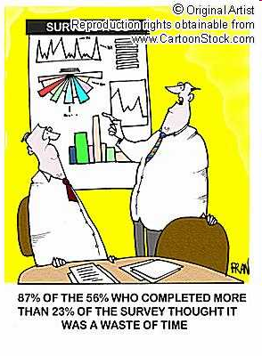
Step 10: Analyze Data next weeks
Data analysis involves entering data into computer files, inspecting data for errors, and running tabulations and various statistical tests.
Data cleaning is a process by which raw data are checked to verify that the data have been correctly inputted from the data collection form to the computer software program.
Pilot research – to test the research approach, sample, objectives, quality of …..
Collection
Coding
Tabulating
Calculating, summarizing, analysing
Interpretation

Slide 37

Step 11: Prepare and Present the Final Research Report
The last step is one of the most important phases of marketing research.
Its importance cannot be overstated because it is the report, or its presentation, that properly communicates the results to the client.
Executive summary
A description of research methods
Discussion of results
Limitations of study
Conclusions and recommendations

Slide 38
Research Design more detailed
Definition
  A framework or blueprint for conducting the marketing research project
Components
  Information needed
  Data collection methods
  Measurement and scaling procedures
  Sampling process and sample size
  Data analysis procedures
  dealing with at least four problems: which questions to study, which data are relevant, what data to collect, and how to analyze the results.
Notes:
38

Slide 39
Differences between research design and research methods (or data and informatin collecton methods – examples of design

Slide 40

Types of Research Design
Three traditional categories:
  Exploratory
  Descriptive
  Causal
  + prediction, evaluation, history (trends)
The choice of the most appropriate design depends largely on the objectives of the research and how much is known about the problem and research objectives.

Slide 41
Basic Research Objectives and Research Design
Research Objective Appropriate Design
To gain background information, Exploratory
to define terms, to clarify
problems and hypotheses,
to establish research priorities
To describe and measure marketing Descriptive
phenomena at a point in time
To determine causality, Causal
to make “if-then” statements
In practice they can be and are mixed

Slide 45
Exploratory Research
Exploratory research is most commonly unstructured, informal research that is undertaken to gain background information about the general nature of the research problem.
By unstructured, we mean there is no formal set of objectives, sample plan, or questionnaire.
It is usually conducted when the researcher does not know much about the problems.
Exploratory research is usually conducted at the outset of research projects.
Uses
  Gain Background Information
  Define Terms
  Clarify Problems and Hypothesis (refine research objectives)
  Establish Research Priorities
  Many questions; many sources
  Defining the problem; getting a “feel”

Slide 46

__________ _______
Exploratory Research
A variety of methods are available to conduct exploratory research.
  Secondary Data Analysis
  Experience Surveys
  Case Analysis
  Focus Groups
  Projective Techniques

Slide 47

Descriptive Research
Descriptive research is undertaken to describe answers to questions of who, what, where, when, and how.
Descriptive research is desirable when we wish to project a study’s findings to a larger population, if the study’s sample is representative.
Two basic classifications:
  Cross-sectional studies
  Longitudinal studies

Slide 48

CLASSIFICATION OF DESCRIPTIVE RESEARCH STUDIES (1)
Cross-sectional studies measure units from a sample of the population at only one point in time.
  Sample surveys: are cross-sectional studies whose samples are drawn in such a way as to be representative of a specific population.
    These studies are usually presented with a margin of error.

Slide 49

CLASSIFICATION OF DESCRIPTIVE RESEARCH STUDIES (2)
Longitudinal studies repeatedly measure the same sample units of a population over time.
Longitudinal studies often make use of a panel which represents sample units who have agreed to answer questions at periodic intervals.
Many large research firms maintain panels of consumers.

Slide 50
Marketing Research Panels
50
Continuous panels ask panel members the same questions on each panel measurement.
Discontinuous panels vary questions from one panel measurement to the next.
  They are sometimes referred to as omnibus (“including or covering many things or classes” – for several firms).

Slide 51
Marketing Research Panels
Discontinuous Panels
Discontinuous panels have the advantage of being able to access large groups of people who have made themselves available for research.
Discontinuous panels represent sources of information that may be quickly accessed for a wide variety of purposes.
Continuous Panels
Continuous panels are used quite differently from discontinuous panels in that one may use data from continuous panels to gain insights into changes in consumers’ purchases, attitudes, etc.
For example, brand switching studies are used to illustrate how consumers change brands, and market-tracking studies track some variable of interest over time.
51

Slide 52

Causal Research
52
Causality may be thought of as understanding a phenomenon in terms of conditional statements of the form “If x, then y.”
Causal research deals with the "why" questions.
Causal studies can be conducted through the use of experiments or communication (surveys)

Slide 53
Experiments
An experiment is defined as manipulating an independent variable to see how it affects a dependent variable, while also controlling the effects of additional extraneous variables.
Extraneous variables are those variables that may have some effect on a dependent variable yet are not independent variables.
Extraneous variables must be controlled through proper experimental design.
Experimental design is a procedure for devising an experimental setting such that a change in a dependent variable may be attributed solely to the change in an independent variable.
53

Slide 54
Control of Extraneous Variables
54
A control group is a group whose subjects have not been exposed to the change in the independent variable.
An experimental group is a group that has been exposed to a change in the experimental variable.

Slide 55
How Valid are Experiments?
55
An experiment is valid if it has:
  Internal validity: which measures the extent to which the change in the dependent variable is actually due to the change in the independent variable.
  External validity: which refers to the extent that the relationship observed between the independent and dependent variables during the experiment is generalizable to the “real world.”

Slide 56
Types of Experiments
Laboratory experiments are those in which the independent variable is manipulated and measures of the dependent variable are taken in a contrived, artificial setting for the purpose of controlling the many possible extraneous variables that may affect the dependent variable.
Field experiments are those in which the independent variables are manipulated and the measurements of the dependent variable are made on test units in their natural setting.
Test marketing is the phrase commonly used to indicate an experiment, study, or test that is conducted in a field setting.
Uses of test markets
  To test sales potential for a new product or service
  To test variations in the marketing mix for a product or service
56

Slide 57
Main points to think about when designing the research
(1) time constraints,
(2) the availability of data,
(3)the nature of the decision to be made,
(4) the value of the research information in relation to costs.
whether or not market research is called for in a particular
situation. Factors that influence this initial decision include the following.
􀁺 Relevance
􀁺 Type and Nature of Information Sought
􀁺 Timing
􀁺 Availability of Resources
􀁺 Cost-Benefit Analysis

Slide 58
Questions and design
1. Why should we do research? This establishes the research purpose as seen by the management team that will be using the results. This step requires understanding the decisions to be made and the problems or opportunities to be diagnosed.
2. What research should be done? Here the management purpose is translated into objectives that tell the researchers exactly what questions need to be answered by the research study or project.
3. Is it worth doing the research? The decision has to be made here about whether the value of the information that will likely be obtained is going to be greater than the cost of collecting it.
4. How should the research be designed to achieve the research objectives? Design issues include the choice of research approach—reliance on secondary data versus conducting a survey or experiment—and the specifics of how to collect the data.
5. What will we do with the research? Once the data have been collected, how will it be analyzed, interpreted, and used to make recommendations for action?

Slide 59
Some fact about research design
Research designs are often a compromise
between the trade-off of the accuracy of the information required against the time and cost of carrying out the research. Companies often use a mixture of research designs, e.g.:
• Hall tests to establish that the product concept was attractive and would be successful.
• Focus groups to get ideas for the package design.
• Depth interviews to test TV and press ads.
• Omnibus interviews to track brand recall.

