Slide 1
Development of WE in the Interwar Period (1920s)

Slide 2
Content
WWI
Post-war situation
Development of powers

Slide 3
World War I
Situation on the eve of the WWI
Von Schlieffen´s plan
Progress of the war
WWI in numbers
Military economies

Slide 4
A1. WWI
in 1914 the situation definitely not peaceful
  Strasbourg and its surroundings, population 50:50, gained by Germany in 1872
  boundaries between AU-HUN and IT
  problems AU-HUN and Serbia ⇨ attempt to take over Bosnia and Herzegovina
  national movement inside AU-HUN – Czechs, Poles, Slovaks
  Germany between FR and Russia + GB easy naval isolation ⇨ von Schlieffen´s plan

Slide 5
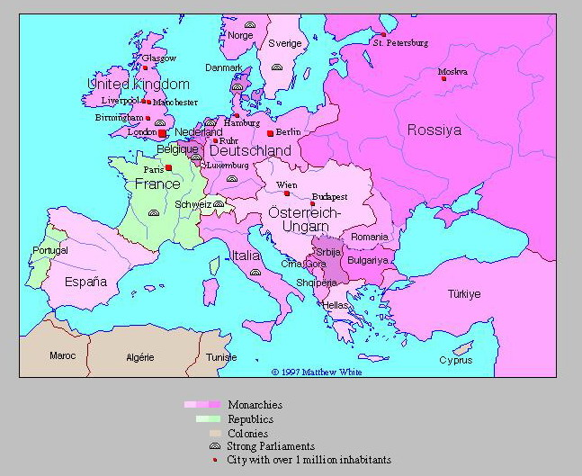
Europe before WWI

Slide 6
A2. von Schlieffen´s plan
prepared in 1880 - 1890
basics: rapid mobilization of FR x Russia slowly but extensively
⇨ at first defeat FR (6 weeks) and then Russia b/c not possible to defeat them at the same time
⇨ plan = in danger immediate mobilization and pass to FR across BE (assumption that BE allow free transit of DE)
  Belgium neutrality since 1830

Slide 7
A3. Progress of the war
death of the successor in Sarajevo
  b/c Serbia supported by Russia ⇨ DE mobilized
rapid attack on neutral BE but BE fought
⇨ DE problems - in Russia only few divisions under Hindenburg (he stopped the Russians- Tanenberg) + others to BE
DE finally broke through Swiss boundaries – Battle of the Marne (last barrier in front of Paris ⇨ DE stopped

Slide 8
trench warfare
GB blockade of sea ⇨ DE without food and raw mat.
22. 4. 1915 – DE use of toxic gas (for the first time)
1915 IT involved on the side of the Entente (Allied Powers)
1917 Lenin sent to Russia?? ⇨ revolution ⇨ Treaty of Brest-Litovsk and Russia have to pay + loss of territory + get outside of the war
1917 - entrance of USA to the war
1918 in DE – no willingness to continue
  + strikes + military failures +turbulent situation
  ⇨ abdication of the kaiser + DE conclude peace
DE: 1,6 mil. dead + high financial costs + BUT territory unaffected ⇨ conviction that they was not be defeated- someone sell them⇨ Jews in government

Slide 9
A4. WWI in numbers
24 states declared war on at least one of the Central Powers
50 seconds – maximum period for ordinary fighter to shoot from machine gun
31 m – range of German flame-thrower
61 m – average daily movement of GB in the Third battle of Ypres (31.7-12.12.1917)
125 km – distance from which DE blasted Paris
58 000 men - GB lost during the first day of the Battle of the Somme
727 km – length of the Western Front in 1914
136 Russian divisions fought in the front line in 1916

Slide 10
A5. Military economies
⇧ state interventions – control of markets
  but private ownership kept
turn away from the gold standard
centrally managed economies –military production
  gov. procurements, raw materials, fuels, LF assigned
strict control of foreign trade
regulations of wages and prices
rationing (basic goods)
financing of the war via loans or inflation
but differences among countries

Slide 11
Post-war situation
Consequences
Political situation
Economic development
  Price level
  Military loans
  International trade

Slide 12
B1. Consequences of WWI
the largest war until that time
huge death tolls and costs
considerable  economies and foreign trade
at the first time
  non-professionals employed on a mass scale
  male professions occupied by women (engineers, drivers, ...)
problems after the return of war veterans– women as cheaper LF

Slide 13
casualties
  in total = 10 mil. dead + 20 mil. severely wounded (!different estimates)
    the greatest share Russia - approximately 50% (+ famine and Spanish Influenza)
    FR = 1,2-1,3 mil. (labour shortage ⇨ import from e.g. Algeria)
    GB = 700 000 (NO labour shortage b/c colonies)
    IT = 600 000
    X GER=1,6 mil.
  casualties = young men with long work perspective
Notes:
0860_2

Slide 14
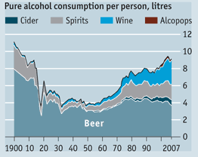

Slide 15
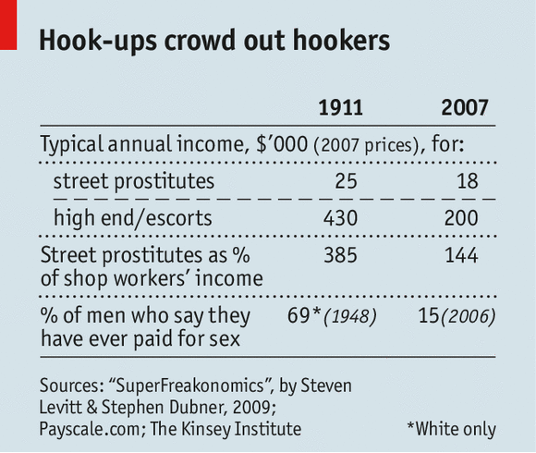

Slide 16
costs
  direct = military expenditures => 180 - 230 mld $ (in prices of 1914)
  indirect = property damage = > 150 bil. $
economy
  rapid  world industrial production
  agricultural production approx. 1/3 below the standard
  EX = 1/2 of the figure from 1913
    … elimination of Eur competitors ⇨  non-Eur production
  ⇨ Σ Eur economies halted for approx. 8 years
  + almost none help from abroad after the war

Slide 17
Growth of industrial production (1913 =100)

Slide 18
B2.Political situation after the war
post-war euphoria = US president Wilson (1918) – 14 points program X to prevent future wars
  peaceful solution of conflicts (moral condemnation + economic pressure)
  fair territorial division
  The League of Nations
  right to self-determination
    ⇧ Eur states from 20 ⇨ 27
      at the expense of Germany, Austria-Hungary, Russia
      without changes only NL, LU, CH, ES and PT
    ⇨ ⇨ huge changes of borders (total length of new borders = 19 200 km)

Slide 19
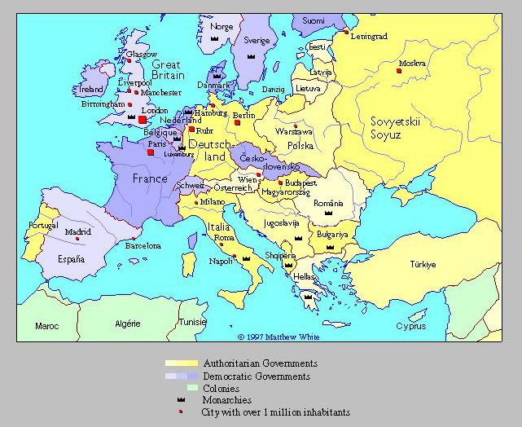
World after WW1 (1937)

Slide 20
newly created states -> problems
  politically unstable countries
  ⇧ borders ⇨ favourable for  protectionism
  Separation from raw materials and markets
  no administrative apparatus
  no (stable) currency ð inflation
  inconvenient transport network
  no experience with governance
  bad economic situation ⇨ danger of famine ⇨ social pressures
  + NACIONALISM ⇨ impact on trade

Slide 21
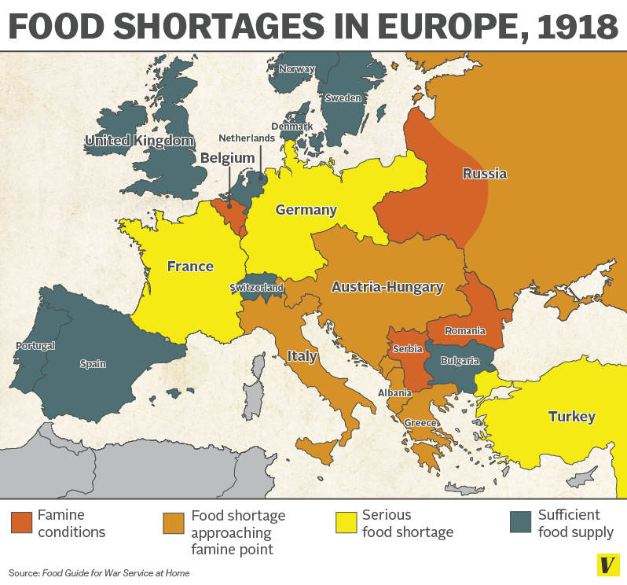

Slide 22
Settlement in Europe
goals of powers after WWI:
  FR – max weakening of DE = to ruin
  GB – maintain the stability = need of relatively powerful DE
  USA - power #1 – creditor of allies -> main interest in the repayment of loans + isolationism
⇨⇨ Paris Peace Conference ⇨ favourable for FR (mostly affected) ⇨ peace treaty – Treaty of Versailles
  high reparations for DE + other weakening
  DE recognized as the only guilty party
  ⇨⇨ humiliation + conviction of not to be defeated
Notes:
feated

Slide 23
B3. Post-war economic development
post-war economic boom
  expectation of recession
    return of war veterans
    end of military orders, ...
    BUT only moderate recession
  on the contrary – spring 1919 rapid growth ⇨ peak in 1920
    GB, USA, JP

Slide 24
the end of 1920 - slowdown ⇨ 1921 crisis
  reasons
    reaction on the previous boom (production met the demand)
    restrictions (G + T + simultaneous monetary restrictions)
    political instability – strikes and political pressures
BUT  only short-term period⇨ 1922 again 
⇨ Eur pre-war level in 1925
  but considerable differences among countries
    NL, NO, CSR and CH - rapid
    X AU, PL – almost stagnation
1925 – 1929 – successful period
  worldwide  production of raw materials and food by 11% +  manufactures by 26%

Slide 25
a. Price level
during the war ñ price level
  take away from the gold standard
  enormous military expenditures
  ð the simplest way = to print money
    = different form of taxation
    to make possible by long-term stable price level (100 years) ⇨ no experience with inflation ⇨ without immediate claims for indexation

Slide 26
in the post-war period – in most cases dealing with inflation
  Serious problems only in newly created states of CEE (PL and HU – in CSR no) + exceptions (AT and DE)
BUT also in developed countries certain ñ prices (mainly shortly after the end of the war)
  saturation of the limited military demand
  disintegration of international trade
  release of military regulations
  expansive fiscal and monetary policy

Slide 27
Inflation after WWI, measured by the CPI (1914=100)

Slide 28
b. Military loans
the biggest problem of the post-war Europe
  During the WWI – weapons, food, ...
Σ loans of the Entente at the end of the war = 20 bill. $
  1/2 USA
  7,5 bill. GB
  2,5 bill FR
USA´s debtors
  GB 5 bill. $ + FR 4 bill. $ + IT 2 bill. $ (CSR 200 mil. $)

Slide 29
Directions of international debts after WWI
GB
France
Italy
Serbia
Belgium

Slide 30
the biggest creditor USA
  Eur – expectation of write-off the loans X USA only  r + extension of period of repayment
  BUT Eur insolvency + need of purchases
  ⇨ USA stopped the loans until EUR start to repay
⇨ in 1920s via bilateral negotiations ⇨ loans to 12 bill. $ ⇨ estimates of really repaid loans Σ 2,6 bill. $

Slide 31
c. International trade
disruption of links during the war
  before the war - GB, DE, FR a USA large shares
    the most reliable partners
  GB immediately after the outbreak of WWI blockade against DE
  enormous trade
protectionism
  quantitative restrictions (in the course of WWI) ⇨ duties
  in total the protection not too high (x 1930s)
problem with binding to gold (parity)
pre-war volume of trade reached in 1924
1925 - 1929 – release of protectionism ⇨  trade by 19%

Slide 32
Protectionism
relations among countries not too friendly
newly created states in the Eastern Europe
USA Fordney-McCumber Tariff (1922)
  during the war no problems with demand⇨ purchase pf technologies by agriculturals (e.g. tractors and combines) ⇨ after the war return of Eur competitors ⇨ overproduction of agric. production ⇨prices
non-Eur countries – cut off from suppliers ⇨ development of own industries ⇨ return of competitors …
problems with BofP
  Eur = IM of raw materials and goods + loans (need of BofP surplus for payments ) X main trading partner USA protection

Slide 33
Average tariffs collected (in %)

Slide 34
Development of Powers
Great Britain
France
Germany
USA

Slide 35
C1. Situation in GB
loss of leading position
the war financed via sale of assets +  T
⇨C +  indebtedness +  navy (DE submarines) + loss of insurance (USA and CH) + loss of center of capital market + printing money ⇨ prices by 2x
after WWI  BUT then long period of stagnation
  high and permanent U

Slide 36
Industrial production (1913=100), Real GDP (mil Ł in 1938 prices) and U in UK
Year | Industrial production | GDP | Unemployment | Unemployment (according to Rostow)
1913 | 100 | 4 121
1918 | 50 | 4 763 | 0.8
1919 | 55.1 | 4 308 | 3.4
1920 | 61.2 | 3 860 | 2
1921 | 48.9 | 3 409 | 11.3 | 17
1922 | 56.5 | 3 542 | 9.8 | 14.3
1923 | 59.9 | 3 657 | 8.1 | 11.7
1924 | 66.5 | 3 765 | 7.2 | 10.3
1925 |  |  | 7.9 | 11.3

Slide 37
C2.Situation in France
10% of the territory devastated
industrial and agricultural production = 60% of pre-war level + EX only a portion
⇧ price level (2,5 x higher than before WWI)
sale of foreign assets + Bolsheviks
problems with BofP (before WWI inflow of profits from INV)
the biggest problems – loans from USA
  ⇨ gain reparations from DE ⇨ FR refused to pay until DE pay the reparations

Slide 38
GB and FR in 1920s
FR – depreciation of EX rate X before WWI + franc undervalued
  Rapid econ. - at the end of 1920s konec 20s substantially positive econ. results-  industrial capacity
GB – gold standard at the pre-war rate (prestige, tradition, …) = pound overvalued by approx. 10%
  constantly worsen economic results - U
    economic policy – restrictive monetary policy ⇨ deflation
⇨ Fr a GB opposite measures ⇨ different economic results
  adequate EX rate very important

Slide 39
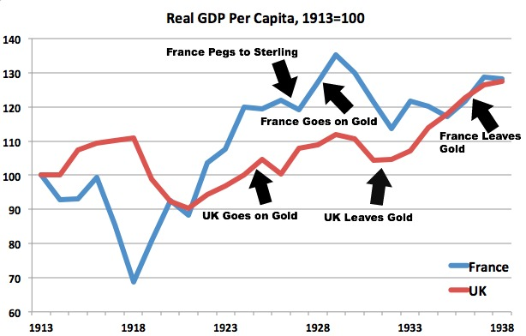
Real GDP p.c. in GB and FR

Slide 40
C3. Situation in Germany
still very powerful
consequences of the Treaty of Versailles
  territory
    return of Alsace-Lorraine to FR
    most of eastern Prussia and a part of Upper Silesia (raw materials) annexed by Poland
    loss of colonies
    + occupation of Saarland for 15 years by FR15 (coal)
    + time unlimited demilitarized zone of 50 km along the right side of the Rhine
    ⇨ 13% of territory lost ⇨ 10% of pop. + 75% of ore deposits, 25% of coal deposits and 15% of fertile land

Slide 41
  army
    interdiction of military air force
    confiscation of navy
    confiscation of weapons and munition
    + long-term limitation of armed forces
  confiscation
    majority of trading fleet
    5 000 locomotives + 150 000 railway trucks + 5 000 lorries + …
  loss of the majority of foreign investments
  + recognized as aggressor ⇨to pay reparations
    amount of reparations defined later

Slide 42
Political development
after WW1 – Weimar Republic
  unstable governments
  attempts at putsch
  ⇧ communist and nacionalist tendencies
international isolation
  Treaty of Rapallo (1922)

Slide 43
Reparations
Reparations Commission ⇨ 1921 results – DE immense r. = Σ 132 bill. Gold marks (33 bill. $)
  mainly FR – loans from USA + to ruin DE + 1871 + DE gain reparations from Russia
quarterly fixed payment (at the beginning of 1922) BUT no money and no possibility to make it
  foreign INV confiscated
  EX blocked
  + lack of raw materials (also for EX)
  ⇨ need of loans BUT either USA did not loan to DE
    attack on neutral BE considered amoral in USA
  ⇨ plea for new negotiations ⇨ rejected by FR⇨ printing money
  + radikalizace společnosti

Slide 44
7/ 1922 DE ask for a moratorium
  GB possible X FR NO
at the end of 1922 – DE proclamation of total depletion of sources
  ⇨ end of payments ⇨ FR and BE in problems – inability to pay loans ⇨ occupation of Ruhr area X DE without army ⇨ passive resistance BUT need of financing = printing money
    favourable for CSR b/c EX of steel, coal and iron to the Ruhr area

Slide 45
Inflation
ñ inflation already during the war
  b/c military expenditures financed due to political reasons not by  T BUT only by bonds
huge gov. deficit in 1919-1923 taxesbelow 3% of expenditures ⇨ the difference financed through printing money
reparations + passive resistance ⇨ printing money
+ pressures of pop to indexate wages + outflow of C to abroad +  taxe revenues ⇨ printing money⇨  hyperinflation
+ similar situation for the exchange rate
  1914 $/DM 1:4,2 ⇨ the end of the war 1:14 ⇨ 7/1922 1:493 ⇨ 1/1923 = 1:17 792 ⇨ free fall 15. 11. 1923 1 : 4,2 trillion (4 200 000 000 000)

Slide 46
German government income and expenditures, 1919 - 1923

Slide 47
Inflation in Germany after WWI (CPI 1913=100)

Slide 48
hyperinflation 1923 = profit for someones BUT in total  activities ⇨ at the end of the year = 1/2 1913 +  U
⇨ demission and new government (Stresemann)
  acceptance of the reality
  end of passive resistance
  possibilities to get over the crisis ⇨ new currency - Rentenmark = only fixed amount = stability
  fiscal rstrictions ( G+  T)
changing attitude of USA⇨ help ⇨ establishment of the commission ⇨ end of 1923 – Dawes Plan
  the plan accepted in DE BUT internal resistance ⇨ nationalism

Slide 49
economic consequences of the Dawes Plan
USA loans BUT no  reparations – only change of repayments – renewal of payments
  return to the gold standard in 1924 - Reichsmark
  possibility to borrow from USA -  capital inflow
    Several times higher than the reparations ⇨ also ordinary expenditures
    1924/1928 huge amount of (governmental and private) loans
    ⇨ = postponing problems
1926 - 29 – conjuncture in DE and world+  loans + DE pay the old ones
1929 end of new loans + requirements to repay the old ones ⇨ problems ⇨ Young Plan
  ⇩ reparations + extension of due time (1988) +  annual repayments
  the plan signed 20.1.1930 X opposition in DE
    Accepted in referendum BUT ñ nationalism

Slide 50
Outbreak of economic crisis before the implementation ⇨ DE´s inability to meet its obligations
  ⇨ Hoover´s moratorium (6/1931)
  ⇨ the reparations remitted at the end of 1932 in Lausanne
  + shift in worldwide public opinion
DE repaid only a part of the reparations
  estimates outside of DE = max 1/4
  BUT impact of reparation on inflation in 1923
  + later political consequence ⇨ since 1924 support of extremist parties ⇨ Hitler

Slide 51
C4. Situation in USA
superpower - Pax Americana
  BUT izolationism (outside of The League of Nations)
crises after WWI + high U
  BUT generally successful decade
  1925/6 moderate recession
  ⇧ productivity + low prices ⇨ real wages ⇨ boom of C ⇨ no revolutionary movement in USA
  end of the old economic pronciples? ⇨ continuous growth?
BUT problems in agriculture
  1920s  price ⇨ attemp to  costs ⇨  mechanization ⇦ loans from banks
+ pop. indebted ⇨⇨ banks in bad situation
+ banking system disintegrated (x monopols)

Slide 52
Reasons
⇧ specialization
⇧ implementation of assembly lines (Model T) - masss production – standardization and labour division
reorganization of the production = new managerial methods – taylorism = separation of production from direction
boom in automobilism (+ construction and electrification)
  movement of pop. to suburban areas ⇨ boom in construction, migration, ...
  ⇧ whole industry b/c car components, roads, petrol stations
new sales methods ⇨ e.g. for the first time loans offered by producers (not by banks)

Slide 53
Stock exchange
since1925 strong increase
speculative growth
  shares not held as property BUT for speculations
  ⇧ difference between price of shares and dividends
  system of purchasing shares – via bank loans (guaranteed by shares )
collapse – Black Friday 24. 10. 1929
  not the cause of the Great Depression !!!
  + only 3% of households with INV in shares X 1987 and today

Slide 54
Thanks for attention

