Slide 1
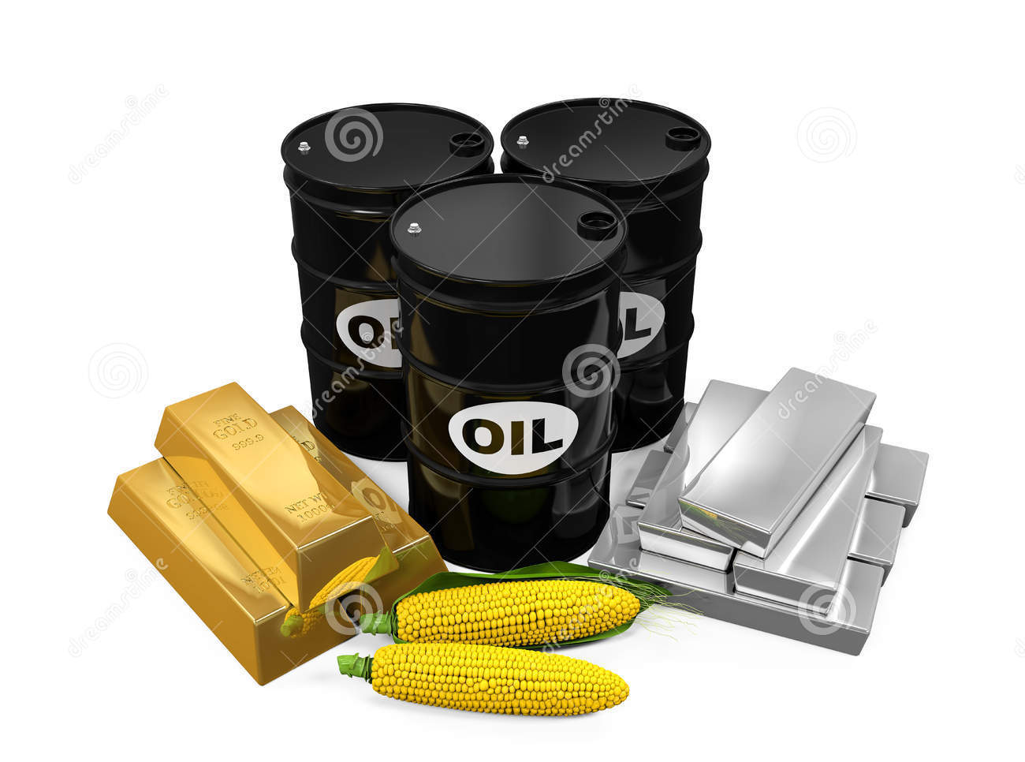
Trading in Oil, Gold and Other Commodities
Lucina Guzmán Ibarra

Slide 2
Buying, selling goods for profit.
Exchange of goods of equal value.

Slide 3
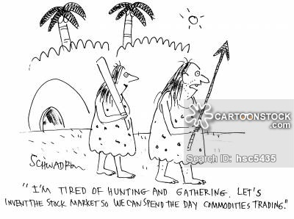
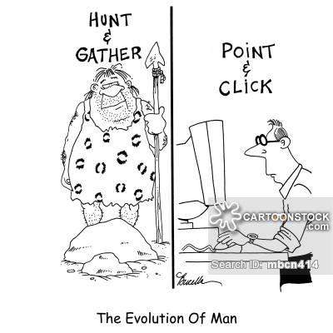
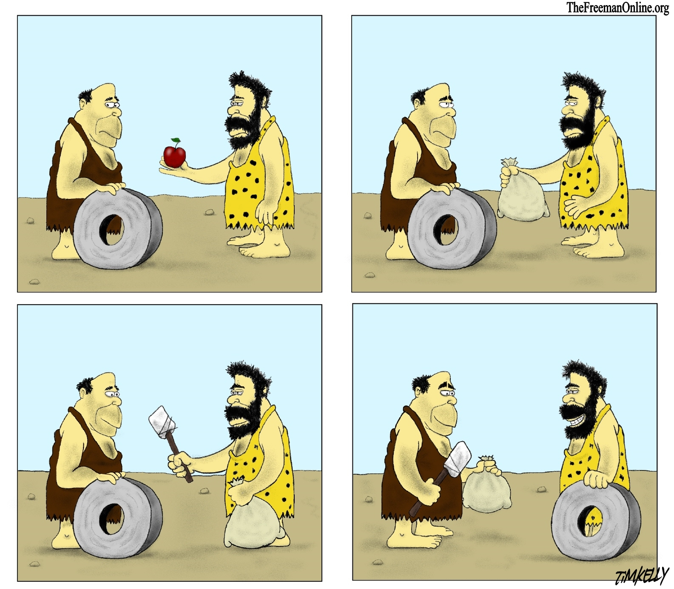
History of Trading

Slide 4
Why is trading so important between countries?
Not all countries have the natural resources to be self suficient in certain matters.
It is sometimes cheaper to buy from another country than to try to produce the good in their national territory.
Seasonal changes
Quality

Slide 5
What can parties, people, countries trade?
Securities
Tangible items
Commodities

Slide 6
What are commodities? + CHARACTERISTICS
Basic good
Interchangeable
They have simply been grown or extracted
No extra added value to them
Slightly quality variations
Priced equally

Slide 7
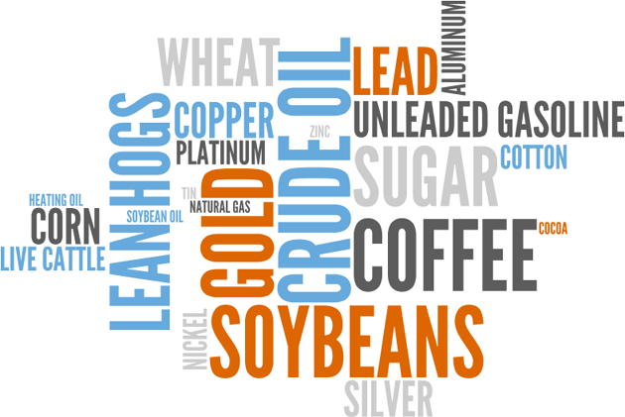
Clasification of commodities
Raw | Hard | Soft
Bought, sold or traded at a commoditie market | Natural resources, mined or extracted | Agricultural products Animal products

Slide 8
How do we trade commodities?
Commodities are traded in the commodity market.
Future contracts: specific quantity, specific price, specific day delivery.
There is no physical delivery at the moment the contract is made.
Future brokers: Commodity futures are bought and sold through an account with a commodity futures broker.
Trading future contracts

Slide 9
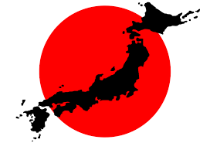
Japan Case
No oil reserves of its own
World’s 4th largest consumer
Must import all it requires

Slide 10
Investing in commodities
Advantages:
Encourages a country to specialise in a primary good.
Production in higher volumes
Increase in quality
Employment
Disadvantages:
Over-specialisation
Loss of jobs when world demand falls
There is no growing from certain industries
Cheaper imports may destroy domestic market.
Volatile market

Slide 11
Types of traders
Buyers and Producers: Guarantee a predetermined cost at a predetermined time, usually before the basic good is processed.
Speculators: Traders that profit from volatile price movements, they never intend to posses the commodity.

Slide 12
How commodities move the market…
Oil = Market volatility (Natural gas)
Other commodities such as corn and gold have a tremendous impact on daily stock prices
Prices rises, pressure on the company’s margins and quarterly earnings, investors start selling and cause falling stock prices.
Fluctuation affects hundreds of the biggest and most widely traded companies

Slide 13
Oil leads the list of commodities that move the market.
Oil is a key input on a variety of products we use daily.
Gold indirectly follows movements in the market.
Metals gain value during market downturns.
Lumber influences directly on the housing market.
Corn is among the most versatile and complex commodities. Single most importan crop in the world.

Slide 14
Questions?

Slide 15
References
http://www.investopedia.com/terms/c/commodity.asp
http://www.investopedia.com/articles/mutualfund/09/commodity-mutual-funds.asp
http://www.nasdaq.com/article/how-oil-prices-gold-and-other-commodities-move-the-market-cm593395
http://www.investopedia.com/terms/t/trade.asp
http://www.economicsonline.co.uk/Global_economics/Why_do_countries_trade.html

