Slide 1

Microfinance and microcredit

Slide 2

Microfinance is a type of banking service that is provided to unemployed or low-income individuals, or groups who otherwise have no other access to financial services.

Slide 3

the definition of “microcredit” by the European Commission (EC) is to fold a business microloan which is a loan under EUR 25 000 to support the development of self-employment and microenterprises, while a personal microloan is a loan under EUR 25 000 for covering clients’ personal consumption necessities such as rent, personal emergencies, education

Slide 4
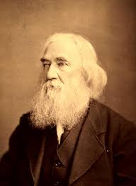
The emergence of microfinance
The first paper about microfinance was published by Lysander spooner in the 1800s

Slide 5
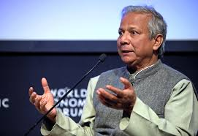
Prof. Muhammad Yunus
Nowadays the most important pioneer of microfinance is professor Muhammad Yunus who won about 80 awards for his work on this subject.
In 1983 he founded the Grameen bank

Slide 6

The Grameen Bank

Slide 7

The Grameen Bank
a Nobel prize winner corporation and the largest MFI in Bangladesh which has spread across 65 countries since its creation in October 1983.
model : based on solidarity lending and banking system for the impoverished people.
average loan : a little up to $100

Slide 8

Avantages vs Disavantages

Slide 9

The goal of microcredit is to allow people who are expelled from the traditional financial system to gain access to a loan.
The main advantage is allowing more people to finance their project.
It also helps impoverished people to get out of this vicious circle where a lack of money lead to trouble in finding a job

Slide 10

As his name implies, micro credit only allows MFI to give a small amount of money in a form a loan
The second big issue is the fact that most of the time, interest rates set are higher than commercial bank.
Finally, A missus of micro credit could lead to over indebtedness for people who are already in debt.

Slide 11


The future of microfinance and microcredits
instore more adequate regulations as well as developing some new securities and insurance
The main goal should be to expand access to financial services in developing countries

Slide 12


The future of microfinance and microcredits
, IMF should use and invest in new technology, mostly in mobile banking applications
IMF needs to study geographical specificities

Slide 13


The future of microfinance and microcredits
To complete this expansion, microfinance should insert itself in public policy making
and legislation making

Slide 14

The future of microfinance and microcredit
Finally, they should keep in mind their main goal : helping people getting out of poverty

Slide 15


