Slide 1
Introduction to MS Dynamics NAV IX. (Transfers Orders)
Ing.J.Skorkovský,CSc.
MASARYK UNIVERSITY BRNO, Czech Republic
Faculty of economics and business administration
Department of corporate economy

Slide 2
Transfers and locations
Benefits
Direct control of transfers : where (locations )do we have what (items) at any moment..
Responsibility of workers in warehouse (Pickers and Pullers)
Responsibility of drivers
Setup enables item tracking (batches, lots)
Better calculation of transport times due to specification of inbound and outbound handling times as well as time of delivery depending on setup of shipping agent services

Slide 3
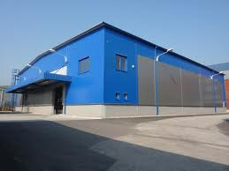
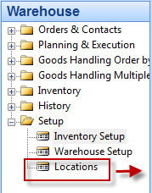
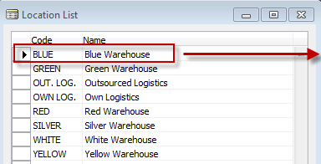
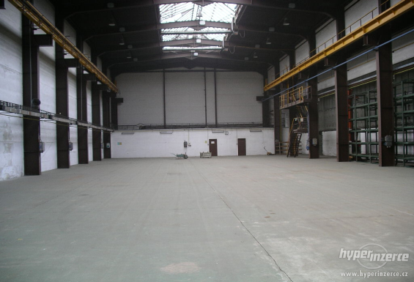
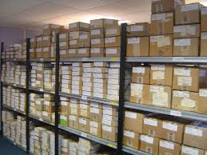
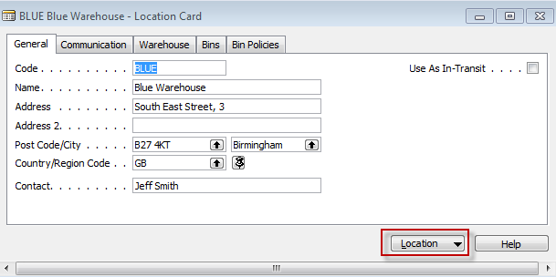
Locations and bins I.
Storage hall (Location)
Storage zone
See bins on
the next slide
Bin

Slide 4
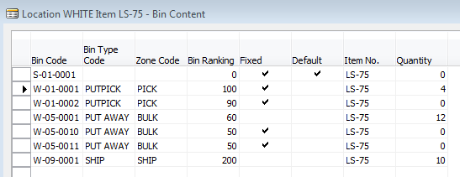
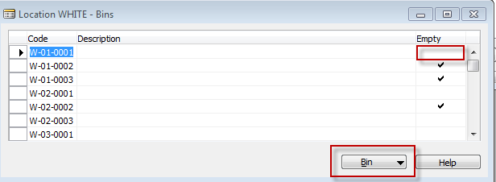
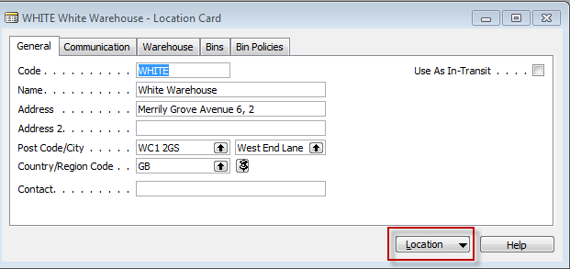
Location White and its bins

Slide 5
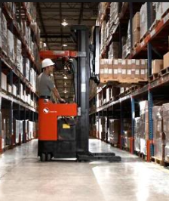
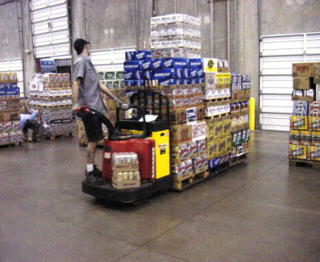
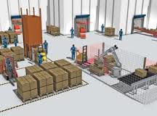
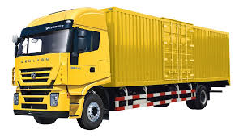
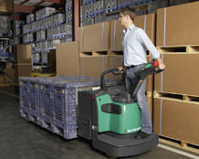
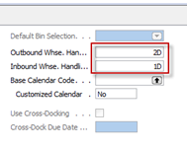
Basic warehouse movements
Put-away
Shipment
Receiving Zone
Inbound (e.g. 1D)
Picking
Outbound (e.g. 2D)

Slide 6
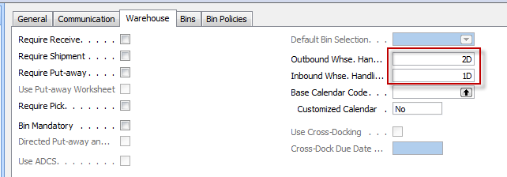
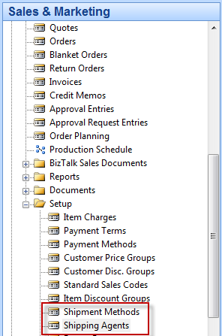
Locations and basic setup shipment

Slide 7
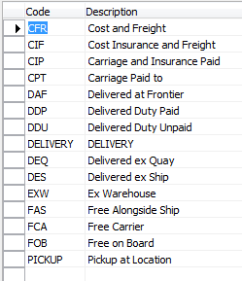
Setup shipment (either from Customer Card, Tab=Shipping or from Sales and Marketing Setup )
Shipment methods
Shipment agents

Slide 8
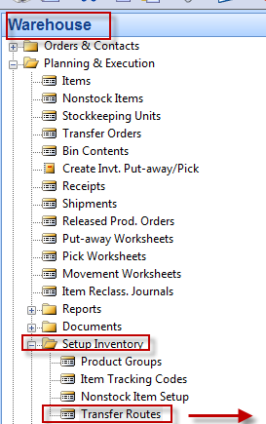
Agent services and Transfer routes
Agent services
Transfer Routes

Slide 9
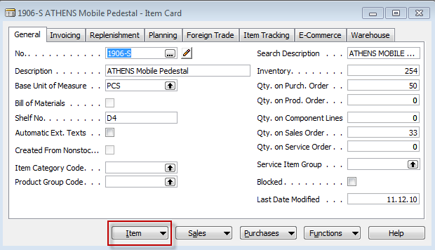
Transfer order
Red Location
Blue Location

Slide 10
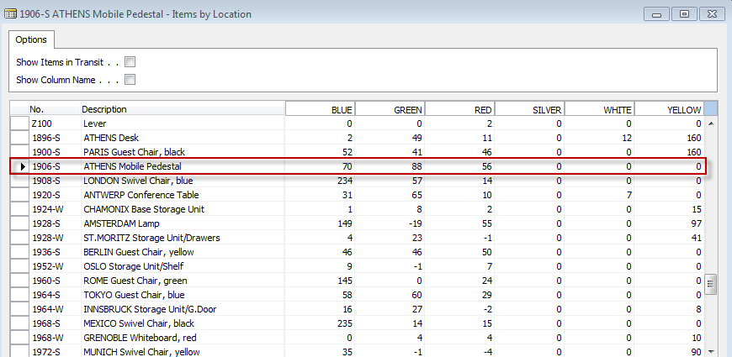
Item by Location (from button Item)

Slide 11
Transfer Order
Next day (1 D ) + Inbound Whse.Handling Time (1D) =2D ->9.9.12+2D=11.9.2012

Slide 12
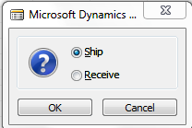
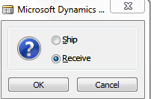
Posting TO (2 times F11)
Item Ledger Entries
The time is same instead of having two dates 9.9.12 and 11.9.12. The reason
is as follows : both movement were posted at same date !!

Slide 13
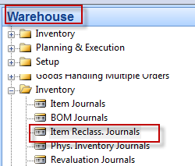
Transfer by use of Item Reclass.Journal
F11
Item Ledger Entries

Slide 14
End of the section IX.

