Slide 1
Introduction to MS Dynamics NAV VI. (Blanket Orders)
Ing.J.Skorkovský,CSc.
MASARYK UNIVERSITY BRNO, Czech Republic
Faculty of economics and business administration
Department of corporate economy

Slide 2
Blanket Orders
Reasons
  One Order frames several partial Order over long period
  Customer can get better prices and call of any time deliveries based on instant needs
  Vendor knows what have to be purchased/produced in the beforehand specified periods – Blanket Order represents a part of forecasting rules
  BO->type of long term contract
  Similar to forecast matrix, but with existing customer

Slide 3
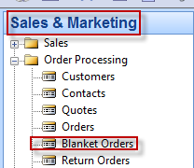
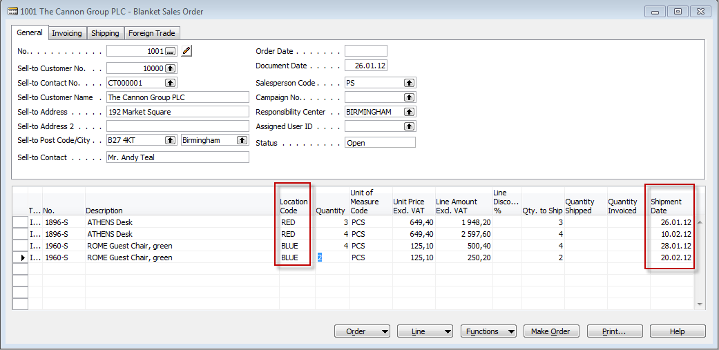
Blanket Orders

Slide 4
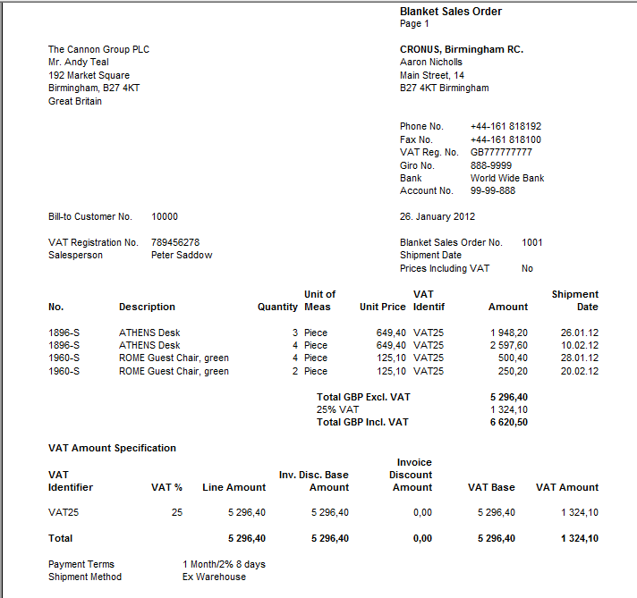
Blanket Order-print (preview)

Slide 5
Partial Sales Order Creation
Blanket Order Header
Customer
4
26.1.12
3
10.2.12
Blanket Order Lines
Item 1
Item 1
2
28.1.12
3
20.2.12
Item 2
Item 2
Sales Order 1
Sales Order 2
2
26.1.12
1
28.1.12
Time

Slide 6
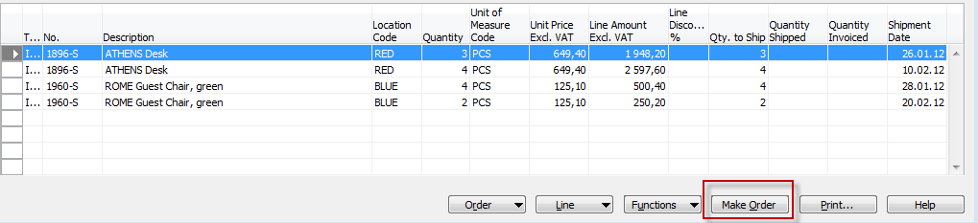
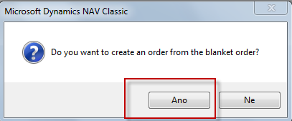
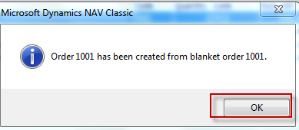
Partial Sales Order Creation

Slide 7
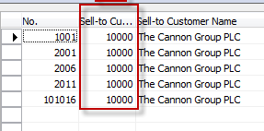
Partial Sales Order Creation
Blanket order is not modified
far the time being !!
Filtered Sales Order List (F7->Customer=10000)
Sales Order 1001
26.1.12
10.2.12
28.1.12
20.2.12

Slide 8
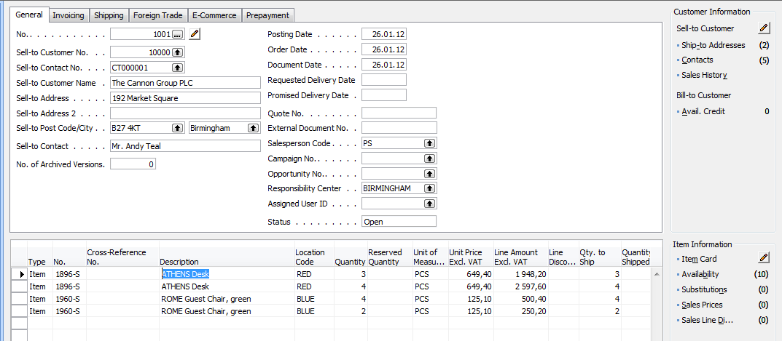
Created Sales Order
It has to be modified based on instant Customer requirements by overwriting fields Quantity –see next slide

Slide 9
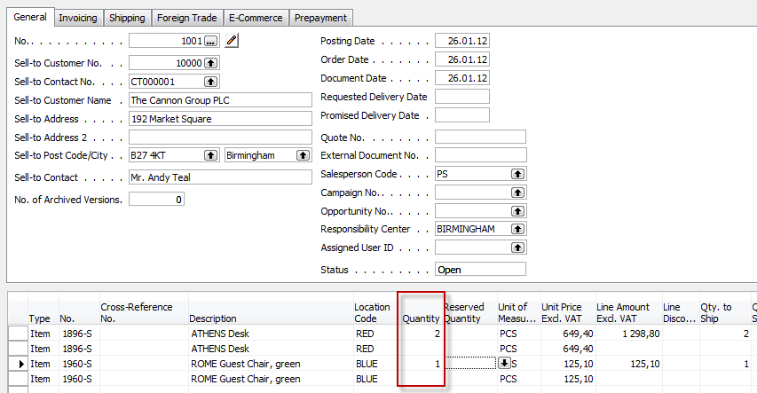
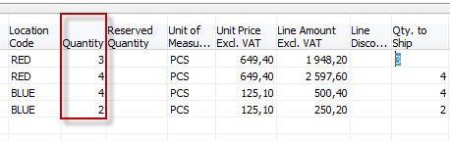
Created Sales Order
New
status
Former
status

Slide 10
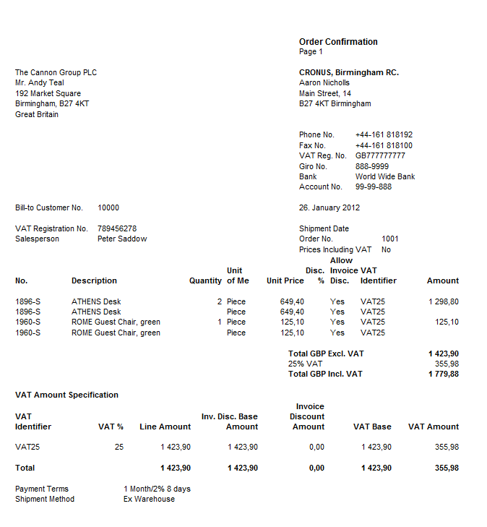
Print of created Sales Order

Slide 11
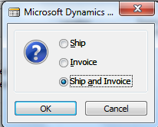
Sales Order - posting
F11

Slide 12
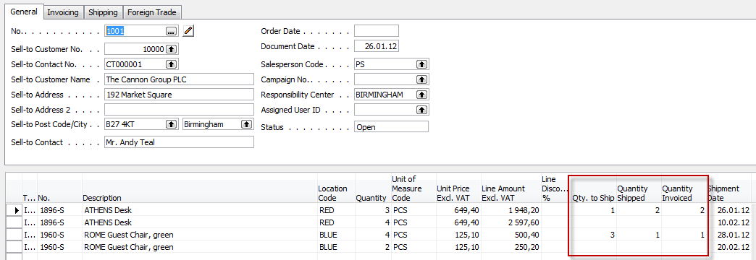
Blanket Order after SO was posted

Slide 13
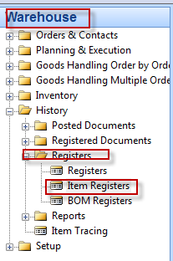
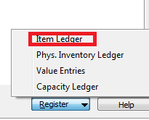
Item Ledger Entries

Slide 14
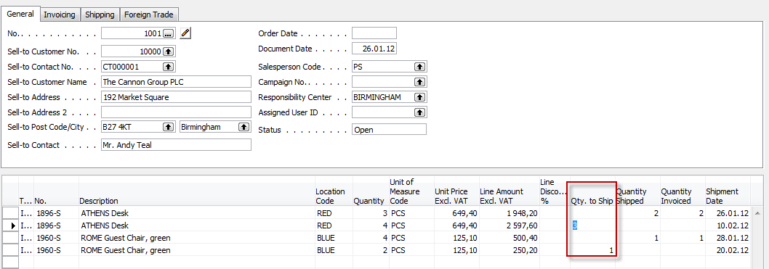

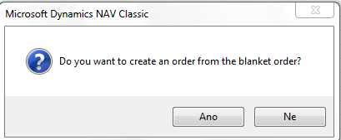
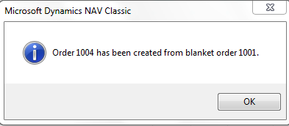
Blanket Order next delivery
Button Make Order ->

Slide 15
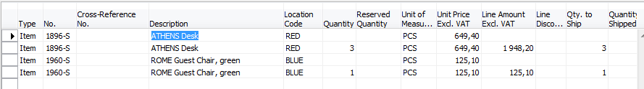
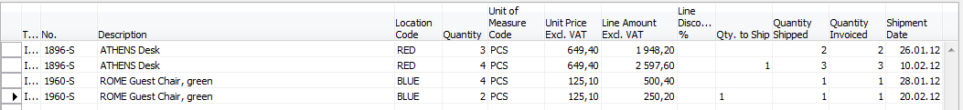
Sales Order covering 2nd and 4th BO lines
Blanket order lines after second creared SO is posted by F11

Slide 16
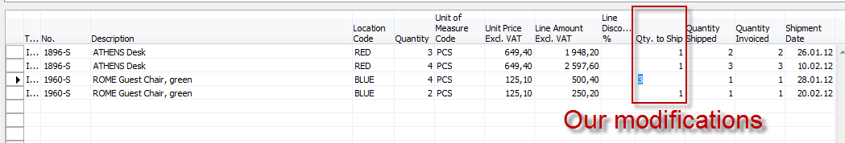
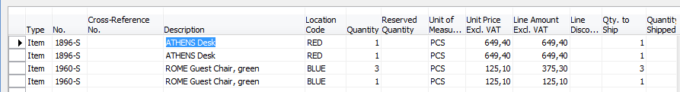
Last (next) possible steps
Blanket Order lines after next modifications by reason of urgent customer needs
Sales Order lines after Make order

Slide 17
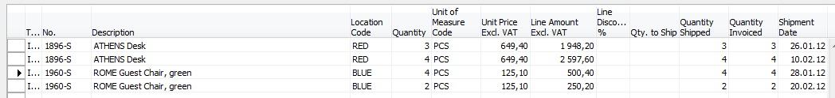
Blanket Order lines after last SO is posted

Slide 18

End of the section VI.

