Slide 1
Introduction to MS Dynamics NAV XIX. (Return Management)
Ing.J.Skorkovský,CSc.
MASARYK UNIVERSITY BRNO, Czech Republic
Faculty of economics and business administration
Department of corporate economy

Slide 2
Return Management
Return Management – better control over claims
Claims – external reaction from Customer
Claims - our reaction to bad quality of delivered items from Vendors
You typically create a sales return order to compensate a customer who is dissatisfied with an item that you have sold them. This could be due to a quality issue or delivery of a wrong item, for example
Assigning Exact Cost Reversing
You may agree to compensate a customer by allowing them to return a sold item against a sales return order. When you invoice the sales return order, you may then want to revalue the item at the unit cost that is connected to the original sales entry.

Slide 3
Task
A representative from customer 10000 calls a salesperson at Cronus and says that
he received five units of item 70011 instead of item 70010 and that two units of
item 1964-W were delivered damaged.
The customer explains that the wrong delivery of item 70010 was his own fault, while item 1964-W appeared to have been damaged during shipment.
The salesperson and the customer agree that item 70011 must be returned to
Cronus and a replacement of the same quantity of item 70010 will be shipped to
the customer.
Regarding this replacement, Cronus will charge the customer a restock fee of 5% of the original order amount.
Meanwhile, item 1964-W should not be returned, and the parties agree to settle the case by Cronus providing the customer with a sales allowance of 15% off the
price of the item.

Slide 4
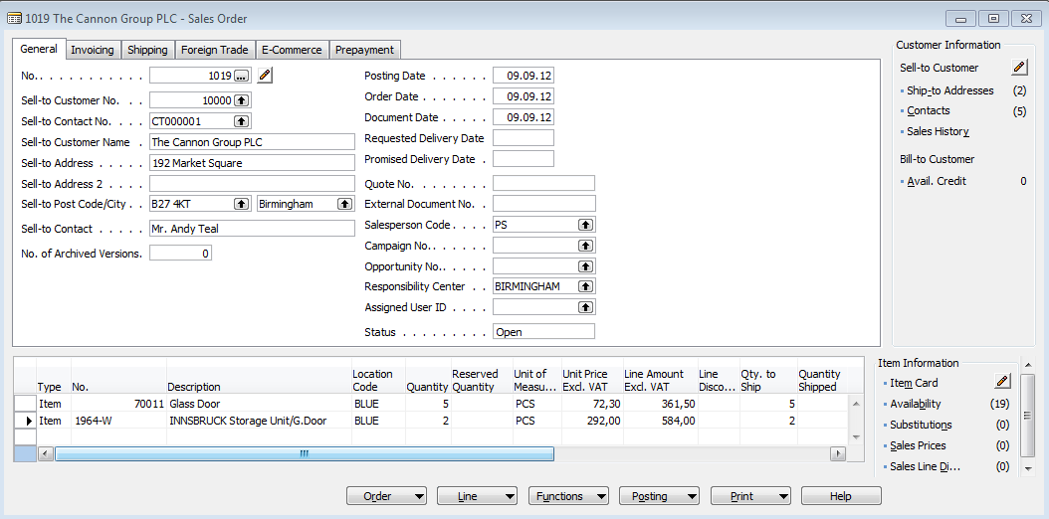
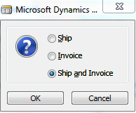
Selling
And post by F11

Slide 5
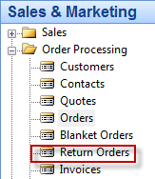
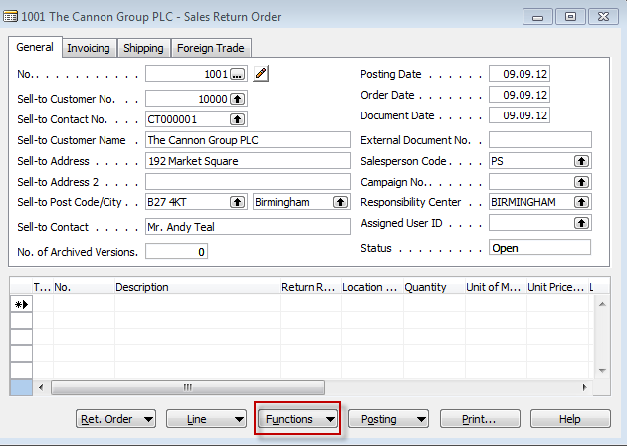
Return Order creation
F3 and customer 10000

Slide 6
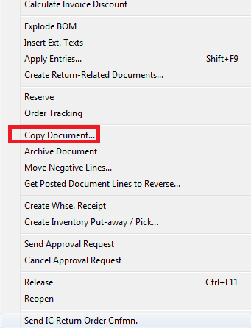
Return Order creation

Slide 7
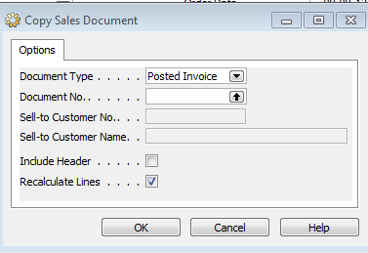
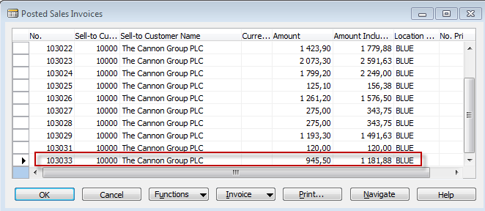
Return Order creation

Slide 8
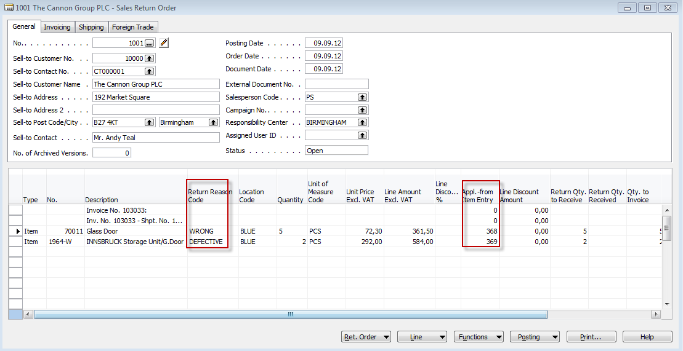
Return Order creation

Slide 9
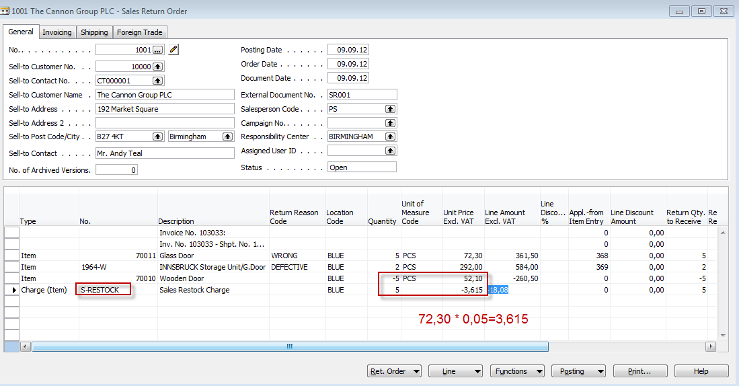
Return Order creation

Slide 10
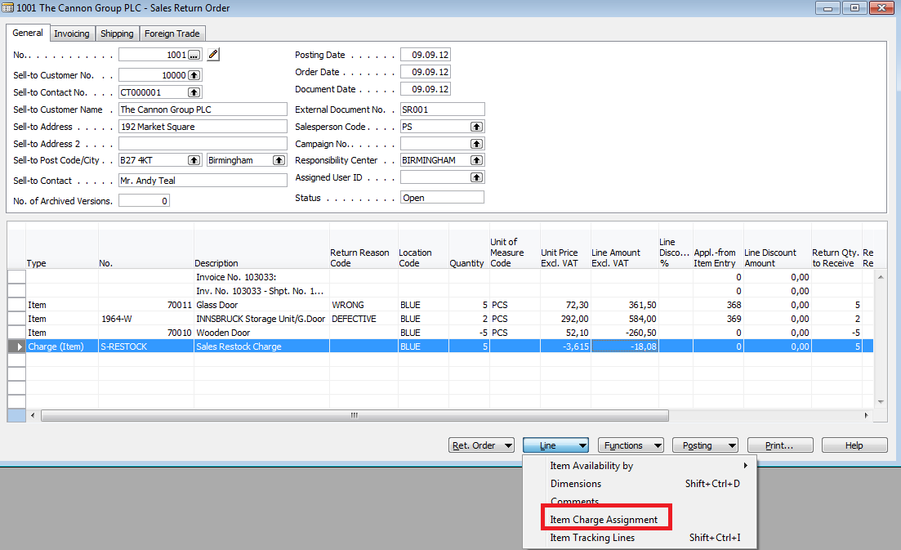
Return Order creation

Slide 11
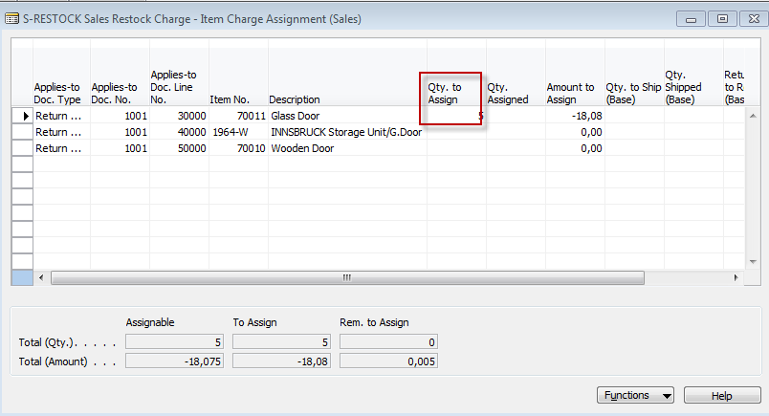
Return Order creation
And Esc

Slide 12
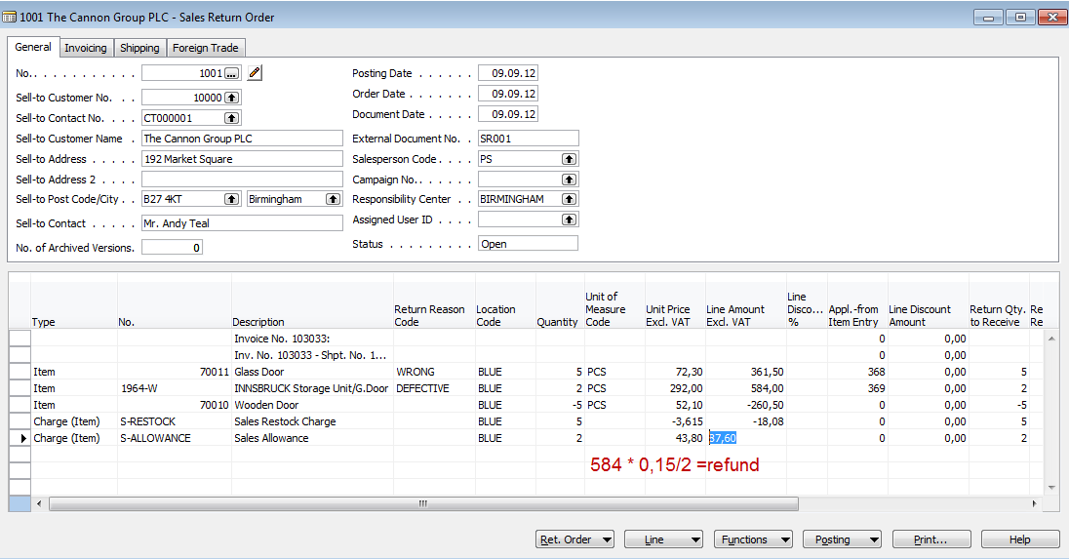
Return Order creation

Slide 13
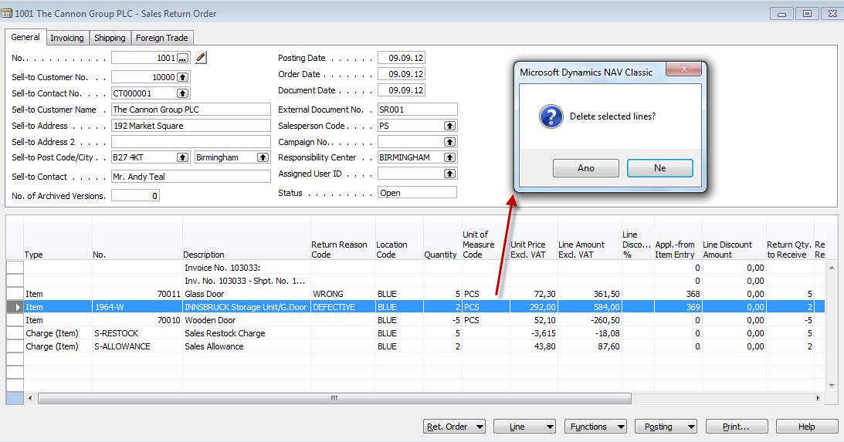
Return Order creation

Slide 14
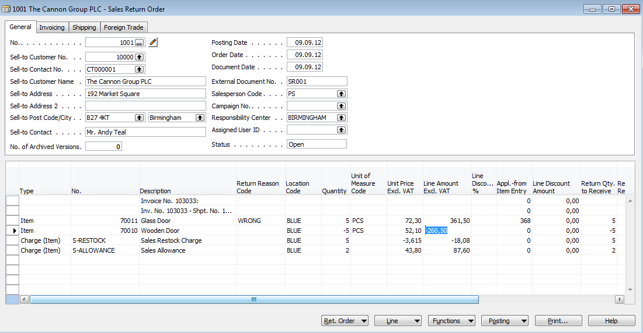
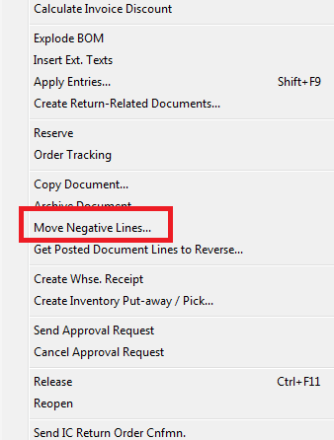
Return Order creation

Slide 15
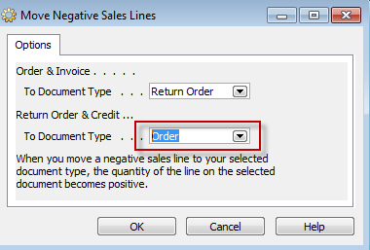
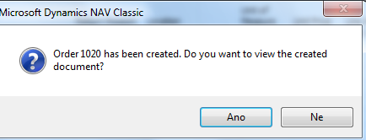
Return Order creation

Slide 16
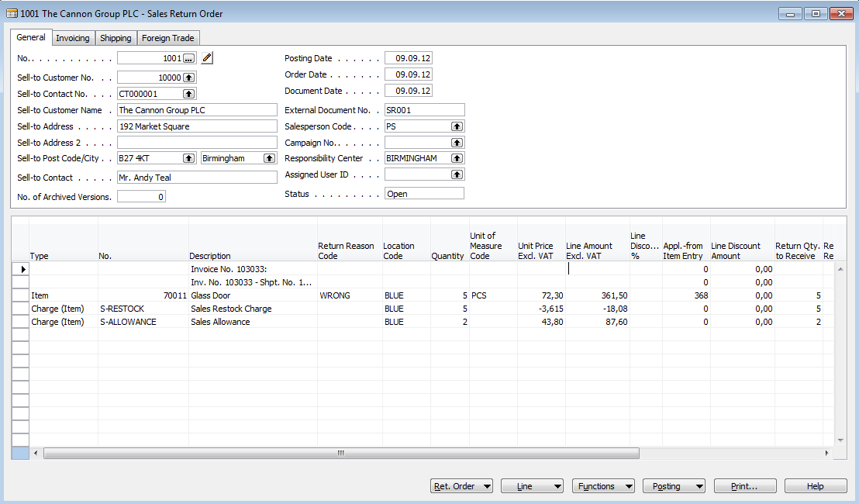
Return Order creation

Slide 17
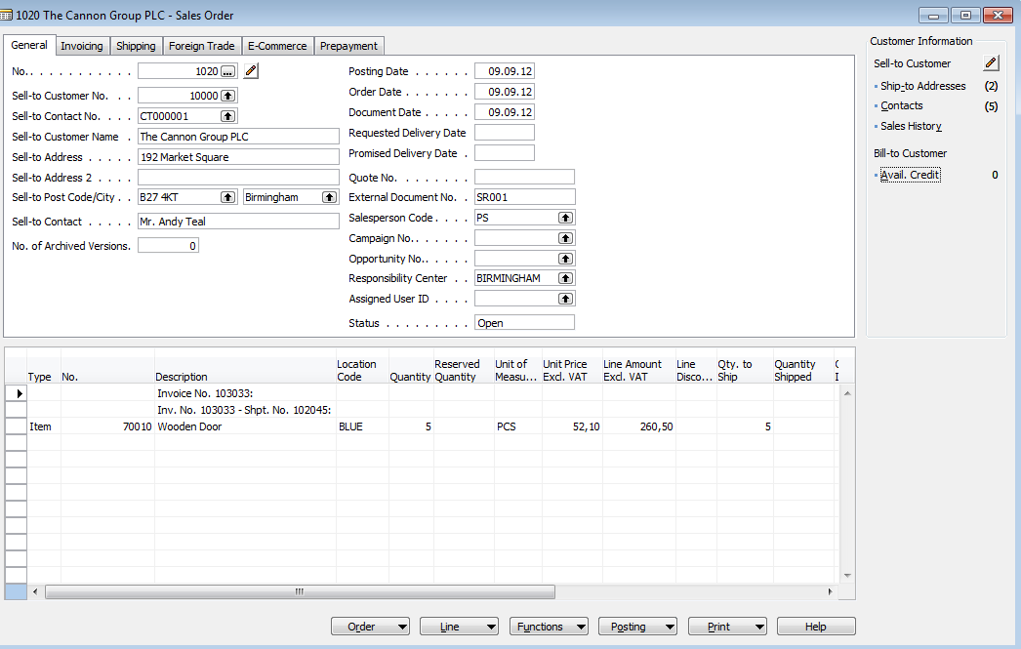
Created order

Slide 18
Created Return order before assigning Sales allowance

Slide 19
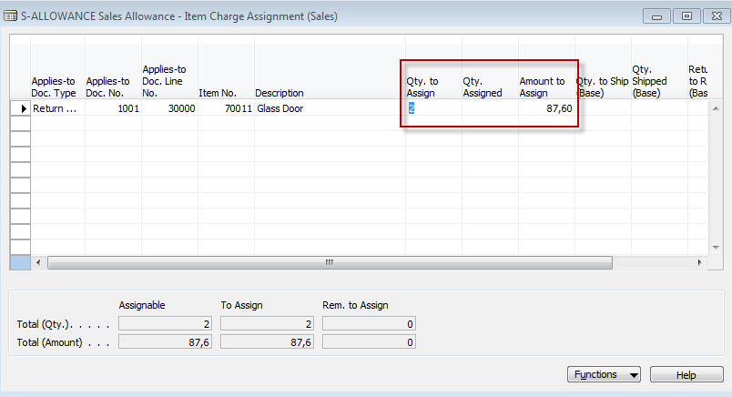
Assign sales allowance

Slide 20
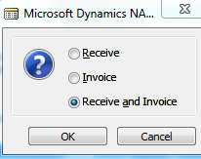
Post RO and new created SO

Slide 21
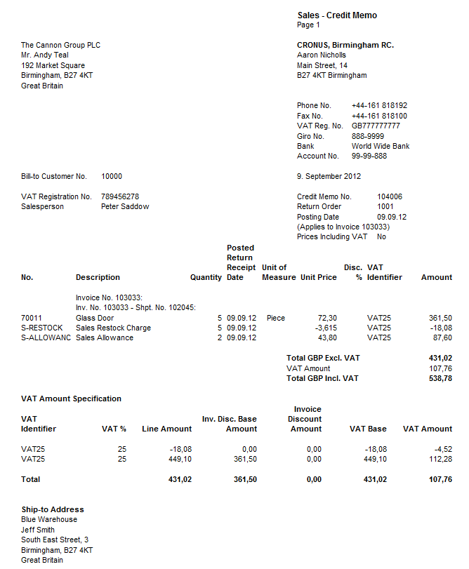
Created Credit Memo

Slide 22
Item Ledger Entries

Slide 23
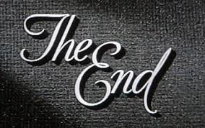
End of the section XIX.
Přihlásit se
Používáte-li nástroj pro čtení obrazovky, vypněte Dynamické vyhledávání Google kliknutím sem.
Internet
Obrázky
Videa
Zprávy
Nákupy
Více
Vyhledávací nástroje
Bezpečné vyhledávání
Výsledky hledání
I
RemixYourHealth Workout Series: The Show Stopper | RemixYourHealth
remixyourhealth.com-940 × 400-Vyhledávání pomocí obrázku
So two weeks ago I introduced you to the ridiculousness that was “The Shredder” workout. Did you try it? How'd it go? If you made it to the end of the ...
Navštívit stránku Zobrazit obrázek
Související obrázky:
Zobrazit další
Na obrázky se mohou vztahovat autorská práva.-Odeslat zpětnou vazbu
Not Dead Yet Radio | Podcast featuring Tommy Bateman & Alex Corolla
www.notdeadyetradio.com-447 × 280-Vyhledávání pomocí obrázku
Tommy starts the show off in an unusual fashion. He announces the show is ending. The time he puts in isn't worth the “rewards” he's getting.
Navštívit stránku Zobrazit obrázek
Související obrázky:
Zobrazit další
Na obrázky se mohou vztahovat autorská práva.-Odeslat zpětnou vazbu
G4 Cancels 'Attack of the Show,' 'X-Play' - Hollywood Reporter
www.hollywoodreporter.com-565 × 318-Vyhledávání pomocí obrázku
Attack of the Show Logo (2) - H 2012
Navštívit stránku Zobrazit obrázek
Související obrázky:
Zobrazit další
Na obrázky se mohou vztahovat autorská práva.-Odeslat zpětnou vazbu

