Slide 1
Introduction to MS Dynamics NAV XI. (WHM)
Ing.J.Skorkovský,CSc.
MASARYK UNIVERSITY BRNO, Czech Republic
Faculty of economics and business administration
Department of corporate economy

Slide 2
Simplified Warehouse Management (WM)
Use of location White-see setup next slides
WM creates another types of entries than Item Ledger Entries, Reservation Entries or Value Entries – Warehouse Entries
Causes of these entries are another stock operations :
Receipt
Put-away
Pick
Shipment

Slide 3
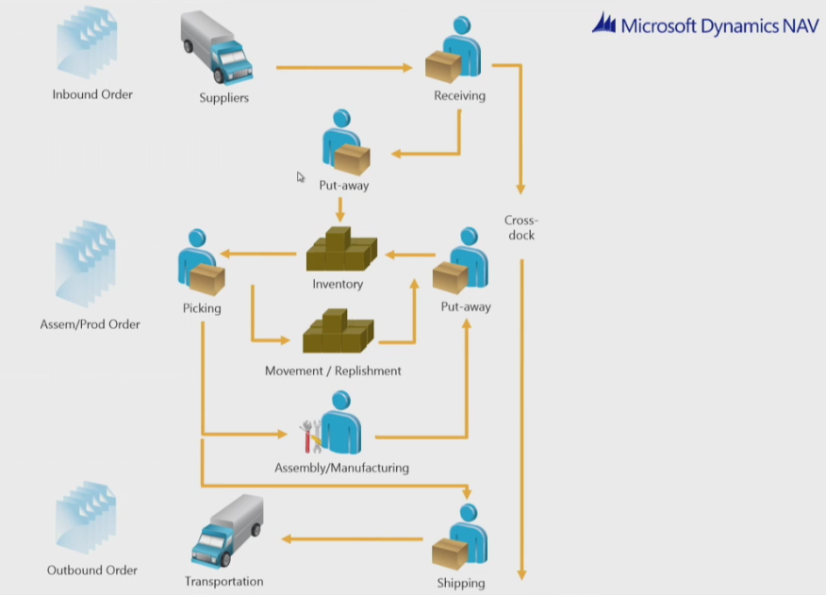
Warehouse workflow

Slide 4
Main WM Outline
Shipping Zone
Receive Zone
Bin PutPick
PO
WHR
PA
B1
Pick
WHS
S0
B2
Bin W_08_001 (B0)
(Receiving Bin)
Bn
Bin W_09_001 ( E )
(Shipment Bin)
Item
Picking Zone
WHR=Warehouse Receipt; PA=Put-away; PO=Purchase Order; SO=Sales Order

Slide 5
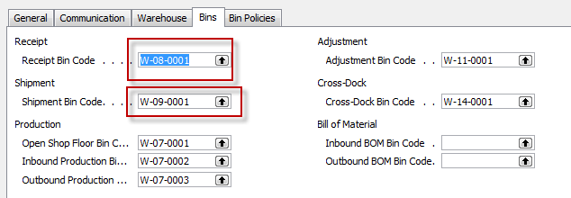
Location White I

Slide 6
Location White II

Slide 7
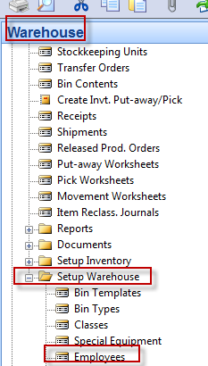
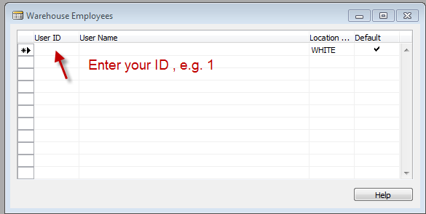
Setup if ID exists and we have to assign warehouse employee

Slide 8
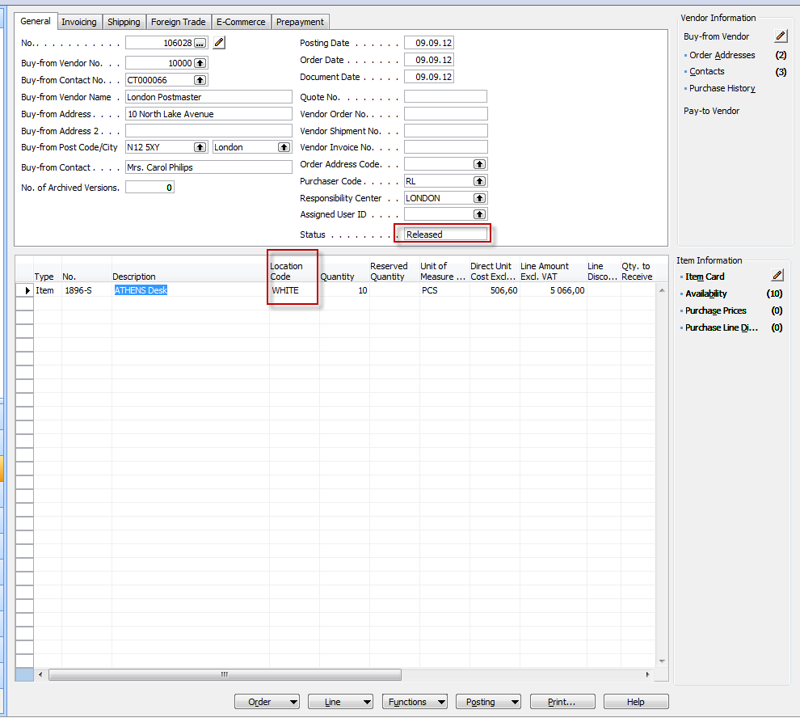
PO and Open->Release

Slide 9
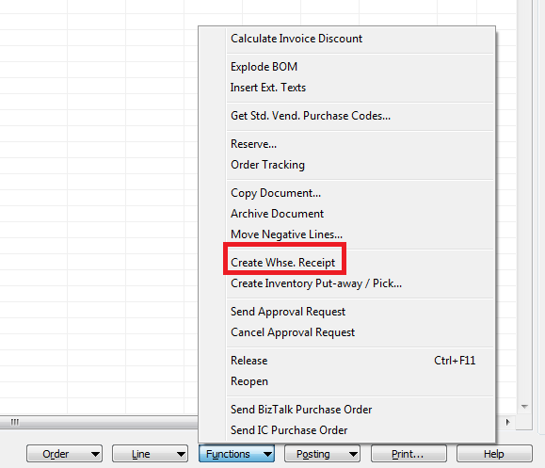
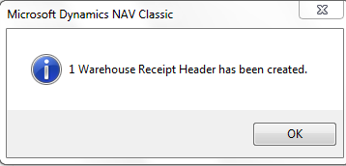
Creation of the Warehouse Receipt

Slide 10
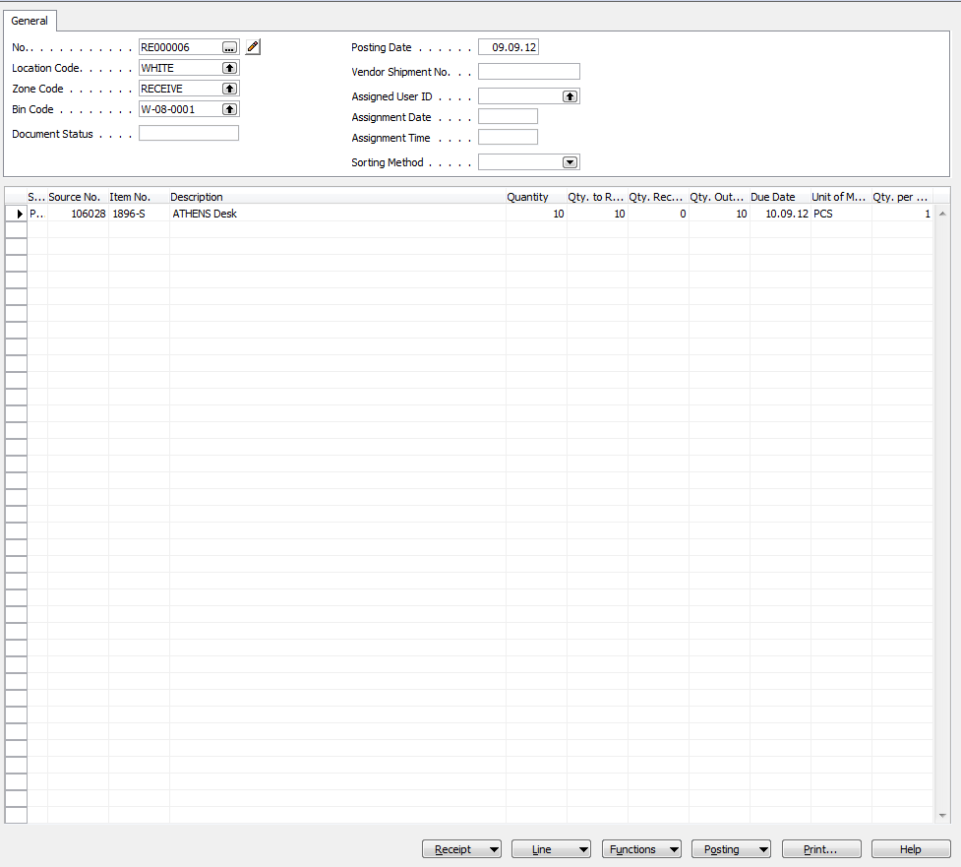
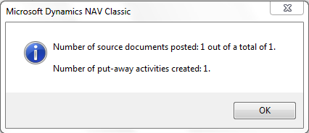
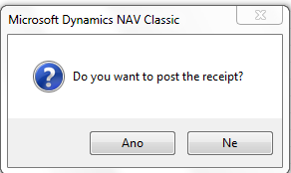
WH Receipt (F11->PA created)

Slide 11
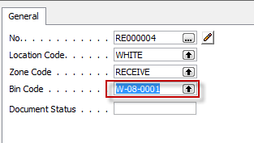
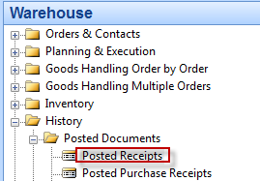
Receipt bin content

Slide 12
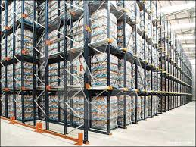
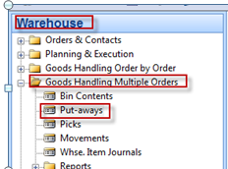
PO Lines after WH Receipt was posted
Created Put-aways
You can show a column there Action /Take-Place)

Slide 13
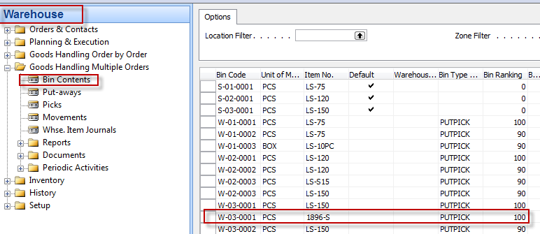
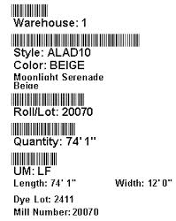
Registering Put-aways (F11)
Warehouse Entries

Slide 14
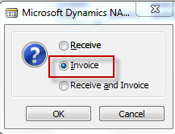
Warehouse Entries
Posting PO (only Invoice)

Slide 15
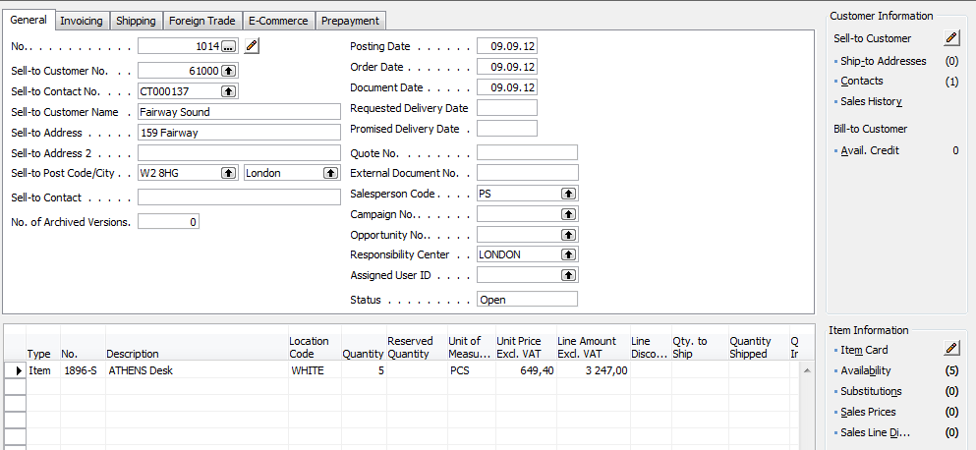
Sales Order
10=5+5

Slide 16
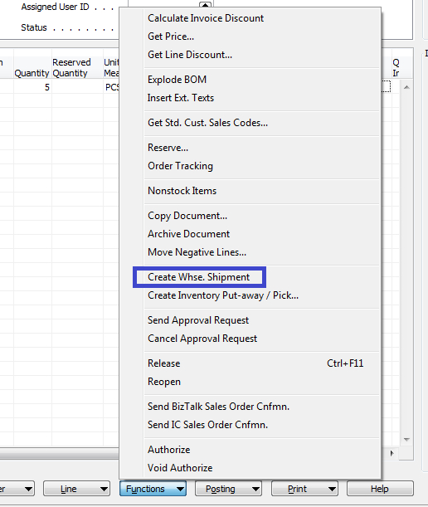
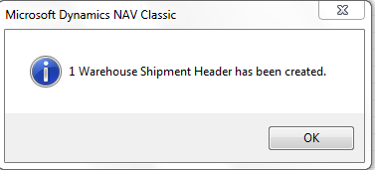
Creation of Warehouse Shipment
Before WH S creation change SO status from Open to Released !!

Slide 17
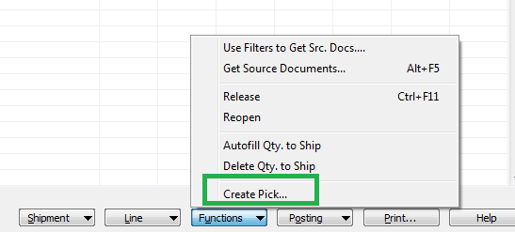
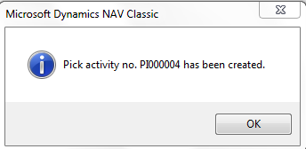
WHS Document and Pick Creation

Slide 18
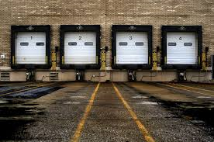
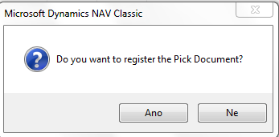
Created Pick
W-03-0001
W-09-0001
YES

Slide 19
Before Registering …
Enter Quantity to Handle

Slide 20
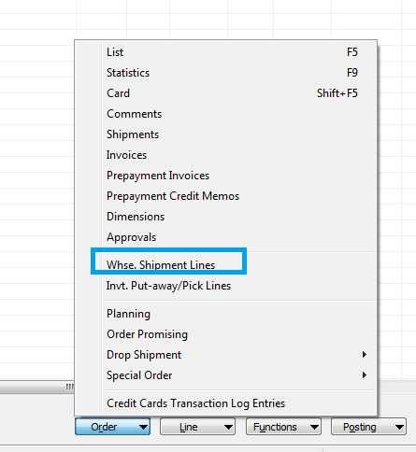
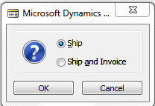
WH Shipment document
How to get there from SO ???

Slide 21
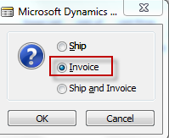
SO –Post only Invoice
Warehouse Entries
See next slide

Slide 22
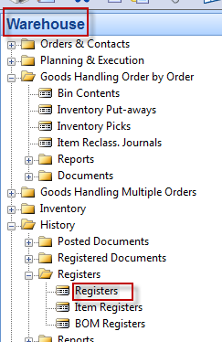
Warehouse Entries
Comment : use filter F7=Item No.=1896-S in order to only Item used in our model!!!

Slide 23
End of the section XI.

