Slide 1
Introduction to MS Dynamics NAV XXVII. (Production)
Ing.J.Skorkovský,CSc.
MASARYK UNIVERSITY BRNO, Czech Republic
Faculty of economics and business administration
Department of corporate economy

Slide 2
Production -basics
What to produce –BOM (Bill of Material)
A BOM is a listing of all the subassemblies, intermediates, parts and raw materials that go into a parent item.
Statuses : New, Under Development, Certified and Closed (archived)
Production BOMs manage the material requirement of production exclusively.
Production BOMs may consist of several levels. You can use up to 50 levels.

Slide 3
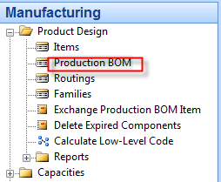
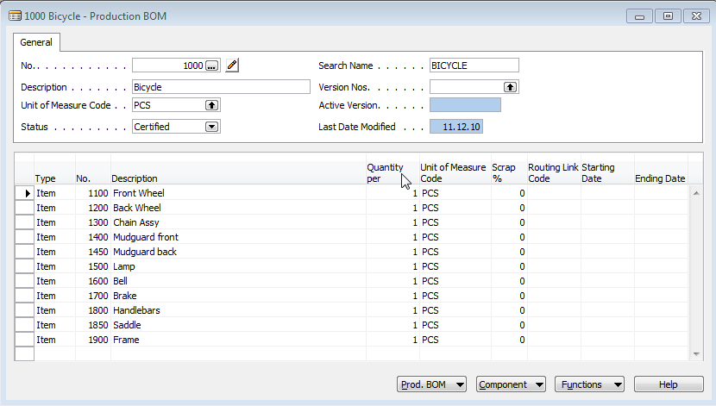
BOM

Slide 4
Production -basics
What resources will be used
Machine Centers
Machines
Workers (only MC)
Costs
Load
Statistics
Absence
Load
Sent-Ahead Quantity (only MC)
Capacity
In general, the capacity is the amount of work that can be done in a specified time period. The capacity of a machine center indicates how many machines or persons are working at the same time. For example, if the capacity is two, it means that twice as much work can be done at the same time
Efficiency
Efficiency measures the output of a machine center relative to the standard output expected. If you enter 100, it means that the machine center will have an actual output that is the same as the standard output

Slide 5
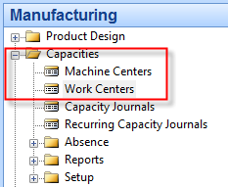
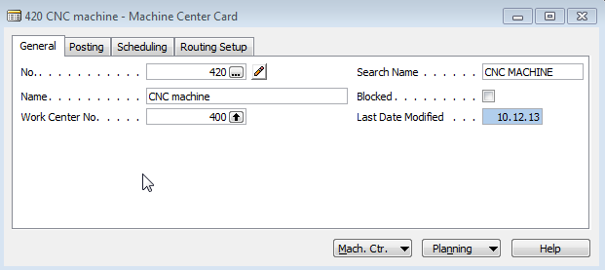
Machine Centers (MC)

Slide 6
Production -basics
What resources will be used
Work Centers
Related machines (group of machines)
Capacity
Efficiency
Costs
Load
Statistics
Absence
Shop calendar (not in MC)
Alternate Work Center (not in MC)
Unit of Measure Code (not in MC)

Slide 7
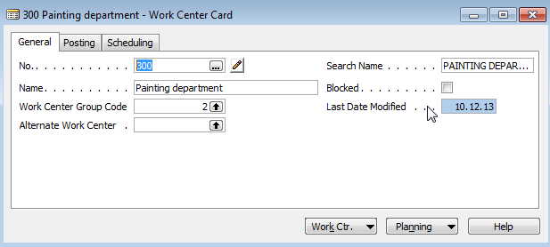
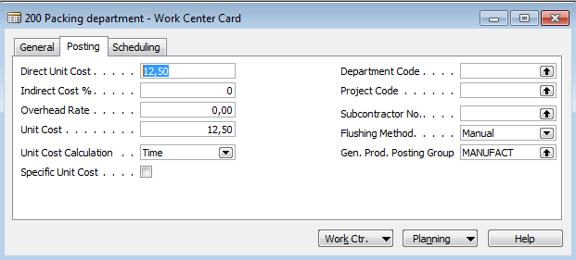
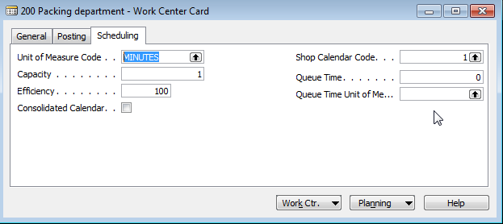
Work Centers (WC)

Slide 8
Production -basics
How the final product will be produces
Routing
Statuses (similar to BOM)
Serial and Parallel operations mode
Operations
Setup and production times
Waiting and Move times
Send-Ahead Quantity
Scrap calculation
Standard Task Codes

Slide 9
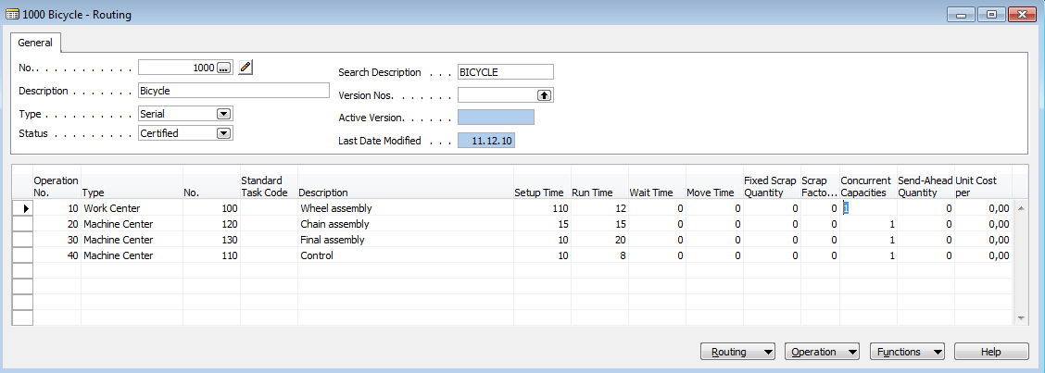
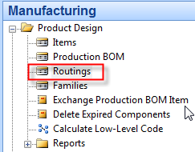
Routing

Slide 10
MRP and MRP-II in NAV
Today
DUE date
MRP
Production order 1
Planning : firstly PO1 and then PO2
MRP
Production order 2
MRP-II
Production order 1
MRP
Production order 2

Slide 11
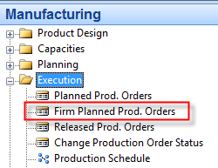
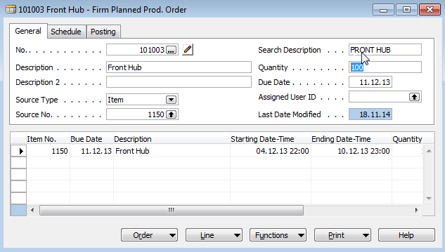
Production Order (manually created)
F3, Enter, Item, F6->1150->Quantity=100->Function->
->Refresh->Backward->Ticked (lines, routings and components)

Slide 12
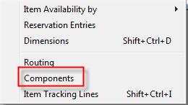
Components from PO

Slide 13
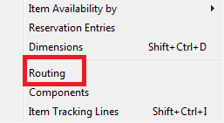
Routing from PO
SEE NEXT SLIDE

Slide 14
Routing

Slide 15
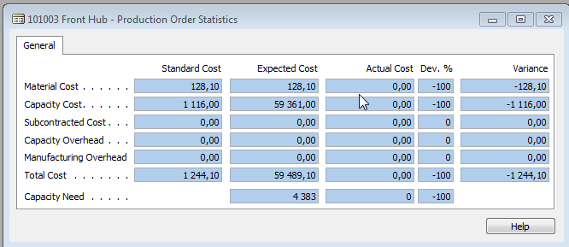
Statistics from PO

Slide 16
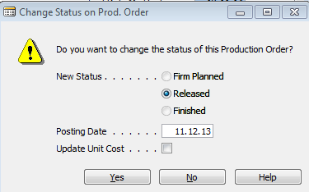
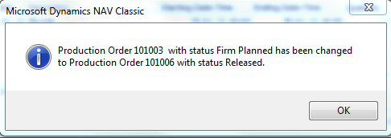
Status change
PO button Function ->Change unit status ->Released
New Released PO has the same structure like Firmed Planned PO !!!

Slide 17
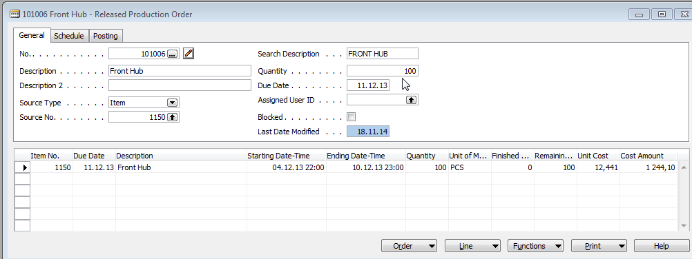
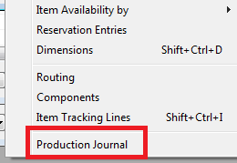
Consumption from Released PO

Slide 18
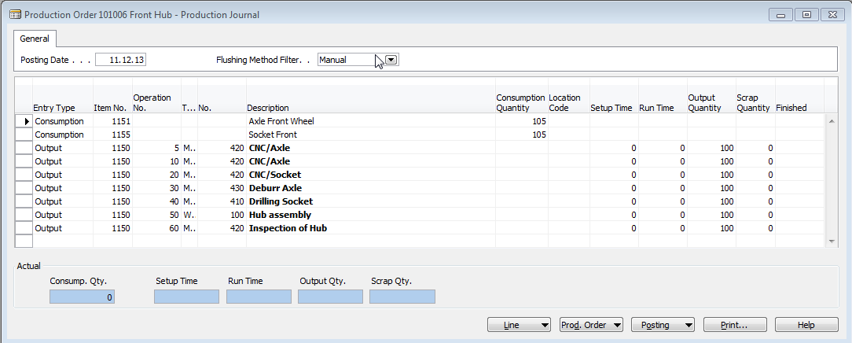
Production Journal I.
You have to enter Setup times and real Run times for every lines
SEE NEXT SLIDE

Slide 19
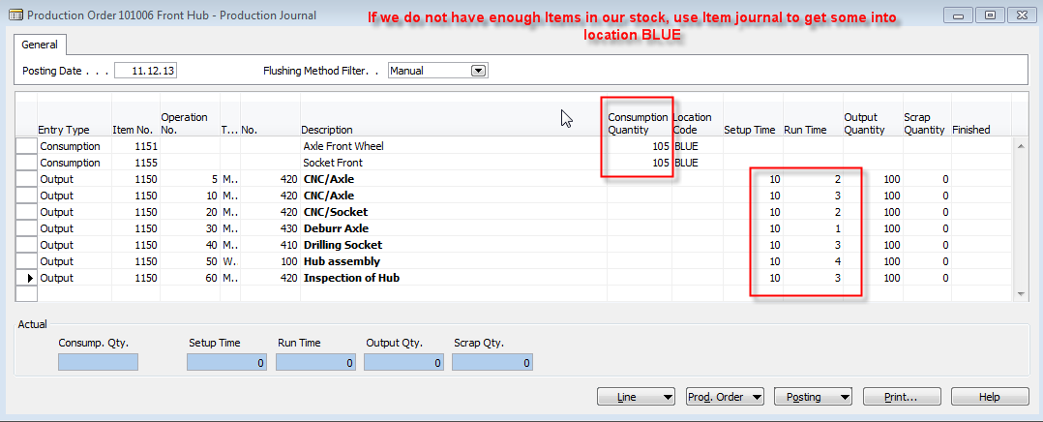
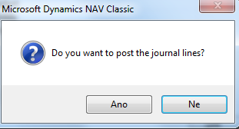
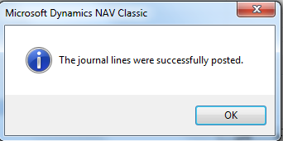
Production Journal II.
F11
SEE NEXT SLIDE

Slide 20
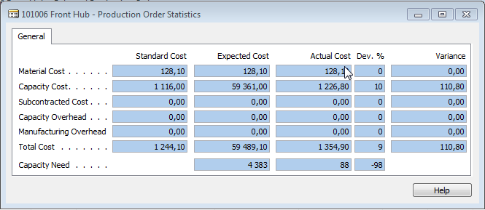
PO Entries and Statistics (F9)

Slide 21
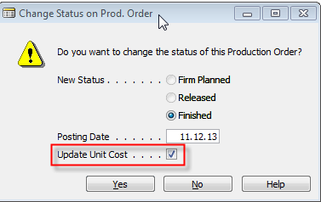
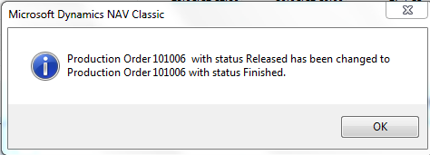
Change status PO->Finished

Slide 22
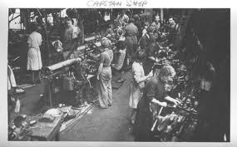
End of the section XXVI.
Přihlásit se
Používáte-li nástroj pro čtení obrazovky, vypněte Dynamické vyhledávání Google kliknutím sem.
Internet
Obrázky
Videa
Zprávy
Nákupy
Více
Vyhledávací nástroje
Bezpečné vyhledávání
Výsledky hledání
I
RemixYourHealth Workout Series: The Show Stopper | RemixYourHealth
remixyourhealth.com-940 × 400-Vyhledávání pomocí obrázku
So two weeks ago I introduced you to the ridiculousness that was “The Shredder” workout. Did you try it? How'd it go? If you made it to the end of the ...
Navštívit stránku Zobrazit obrázek
Související obrázky:
Zobrazit další
Na obrázky se mohou vztahovat autorská práva.-Odeslat zpětnou vazbu
Not Dead Yet Radio | Podcast featuring Tommy Bateman & Alex Corolla
www.notdeadyetradio.com-447 × 280-Vyhledávání pomocí obrázku
Tommy starts the show off in an unusual fashion. He announces the show is ending. The time he puts in isn't worth the “rewards” he's getting.
Navštívit stránku Zobrazit obrázek
Související obrázky:
Zobrazit další
Na obrázky se mohou vztahovat autorská práva.-Odeslat zpětnou vazbu
G4 Cancels 'Attack of the Show,' 'X-Play' - Hollywood Reporter
www.hollywoodreporter.com-565 × 318-Vyhledávání pomocí obrázku
Attack of the Show Logo (2) - H 2012
Navštívit stránku Zobrazit obrázek
Související obrázky:
Zobrazit další
Na obrázky se mohou vztahovat autorská práva.-Odeslat zpětnou vazbu

