Slide 1
Introduction to MS Dynamics NAV XXXIII-Expected Costs
Ing.J.Skorkovský,CSc.
MASARYK UNIVERSITY BRNO, Czech Republic
Faculty of economics and business administration
Department of corporate economy

Slide 2
Expected costs initial setup
Expected costs are the estimate that you make of the cost of, for example, purchasing an item before you actually receive the invoice for the item
You can post expected cost to both inventory and to G/L. Whenever you post a document, such as an order or a journal, as received or shipped, a value entry line will be created with the expected cost. This expected cost will affect inventory value, but it will not be posted to G/L unless you have set the program up to do that
Expected costs are posted to interim accounts in the general ledger. If you want to post expected cost, you must set up interim accounts for the relevant posting groups in the General Posting Setup table.
See setup later in this show

Slide 3
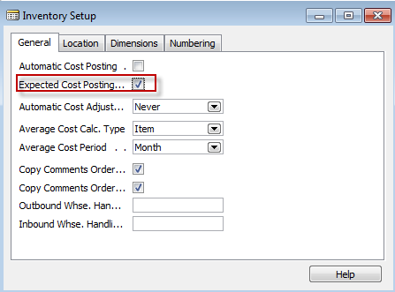
Expected costs initial setup I
If there is a check mark in the field, the program will post expected costs to interim accounts.

Slide 4
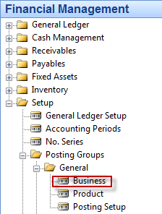
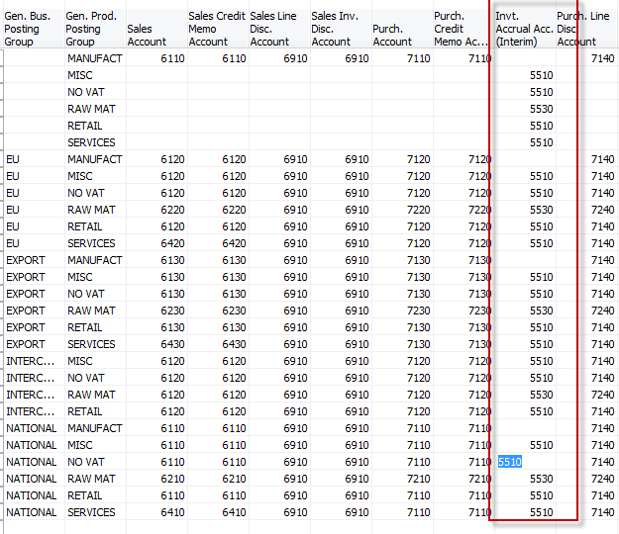
Expected costs initial setup II.

Slide 5
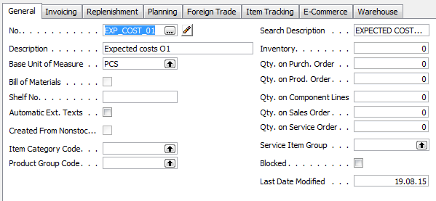
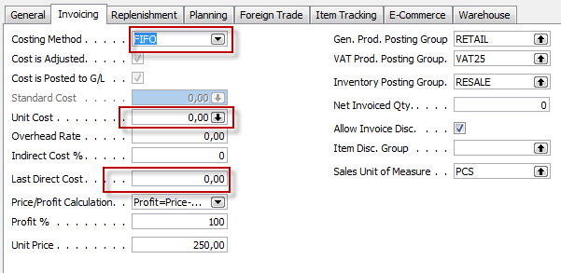
New item

Slide 6
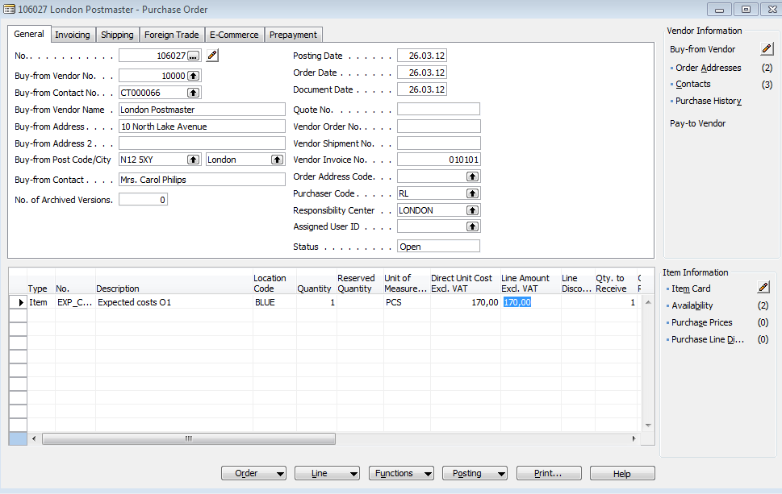
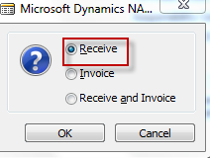
Purchase order (origical cost=190)
Expected cost
Posting : Only shiping !!!

Slide 7
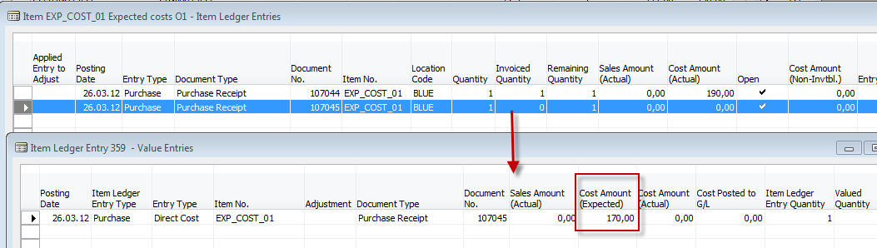
Item card-entries after posting
Adjustment see next slide

Slide 8
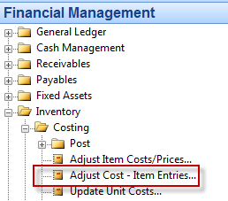
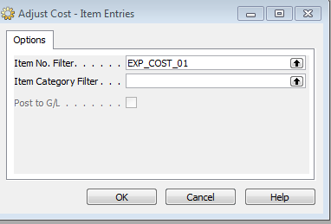
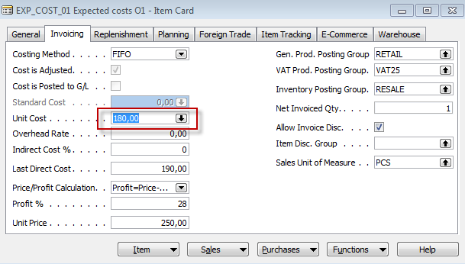
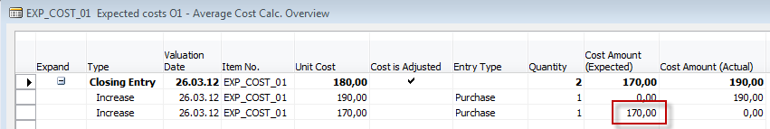
Adjustment

Slide 9
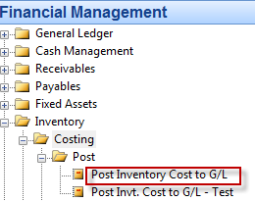
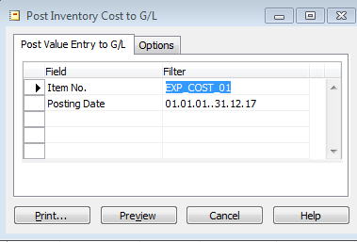
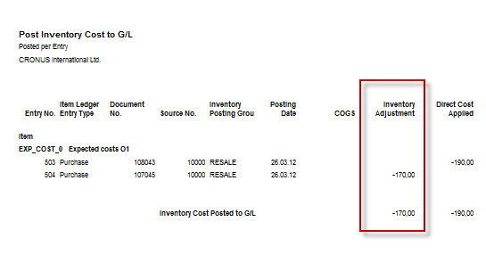
Post inventory cost General Ledger

Slide 10
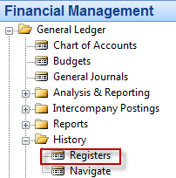
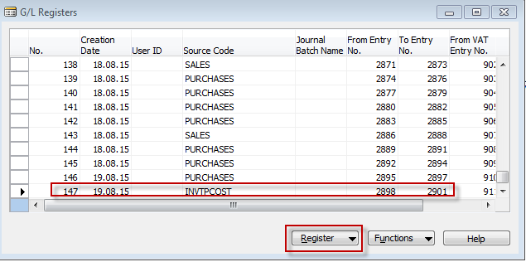
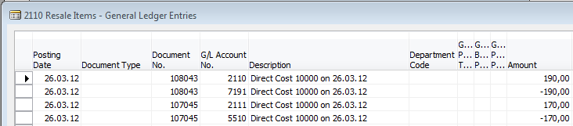
General Ledger Entries
2110
7191
2111 (interim)
5510 (interim)
190
190
170
170

Slide 11
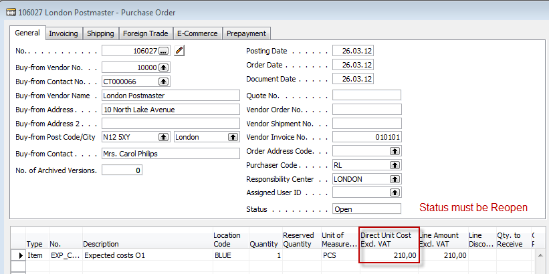
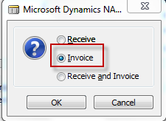
Modification of expected costs to real one related to invoice and post as described below

Slide 12
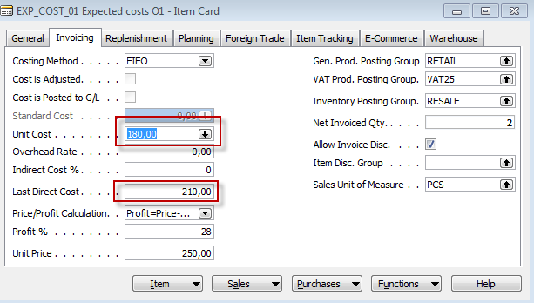
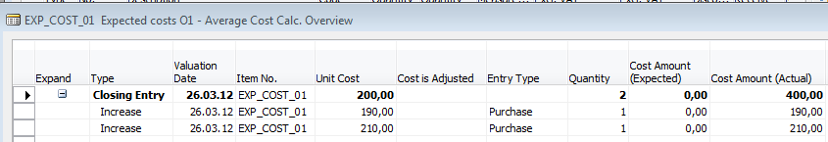
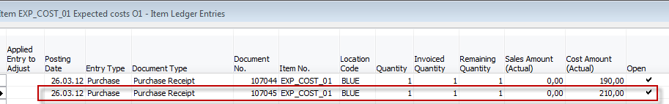
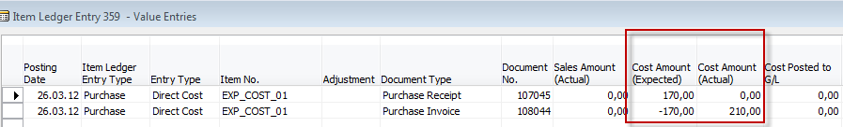
Item card and Average cost calculation overview Item ledger entries and Value entries

Slide 13
Item ledger entries and Value entries

Slide 14
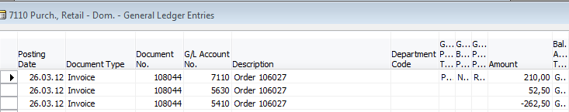
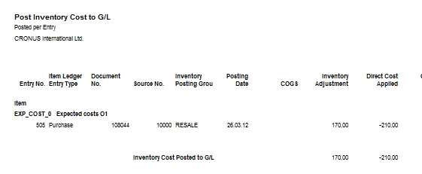
General Ledger entries corresponding real cost
After adjustment and posting to G/L

Slide 15
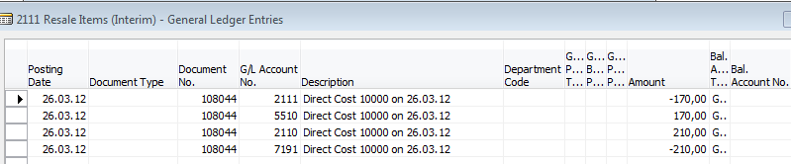
General Ledger Entries
2110
7191
2111 (interim)
5510 (interim)
Before
190
190
170
170
2110
7191
2111 (interim)
5510 (interim)
After
210
210
170
170
170
170
Where previous purchase cost was 190 and next real one 210. Expected cost 170 was neutralized

Slide 16

End of the section XIII.

