Slide 1
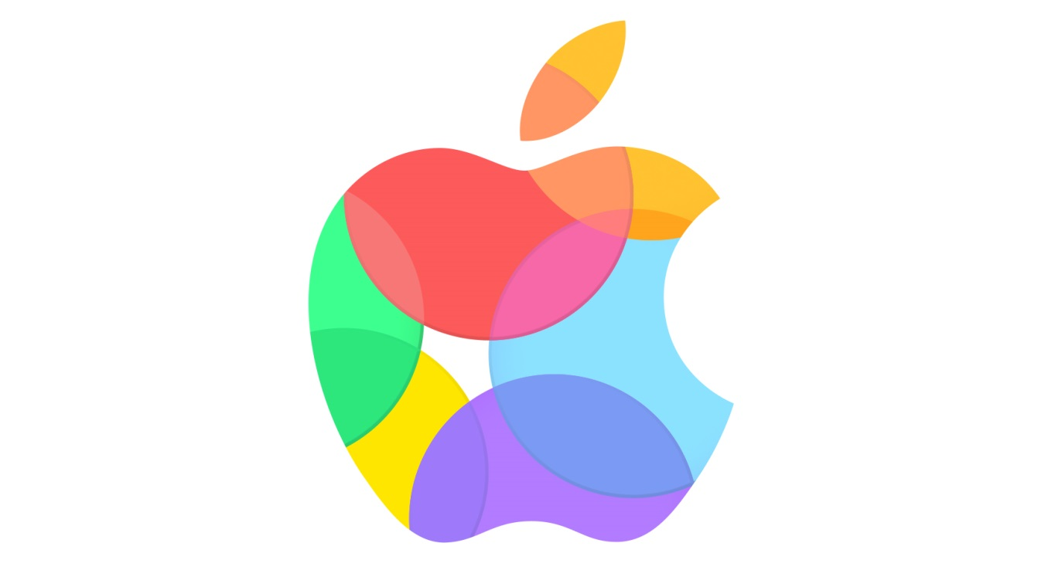
Apple Inc.
«Auditing»
Galoyan Shushanik

Slide 2
INTRODUCTION
Apple Inc. is an American multinational technology company headquartered in Cupertino, California, that designs, develops, and sells consumer electronics, computer software, and online services.
Apple was founded by Steve Jobs, Steve Wozniak, and Ronald Wayne in April 1976 to develop and sell personal computers. It was incorporated as Apple Computer, Inc. in January 1977, and was renamed as Apple Inc. in January 2007 to reflect its shifted focus toward consumer electronics. Apple (NASDAQ: AAPL) joined the Dow Jones Industrial Average in March 2015.

Slide 3
Apple‘s
Fiscal year is October-September 2015 | All values USD
Sales | More than 233 B
Net Income | More than 57 B
Cash-Flow of operating activities | More then 81 B
Total Assets | 89 B

Slide 4
Apple‘s Products
Ipad
Iphone
Apple Watch
Apple TV
MacBook
Ipod

Slide 5
Operating system and Digital content
IOS
ITunes Store
App store
OS X
IBook Store

Slide 6
Apple's competitors
Samsung
Nokia
Sony Mobile
Motorola

Slide 7
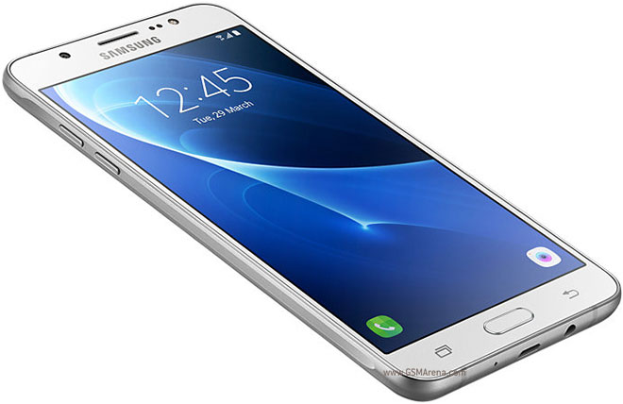
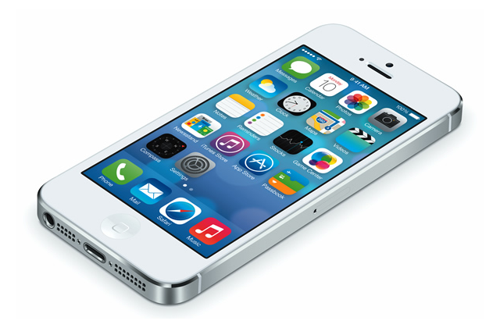
The smartphone industry is dominated by Apple and Samsung, that took together 88.1 percent of the $215 billion profit that was generated in this industry over the last six years.

Slide 8
Apple Suppliers
Apple have top 200 suppliers, including component providers and others representing at least 97 percent of procurement expenditures for materials, manufacturing, and assembly of products worldwide in 2015. For example.
3M Co.
Austria Microsystems (AMS AG)
Broadway Industrial Group Ltd
Career Technology (Mfg.) Co. Ltd
Foxconn Interconnect Technology
.....

Slide 9
Apple‘s consumer
Target audience between age 25-45.
First focus on middle and upper income individuals.
Secondary focus is on students.
Apple Products and Consumer Laws in the United Kingdom
Under consumer laws in the UK, consumers are entitled to a free of charge repair or replacement, discount or refund by the seller, of defective goods or goods which do not conform with the contract of sale. For goods purchased in England or Wales, these rights expire six years from delivery of the goods and for goods purchased in Scotland, these rights expire five years from delivery of the goods.

Slide 10
Apple distribution
Apple websites will allow the customers to purchase their products like iPods, laptops mobile, directly through the apple online.
Apple stores many cities have a building store either free-standing or in a shopping mall.
Large electronics /computer sell apple products in their store as well as online amzon.com also sells most apple products
By the help of the media and giving advertisement and promotion will attract the buyer to purchase the product 9 of 16

Slide 11
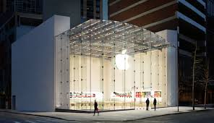
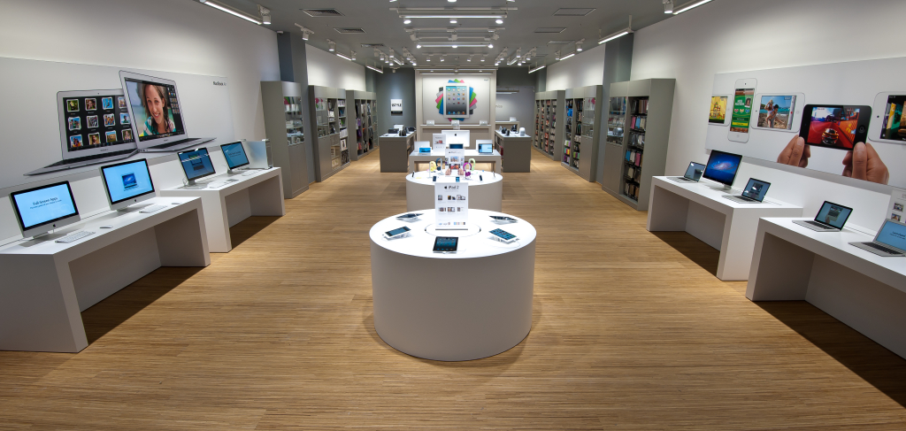
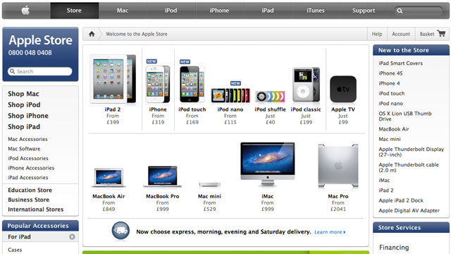
Apple Store
Apple premium reseller
Apple Online Store

Slide 12
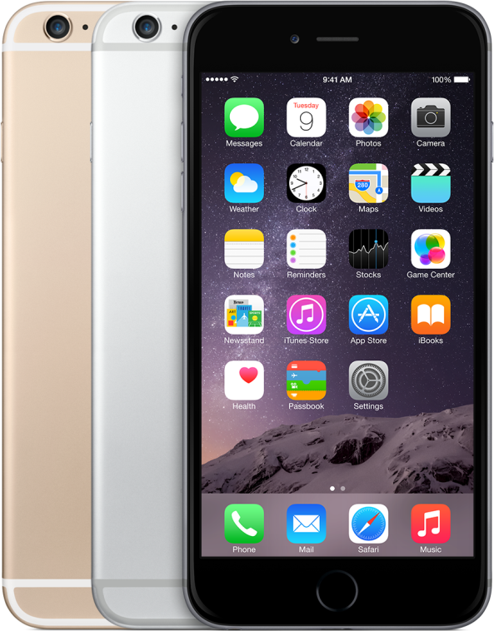
Apple's basic business strategy
Aim - Broad market reach
Apple’s basic business strategy is broad differentiation. This generic strategy focuses on key features that differentiate the company and its products from competitors. Through the broad differentiation generic strategy, Apple stands out in the market.

Slide 13

Critical Business Processes And Business Strategy
The critical business processes for Apple relating to the business strategy include:
innovation
supply chain process
the research and development process
the marketing processes within the company.

Slide 14
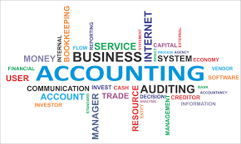
Accounting Information And The Critical Business Processes
The accounting information associated with the critical business processes include:
The cost of marketing
Costs of investment in research and development
The sales revenue data on the income statement.

Slide 15
Accounting Methods Vor The Critical Business Processes And Material Misstatement Risk
Apple uses GAAP to report the accounting information related to the critical business processes.
GAAP helps in providing the disclosure ofthe issues and information relating to the significant business processes.
The risk of material misstatement identifies the potential for errors and adverse reporting of the financial information and data (Apple Annual Report, 2015).

Slide 16

THANK YOU FOR ATTENTION

