Slide 1

Auditing | Ing. Oleksandra Lemeshko
By Fabian Paschen

Slide 2
Agenda
1. Introduction
2. Background
3. Accounting Manipulations
4. Question and Answers

Slide 3
1. Introduction
- Xerox Corporation was once “a star in the technology sector of economy“
- Accounting scandal in the year 2000
- 1997-2000: Overstated revenues by $3 billion
                pre-tax earnings by $1.5 billion
- KPMG responsible auditor

Slide 4
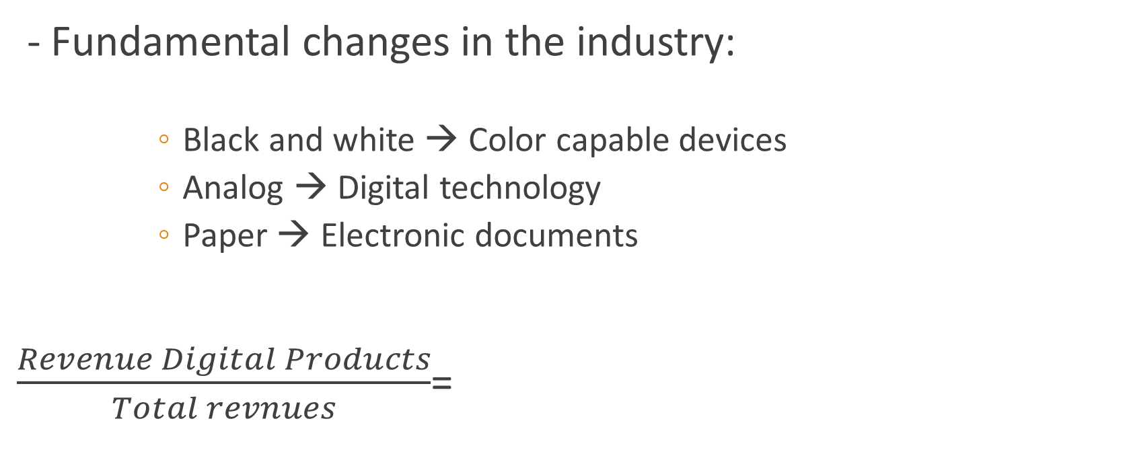
2. Background
- Fundamental changes in the industry:
              Black and white → Color capable devices
              Analog → Digital technology
              Paper → Electronic documents
$\frac{Revenue Digital Products}{Total revnues}$=
1997 | 1999
0.35 | 0.53

Slide 5
2. Background
- No growth in revenues or earnings
- Pressure was built up by:
                High Wall Street expectations
                Maintain strong credit rating
                Compensation system
- Restructuring program as an answer to challenges

Slide 6
3. Accounting Manipulations
Acceleration of Lease Revenue Recognition from Bundled Leases
Bundled Leases consist of: Equipment, service, supplies & financing
GAAP (sales-type lease): - Equipment revenues recognized immediately
- Non-equipment revenues recognized over term of the lease
→reallocation of revenues from finance and service to equipment
Finance activities → equipment: „return on equity“
Service activities → equipment: „margin normalization“

Slide 7
3. Accounting Manipulations
Acceleration of Lease Revenue from Lease Price Increase and Extensions
Renegotiation of contracts
GAAP: increases of price and length recognized over the remaining life of a lease
Xerox recognized them immediately.

Slide 8
3. Accounting Maipulations
Increase in the Residual Values of Leased Equipment
Cost of sales for leased equipment = equipment cost – expected residual value
GAAP: no upward adjustment of estimated residual value allowed after inception
Xerox periodically increased the expected residual value (previously recorded equipment)
→ reduction of cost of sales

Slide 9
3. Accounting Manipulations
Acceleration of Revenues from Portfolio Asset Strategy Transactions
Difficulties with sales lease agreements in Brazil → rental contracts
GAAP: revenues from rental contracts not recognized immediately
Xerox sold those contracts to investors → immidiate recognition of revenue
Problem: no disclosure of that approach in reports (filed with SEC)

Slide 10
3. Accounting Manipulations
Manipulation of Reserves
GAAP: reserves for identifiable, probable and estimable loss contigencies
Xerox: 1. Reserve for unknown business risks established
2. unrelated business expenses recorded and claimed the reserve account
→ reducing operating expenses → increasing net income

Slide 11
3. Accounting Manipulations
Manipulation of Other Income
Tax dispute: Xerox won a tax dispute in 1996 → taxes and interest payments on disputed amount were refunded
GAAP: Recognize the interest income in period the dispute is finalized and interest is due
→ in Xerox case: 1995 & 1996
Xerox recognized them in the periods 1997-2000.

Slide 12
3. Accounting Manipulations
Failure to Disclose Factoring Transactions
Cash position: Concerns about the very low cash position
(1999: $126 millions of cash compared to 28.814 billions of assets)
Factoring transactions: Xerox sold future cash flows(receivables) to banks
→ immediate cash
Problem: Again no disclosure in the reports filed with SEC

Slide 13
4. Questions
1. Comparison of Hewlett Packard and Xerox in the period 1997-2000.
How were Xerox´s and Hewlett Packards businesses similar and disssimilar during the relevant time periods?
How did the two companies financial performance compare?
Both companies had to challenge the same competition, technology and especially the same changes in that time.

Slide 14
4. Questions
Revenues (in $):
Xerox:
Hewlett
Packard:
 | 1997 | 1998 | 1999 | 2000
Revenues(in mio) | 18,144 | 19,447 | 19,228 | 18,632
Annual growth |  | 7.2% | -1.1% | -3.1%
 | 1997 | 1998 | 1999 | 2000
Revenues(in mio) | 35,465 | 39,419 | 42,370 | 48,782
Annual growth |  | 11.1% | 7.5% | 15.1%
https://www.sec.gov/Archives/edgar/data/47217/000091205701002796/a2032630z10-k.txt

Slide 15
4. Questions
Net Earnings (in million $):
In the year 2000:
 | 1998 | 1999 | 2000
Xerox | 395 | 1,424 | -384
Hewlett Packard | 2,945 | 3,491 | 3,697
 | Assets/Liabilites and Equity | Equity-Ratio | Cash-ratio
Xerox | $29,687 (mio) | 0.12 | 0.06
Hewlett Packard | $34,009 (mio) | 0.41 | 0.22

Slide 16
4. Questions
2. a) What responsibility does an auditor have to detect material misstatements due to error and fraud?
Auditor has to find and disclose all misstatments
Ensure that reports and balance sheets are completly correct and legal represented
Auditors of KPMG haven‘t acted resposibly in that case

Slide 17
4. Questions
b) What two main categories of fraud affect financial reporting?
1. “Misstatements arising from fraudulent financial reporting” (SAS No. 99.06)
→ Manipulation, falsification, misrepresentation or omission of records or financial information
2. “Misstatements arising from misappropriation of assets” (SAS No. 99.06)
→Misappropriation of assets, for example: stealing assets, company pays for goods or other benefits which are destined for you

Slide 18
4. Questions
3. Using hindsight, indentify factors present at Xerox that are indicative of each of the three fraud conditions.
Incentive or „under pressure“ → reason to commit fraud
Opportunity for a fraud → lack of controls or ineffective controls
Ability to rationalize the fraud → depends on the attitude and ethical values of a person
(SAS No. 99.07)

Slide 19
4. Questions
1. Incentives: Compensation system of senior management linked to presented results
Under pressure: Wall Street expectations, strong competition
2. Opportunity for a fraud: lack of controls by KPMG, they were not firm but approving
3. Ability to rationalize the fraud: Senior managers were resolute, called them „Accounting Opportunities

Slide 20
4. Questions
a) For each accounting manipulation identified, indicate the financial statement accounts affected.
Bundled Leases Recognition:
→greater revenues in the profit and loss statement→ greater profit/earnings
→ Bigger position of Equity or profit for shareholders through dividends
Price Increases and Extensions through renegotiations:
Basically the same

Slide 21
4. Questions
Increase in Residual Values:
→ Higher valuation of the assets (equipment) → increase in the asset position land, building and equipment
→reduction of cost of sales→ increase in the profit→ increase in equity or shareholders wealth
Portfolio Asset Strategy Transactions:
Effect of immediate revenues the same (like first two examples)

Slide 22
4. Questions
Manipulation of Reserves:
→ First increase of Reserves (reserve for unknown business risk)
→ Periodically reduction of that account by unrelated business expenses
→reduction of operation expenses → increase in net income
Manipulation of other Income/tax dispute:
→Effect of the interes payments on the other income were delayed
→ Again effect on the equity (increase was delayed)
→ Income in the years 1997-2000 again inflated

Slide 23
4. Questions
Factoring Transactions:
- No effect on revenues (asset exchange)
→ Cash position increased→ financial receivables decreased

Slide 24
Sources
Case 4.5: „Xerox Corporation: Evaluating Risk of Financial Statement Fraud“ by Mark S. Beasley, Frank A. Buckless, Steven M. Glover, Douglas F. Prawitt (2015 Pearson Education)
„Annual report of Hewlett Packard“, published by the Securities and Exchange Comission:
https://www.sec.gov/Archives/edgar/data/47217/000091205701002796/a2032630z10-k.txt
(Filing date: 25/01/2001)
„Consideration of Fraud in a Financial Statement Audit“, AU Section 316, SAS No. 99:
http://www.aicpa.org/Research/Standards/AuditAttest/DownloadableDocuments/AU-00316.pdf

