Slide 1
“not marketing” presentation about Measuring Human capital in an organization
Group 1: Mohammad Zafar Durani
Gombojav Otgonbayar
Srdjan Višnjevac
Elis Agolli

Slide 2
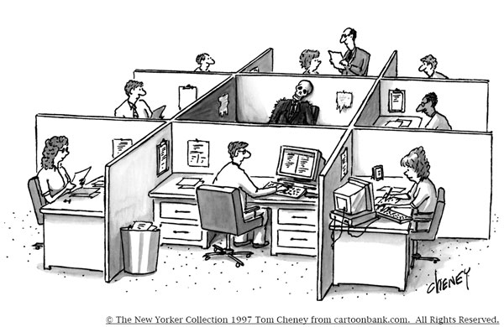
What is Human Capital?
Company A
Company B
Same office, same finance… does it mean they perform the same?

Slide 3
Why do we need to measure Human Capital?
Because if we do so, we would know the real value of our employees, and how to turn it in the most efficient way for the good of the company!
We need to keep in mind that HC is arguably the most important asset in every organization. And it’s the asset that makes thing work!

Slide 4
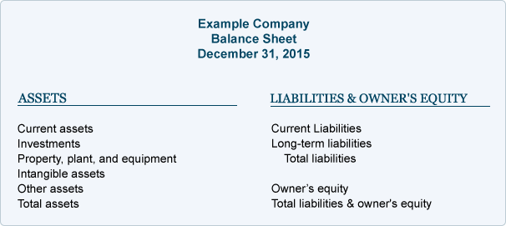
People should be regarded as assets rather than variable cost, in other words, treated as human capital (Beer 1984)

Slide 5
Human Capital Measurement models
Input model
Output model
Comparison value model
KPI model
Also
Conventional
New
(Cost based model)
(Income based model)
(Integration model)
(Indicator model)

Slide 6
Input Model
Measures accumulated values of all expenditures
Historical costs
Costs are tangible and intangible
Limitations:
No necessary relationship between investment and quality of the output
Not easy to divide costs of consumption and cost of investment

Slide 7
Output Model
Measures all discounted values of future earnings through lifetime
It values HC at market prices
Dynamic economy is more interested
Weak points
Model assumes that differences in wages can perfectly reflect differences in productivity
What kind of expenditure should be classified as maintenance
In developing countries is not easy to find data

Slide 8
Comparison
It s the combination of above two models (Input and output), as investment in human capital determine the stock of human capital (input model), which in turn determine the individual earnings (output model). (Tao & Stinson)
Limitation
The categorization of rearing costs
The ability of graduates with SAT scores

Slide 9
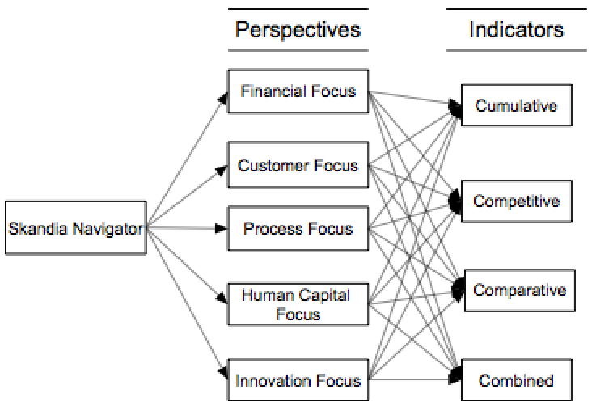
Indicator Model
The estimation of human capital from the point of view of the investments in education, without allocating any monetary values to the human capital. The most frequently use indicators are literacy rates, school enrollment rates and average years of education.
In this model the Skandia navigator can be named.

Slide 10
Conventional & New measurement
Conventional measurement OECD
1. Investment in human capital
2. Quality adjustment in human capital investments
3. Results of education
New measurement
HDI Measures a country’s human development and well-being
The structure of HDI is constituted with health, Knowledge and standard living

Slide 11
Is it so complicated?

Slide 12
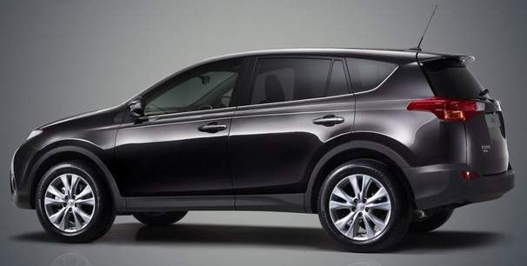
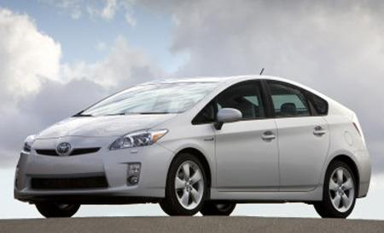

Slide 13
Input Model : Cost
2
3
4
1

Slide 14
Output model: Price
1
3
4
2

Slide 15
Comparison: Margin %
3
1
2
4

Slide 16
Indicator: Off-road performance
3
2
4
1

Slide 17
Indicator: Energy efficiency
3
2
1
4

Slide 18
Why is it so complicated?
Because every model gives different results. For example…….

Slide 21
Literature:
The 3rd OECD World Forum on “Statistics, Knowledge and Policy” Charting Progress, Building Visions, Improving Life Busan, Korea - 27-30 October 200
Approaches for Human Capital Measurement with an Empirical Application for Growth Policy Rewat Thamma-Apiroam1 1 Department of Economics, Faculty of Economics, Kasetsart University, Bangkok, Thailand
https://www.unece.org/fileadmin/DAM/stats/documents/ece/ces/bur/2016/February/15-Add1-Human_Capital_Guide_after.pdf
http://www.employment-studies.co.uk/system/files/resources/files/454.pdf
https://frcatel.fri.uniza.sk/hrme/files/2011/2011_2_05.pdf
The scientific journal of human studies - http://eds.a.ebscohost.com/
International journal of economics, commerce and management - http://ijecm.co.uk/
Human capital and its measurement - The 3rd OECD World Forum on “Statistics, Knowledge and Policy”

Slide 22
SO !!

