Slide 1
Project of Writing a Thesis
AOMA – Seminar Work
Martin Lofaj
390496

Slide 2
Contents
Intro
Theory
Diagrams
Conclusion

Slide 3
Introduction
Thesis: XRM and ERP Integration
Due: May 13th, 2016

Slide 4
Theory
Balanced ScoreCard
TOC
CCPM
Thinking Tools
Ishikawa FBD

Slide 5
Diagrams
TOC
  Resource Processing
  Questionnaire Processing
Thinking Tools
  CRT
  PT
Cause and Effect
  Ishikawa Diagram
  Pareto and Lorenz

Slide 6
Conclusion
Benefits of approach
  Insight
  Awareness
  Control
Advance final DDL

Slide 7
Thanks.
“Repetition of the same thought or physical action develops into a habit which, repeated frequently enough, becomes an automatic reflex.”
- Norman Vincent Peale

Slide 8
Resource Processing

Slide 9
Questionnaire Processing
Common | Individual

Slide 10
Current Reality Tree

Slide 11
Prerequisite Tree

Slide 12
Ishikawa Diagram

Slide 13
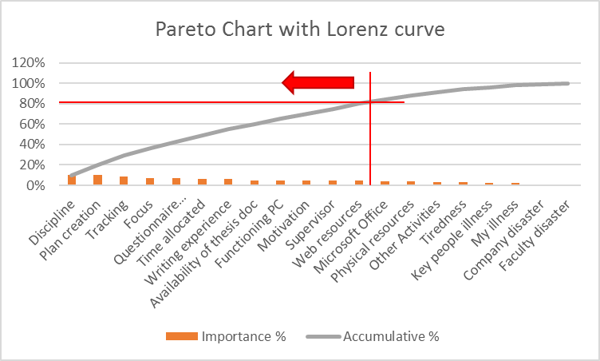
Pareto Chart & Lorenz Curve

Slide 14
Ishikawa Diagram

