Slide 1
Balanced Scorecard
Ing.J.Skorkovský,CSc.
and various listed resources
Department of Corporate Economy

Slide 2

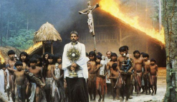



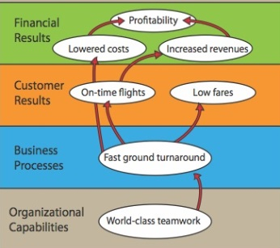
Balanced Scorecard and continuum of value (1st part)
Balanced Scorecard is a step in the continuum describing value
and how the value is created
Mission – why we exist
Values – what is important to us
Vision – what we want to be
Strategy – our game plan
Strategy map – translate to strategy
Balanced scorecard – measure and focus
See next show

Slide 3
Balanced Scorecard and continuum of value (2nd part)
Balanced Scorecard is a step in the continuum describing value
and how the value is created
Target – what WE need to do (plan, project, budget, …)
Personal Objectives – what I need to do
Strategic Outcomes
Satisfied Shareholders
Delighted Customers
Efficient and Effective Processes
Motivated and Prepared Workforce

Slide 4




Definition
BS developed by Robert Kaplan and David Norton
BS examines a firm´s performance in four critical areas
Finances – how should we look to our shareholders ?
Customers – how should we look to our customer ?
Processes – at which business processes must we excel ?
Learning and Growing – how will we sustain our ability to change and improve ?
Resource : Operation Management, Quality and Competitiveness in Global Environment, Russel &Taylor

Slide 5
Basic strategy map (two lower BS levels)
Production and Services
Lower cost of production
Continuous improvement (Kaizen)
Reduced cycle time (see Little´s law)
Shorter production lead times
Working capital efficiency (fin. leverage)
MRP,MRP_II
Advanced Planning and Scheduling
Good Resource Planning
Perfect way of cost calculation (actual-expected)
Application of Theory of Constraints
SCM-Supply Chain Management
Lower cost of transport
Better way of replenishment
Better delivery performance
Supplier Relationship
Lower cost of ownership
JIT delivery
TQM – High quality supply
Risk Management
Financial risks
Cash flow management
Operational risk
Technological risk
Human capital Organizational Capital Information Capital
Excellent training
of resources
Efficient and flexible
structures and reporting
system, teamwork, culture
Analytic applications
BI, transaction processing
applications=ERP, ..)
Resource : Operation Management, Quality and Competitiveness in Global Environment, Russel &Taylor (not the red ones)

Slide 6
Basic strategy map (two upper BS levels)
Shareholder value
Productivity Strategy
Growth Strategy
Finance
Become industry cost leader (Gartner Magic Quadrant Matrix)
Maximize use of existing assets
Improve cost management
Strategy
Increase value of customer account
Stars and Milk Caws segments of Boston Matrix
Stable product portfolio
New resources generation (higher market share )
R&D related to current product portfolio
Competitive prices Low cost of supply Perfect Quality Deliveries in time
Processes – at which business processes must we excel (see previous slide) ?
Resource : Operation Management, Quality and Competitiveness in Global Environment, Russel &Taylor (not the red ones)

Slide 7
Balanced Scorcard worksheet
(KPI/Goal)*100
(50+80)/2
80%
(95+80)/2
80%
(80+67)/2
50%
(60+50)/2
Explanations : FTL-full truck load, LTL- less than truck load , SPC=statistical process control, EDI=electronic data interchange, Cycle time=time/unit=(e.g.7 min/1 customer request)
Resource : Operation Management, Quality and Competitiveness in Global Environment, Russel &Taylor

Slide 8
Some units
NoT MPH_AOMA !!!!!!!!!!
Will be presented later in sections such as :
  Little´s law (LT=WIP*CT=WIP/Throughput)
  Theory of Constraint…
Cycle Time (CT)– time to complete task (time/unit)
Takt Time (TT) – rhythm in which we have to produce in order to satisfy customer demand (demand is 240 toaster ovens and we can produce these in 480 minutes ->TT= 480/240=2
Lead Time (LT) – Number of minutes, hours, or days that must be allowed for the completion of an operation or process, or must elapse before a desired action takes place –see next slide
Comment : CT<>LT !!

Slide 9
Lead time
NoT MPH_AOMA !!!
The lead time is the time and not the effort. You may have a lead time of 100 days and only have to work 1 hour to fix the bug. Sometime you start working on the bug. The cycle time is the time from the start of the work until the bugfix is live.
Priority of the task
is set
Cycle time
Lead time (fix)
Request
(bug reported)
Start work
Bug solved

Slide 10
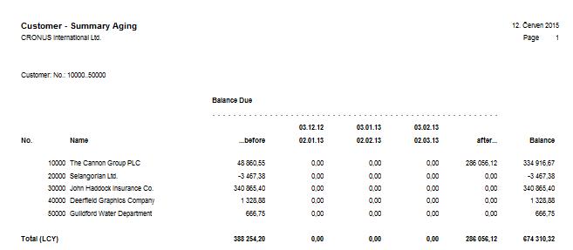
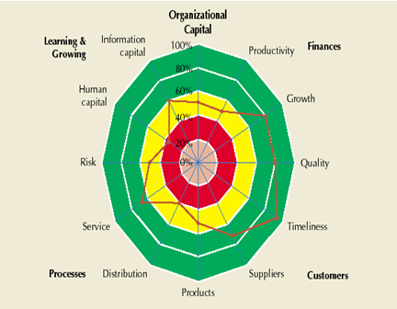
ERP outputs and BS
Report generated from
ERP MS Dynamics NAV
Financial way of
reporting
BS way of reporting
(Radar Chart)
Based on KPI estimation in % out
analysed company is excellent,
but on the other hand,
collecting money, credit limit
and overdue management
is falling behind
Resource : Operation Management, Quality and Competitiveness in Global Environment, Russel &Taylor (only radar chart)

Slide 11
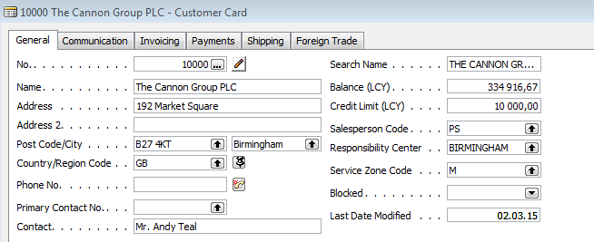
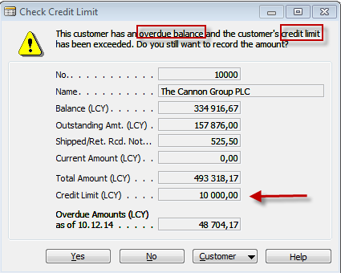
ERP forms related to customer aging report

Slide 12
Balanced Scorecard and Operation Management
Finances – how should we look to our shareholders ?
Processes – at which business processes must we excel ?
Customers – how should we look to our customer ?
Learning and Growing – how will we sustain our ability to change and improve ?
Project management
Theory of constraints
Production
Linear programming
Total quality
management
Product postitioning
Business Intelligence
Workflow
Critical chain
Drum –buffer-rope
MRP-MRP-II,JIT,APS
Cutting, blending
Pareto, ishikawa
Boston Matrix
Gartner QM
Decision
making
CONWIP
Logistics
Yield management
Kepner-Tregoe
EOQ, ABC
Hurviwtz
Little´s law
Prospect theory
ERP MS Dynamics NAV 2009 !!!!!!!!!

Slide 13
Strategic initiatives
(two bottom BSC layers have defined Goal-Measurement-Intention-Action program
Satisfied shareholders
Growing sales
Growing margins
Action
program
Provided value
Better relationships
Goal
Measurement
Intention
Ratio WIN/LOST
Keep
existing clients
Ratio WIN/LOST
Action
sales
Increase
of market
share
By 100 %
in 2 years
(increase)
Support of
company image
Turnover of sales channel
Quantity of
new clients
Arrived for the first time
Unpleasant surprise
Quantity of
problems
By 50 %
in 2 years
(decrease)
Program
of direct
marketing
Marketing
skills
% skills
% clients with
good data
By100% -1 Y
By 80 % -2 Y
T raining
New SW (ERP)
Marketing skills
Database of customers

Slide 14
Processes-methods - Goals-benefits
 | Profit | Market share | Reject/Good products | Satisfied owners | Market growth | High staff skills | Faster reaction | Acceptable price | Cost reduction | Due date performance
Advanced production planning | 16 |  |  |  |  |  |  |  | 10 | 20
Applied workflow |  |  | 10 |  |  | 36 |  |  | 4 | 23
Advanced stock replenishment |  |  |  |  |  |  |  | 12 |  | 18
Applied BI |  | 3 |  |  | 30
E-learning |  |  |  |  |  | 40
Lean manufacturing |  |  | 50 |  |  |  |  |  | 31
CRM |  | 14
Use of portable devices | 9 |  | 37 |  |  |  |  |  | 23
Quality management |  |  | 40
Methods
Goals

Slide 15
BS (for inspiration only)
Satisfied
owners
Higher turnover
Profit
Shareholders
Market share
Market growth
Customer
area
Reject/Good
products
Acceptable price
Cost reduction
Faster reaction
to client´s requirement
Due date performance
Internal
processes
Quality management
Applied BI
Advanced stock replenishment
CRM
Lean manufacturing
Learning
High staff skills
E-learning

Slide 16
Test 1
What is the main goal of a company?
A) Obtain the highest profit
B) Find solutions that will be in the best interests of stakeholders
C) Produce as many products as possible
D) A and C
E) None of the above
Notes:
B)

Slide 17
Test 2
Which of the following is Operations Management Technology not concerned with?
A) Product & Service Technology
B) Process Technology
C) Globalization Technology
D) Information Technology
E) All of the above
Notes:
C)

Slide 18
Test 3
Which of the following would be considered an input when converting inputs into outputs during the transformation process?
A) Land
B) Capital
C) Raw Materials
D) Facilities
E) All of the above
Notes:
E)

Slide 19
Test 4
Which of the following is not a key element of supply chain management ?
A) Purchasing
B) Suppliers
C) Locations
D) Logistics
E) Managers decision
Notes:
E)

Slide 20
