Slide 1
Introduction MS Dynamics NAV I.
Ing.J.Skorkovský,CSc.
MASARYK UNIVERSITY BRNO, Czech Republic
Faculty of economics and business administration
Department of corporate economy

Slide 2
First steps
F12 to open
Password (if applied)
Menu File->database
Menu File->company
Application menu : Financial Management, Sales, Purchase, Warehouse Management….Administration

Slide 3
Working area
Working area

Slide 4
Source data
Customer
Vendor =Supplier=Creditor
Item
Account
Number | Name | Balance | Credit limit
10000 | The Cannon Group PL |  | 100000
20000 | Selangorian Ltd. |  | 300000

Slide 5
Table->form (window) to display data
Number | Name | Balance | Credit limit
10000 | The Cannon Group PL |  | 100000
20000 | Selangorian Ltd. |  | 300000
List (F5)

Slide 6
Item
List (F5)

Slide 7
Searching in lists
Cursor position

Slide 8
Sorting in lists

Slide 9
Simple filter setup (one field only)
To get filtering criteria
See next slide
Cursor position

Slide 10
Filtering criteria

Slide 11
Fuction keys

Slide 12
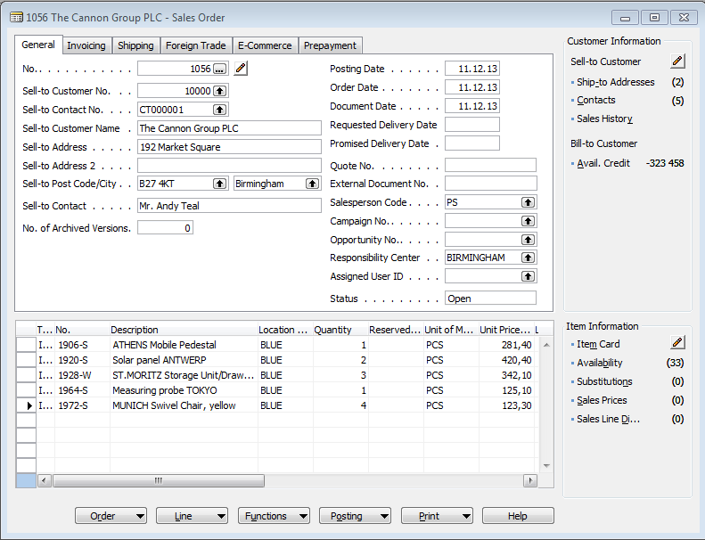
Header-lines (documents)
Sales quote
Sales order
Sales Invoice
Delivery list
Purchase quote
Purchase order
Purchase invoice
Receipt
Credit memo
HEADER
Line(s)

Slide 13
Basic principles in one picture only
Customer
Sales Order
Posted Sales Invoice
Vendor
List of delivery
(Sales-shipment)
Item
Purchase Order
Account
Posted Purchase Invoice
GRN
GRN=Good Receiveing Note

Slide 14
After posting (registering) document (F11) a system creates entries (transactions)
Sum of these amounts
is Balance (calculated field)
Ctrl-F5

