Slide 1
Introduction to MS Dynamics NAV XVI. (CRM for MPH_AOMA )
Ing.J.Skorkovský,CSc.
MASARYK UNIVERSITY BRNO, Czech Republic
Faculty of economics and business administration
Department of corporate economy

Slide 2
CRM – Customer Relationship Management
PROs
It enables to keep track of all prospective customer (suspects and prospects)
Improve sales and marketing service
Company can promote the work it has done for its customers in order to approach prospects
CONs
CRM software may not integrate well with other email and accounting systems
Another disadvantage to a newly implemented CRM software is the learning curve.

Slide 3
CRM – Customer Relationship Management
Relationship management is a customer-oriented feature with service response based on customer input, one-to-one solutions to customers’ requirements, direct online communications with customer and customer service centers that help customers solve their issues.
Sales force automation
Sales promotion analysis
Advertising
Personal selling
Direct marketing
Public relations
automate tracking of a client’s account history
Use of technology (ERP)
Opportunity Management

Slide 4
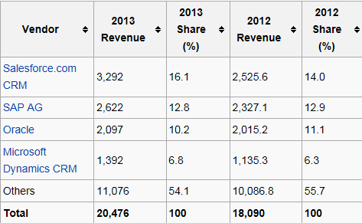
Market leaders
figures in millions of US dollars
Resource:

Slide 5
Vendor
Statistic :
Costs/Revenue
Only Czech course
BPH_PIS 1| 2 !!!!
and MPH_AOMA
But for AOMA only
marked areas
Customer Entries
Customer
AOMA
Interaction
Log
Entries
Contact
Card
Salesperson
To-Do
Card
Interaction
Log
Entries
Profile (parameters)
(To-Do)
Assigned
activities
Statistics:
Interactions, Stages,
Chances, Values,..
ABC (Pareto)
analysis
AOMA
Opportunity
Activity
(code)
Sales Cycle
Stage
Partial Activities
Meeting /Telephone call
Interaction Log
Entries
Stage number
Activity

Slide 6
ERP-CRM
20000
70%
Meeting
Task1
Task22
Task p
Opportunity
ERP n
CRM
Customer
Card
QUOTE
ERP 2
ERP 1
Products
Task p+1
Task p+2
Task q
Opportunity
Financial
estimation
Success estimation
in %
Interactions

Slide 7
Contact cards
Contact card- company
Contact card- person
Contact Character– profiles, technologies,..
Interactions
Business Opportunities (estimated close date and value, probability,.. )
Sales Cycles
Customer Card creation from Contact card
Quotes

Slide 8
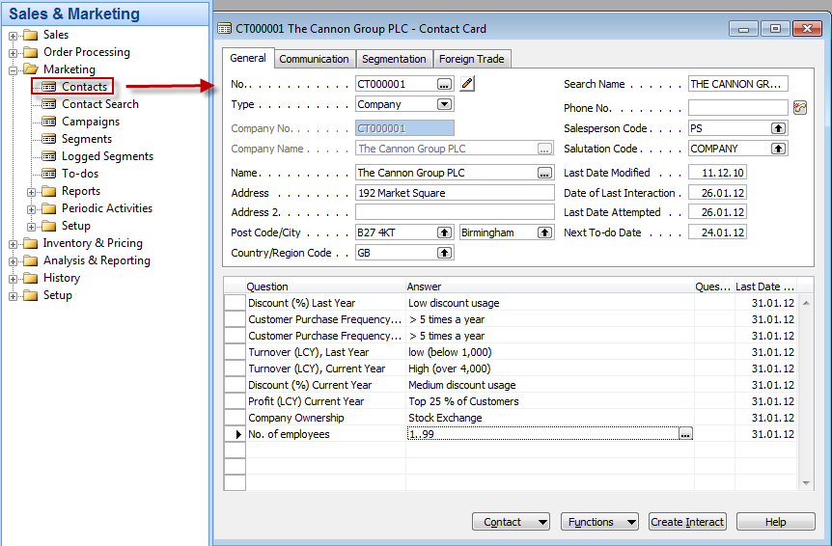
Contact Card

Slide 9
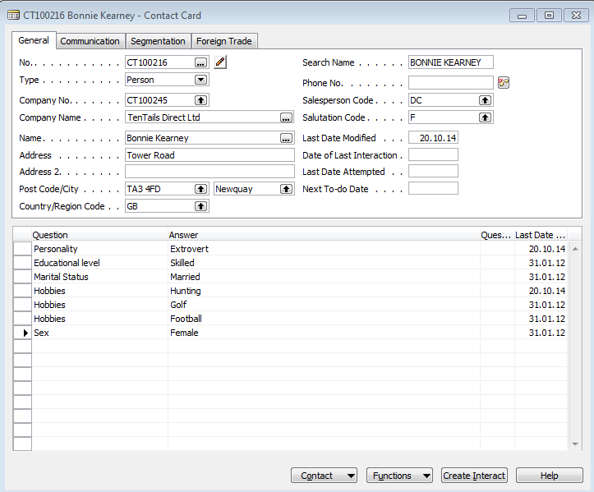
Contact Card- Person
Profile

Slide 10
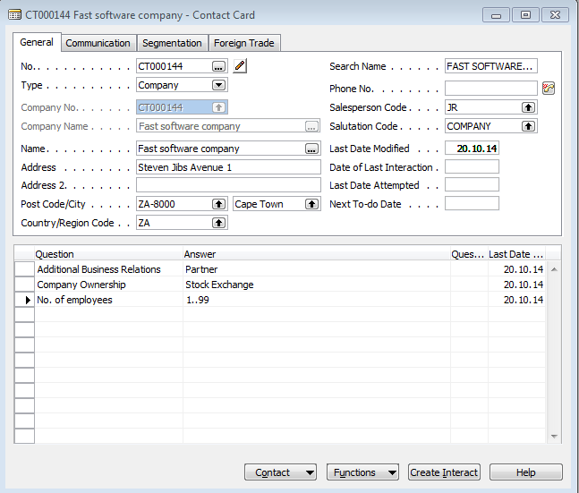
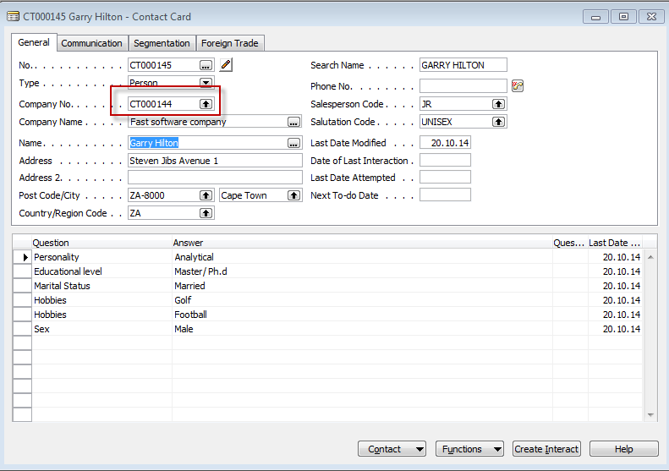
Contact Card-> Company-person

Slide 11
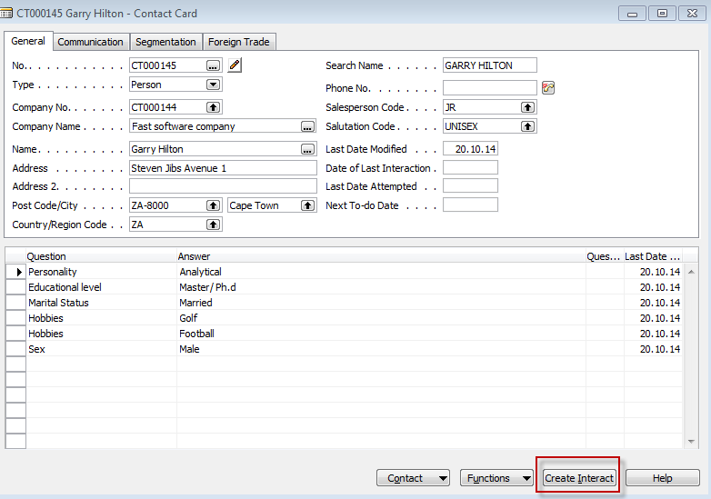
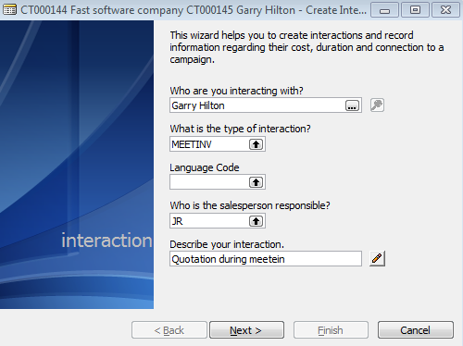
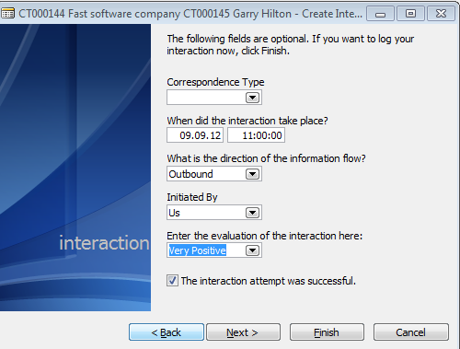
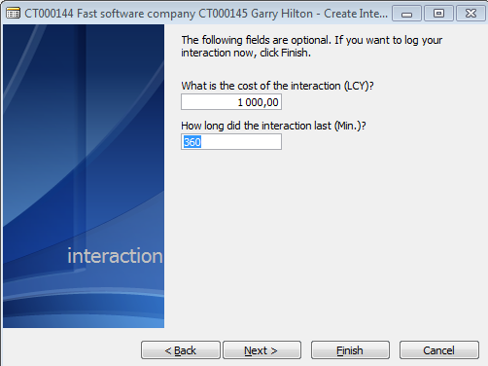
New interaction

Slide 12
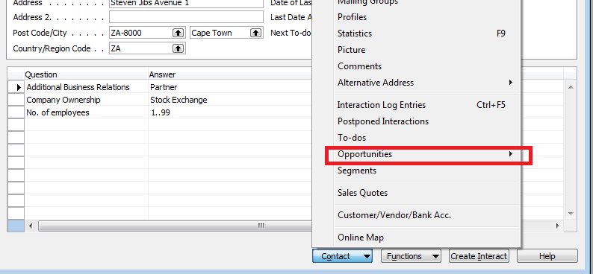
New interaction
Interaction entry
Create new opportunity

Slide 13
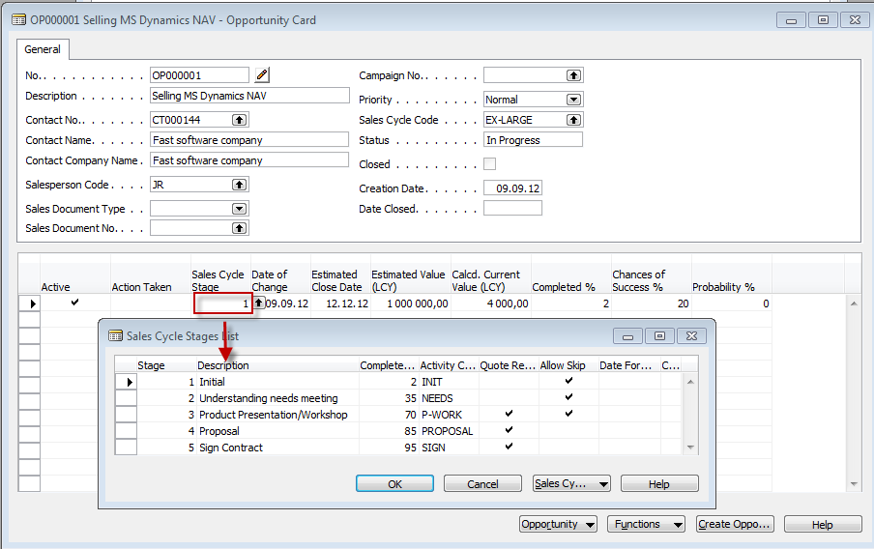
New oportunity – already created
From here you can create various To-Dos and and change Sales Cycle stages

Slide 14
Sales Cycle Stages

Slide 15
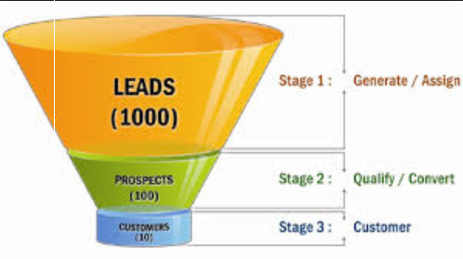
End of the section XVI.

