Slide 1
Costing methods in MS Dynamics NAV (Inventory Costing-basics)
Ing.J.Skorkovský,CSc.
MASARYK UNIVERSITY BRNO, Czech Republic
Faculty of economics and business administration
Department of corporate economy

Slide 2
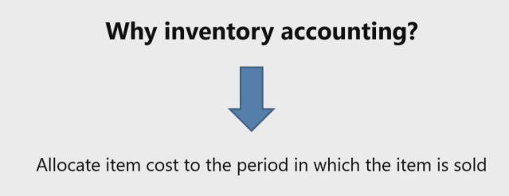
Inventory Costing overview
Known
Known
Recorded
Solved for - vypočítáváno

Slide 3
Inventory costing overview

Slide 4
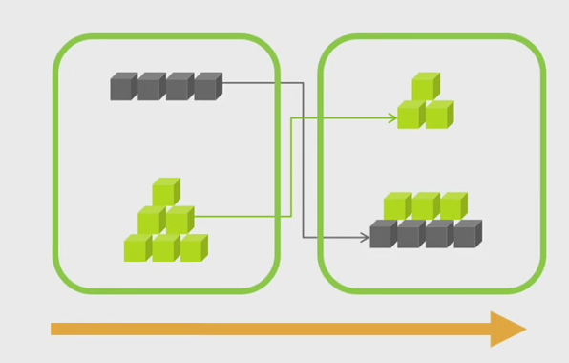
Costing methods (FIFO)
Sklad-start
Sklad-konec
Prodej (Náklady na prodané zboží )
Nákup

Slide 5
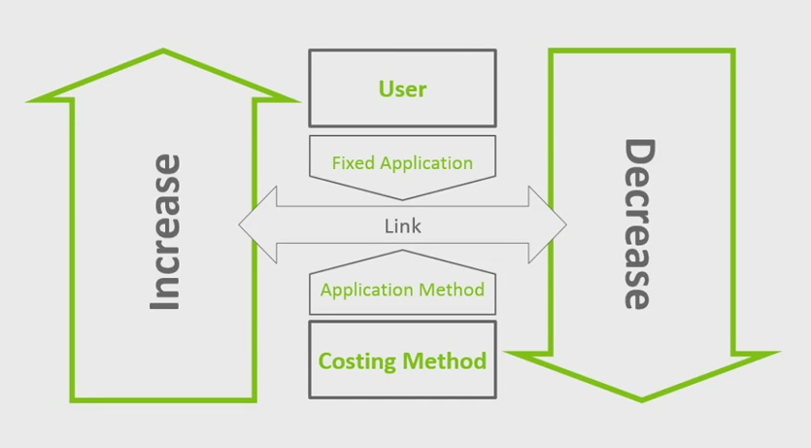
Cost flow assumption

Slide 6
Accounting and inventory
0D
.
Starting Date
.
.
.
.
.
.
.
.
.
.
Ending Date
Value of Quantity on Hand
Value of Inventory Increases
Value of Inventory Decreases
Inventory Value on Ending Date

Slide 7
Inventory costing flow– zaúčtování množství
Sales (incl. purchase returns)
Purchases (incl. sales returns)
Distributor
Transfers
Inventory Adjustments
Manufacturer
Consumption
Output
Item Ledger Entries

Slide 8
Inventory costing flow– zaúčtování hodnoty
Direct Costs
Indirect Costs
Rounding
Revaluations
Variances
Value Entries

Slide 9
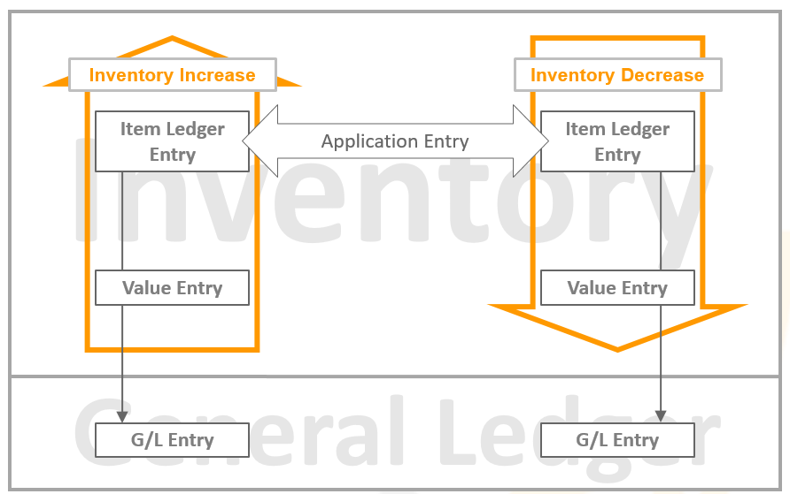
Inventory posting flow

Slide 10
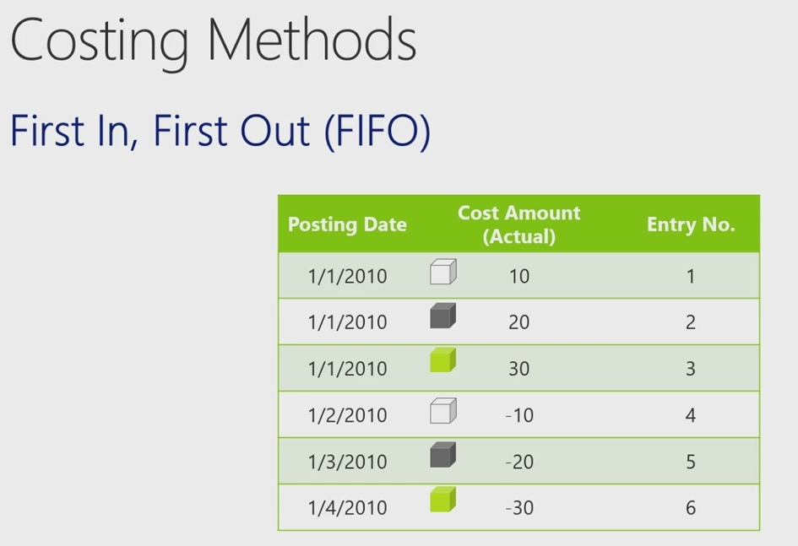
FIFO

Slide 11
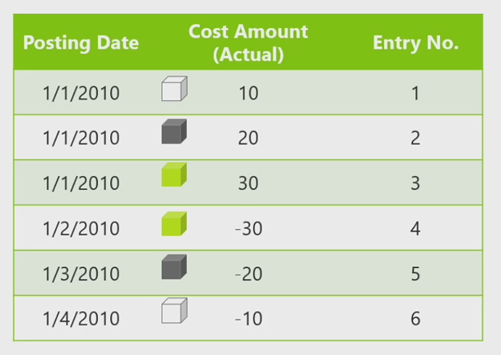
LIFO

Slide 12
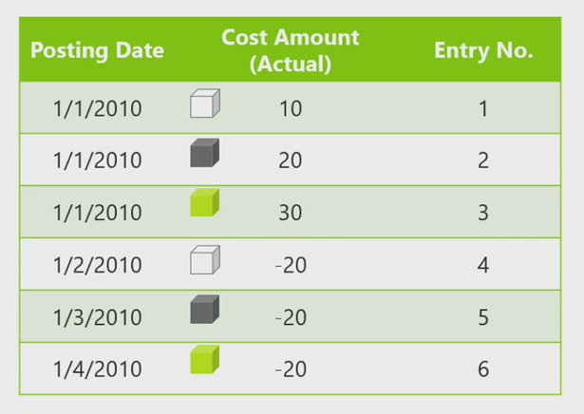
Average

Slide 13
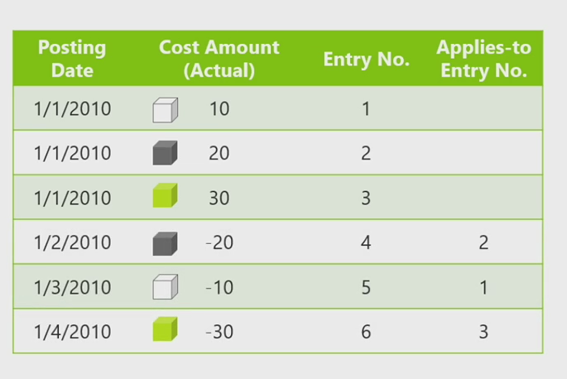
Specific (Fixed application)
Viz označování položek s pomocí šarží !!! Výběr vyrovnání je určován
uživatelem.

Slide 14
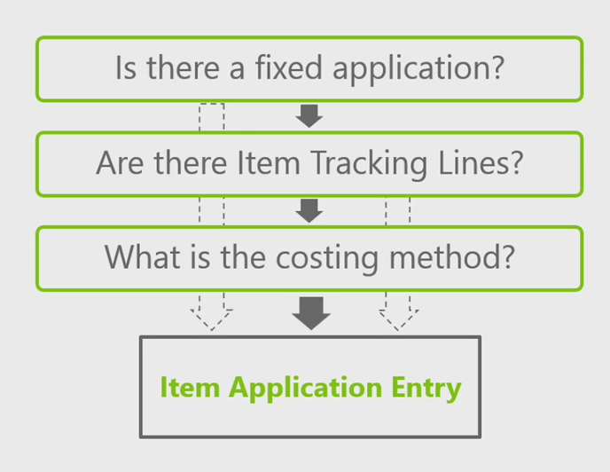
Application algorithm - algoritmus vyrovnávání

Slide 15
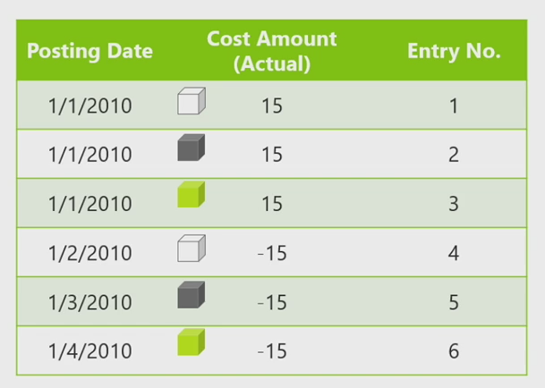
Standard – pevná cena

Slide 16
Fixed application -pevné vyrovnání

Slide 17
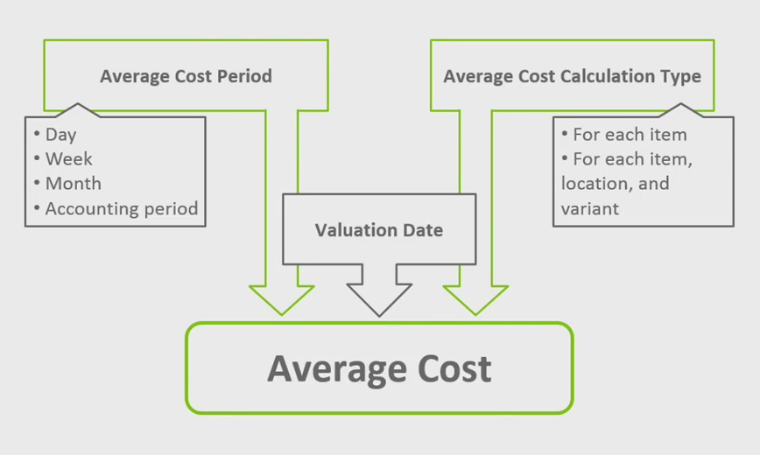
Average Cost Calculation
Stock Keeping unit
(Skladové jednotky)

Slide 18
Inventory Value determination
Posting
Reconciliation
Value Entries
(položky ocenění)
Item Ledger Entries
(položky zboží)
General Ledger Entries
(hlavní kniha)
Inventory Transaction

Slide 19
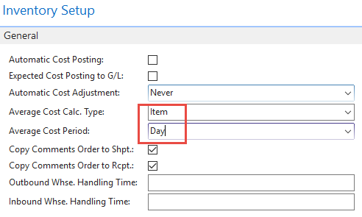
Average Cost calculation setup

Slide 20
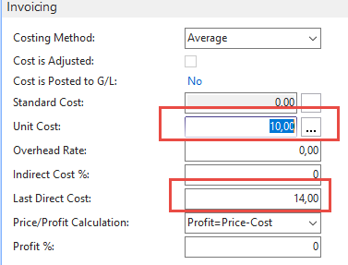
Average Calculation per day
3 times Purchase of one item
With Costing methods=Average,
Costs 10, 12 and 14 ->36/3=12

Slide 21
Average Calculation per day
We have sold by use of item journal one item with cost (manually entered) 20,
so Closing Entry is 36-20=16 and Unit Cost per one item is 16/2=8

Slide 22
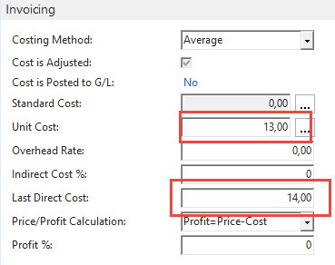
After adjustment
Values entered were 10+12+14 and finally applied value after sales was 10, so
36-10=26 = ending inventory value
26/2=13

Slide 23
After adjustment
So manually entered unit cost=20 was
replaced by applied item entry with cost 10

Slide 24
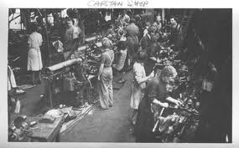
End of section (Costing methods)

