Slide 1
Introduction to MS Dynamics NAV (Detailed Customer and Vendor Entries - Detailní položky)
Ing.J.Skorkovský,CSc.
MASARYK UNIVERSITY BRNO, Czech Republic
Faculty of economics and business administration
Department of corporate economy

Slide 2

Description (source-NAV help) -
Tabulka Detailní položky zákazníka obsahuje všechny účtované položky, včetně adjustací, spojených s dokladem a s položkami řádku deníku v tabulce Položka zákazníka (karta Zákazník ->Ctrl-F7)
Kromě původní položky a vyrovnané položky, tabulka Detailní položka zákazníka obsahuje všechny adjustace vytvořené pro položku zákazníka. To mohou být skonta, realizované a nerealizované ztráty a zisky ze změn směnných kursů, zaokrouhlení vyrovnání a oprav z důvodu zaokrouhlení různých měn.

Slide 3
Description (source-NAV help) - ENG
You use the Detailed Cust. Ledg. Entries window to view a summary of all the posted entries and adjustments related to a specific customer ledger entry in the Customer Ledger Entries window. This feature allows you to see why a certain entry was made on a certain account in connection with discounts, roundings, and currency exchange adjustments.

Slide 4
How to view DCLE
To view detailed customer ledger entries
In the Search box, enter Customers, and then choose the related link. Open the relevant Customer card.
On the Navigate tab, in the History group, choose Ledger Entries.
Select the relevant customer ledger entry.
On the Navigate tab, in the Entry group, choose Detailed Ledger Entry.
OR two times Ctrl-F7 !!!

Slide 5
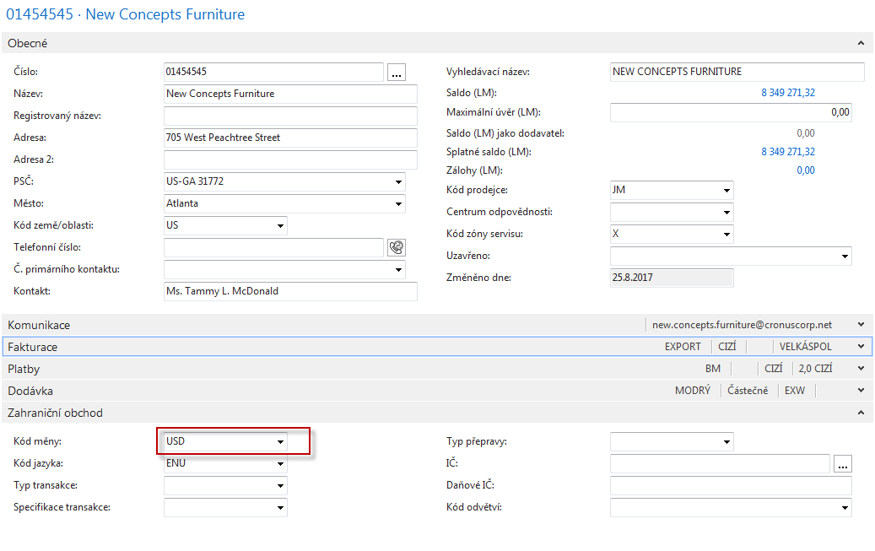
Example – SO I
Customer with USD currency

Slide 6
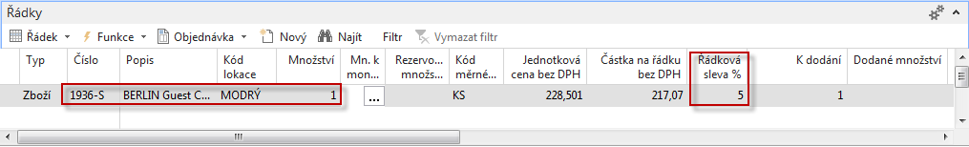
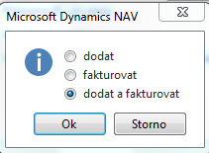
Example – SO III
SO header with chosen customer
See line discount !!!
Post it by F9

Slide 7
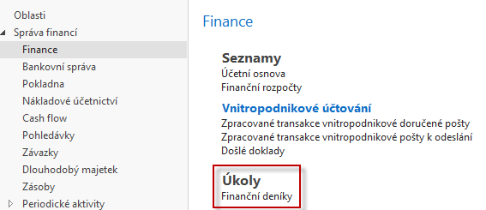
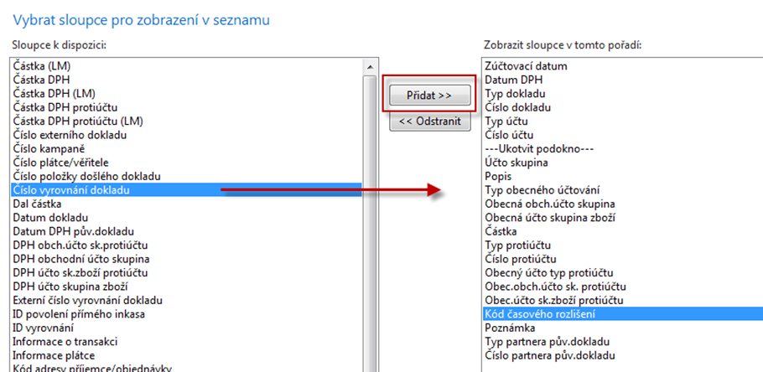
Go to GL Journal
Add field as shown belowand move it up

Slide 8
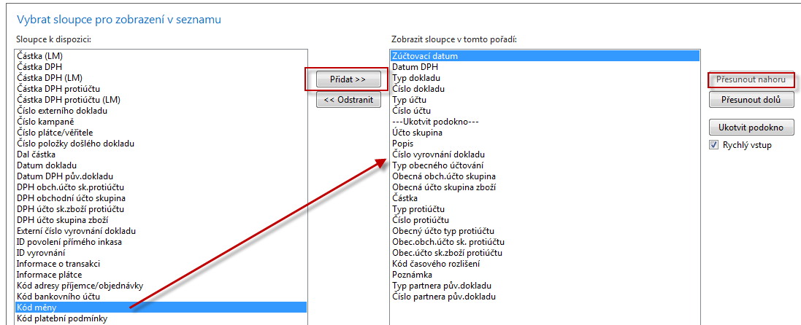
GLJ- another modification

Slide 9
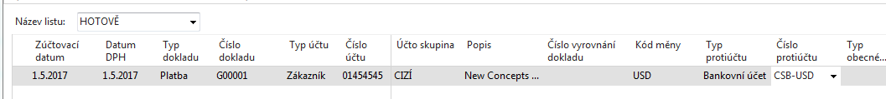
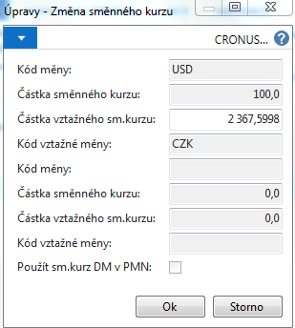
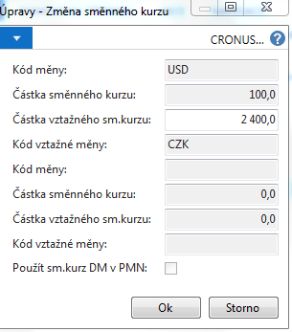
GLJ

Slide 10
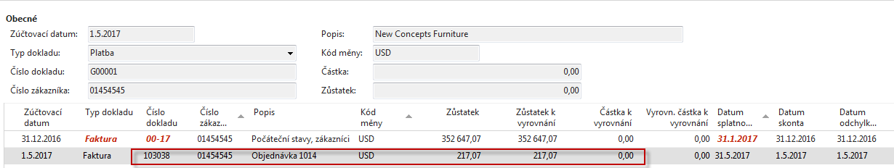
GLJ

Slide 11
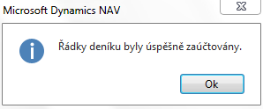

GLJ
F9
And all entries are created (Item, Customer, GL and Detailed Customer ones) !!!

Slide 12
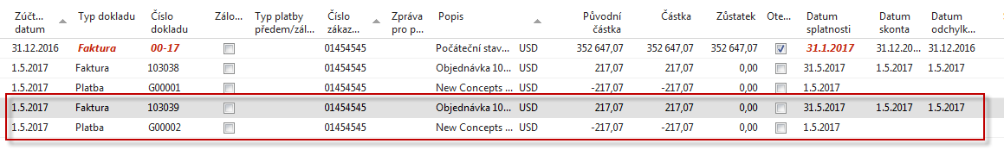
Customer Ledger Entries

Slide 13
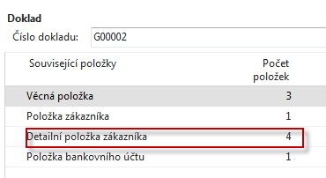
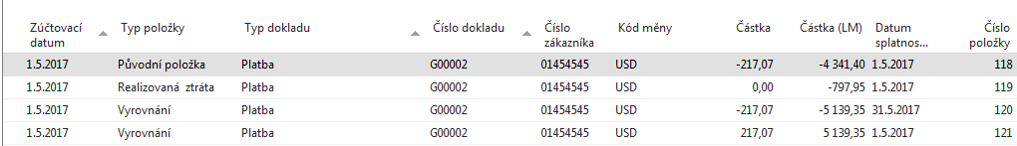
Detailed CLE
Action->Navigate ->
From CE type Payment

Slide 14
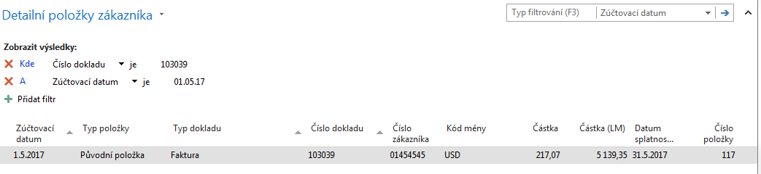
Detailed CLE
Action->Navigate ->
From CE type Invoice

Slide 15
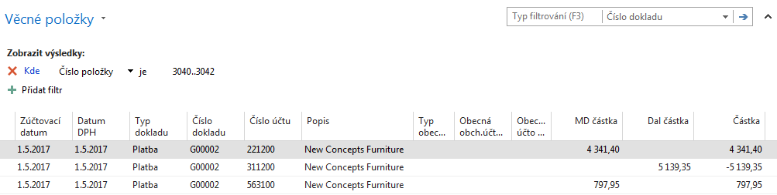
GL Registers

Slide 16
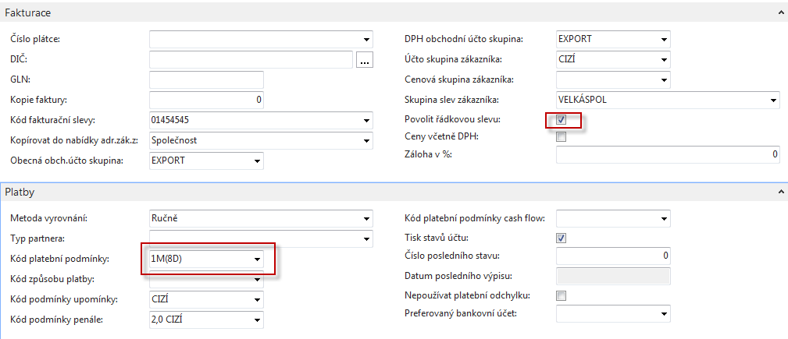
Example II
Change Payment Terms Code to 1M(8D) – will be expained !!!
Change Location from Yellow to BLUE !

Slide 17
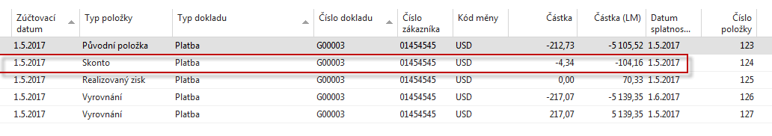
SO and Payment and change of Exchange Rate (USD)and see DCLE ….

Slide 18

End of section
(Detailed Customer and Vendor Entries – Detailní položky)

