Slide 1
Introduction to MS Dynamics NAV
(Inventory applying by use of fixed application)
Ing.J.Skorkovský,CSc.
MASARYK UNIVERSITY BRNO, Czech Republic
Faculty of economics and business administration
Department of corporate economy

Slide 2
Reason of this example
To understand main application principles in inventory costing :
  Costing Method FIFO
  Fixed application
Will be later useful in :
  Understanding of Inventory Adjustment
  Lot numbers and Costing method Specific
  Credit memos and Return management
Basic use of Item Journals

Slide 3
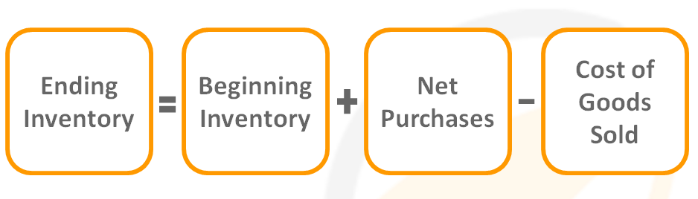
Basic equation
Known
Known
Recorded
Solved for
Inventory costing will be presented more in detail later in this course

Slide 4
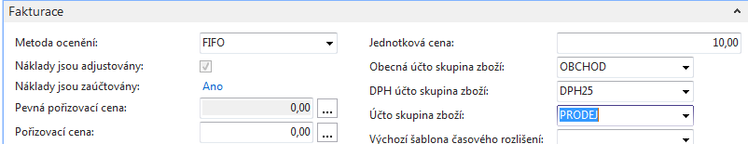
Create new Item Card
Search window – Item (Zboží if Czech database)
Ctrl-N (pozor, na rozdíl od zákazníků nebo dodavatelů neexistuje šablona – no Item Template !!) – or icon Nový (New) in upper left corner of the ribbon
Enter data mainly in the fields with yellow asterisk (*)( default fields)
Number and name it for example : A 1 , Test item
Tab Invoicing (Fakturace) : FIFO, Unit Price (Jednotková cena) =10, and all Posting group see below :

Slide 5
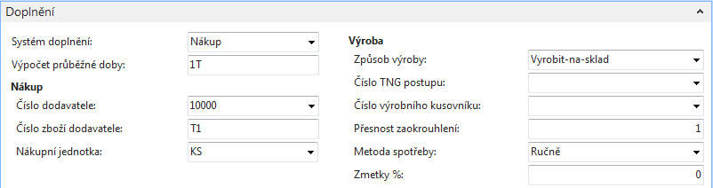
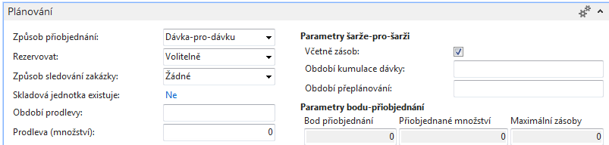
Create new Item Card
Tab Replenishment (Doplnění) as well as Planning Tab see below

Slide 6
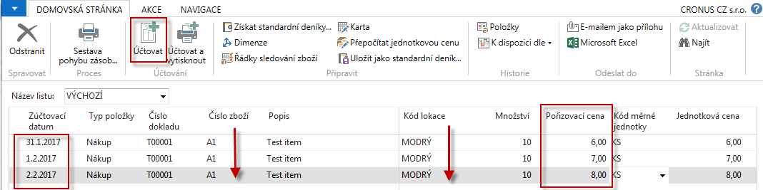
Purchase three times A1 using Item Journal
Use of Item Journal (Deník zboží)
  Warehouse->Inventory- Tasks->Item journals
  Sklad –Zásoby->Úkoly ->Deníky zboží
To copy to new line use key F8 (see red arrows) . See different Cost prices (Pořizovací ceny) . We used Item journal in order to be faster and to avoid creation of Vendor ledger entries (Položky dodavatele)
Post by F9

Slide 7
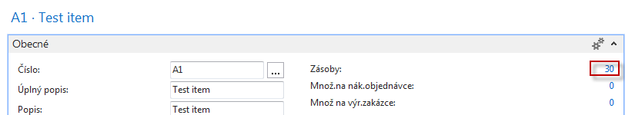
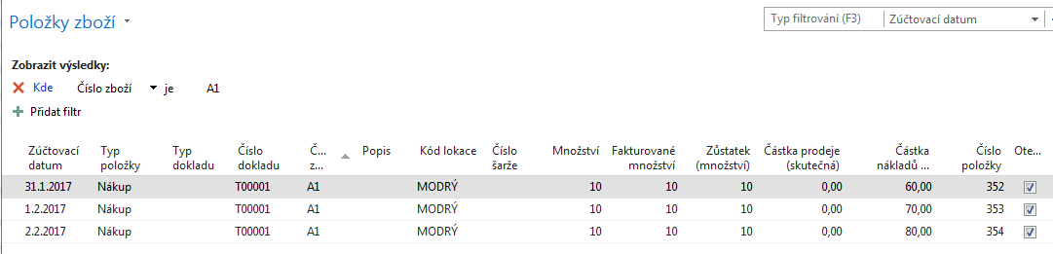
See Item Ledger Entries - Položky zboží
Item A1-> Ctrl-F7
Wee do not mentioned Inventory Adjustment, which will be presented later

Slide 8
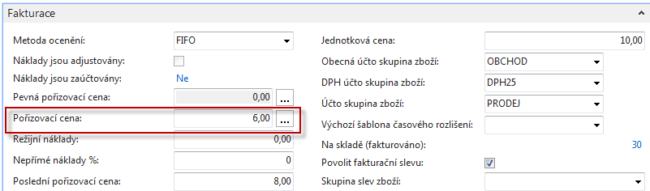
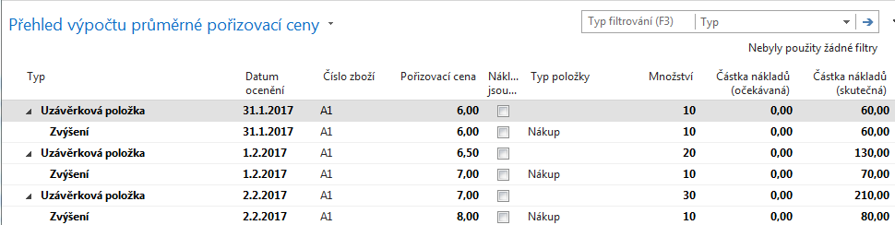
Item Card- Tab Invoicing (Fakturace)
Open Field Cost price (Pořizovací cena) and open all Closing entries (Uzávěrkové položky) !!

Slide 9
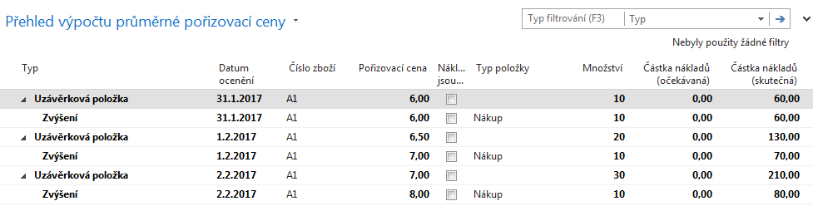
Closing Entries (Uzávěrkové položky)

Slide 10
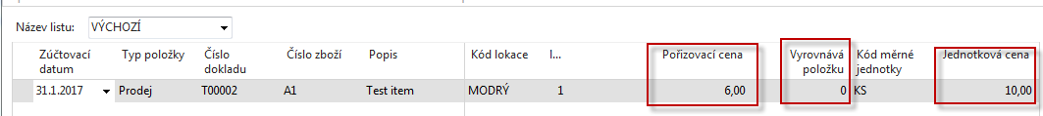
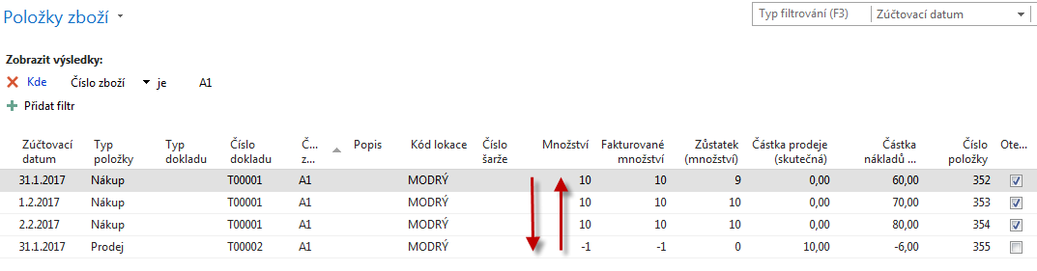
Selling one item A1 using Item Journal
System MS Dynamic NAV 2016 will apply input entries by use of FIFO Costing method
  (Warehouse->Inventory- Tasks->Item journals ) and after data entries post by F9
Item Ledger Entries
So inventory decrease the value by 6 so total value of stock should be 204 !
(no adjustment have been started- will be presented in following lessons)

Slide 11
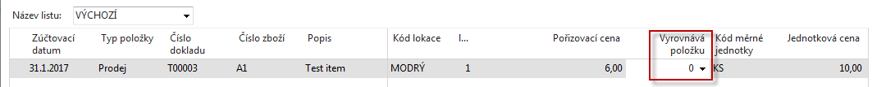
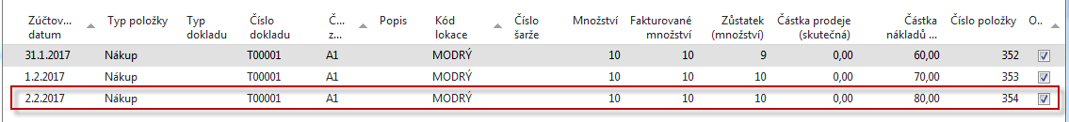
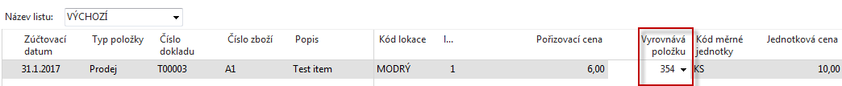
Second Sales of A1 using Item Journal with fixed application
Using Fixed application (Applied by entry number )
will block FIFO Costing method
F9

Slide 12
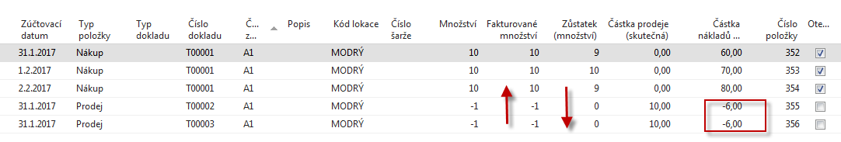
Item Ledger Entries
So instead of applying to Item Ledger Entry number 352 a last input Item entry (354)
was applied by use of fixed application but still decreased by 6
(without starting adjustment batch)
This example will be used later as it is (only instead of A1 we will use ne Item A2),
in order to continue with adjustment.
Anyhow for the time being (no more deep explanation) see next slide

Slide 13
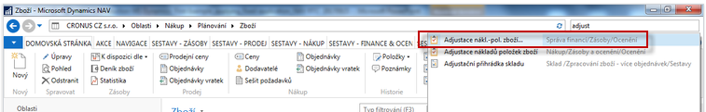
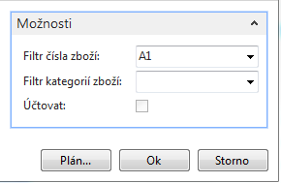
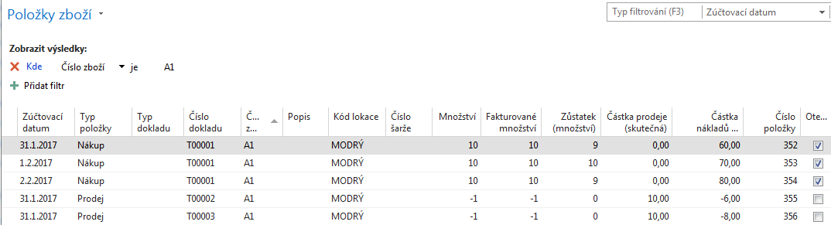
Adjustment
Search window- Adjustment

Slide 14
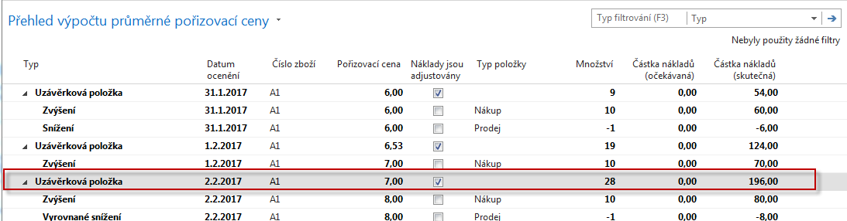
Closing entries after adjustment job
196=(10*6+10*7+10*8)-6-8
Cost price=7=210/30

Slide 15
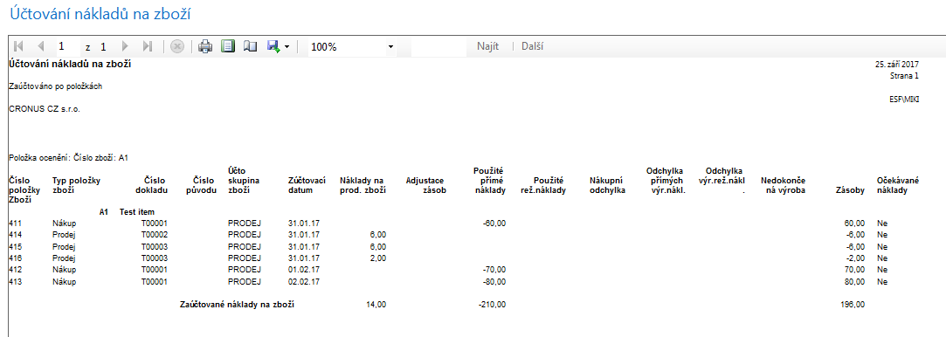
General Ledger
(after job Post Inventory Costs to G/L)

Slide 16

End of the section
(Inventory applying by use of fixed application)

