Slide 1
Introduction to MS Dynamics NAV
(Serial numbers , Lot numbers & Item tracking and Item tracing)
Ing.J.Skorkovský,CSc.
MASARYK UNIVERSITY BRNO, Czech Republic
Faculty of economics and business administration
Department of corporate economy

Slide 2
Lot numbers (batches)-Item Tracking
It enables to mark Item Ledger Entries by Lot (Batch) Number, which is part of the batch card. It enables :
  Item tracking from purchase, possible subsequent production , transfers and sales
  It enables to control quality and better specification of rejects (scraps)
  It enables to control warranty and expiration
  It work similarly if serial numbers are created (assigned)

Slide 3

New card creation
It is necessary to start our model with brand new card without any Item Ledger Entry created in the past

Slide 4
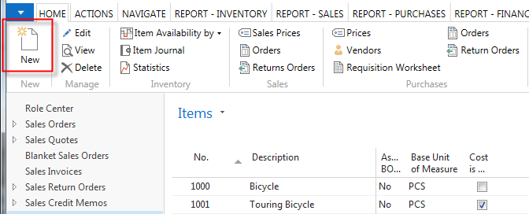
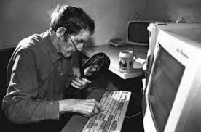
New card creation
You have to enter data to all fields marked by *

Slide 5
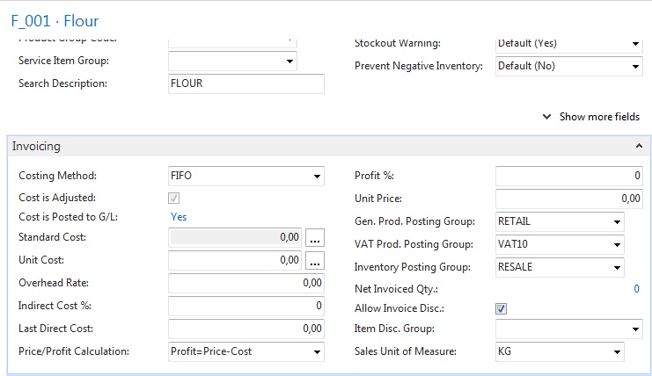
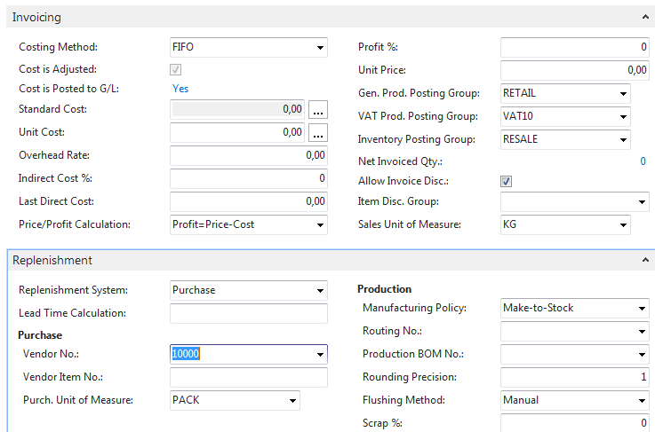
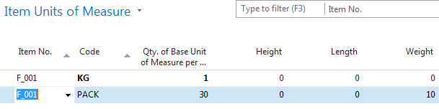
Item Card -Flour

Slide 6
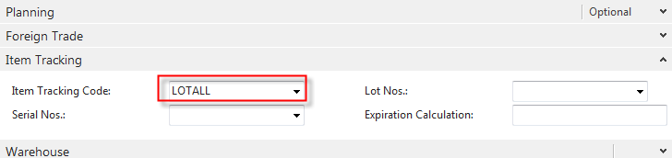
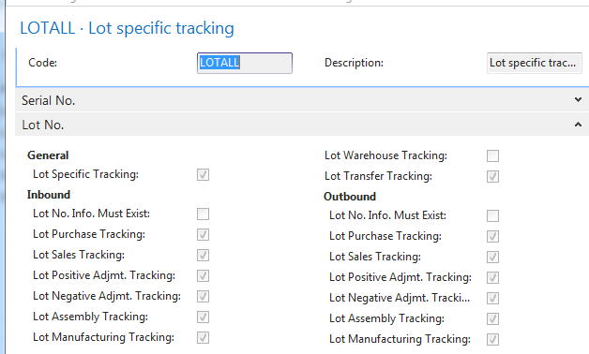
Item Card -Flour

Slide 7
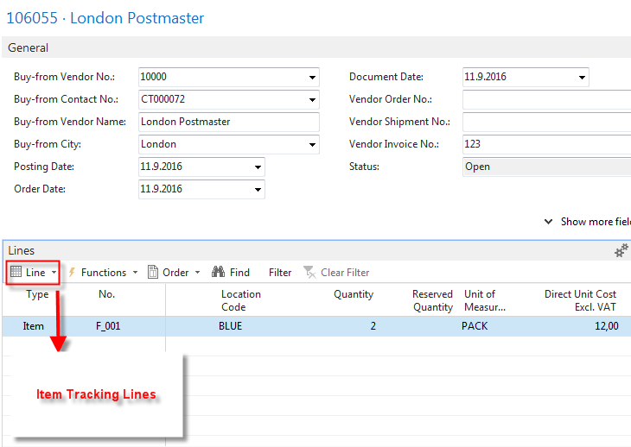
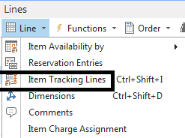
Purchase Order : 2 packs of flour

Slide 8
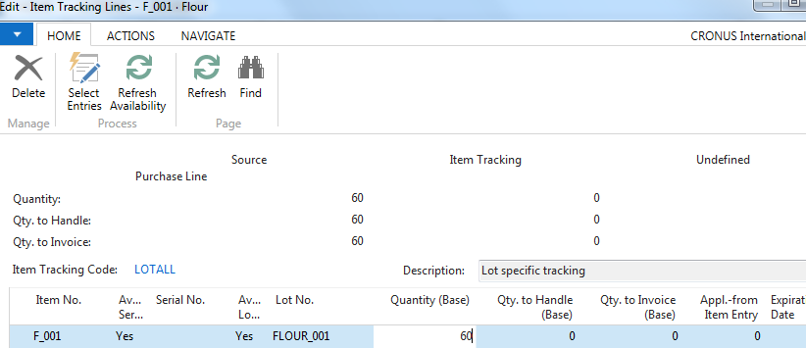
Purchase Order : 2 packs of flour
ESC + F9

Slide 9
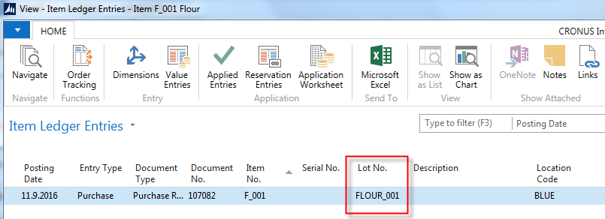
Item Ledger entries after PO posting
PO=Purchase Order

Slide 10
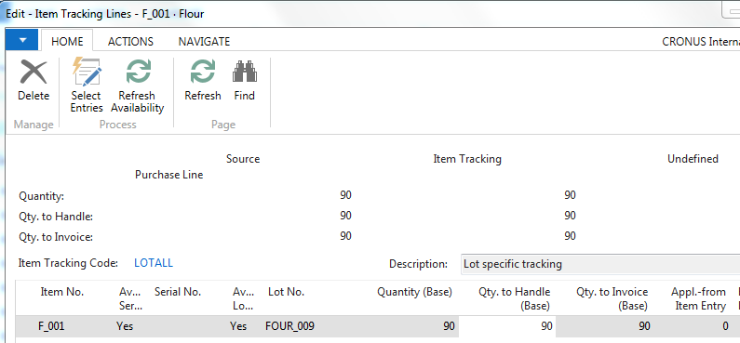
Second PO – Flour and Lot number Information card
PO : Ctrl-N
Enter Vendor :10000 and enter Vendor invoice number
Enter line F_001 and 3packs and location blue
Go to Icon Line and Item tracking lines

Slide 11
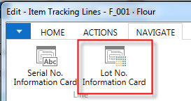
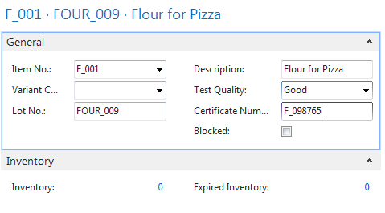
Second PO – Flour and Lot number Information card
Click New

Slide 12
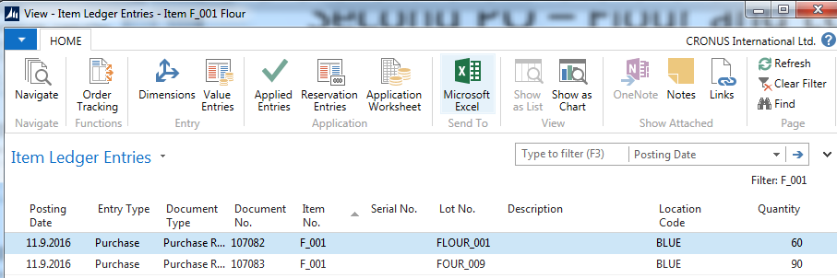
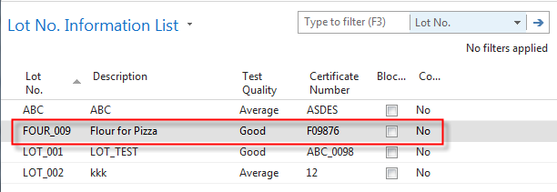
Item Ledger entries after PO posting

Slide 13
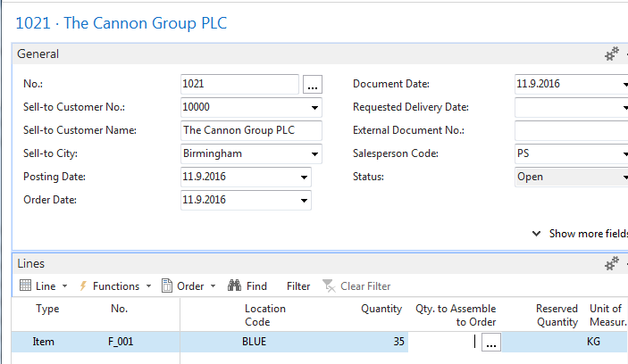
Sales Order

Slide 14
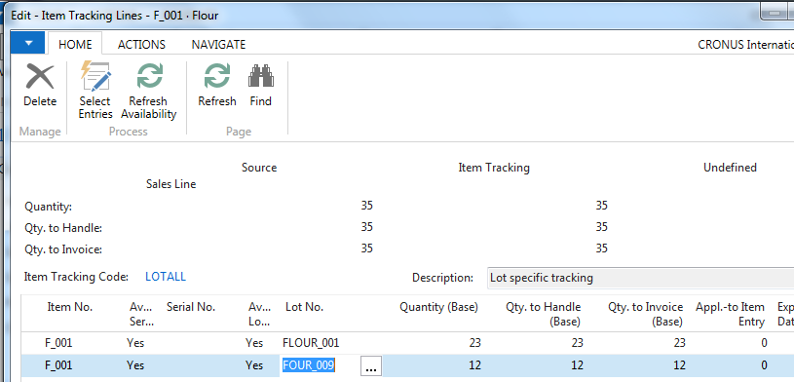
Assigning Lots (two different ones)

Slide 15
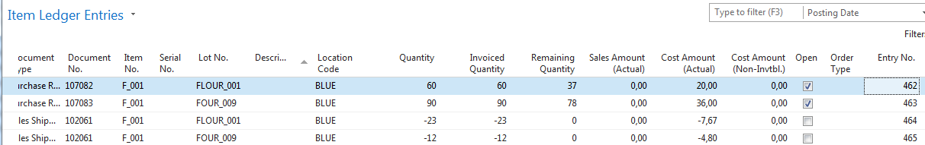
Item Ledger Entries after posting SO
S0 = Sales Order

Slide 16
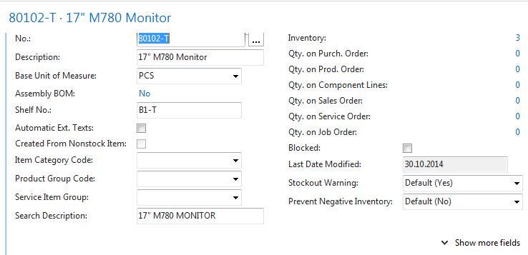
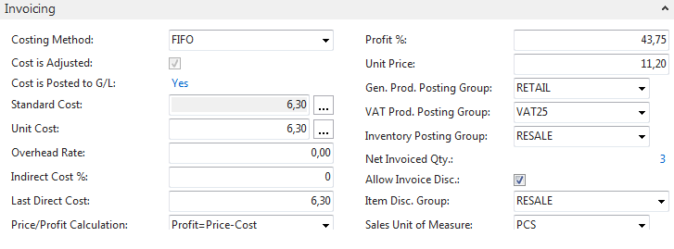
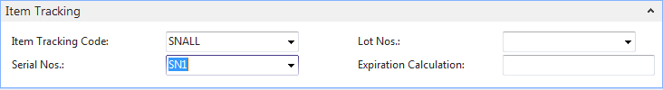
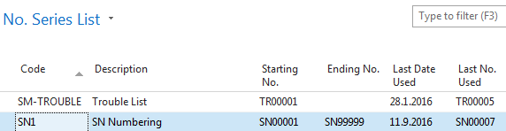
Purchase an item with Serial number setup

Slide 17
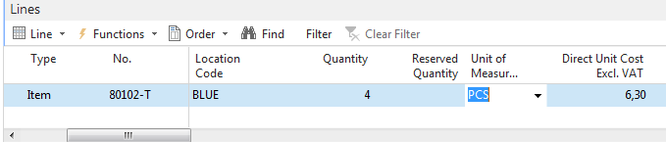
Purchase Order (only PO line shown)

Slide 18
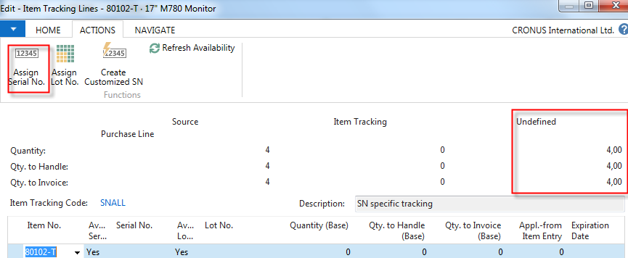
Assigning Serial Numbers - before

Slide 19
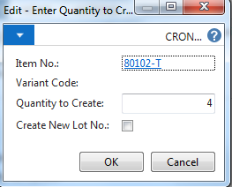
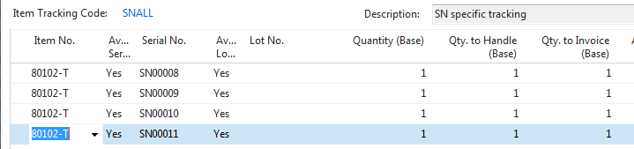
Assigning Serial Numbers - after
Esc a F9

Slide 20
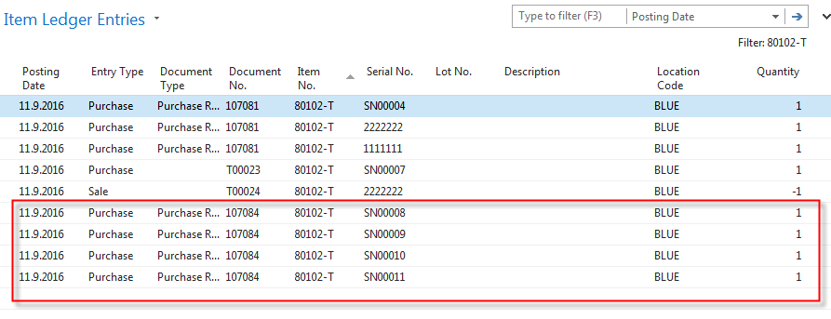
Item Ledger Entries

Slide 21
Complex Examle (CE) to show Item tracking
Create new Item Card X1
PO1 - Assign LN1 and LN2 , 10 pcs (6 and 4)
PO2- Assign LN3 and LN4, 10 pcs (7 and 3)
SO1 – 12 pcs of X1 (mixed Lots from all Lots)
Show tracking window
Comment : Czech database, English texts in PWP, NAV 2016 CZE

Slide 22
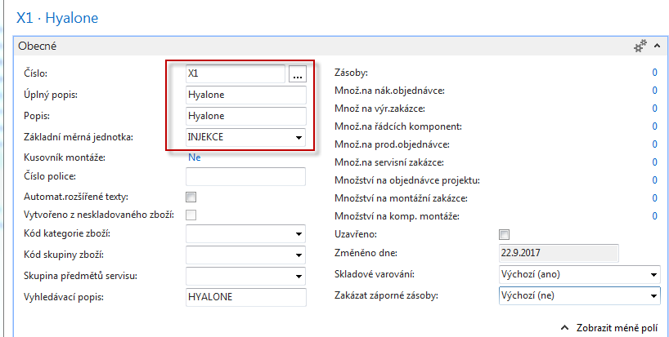
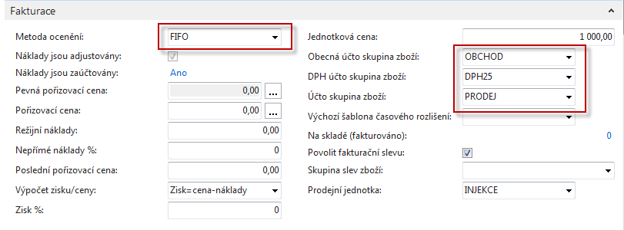
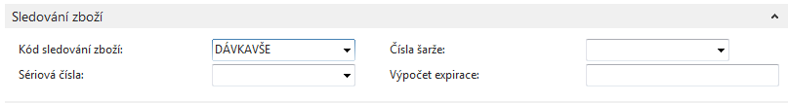
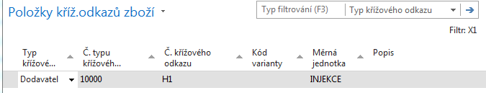
CE1

Slide 23
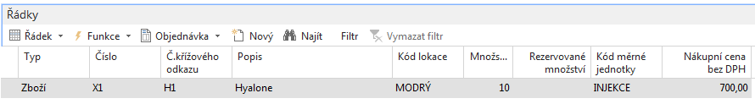
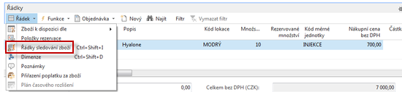
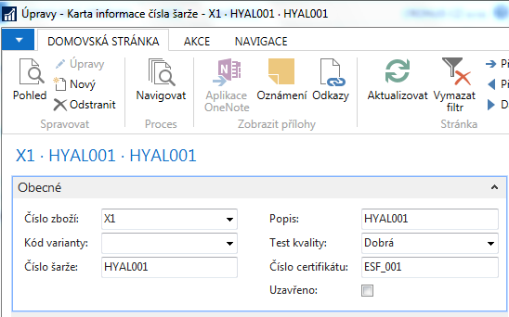
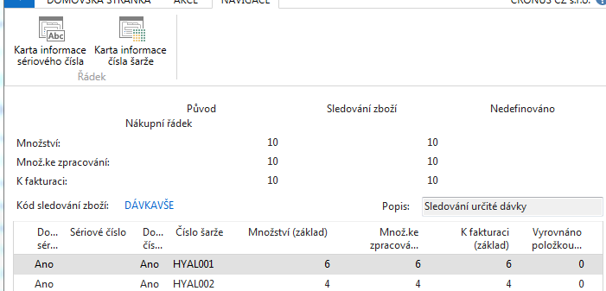
PO1
PO1 line

Slide 24
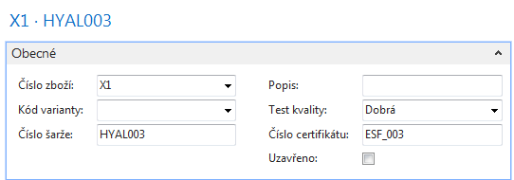
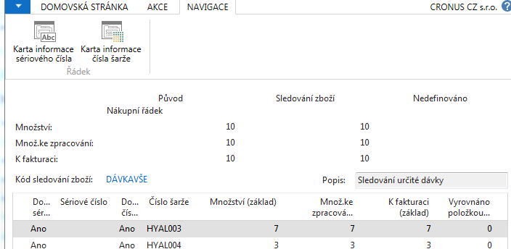
PO1

Slide 25
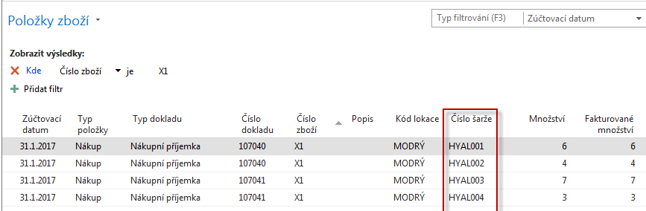
X1 Item Ledger Entries

Slide 26
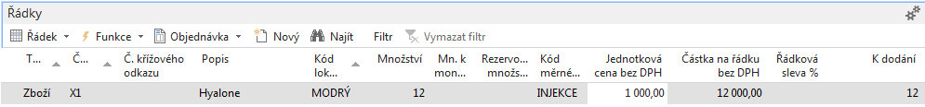
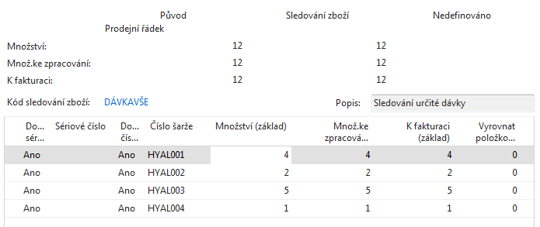
Sales Order
Sales order line
Post it by F9

Slide 27
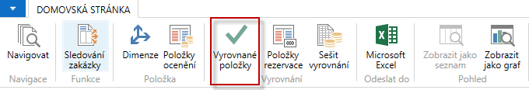
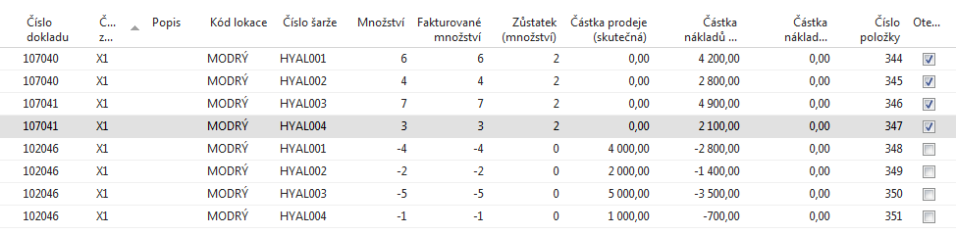
X1 Item Ledger Entries

Slide 28
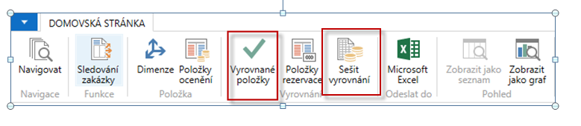
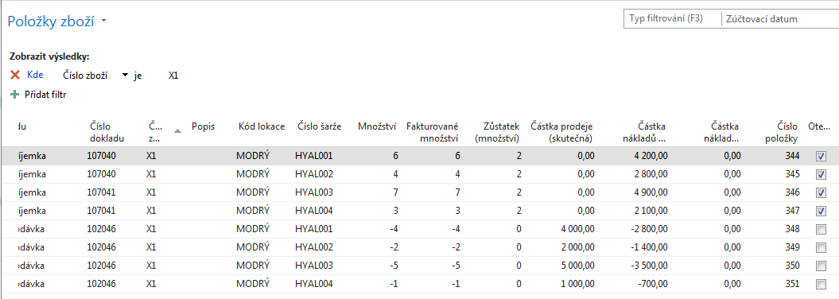
X1 Item Ledger Entries

Slide 29
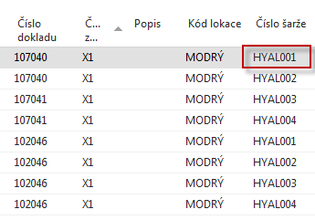
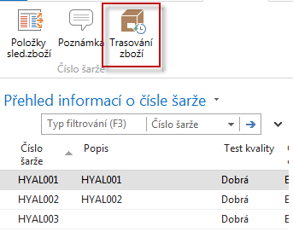
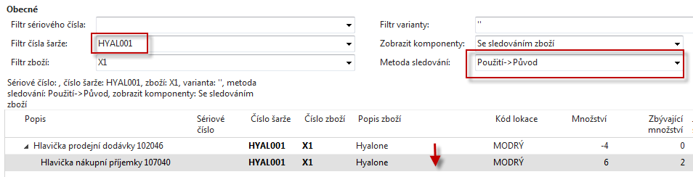
Item Tracing

Slide 30
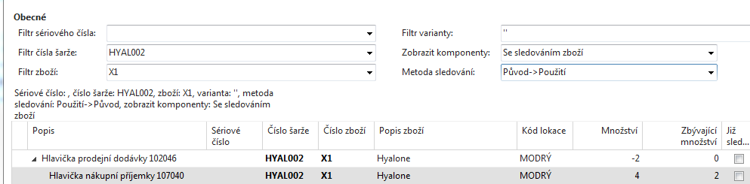
Item Tracing
Použití -> Původ
Pokud vyberete tuto volbu, program nejprve zobrazí místo, kde byla daná položka zboží použita, a poté místo, odkud položka zboží pro dané konkrétní použití pochází.
Původ -> Použití
Pokud vyberete tuto volbu, program nejprve zobrazí místo, odkud daná položka zboží pochází, a poté místo jejího použití.

Slide 31
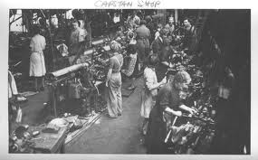
End of section
Serial numbers , Lot numbers & Item tracking & Item tracing

