Slide 1
Basic production algorithms and its main concepts
Ing.J.Skorkovský,CSc.
and various listed sources
Department of Corporate Economy
Slides 2-18 –basic production theory and 29-48 practical NAV example
Comment : without basic production theory it is useless to model production in ERP

Slide 2
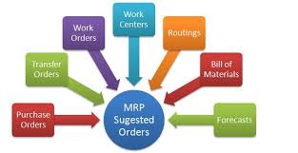
Main concepts
MRP=Material Requirements Planning (push)
MRP_II=Manufacturing Resource Planning (push)
APS = Advanced Planning and Scheduling
JIT = Just In Time (pull)
TOC (Drum Buffer Rope) (push-pull->combined) – will be preseneted in another session of this course
Work Order=Production order in MS Dynamics NAV

Slide 3
BOM=Bill Of Material (structure of the product)
Component
0
A
B
Product|Semiproduct
500
1
200
0,1,2,,..Low Level Codes
100
100
600
2
300
300
400
3
300
400
Independent demand for products and semi-products and dependent for components
Planning backwards from production schedule (independent) to dependent- demand components -without statistically calculated Reorder Point (ROP)– see next lesson and next slide as well
IF ROP is not taken into consideration – MRP is PUSH system -> it computes schedule of what should be started (pushed) into system, that authorize production as inventory is consumed (ROP will be explained later in this session)

Slide 4

Push system
Purchase orders
Forecast
MRP|ERP
Operation 1
Operation 2
Operation 3
Operation 4
Supplier1
WIP
WIP
Customer 1
ROUTING
Supplier 2
Component
warehouse
FG warehouse
Customer 2
Take it !
WIP

Slide 5
PUSH and PULL
PUSH : production jobs (production orders) are scheduled: MRP and MRP_II= Manufacturing Resource Planning
  often not feasible plans are generated and problems are often detected too late (rejects, lack of components,..)
  used fixed lead times=LT (see next slide) do not depend on capacity utilization
  Having in mind , that production is random process, Lead Time is very pessimistic constant
PULL : production jobs (production orders) starts are triggered by completion of another job (JIT-see later in this session)
Black box
t=start of the job
t+LT=end time of the job (where LT=constant)

Slide 6
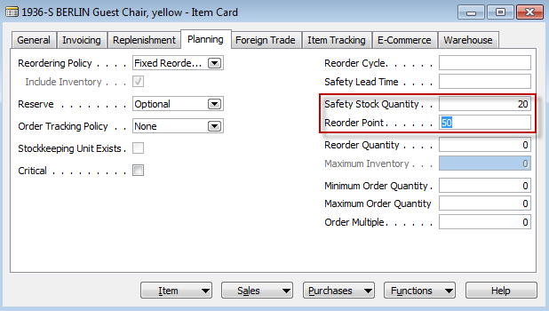
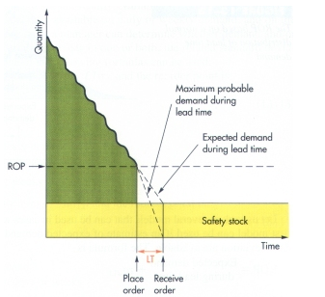
Determination of the Reorder Point (ROP)
ROP=expected demand during lead time + safety stock
Expected demand=30
50-20=30
50=ROP
20
LT =Lead time

Slide 7
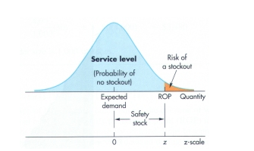
Determination of the Reorder Point (ROP)
(home study)
ROP = expected demand during lead time + z* σ_{dLT}
where z = number of standard deviations and
σ_{dLT =} the standard deviation of lead time demand and z* σ_{dLT} =Safety Stock
aan

Slide 8
Example
(home study- also Pareto analysis and ABC model simplified- PWP will be shown later)
The manager of a construction supply house determined knows that demand for sand during lead time averages is 50 tons.
The manager knows, that demand during lead time could be described by a normal distribution that has a mean of 50 tons and a Standard Deviation of 5 tons (σ_{dLT )}
The manager is willing to accept a stock out risk of no more than 3 percent

Slide 9
Example-data
(home study)
Expected lead time averages = 50 tons.
σ_{dLT} = 5 tons
Risk = 3 % max
Questions :
  What value of z (number of standard deviations) is appropriate?
  How much safety stock should be held?
  What reorder point should be used?

Slide 10
Example-solution
(home study)
Service level =1,00-0,03 (risk) =0,97 and from probability tables you will get z= +1,88
See next slide with probability table

Slide 11
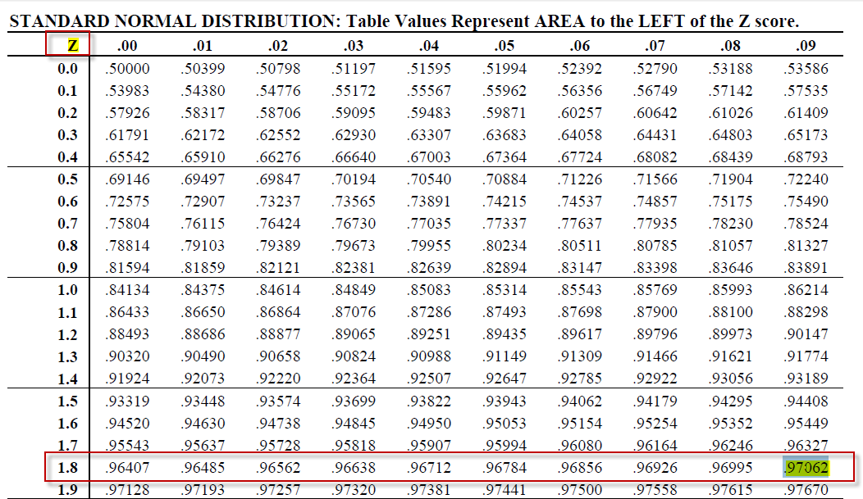
Probability table

Slide 12
Example-solution
(home study)
Service level =1,00-0,03 =0,97 and from probability tables we have got : z= +1,88
Safety stock = z * σ_{dLT} = 1,88 * 5 =9,40 tons
ROP = expected lead time demand + safety stock = 50 + 9.40 = 59.40 tons
For z=1 service level =84,13 %
For z=2 service level= 97,72 %
For z=3 service level = 99,87% (see six sigma)

Slide 13
Schematic of MRP
BOM
On-hand inventory
Scheduled receipts
MPS
MPS=Master Production Schedule
Netting – Lot Sizing –Time Phasing –BOM Exploding
Production
Orders (jobs)
Purchase
orders
Exception and change notices
Net requirement =Gross requirement – Stock in hand – Purchases + Sales + Safety Stock
Lot sizing= divide netted demand into appropriate lot sizes to form jobs (see LLC) and EOQ PWP show (later)
Time Phasing = offset the due dates of the jobs with lead times to determine start times
(Due Date-Lead time = Start of the job)

Slide 14
MRP matrix calculation (see related xls file in study material)
(home study)
Parameters
  Gross requirements
    Derivied from Master Production Scheduled or Planned order releases of the parent BOM (finished good)
  Scheduled receipts
    On order (issued) and scheduled to be received
  Projected on hand = Stock in Hand
    Anticipated quantity on hand at the end of the period
  Net requirement
    Net requirement =Gross requirement – Stock in hand – Purchases + Sales + Safety Stock
  Planned order receipts
    When order need to be received (documents are not issued)
  Planned order releases
    When order need to be placed to be received on time

Slide 15
MRP matrix example 1
(home study)
MRP basic calculations |  | Lot-for lot - ordering exact quntity needed
 |  | Lead Time =1 - time to get item from the moment the purchase order is issued or to make it
Master Production Schedule
Part A | Projected on hand | 1 | 2 | 3 | 4 | 5
Gross Requirements |  | 85 | 95 | 120 | 100 | 100
MRP
Part A |  | 1 | 2 | 3 | 4 | 5
Gross Requirements |  | 85 | 95 | 120 | 100 | 100
Scheduled Receipts | Is already issued | 175
Projected on hand (POH) | 25 | 115 | 20 | 0 | 0 | 0
Net requirements |  | 0 | 0 | 100 | 100 | 100
Planned order receipts |  |  |  | 100 | 100 | 100
Planned order releases |  |  | 100 | 100 | 100
 |  | Period | Action
 |  | 1 | 25+175-85=115=POH
 |  | 2 | POH=115-95=20
 |  | 3 | Cannot cover GR, so we have to release one PO for 100 one period earlier in order to get it in period 3
 |  | 3 | Net req=120-20 =100, POH in period 3=120-20-100=0
 |  | 4 | Net req =100-0=100-POH=100, so we heave to release one PO one period earlier in order to cover demand in period 4
 |  | 5 | Similar to period 4
period
period

Slide 16
MRP matrix example 2
(home study)
MRP
Part A |  | 1 | 2 | 3 | 4 | 5 | 6 | 7 | 8
Gross Requirements |  | 20 | 30 | 50 | 50 | 60 | 90 | 40 | 60
Scheduled Receipts | Is already issued |  | 50
Projected on hand (POH) | 40 | 20 | 40 | 40 | 40 | 30 | 0 | 10 | 0
Net requirements |  |  |  | 10 | 10 | 20 | 60 | 40 | 50
Planned order receipts |  |  |  | 50 | 50 | 50 | 60 | 50 | 50
Planned order releases |  | 50 | 50 | 50 | 60 | 50 | 50
 |  | Period | Action
 |  | 1 | Can be covered from POH and new POH=40-20=POH-GR=20
 |  | 2 | In period 2 GR can be covered by POH and SR, but next period where GR=50 will be not covered, so POR must be released in per 1 (LT=2)
 |  | 3 | We have got 50, POH=40, so altogether we have 90 nad after demand is covered only 90-50=40=POH
 |  | 3 | Net req=50-40=10 in order to cover demand in period 4, but we can released only 50 or more, so in period 2 another 50 is released
 |  | 4 | Demand is covered by receipt 50 and POH =10 but for the next period net req=60-40=20
 |  | 5 | Net req= 60-40=20, so demand in period 5 can be covered by POH=40+ quantity X, which have to be ordered 2 period earlier
 |  | 5 | Quantity X can 50 or more. So take it 50 as sufficient quantity, and POH =30=40+50-60
 |  | 6 | To cover demand in period 6 we need at least 90 and we have only 30 in POH, so 90-POH=90-30=60 have to ordered 2 period earlier
 |  | 6 | POH-90-60-30=0; Ner req=90-30=GR-POH=60 , which is reason why we have ordered 60 two period earlier
 |  | 7 | Net req= 40 because 40-0=GR-POH=40. To cover it we have to order two period earlier 50
 |  | 8 | and so on

Slide 17
Benefits of MRP
Low levels of in process inventories
The Ability to keep track of material requirements
A means of allocating production time
The ability to easily determine inventory usage by back flushing (see explanation below)
Process of determining the number of parts that must be subtracted from inventory records. This number is computed by referring to the number of parts withdrawn from the inventory (and delivered to the shop-floor) and the number of parts assumed (according to the BOM) to have been consumed in a manufacturing line at one or more deduct points- HOME STUDY

Slide 18
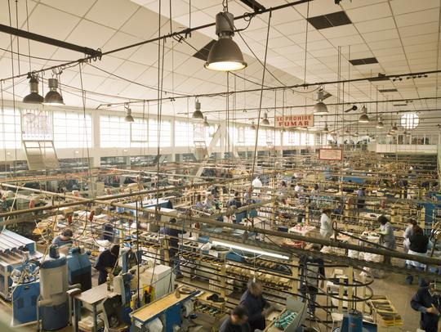
MRP_II =MRP + resource capacity planning
Rough-cut capacity planning
MPS
Demand
management
BOM
MRP
Intermediate-range
planning
Scheduled
receipts
Job
Pool (planned)
Capacity requirement planning
Job Release
Routings
(operations)
Short term
control
(Shop floor)
Job
Dispatch
Dispatch=rozvrhování (na který stroj se dá která operace při dílenském řízení)

Slide 19
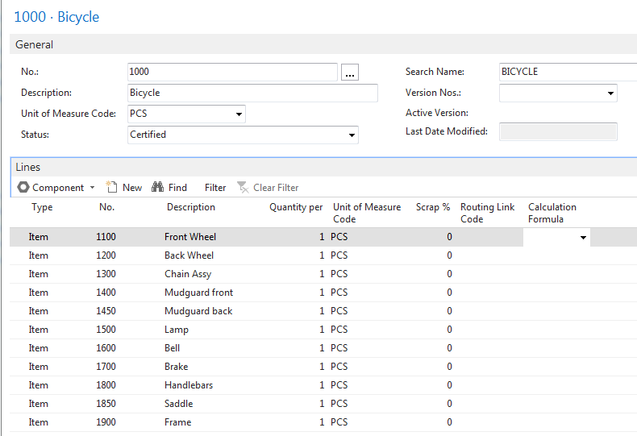
BOM in MS Dynamics NAV

Slide 20
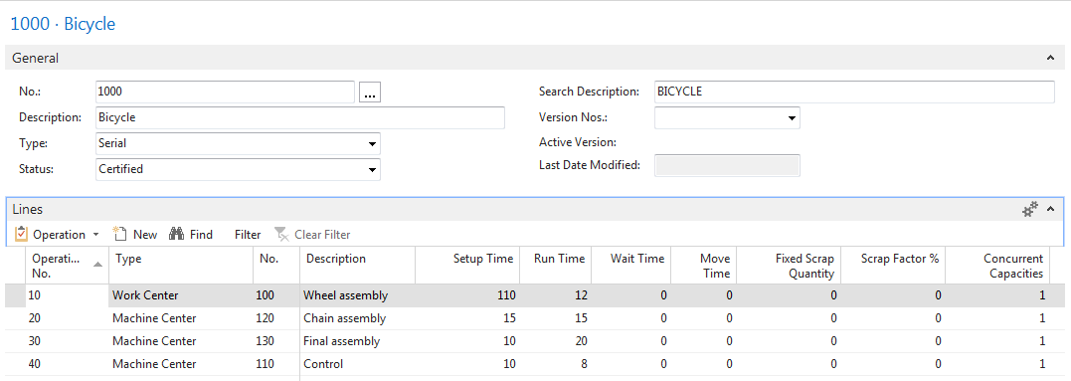
Routings in MS Dynamics NAV

Slide 21
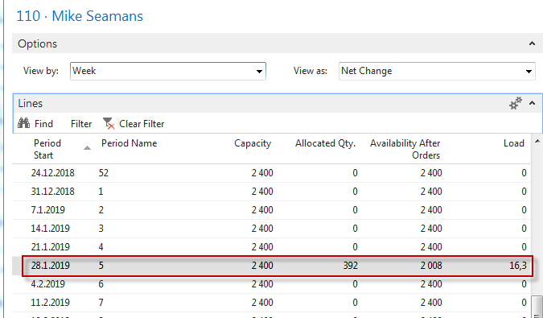
Capacity of resources in MS Dynamics NAV

Slide 22

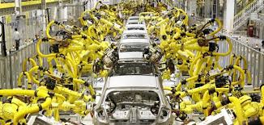
JIT=Just In Time
Toyota Motors and Taiichi Ohno
Production based only on demand
Lower inventory costs
The concept behind it is that a company can save money on parts and components---by not have having to store them--- if they are delivered to the assembly line just in time to be installed on the car as it is being built.

Slide 23
JIT=Just In Time
Components for Job N needed…
1 (kanban = card=signal)
2
Demand
Operation (Job1)
Operation (Job2)
Operation (JobN)
Components for Job N produced and
Supplied (pulled)
UPSTREAM
Authorization
to start Job 2
DOWNSTREAM
1
=kanban
Controlling parameter
Production
The number of kanban cards in the system determines the WIP levels in the plant

Slide 24
JIT (manufacturing philosophy)
Kanban is not JIT !!!
JIT encompasses :
  kanban cards (kan=card, ban=signal)
  total quality control (TQM) – e.g. scrap loss not tolerated….
  setup reduction (snížení nastavovacích časů)
  worker participation
  lean production (low level of waste)
Advantages of JIT philosophy :
  reduced WIP (Work in Progress)->higher Throughput (see Little´s law- will be presented later-not for BPH_PIS2 2017_2018)
  shorter production times
  lower production costs
  greater customer responsiveness

Slide 25
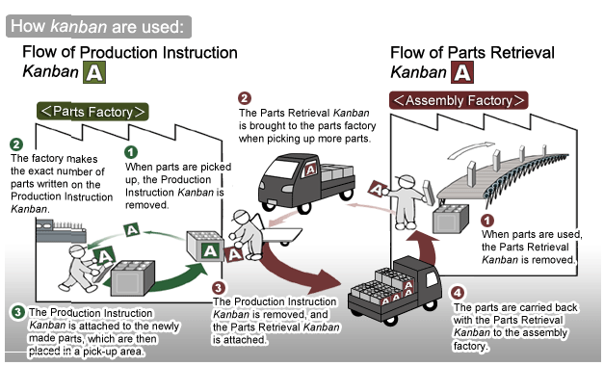
Kanban principle
(home study)
Resource :

Slide 26
Some units
(not for BPH_PIS2 2017_2018)
Will be presented later in sections such as :
  Little´s law (LT=WIP*CT=WIP/Throughput)
  Theory of Constraint…
Cycle Time (CT)– time to complete task (time/unit)
Takt Time (TT) – rhythm in which we have to produce in order to satisfy customer demand (demand is 240 toaster ovens and we can produce these in 480 minutes ->TT= 480/240=2
Lead Time (LT) – Number of minutes, hours, or days that must be allowed for the completion of an operation or process, or must elapse before a desired action takes place –see next slide
Comment : CT<>LT !!

Slide 27
Lead time
(not for BPH_PIS2 2017_201
8)
The lead time is the time and not the effort. You may have a lead time of 100 days and only have to work 1 hour to fix the bug. Sometime you start working on the bug. The cycle time is the time from the start of the work until the bugfix is live.
Priority of the task
is set
Cycle time
Lead time
Request
(bug reported)
Start work
Bug solved

Slide 28
Orders Tracking
Customer
Vendor
Sales Order
Tracking
Planning production (MRP-II )
Requisition Worksheet (MRP)
Tracking
Sales Order Line
Tracking
Production Order
Purchase Order
Tracking
Bill of Material
Stock
Supply
Demand
Routing (OP1-OP4)
Supply
Tracking

Slide 29
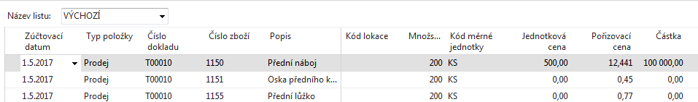
Požadavek
Požadavek (Prodejní objednávka) bude na prodej Předního náboje 1150 (na skladě 200),
jehož kusovník se skládá ze dvou komponent 1151 (200 na skladě)
a 1155 (200 na skladě).
Příprava dat pro příklad : Změňte u obou komponent (1151 a 1155)
Způsob přiobjednání na Dávka-pro- dávku. Dále s pomocí deníku zboží prodejte 200 ks
výrobku 1150 a jeho komponent 1151 a 1155. Pozor : komponenty i výrobek
nejsou uloženy na žádné lokaci. Dále změňte na záložkách Doplnění
u obou komponent dodavatel na 10000.
Výsledkem požadavku bude naplánování Výrobní zakázky a její následné odhlášení
(komponenty do spotřeby a výrobek na sklad)

Slide 30
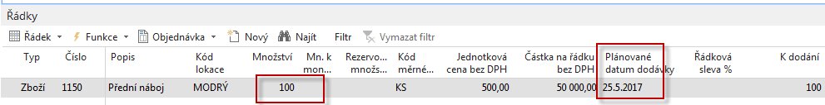
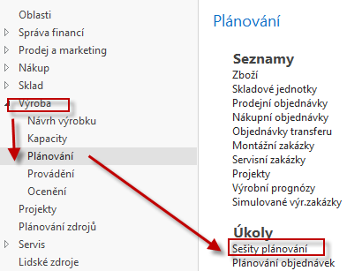
Prodejní objednávka na 100 ks 1150
Dostaneme upozornění, že podsestava kola 1150 není na skladě !! Reakce->ANO
Dále změňte Plánované datum dodávky na datum 25.5. , tedy dostatečně daleko od pracovního data – Důvod : aby plánovací algoritmus nezáplánoval počátek výroby na data před pracovním datem.
Prodejní řádek

Slide 31
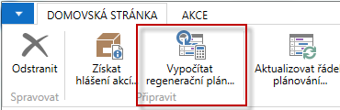
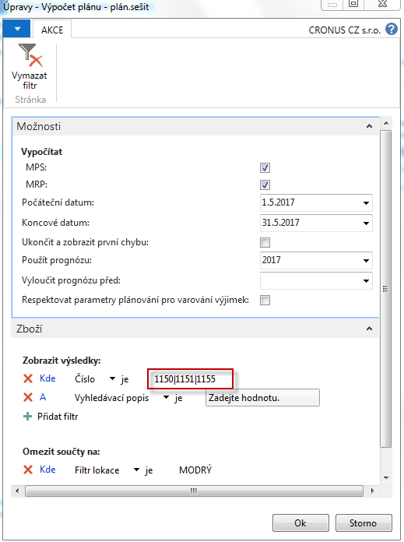
Plánovací sešit
Plánované datum dodávky (viz prodejní řádek)
je pro tuto databázi 4.5.2017. Do Čísla zboží zavedeme ručně Jak číslo výrobku tak i čísla komponent ->1150|1151|1155

Slide 32
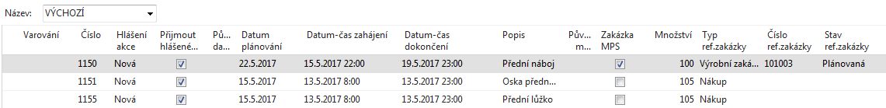
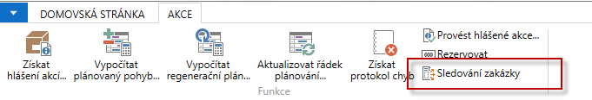
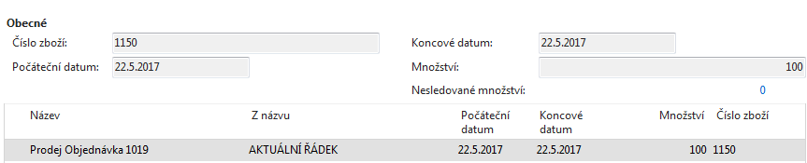
Naplánovaný řádek (výrobní zakázka)
Viz karta zboží,
záložka Doplnění
a Zmetky %

Slide 33
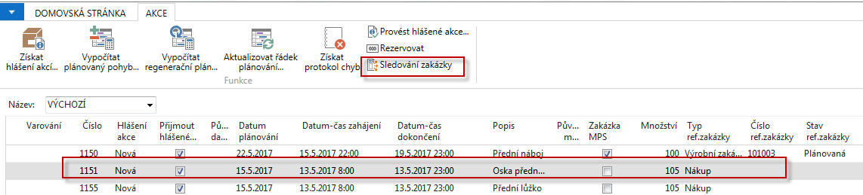
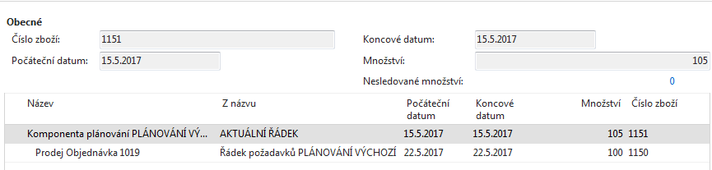
Naplánovaný řádek (výrobní zakázka)

Slide 34
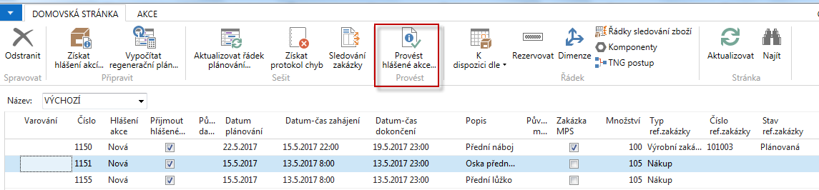
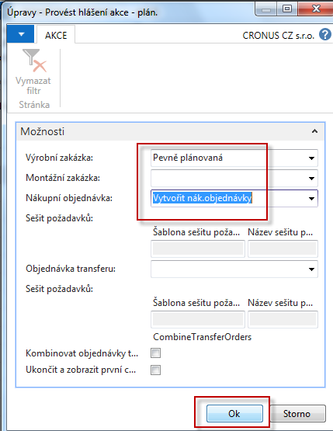
Vytvoření VZ (pevně plánované-bude vysvětleno)

Slide 35
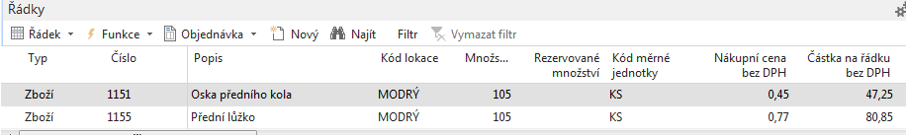
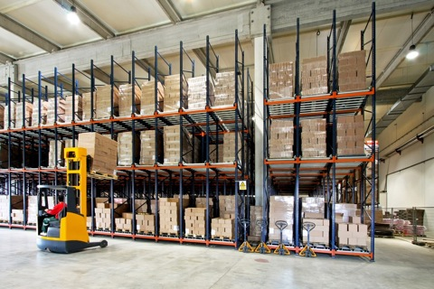
Řádky nákupní objednávky

Slide 36
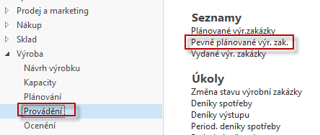
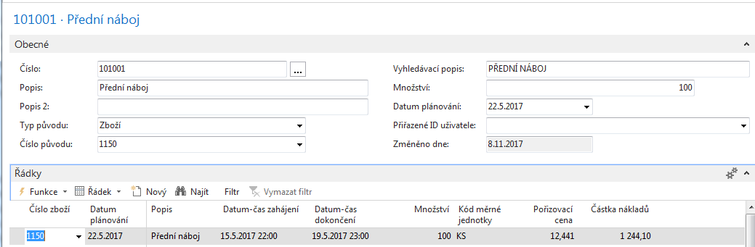
Výrobní zakázka (VZ)
Podívejte se na Sledování zakázky : vazby mezi výrobou, nákupem a prodejem
Najdete to na ikoně Funkce v řádcích VZ

Slide 37
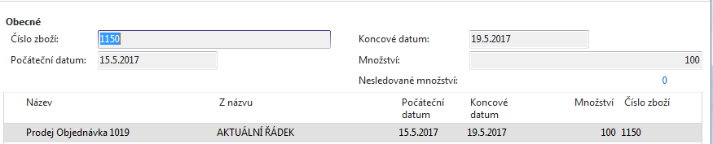
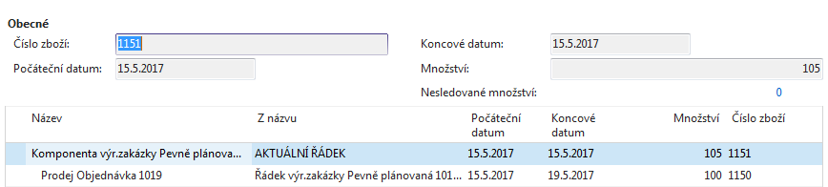
Sledování zakázky
VZ<->PO
NO<->PO

Slide 38
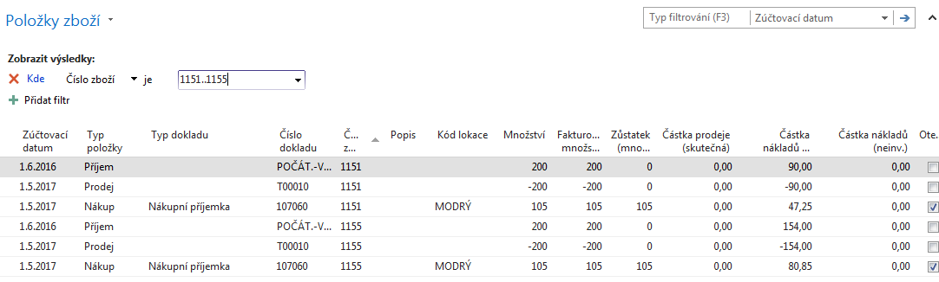
Zaúčtujte příjem komponent na NO

Slide 39
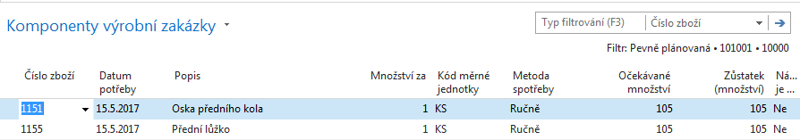
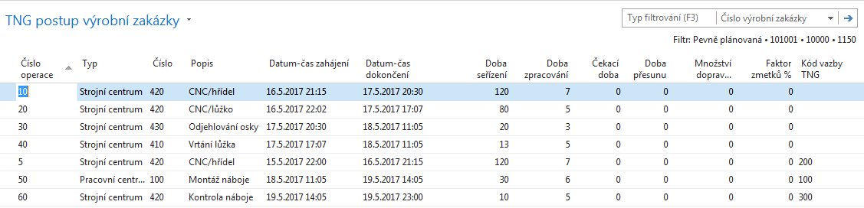
Výrobní zakázka-komponenty a TNG postup
(TNG= Technologický)
Řádek VZ->Komponenty
Řádek VZ->TNG postup

Slide 40
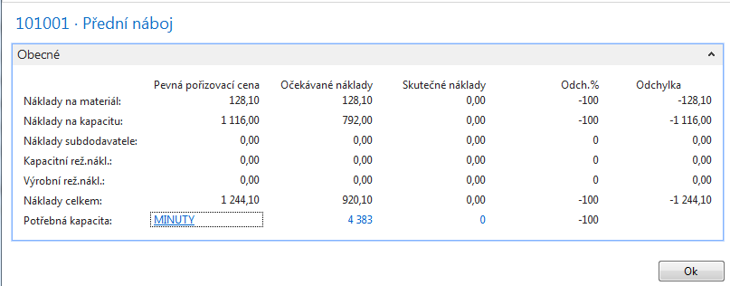
Statistika VZ (s pomocí F7)

Slide 41
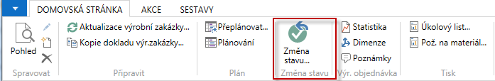
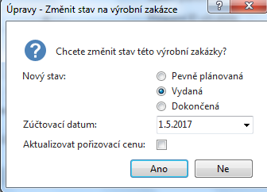
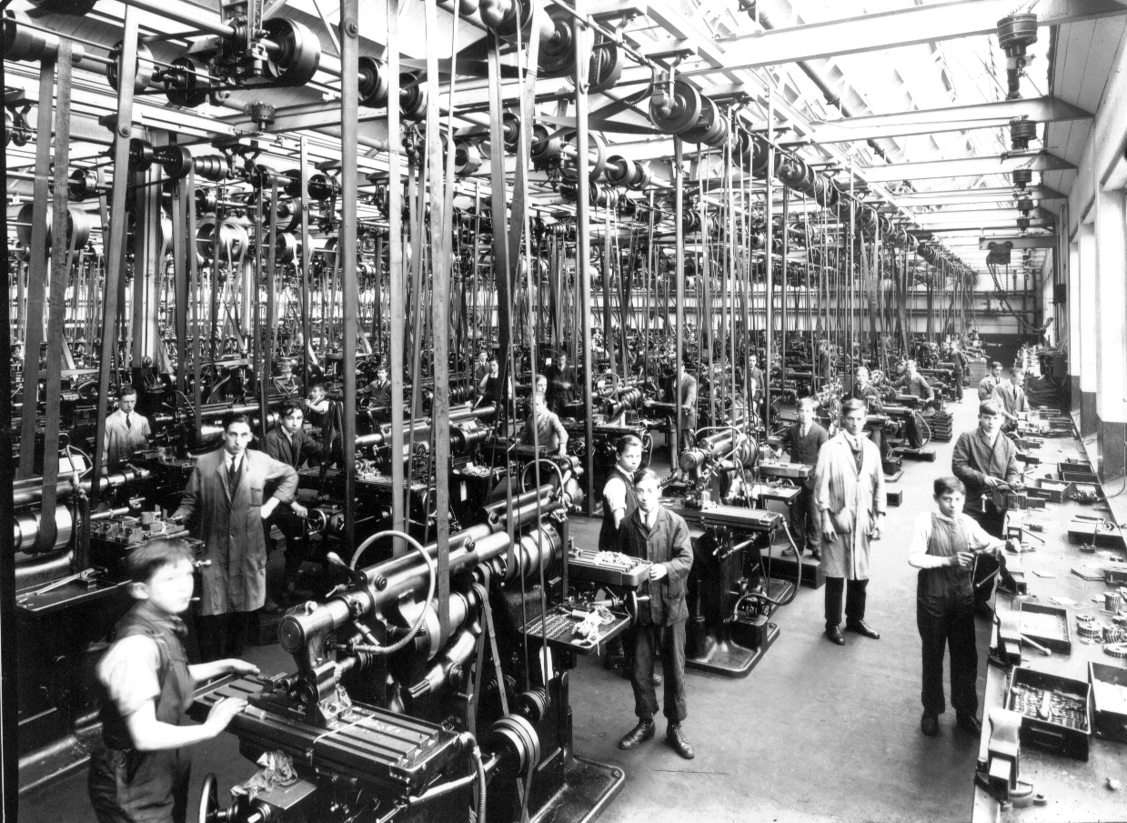
Převedení do stavy VZ Vydaná (od plánovače do dílny)

Slide 42
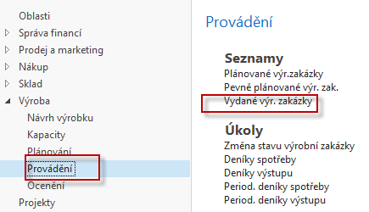
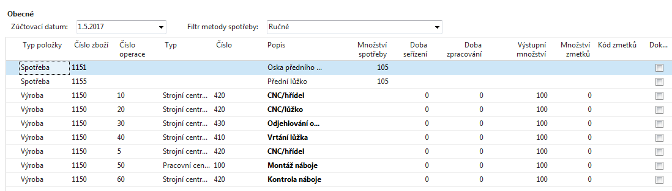
Odhlášení spotřeby a zdrojů
V řádku VZ vydané, kde je ikona Funkce najdete Deník výroby
Zadejte odhadnutou dobu seřízení a zpracování včetně spotřeby materiálu.
Zadané hodnoty by se neměly lišit od TNG postupu uvedeného pře několika snímky.
Na dalším obrázku to zobrazíme ještě jednou pro ulehčení zadávání hodnot do
Výrobního deníku. Zde se často používají dotykové obrazovky a BAR čtečky

Slide 43
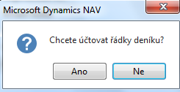
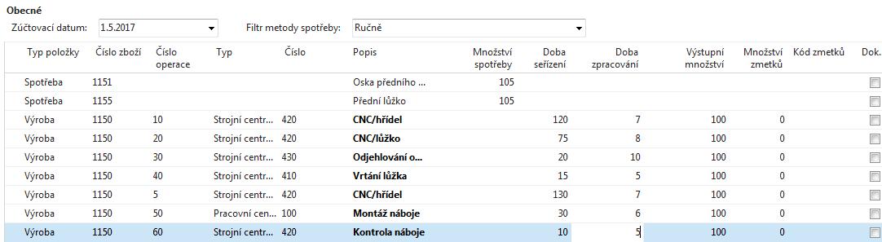
Deník výroby po vyplnění
Záměrně byly některé časy změněny- reálné časy nemusí přesně odpovídat plánu.

Slide 44
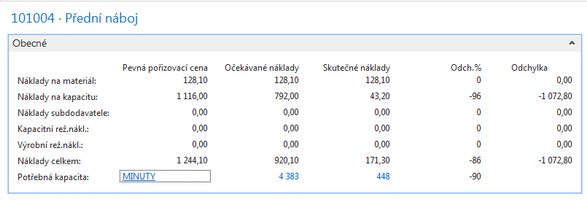
Statistika VZ po zaúčtování deníku

Slide 45
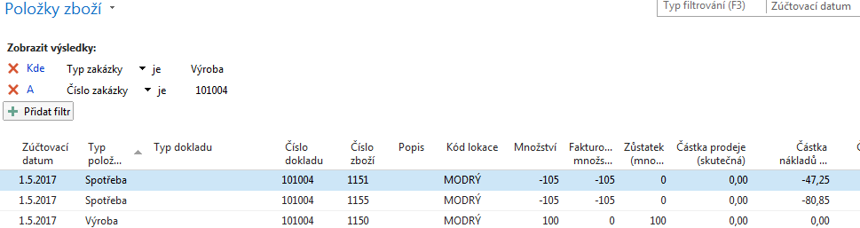
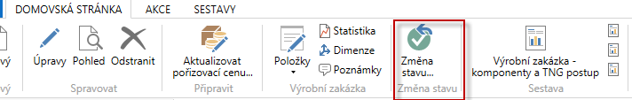
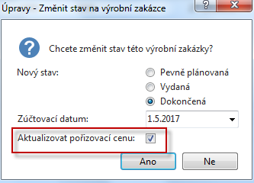
Položky VZ po zaúčtování (VZ->Ctrl-F7)

Slide 46
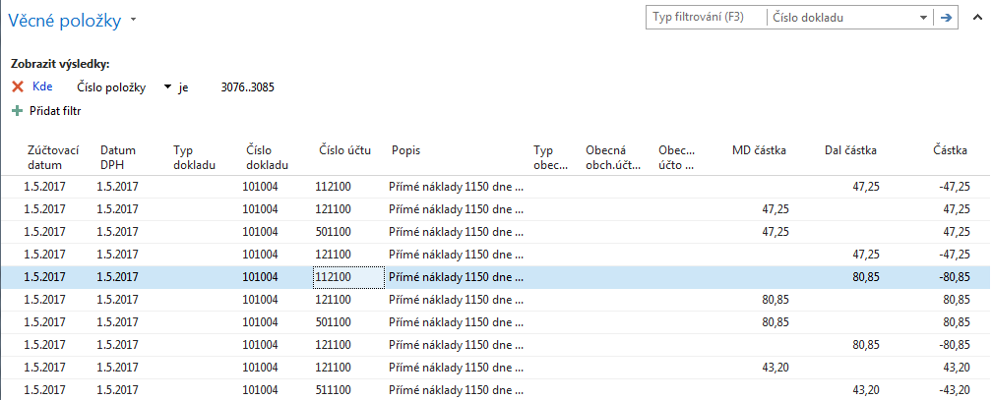
Věcné položky po změně stavu VZ- >Dokončená
Spotřeba a účtování NV (nedokončená výroba)

Slide 47
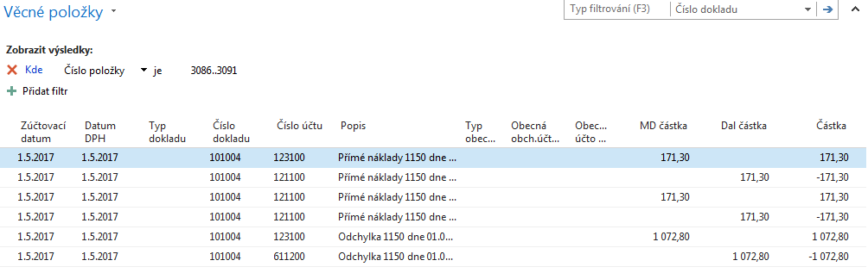
Věcné položky po změně stavu VZ- >Dokončená
Naskladnění výrobku a deaktivace NV

Slide 48
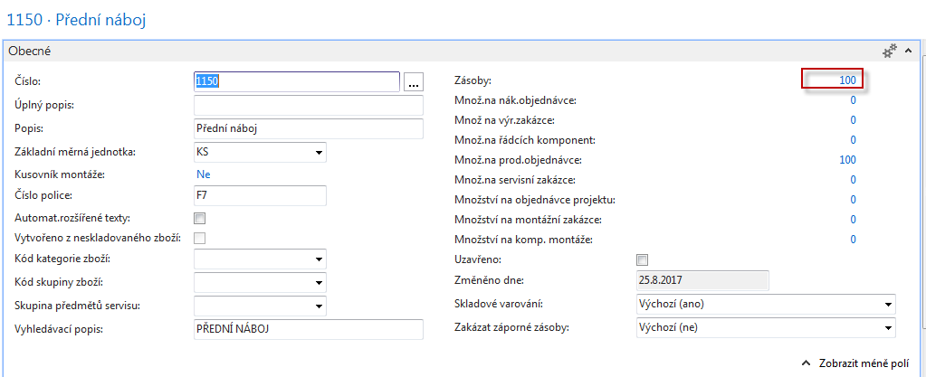
Karta výrobku

Slide 49
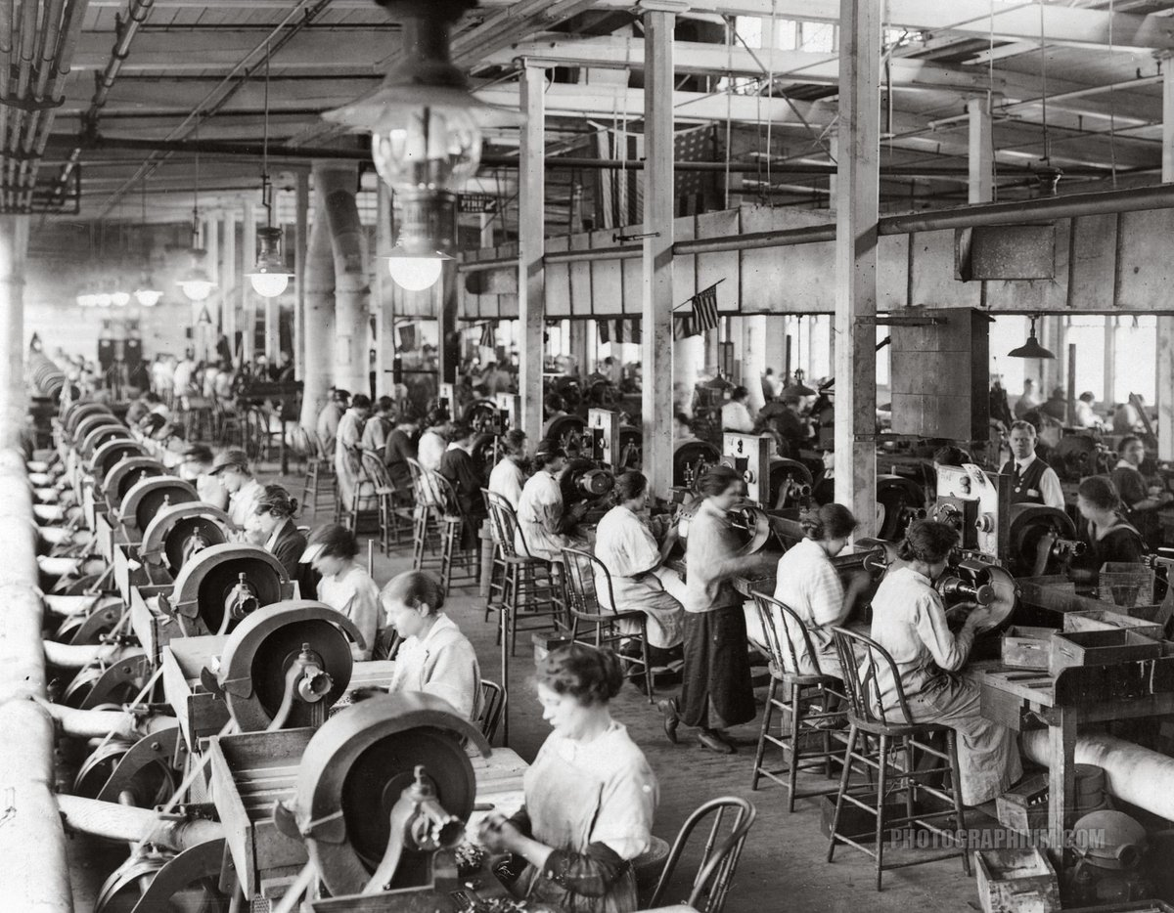
Konec sekce
Děkuji za pozornost !!

