Slide 1
Introduction to MS Dynamics NAV (Requisition Worksheet-Sešit požadavků)
Ing.J.Skorkovský,CSc.
MASARYK UNIVERSITY BRNO, Czech Republic
Faculty of economics and business administration
Department of corporate economy

Slide 2
Requisition Worksheet (RW) (tool for automatic replenishment suggestion)
Impacts of using RW tool
Lower inventory level
It balances supply and demand across locations
Lower inventory and handling cost
Higher liquidity
Sufficient service level is maintained. Such a Service level represents the expected probability of not hitting a stock-out. This percentage is required to compute the Safety Stock. Intuitively, the service level represents a trade-off between the cost of inventory and the cost of stock-outs (which incur missed sales, lost opportunities and client frustration among others).
Based on MRP principles (Material Requirement Planning)

Slide 3
Parameters controlling RW functions (you can find them on the Item card, Tab =Planning)
Reorder Policy – It uses the reordering policy to calculate the lot size per planning period, which you define in the Reorder Cycle field – (Způsob přiobjednání)
Reorder Cycle - In this field, you enter a date formula that sets the planning time frame for the item. – (Období kumulace dávky)
Safety Stock – (Bezpečnostní zásoby, Minimum na skladě)
Reorder Point - Replenishment is typically triggered when the inventory level hits the Reorder Point, which is also called Reorder Trigger Level. - (Bod přiobjednání)
Reorder Quantity - See Excel file example (resource mentioned there) – (Přiobjednávané množství)
Min and Max Order Quantity - (Min a Max objednávané množství)
Order Multiple- (Násobek objednávky)

Slide 4
Reorder Policy (see F1 to get detailed Help concerning Reorder Policy)
Fixed Reorder Quantity (Pevné přiobjednávaní množství)
Maximum Quantity (Maximální množství)
Order (Objednávka)
Lot-for-Lot (Dávka pro dávku)

Slide 5
Model-test
Creation of the new item card XX1
The method and some tiny modifiction of the this procedure is presented in the next few slides
Create new Sales Order with 100 pcs of XX1
Do not post it !! This order represents demand !!
Create new Purchase Order with 30 pcs of XX1
Do not post it !!

Slide 6
How to create a new Item card XX1
CTRL-N in order to create a new item card XX1
Basic unit of measure =Pcs (kusy)
Costing method FIFO
Tab Replenishment ->make a choice of you principal Vendor=20000
Tab Planning ->Reorded Policy (Způsob přiobjednání) = Fixed Order Quantity (Pevné přiobjednávané množství)

Slide 7
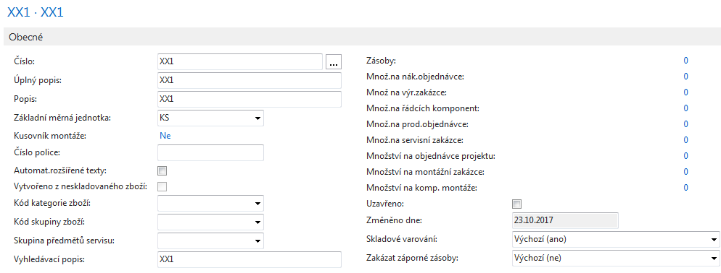
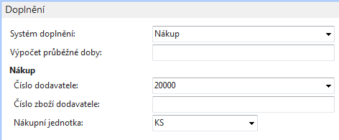
Item XX1
And it's done
Will be used later

Slide 8
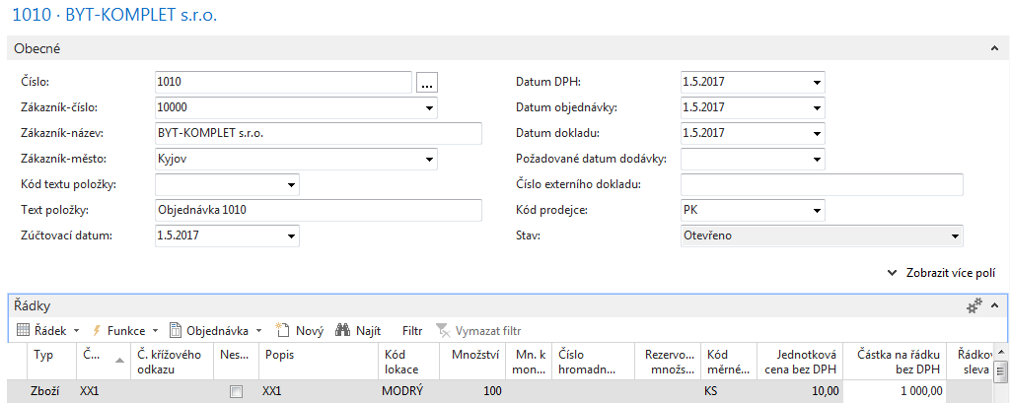
Created Sales Order (SO)
Demand

Slide 9
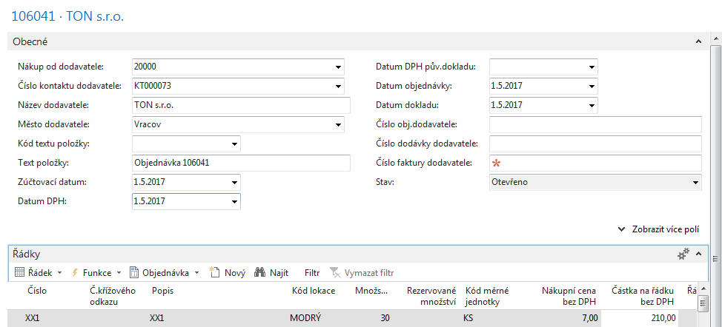
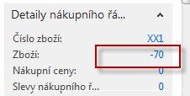
Created Purchase Order
100 (demand) -30=70 (still have to be replenished)

Slide 10
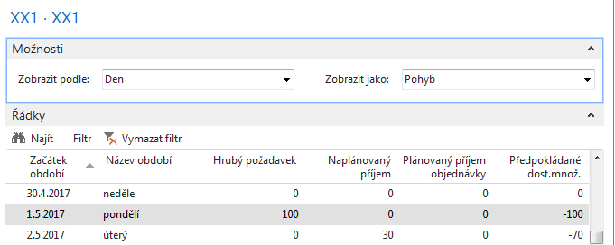
Availability – (Dostupnost)
Based on period – K dispozici podle období

Slide 11
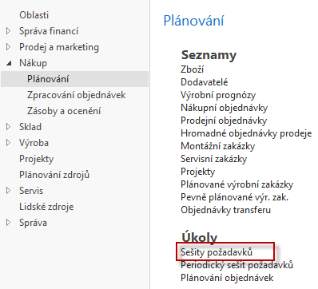
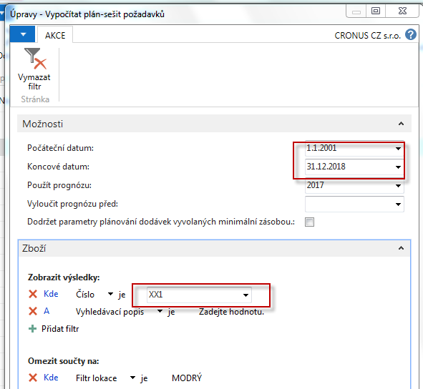
RQWS window and how to start batch job
Calculate plan =batch job (Dávková úloha)
See next slide
Časové okno
OK

Slide 12
RQWS window and how to start batch job
System suggested to cancel existing Purchase Order (second line) in order to get 100 %
balance . First line will serve as a resource line for second (new) Purchase Order creation.
Availability looks like this (Planned Order Releases represents first line of RQWS) :
Before Carry out – Provést hlášené akce

Slide 13
Carry Out Action Messages- (provést hlášené akce)
After Carry Out Action Messages you will get
First manually created Purchase Order for 30 pcs has been deleted
by MRP algorithm and new PO for 100 pcs of XX1 was created !!!

Slide 14
Modification of input parameters I.
Change of Reordering policy on Item Card
First Sales Order
Outbound WH handling time=1D
Second (new) S0
Outbound WH handling time=1D
New Req Worksheet line (see integrated requirements 100+110=210)

Slide 15
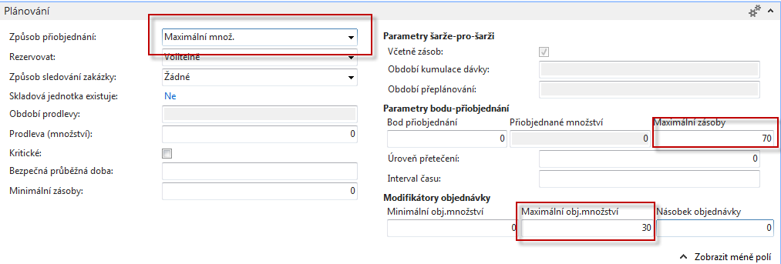
Modification of input parameters II.
Program použije množství zadané v poli Maximální zásoby k určení maximální velikosti dávky. Program může upravit toto množství tak, aby odpovídalo dalším požadavkům nebo zadané úrovni zásob.
Pokud vyberete tuto možnost, program deaktivuje se pole Přiobjednané množství, které používá výlučně s možností Pevné přiobjednané množství .
Pozor : V příkladu je nastaveno Maximální Obj.Množství=30 !!!

Slide 16
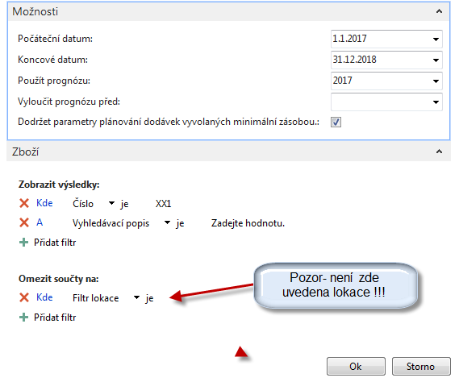
Modification of input parameters II.
SEE NEXT SLIDE

Slide 17
Modification of input parameters II
100 pc for existing Sales Order and location BLUE
30+30+10=MAXIMUM INVENTORY=70
30= MAXIMUM ORDER QUANTITY

Slide 18
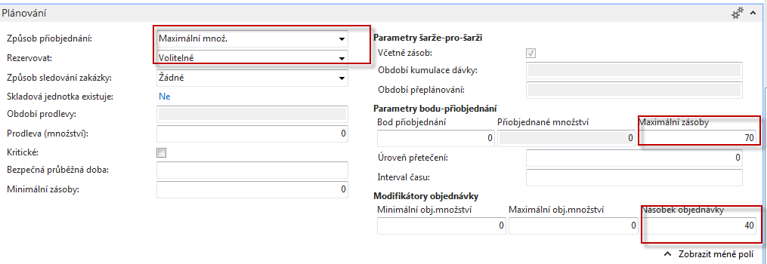
Modification of input parameters III
80=2 x 40>70,
because 1 x40<70 (max)
100 pc for existing Sales Order and location BLUE

Slide 19
Modification of input parameters IV.
90=3 x 30>70 (max), because 2*30=60<70 (max)

Slide 20
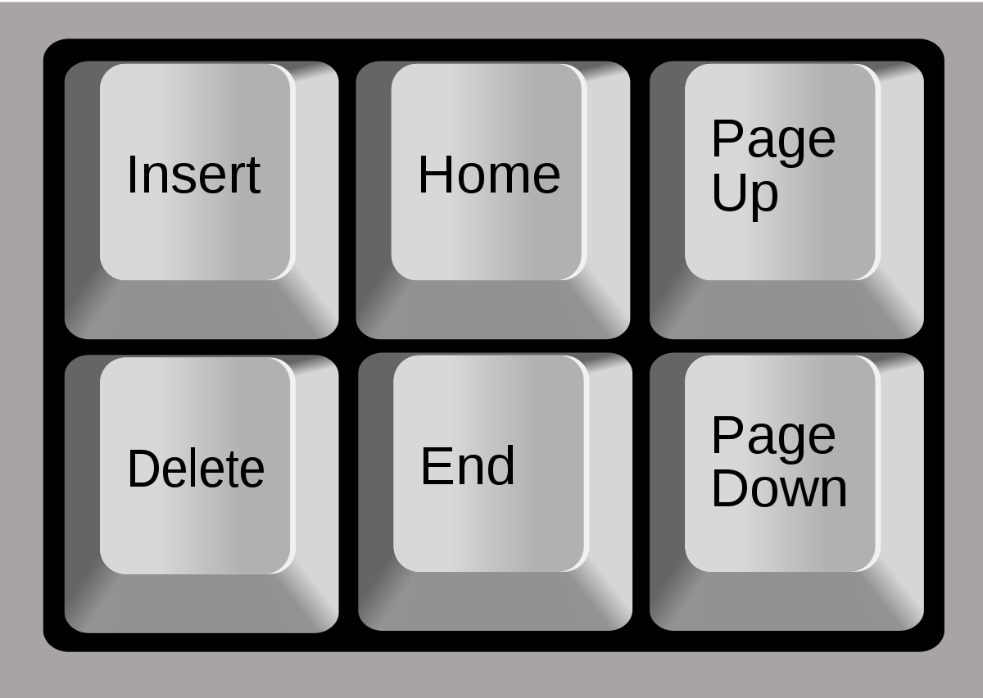
End of section (Requisition Worksheet-Sešit požadavků)

