Slide 1
Introduction to MS Dynamics NAV (Return Management)
Ing.J.Skorkovský,CSc.
MASARYK UNIVERSITY BRNO, Czech Republic
Faculty of economics and business administration
Department of corporate economy

Slide 2
Return Management
Return Management – better control over claims (reklamace)
Claims – external reaction from Customer
Claims - our reaction to bad quality of delivered items from Vendors or shipped to Customers
You typically create a Sales Return Order to compensate a Customer who is dissatisfied with an item that you have sold them. This could be due to a quality issue or delivery of a wrong item, for example
Assigning Exact Cost Reversing
You may agree to compensate a Customer by allowing them to return a sold item against a Sales Return Order. When you invoice the Sales Return Order, you may then want to revaluate the item at the unit cost that is connected to the original sales entry.

Slide 3
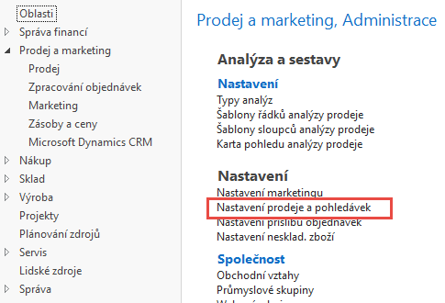
Setup (use searching window)
OR

Slide 4
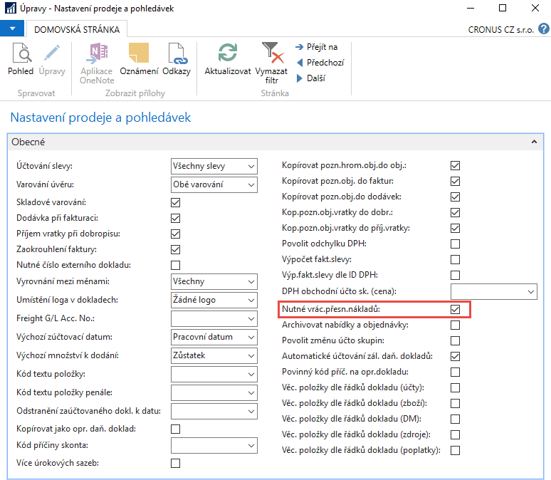
Setup

Slide 5
Nutné vrácení přesných nákladů – CZ verze
Zaškrtnutí tohoto pole znamená, že program nepovolí vrácení transakce, která se má zaúčtovat, pokud pole Vyrovnáno položkou zboží na řádku prodejní objednávky neobsahuje číslo položky.
Tato funkce se používá, pokud má firma použít způsob vrácení přesných nákladů ve spojení s prodejními vratkami.
To znamená, že prodejní vratka je oceněna přesně stejnou cenou jako původní prodej, pokud se vrátí zpět do zásob.
Pokud se později k původnímu prodeji přičtou další náklady, program hodnotu prodejní vratky adekvátně zaktualizuje.

Slide 6
Task
A representative from customer 10000 calls a salesperson at Cronus and says that
he received five units of item 70011 instead of item 70010 and that two units of
item 1964-W were delivered damaged.
The customer explains that the wrong delivery of item 70010 was his own fault, while item 1964-W appeared to have been damaged during shipment.
The salesperson and the customer agree that item 70011 must be returned to
Cronus and a replacement of the same quantity of item 70010 will be shipped to
the customer.
Regarding this replacement, Cronus will charge the customer a restock fee of 5% of the original order amount.
Meanwhile, item 1964-W should not be returned, and the parties agree to settle the case by Cronus providing the customer with a sales allowance of 15% off the
price of the item.

Slide 7
Task
Cronus company
Customer 10000
70011
Sales Order
70011
70011
Restock fee 5%
70011
Return Order
70010
70010
1964-W
Sales Order
1964-W
Sales allowance 15%

Slide 8
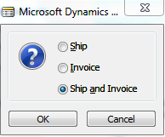
Selling (Sales Order)
Customer 10000
And post by F9

Slide 9
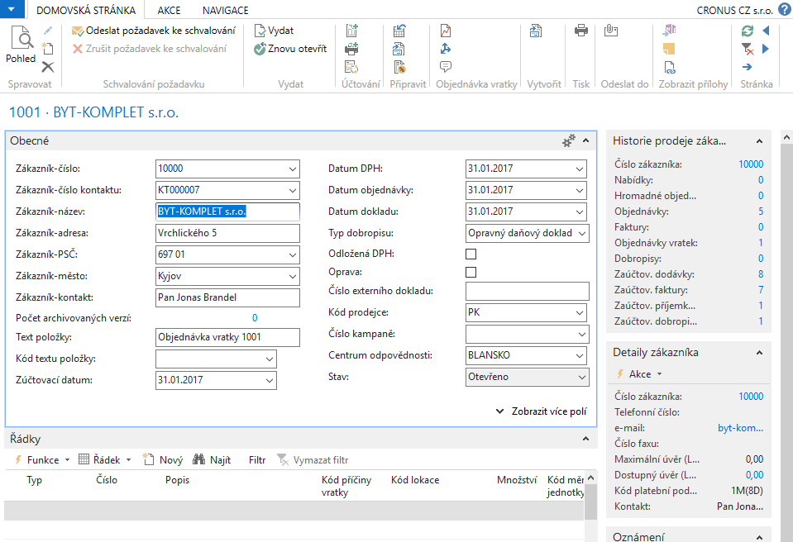
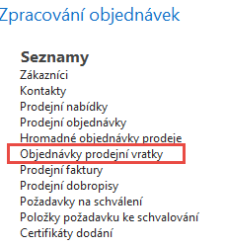
Return Order creation
Ctrl-N and customer 10000

Slide 10
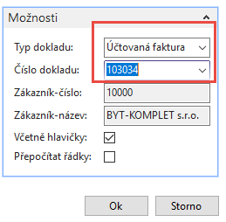
Return Order creation
See next slide

Slide 11
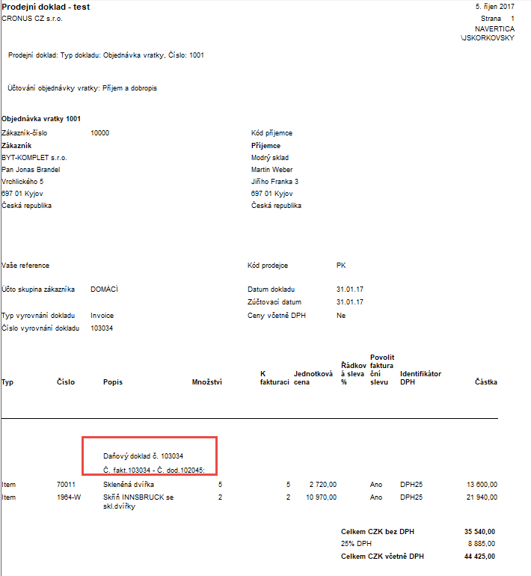
Return Order creation
Customer 10000

Slide 12
Return Order creation - adding reason codes
Customer 10000

Slide 13
Return Order creation –restock calculation
Customer 10000
2720*0,05=136 and 136*5=680

Slide 14
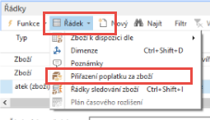
Return Order creation- assignment of the restock cost to 70011 delivery
You have to be with cursor or the line with calculated
restock cost
Do it manually – no with „Navrhnout přiřazení“= Suggest Assignment
and Esc

Slide 15
Return Order creation - creation-added another extra costs (15 %)
Customer 10000
10970*0,15=1645,50 and 1645,50*2=3291

Slide 16
Return Order creation-removal of one line (related to item 1964-W)
Ctrl-Del

Slide 17
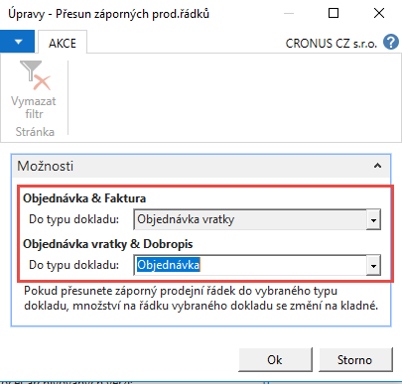
Return Order creation – move negative lines

Slide 18
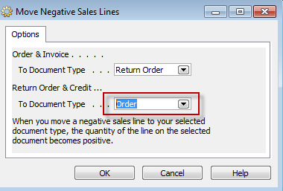
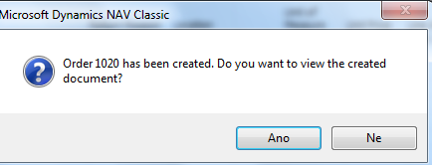
Return Order creation
See next line

Slide 19
Created Sale order – only SO Line
Back to Return Order

Slide 20
Return Order creation- only SO Line
Change sign of restock line to minus- we are on RO !!!

Slide 21
Assign sales allowance
Do it manually !!

Slide 22
Post RO and new created SO and see impacts

Slide 23
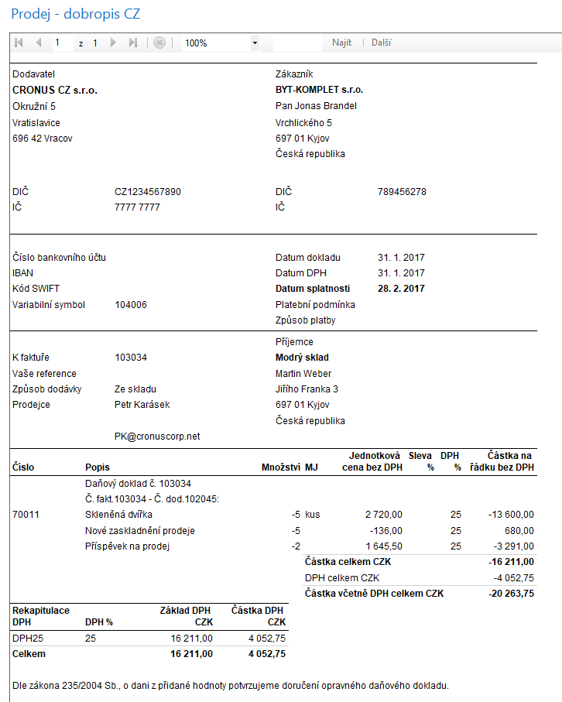
Created Credit Memo

Slide 24
End of the section (Return Management)

